Slide 1
Disclaimer
We hope you find the information on our website and resources useful.
Animations
This resource has been designed with animations to make it as fun and engaging as possible. To view the content in the correct formatting, please view the PowerPoint in ‘slide show mode’. This takes you from desktop to presentation mode. If you view the slides out of ‘slide show mode’, you may find that some of the text and images overlap each other and/or are difficult to read.
To enter slide show mode, go to the slide show menu tab and select either from beginning or from current slide.
You may wish to delete this slide before beginning the presentation.

Slide 3
/ai/, /a-e/, /ay/, /eigh/ or /ey/?
ai
ai
a-e
ay
eigh
ey

Slide 4
/ai/, /a-e/, /ay/, /eigh/ or /ey/?
ai
a-e
ay
eigh
eigh
ey

Slide 5
/ai/, /a-e/, /ay/, /eigh/ or /ey/?
ai
a-e
a-e
ay
eigh
ey

Slide 6
/ai/, /a-e/, /ay/, /eigh/ or /ey/?
ai
a-e
ay
ay
eigh
ey

Slide 7
/ai/, /a-e/, /ay/, /eigh/ or /ey/?
ai
a-e
a-e
ay
eigh
ey

Slide 8
/ai/, /a-e/, /ay/, /eigh/ or /ey/?
ai
a-e
ay
eigh
ey
ey

Slide 9
/ai/, /a-e/, /ay/, /eigh/ or /ey/?
ai
a-e
ay
ay
eigh
ey

Slide 10
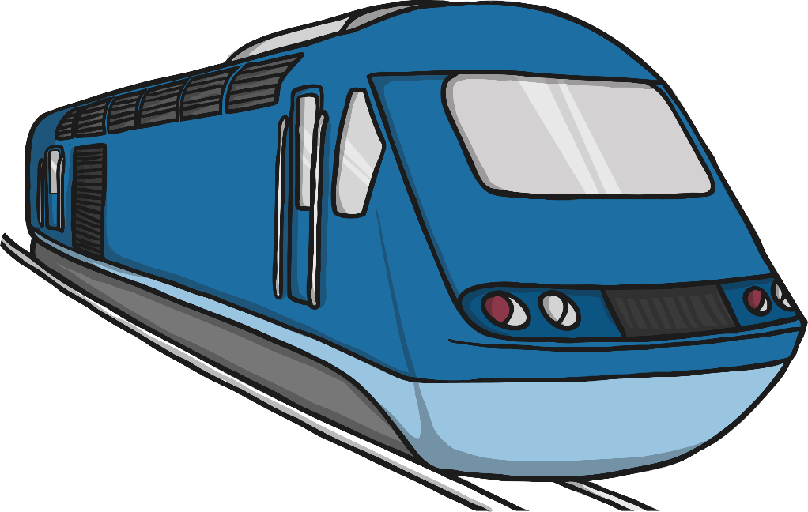
/ai/, /a-e/, /ay/, /eigh/ or /ey/?
ai
ai
a-e
ay
eigh
ey

Slide 11
/ai/, /a-e/, /ay/, /eigh/ or /ey/?
8
8
ai
a-e
ay
eigh
eigh
ey

Slide 12
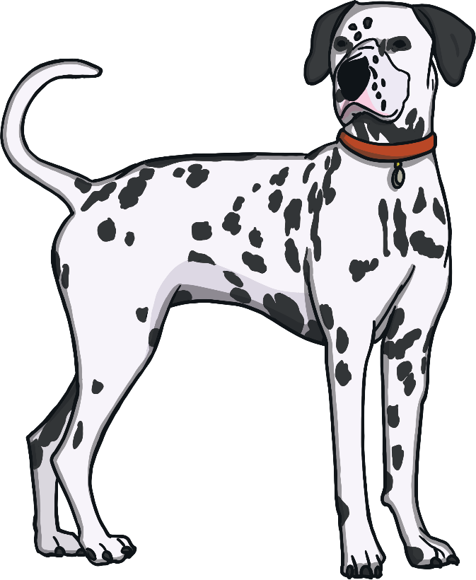
/ai/, /a-e/, /ay/, /eigh/ or /ey/?
ai
ai
a-e
ay
eigh
ey

Slide 13
/ai/, /a-e/, /ay/, /eigh/ or /ey/?
ai
a-e
ay
ay
eigh
ey

Slide 14
/ai/, /a-e/, /ay/, /eigh/ or /ey/?
ai
ai
a-e
ay
eigh
ey

Slide 15
/ai/, /a-e/, /ay/, /eigh/ or /ey/?
ai
a-e
a-e
ay
eigh
ey

Slide 16
/ai/, /a-e/, /ay/, /eigh/ or /ey/?
ai
a-e
ay
eigh
ey
ey

Slide 17
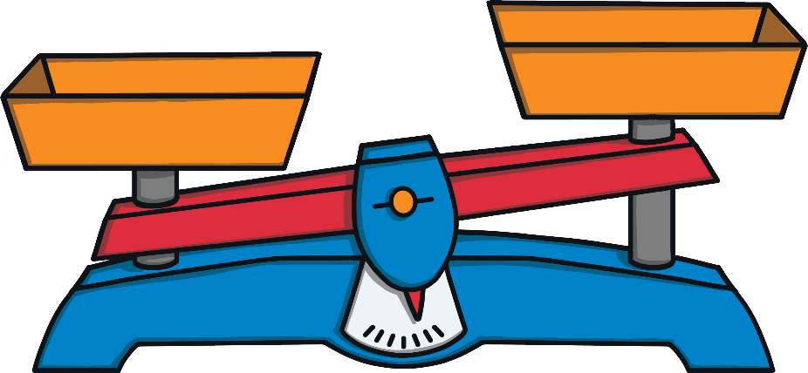
/ai/, /a-e/, /ay/, /eigh/ or /ey/?
ai
a-e
ay
eigh
eigh
ey

Slide 18
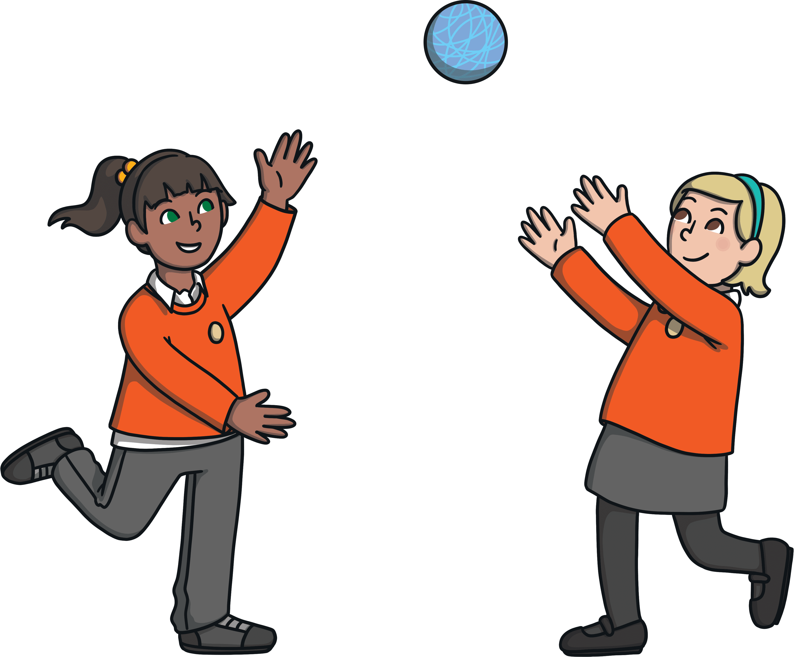
/ai/, /a-e/, /ay/, /eigh/ or /ey/?
ai
a-e
ay
ay
eigh
ey

Slide 19
/ai/, /a-e/, /ay/, /eigh/ or /ey/?
ai
a-e
a-e
ay
eigh
ey

Slide 20
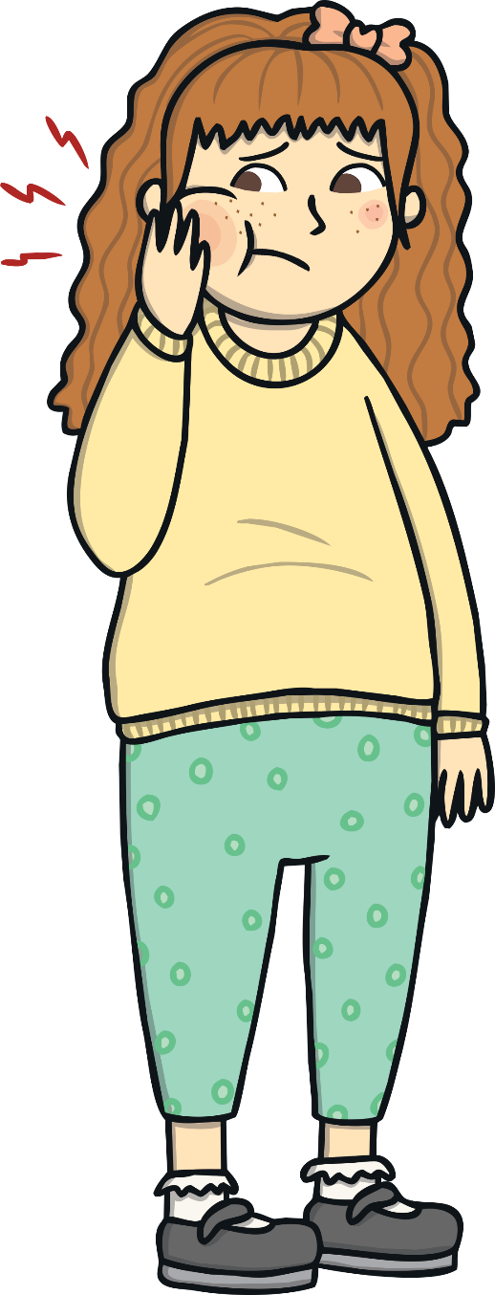
/ai/, /a-e/, /ay/, /eigh/ or /ey/?
ai
ai
a-e
ay
eigh
ey

Slide 21
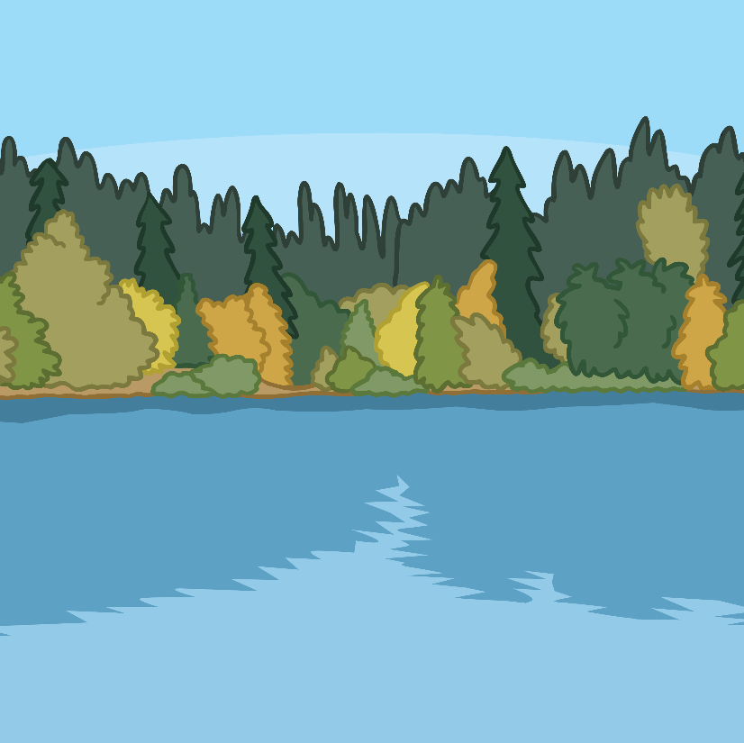
/ai/, /a-e/, /ay/, /eigh/ or /ey/?
ai
a-e
a-e
ay
eigh
ey

Slide 22
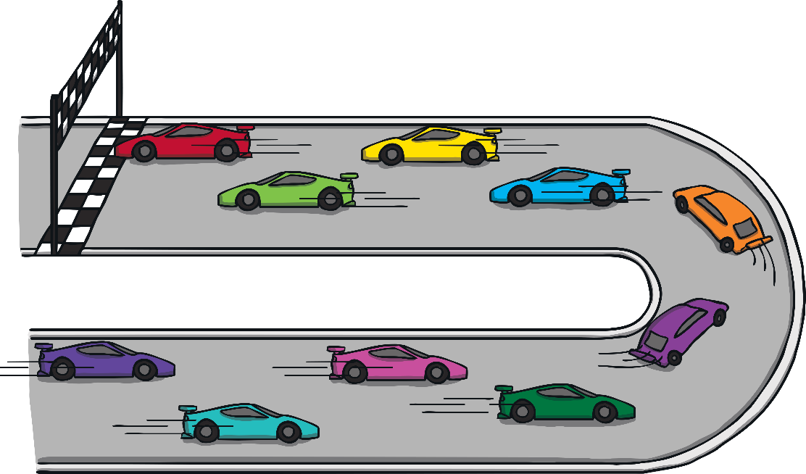
/ai/, /a-e/, /ay/, /eigh/ or /ey/?
ai
a-e
ay
eigh
eigh
ey

