Slide 2
_ocks

Slide 3
_pple

Slide 4
_omato

Slide 5
_ig

Slide 6
_gloo

Slide 7
_ose

Slide 8
_ap

Slide 9
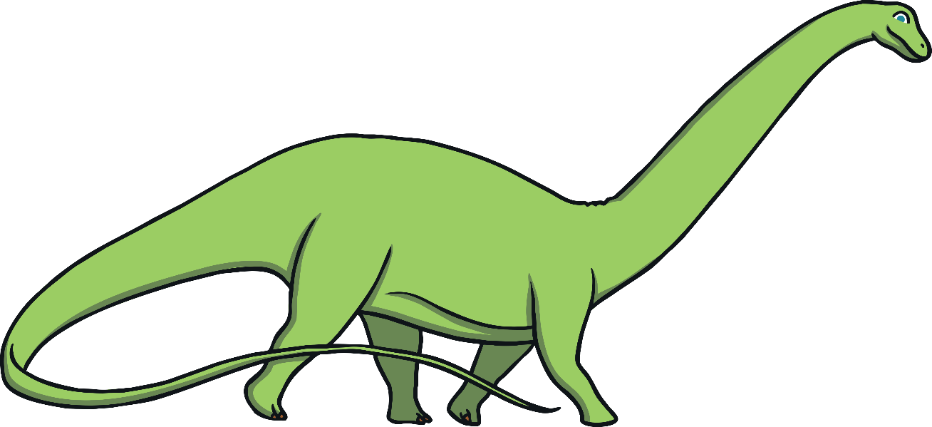
_inosaur

Slide 10
_range

Slide 11
_arrot

Slide 12
_ey

Slide 13
_lephant

Slide 14
_obot

Slide 15
_and

Slide 16
_ird

Slide 17
_lowers

Slide 18
_eaf

