Slide 2
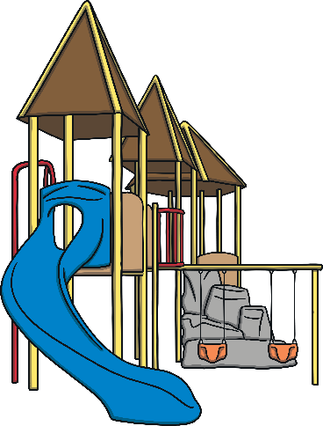
slide
Start Timer
Start Timer
Use Timer
Show Answer
Next

Slide 3
kide
Start Timer
Show Answer
Start Timer
Use Timer
Next

Slide 4
gime
Start Timer
Show Answer
Start Timer
Use Timer
Next

Slide 5
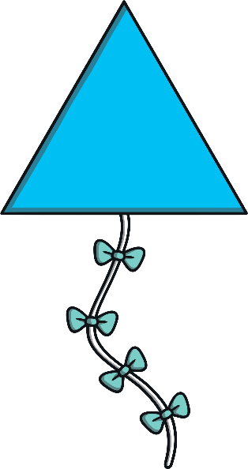
kite
Start Timer
Start Timer
Use Timer
Show Answer
Next

Slide 6
quibe
Start Timer
Show Answer
Start Timer
Use Timer
Next

Slide 7
prize
Start Timer
Start Timer
Use Timer
Show Answer
Next

Slide 8
hine
Start Timer
Show Answer
Start Timer
Use Timer
Next

Slide 9
drike
Start Timer
Show Answer
Start Timer
Use Timer
Next

Slide 10
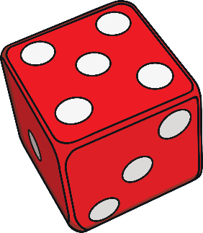
five
Start Timer
Start Timer
Use Timer
Show Answer
Next

Slide 11
time
Start Timer
Start Timer
Use Timer
Show Answer
Next

Slide 12
trife
Start Timer
Show Answer
Start Timer
Use Timer
Next

Slide 13
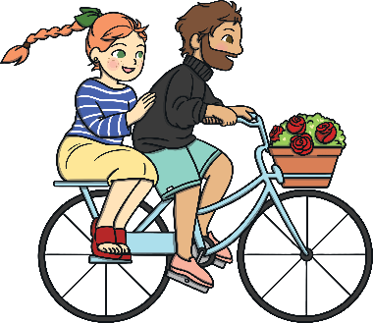
bike
Start Timer
Start Timer
Use Timer
Show Answer
Next

Slide 14
gline
Start Timer
Show Answer
Start Timer
Use Timer
Next

Slide 15
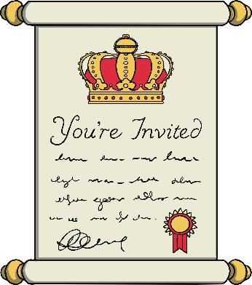
invite
Start Timer
Start Timer
Use Timer
Show Answer
Next

Slide 16
white
Start Timer
Start Timer
Use Timer
Show Answer
Next

Slide 17
krite
Start Timer
Show Answer
Start Timer
Use Timer
Next

