Slide 2
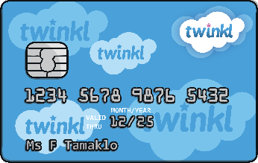
pay
Start Timer
Start Timer
Use Timer
Show Answer
Next

Slide 3
kayon
Start Timer
Show Answer
Start Timer
Use Timer
Next

Slide 4
blay
Start Timer
Show Answer
Start Timer
Use Timer
Next

Slide 5
spray
Start Timer
Start Timer
Use Timer
Show Answer
Next

Slide 6
tray
Start Timer
Start Timer
Use Timer
Show Answer
Next

Slide 7
chay
Start Timer
Show Answer
Start Timer
Use Timer
Next

Slide 8
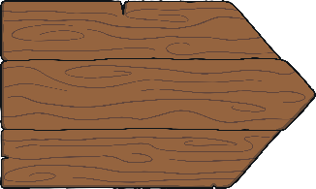
way
Start Timer
Start Timer
Use Timer
Show Answer
Next

Slide 9
scay
Start Timer
Show Answer
Start Timer
Use Timer
Next

Slide 10
play
Start Timer
Start Timer
Use Timer
Show Answer
Next

Slide 11
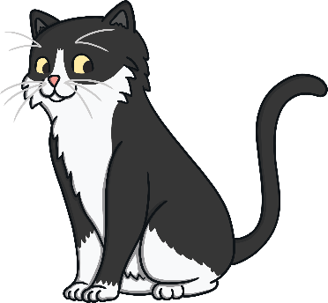
stray
Start Timer
Start Timer
Use Timer
Show Answer
Next

