Slide 1
Disclaimer/s
We hope you find the information on our website and resources useful.
Animations
This resource has been designed with animations to make it as fun and engaging as possible. To view the content in the correct formatting, please view the PowerPoint in ‘slide show mode’. This takes you from desktop to presentation mode. If you view the slides out of ‘slide show mode’, you may find that some of the text and images overlap each other and/or are difficult to read.
To enter slide show mode, go to the slide show menu tab and select either from beginning or from current slide.
You may wish to delete this slide before beginning the presentation.

Slide 3
Learning Intention:
We are learning about different types of landforms.
Success Criteria:
I can define different landforms and name landforms in my country, state or local area.

Slide 4
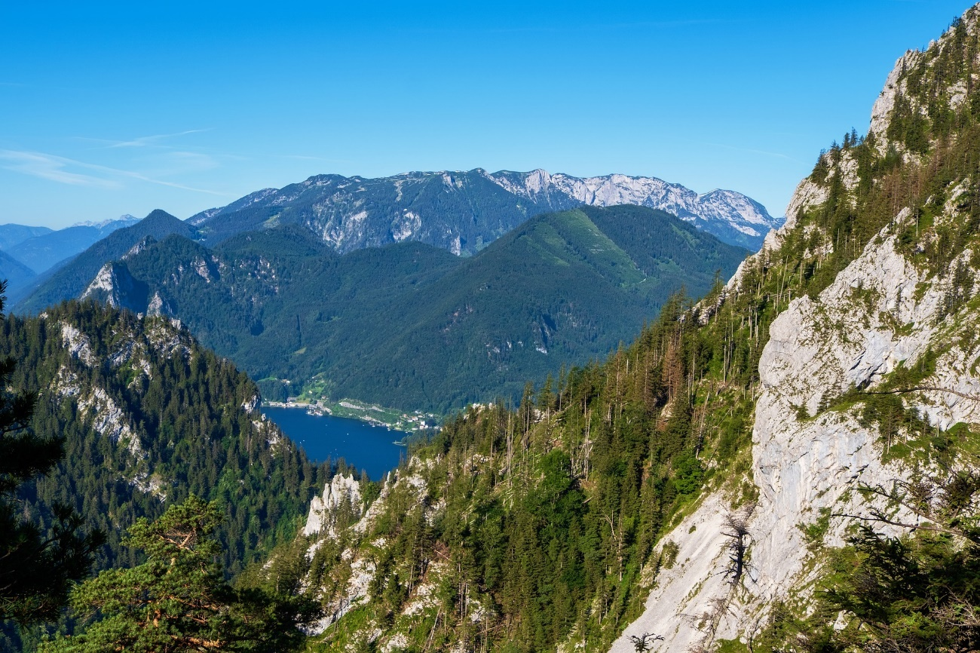
What is a Landform?
Have a think – what do you think a landform is?
Talk to a partner or with the class.

Slide 5
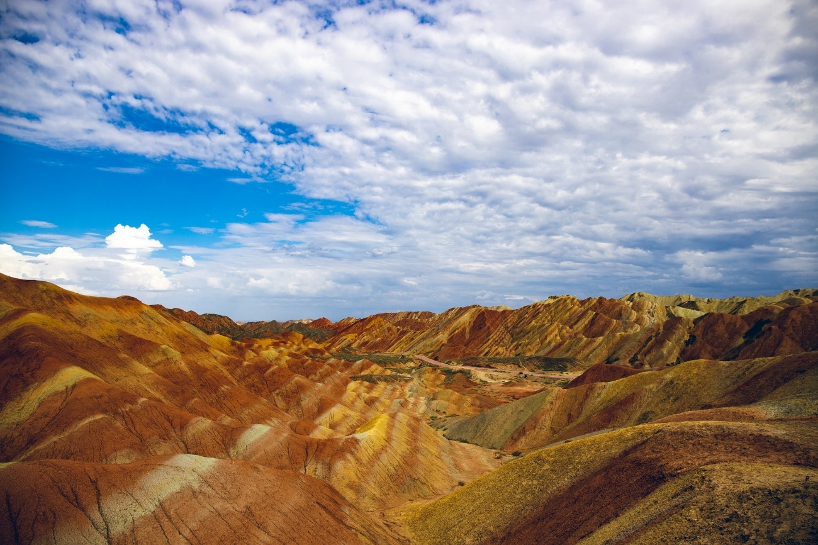
What is a Landform?
Landforms are naturally-formed features that can be found on Earth’s surface. Many of them are created by natural forces such as the sea or wind.
Landforms often occur above sea level, but some can form under the ocean.
There are many different types of landforms. How many can you think of?

Slide 6
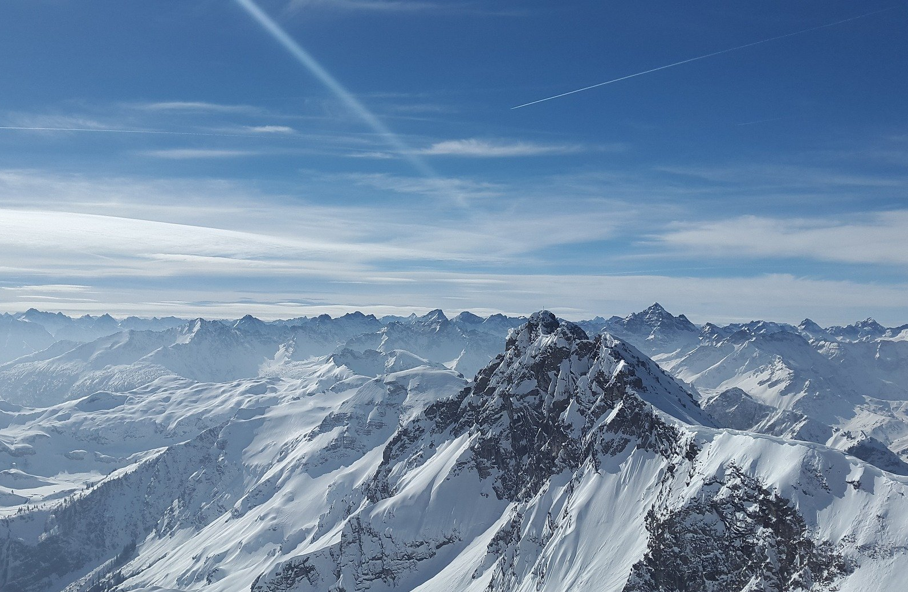
Mountains
Mountains are parts of the Earth’s surface which rise 300 metres into the air or higher. They often have very steep slopes and a rocky surface.
Anything smaller than 300 metres is known as a hill.

Slide 7
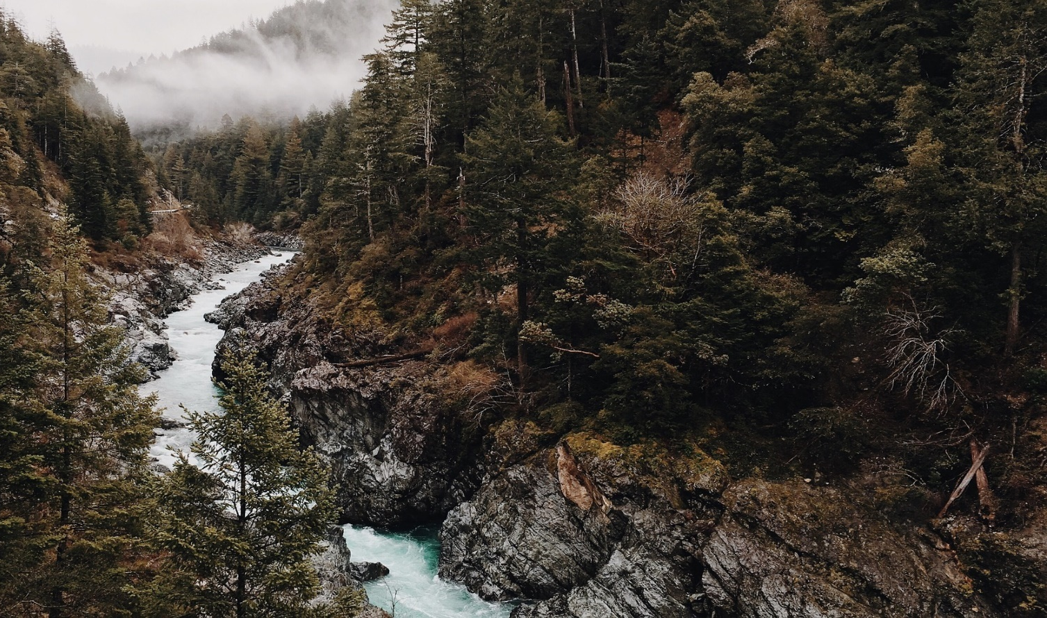
Valleys
Valleys are low areas that are found between mountains or hills. There is often a stream or a river running through a valley.

Slide 8
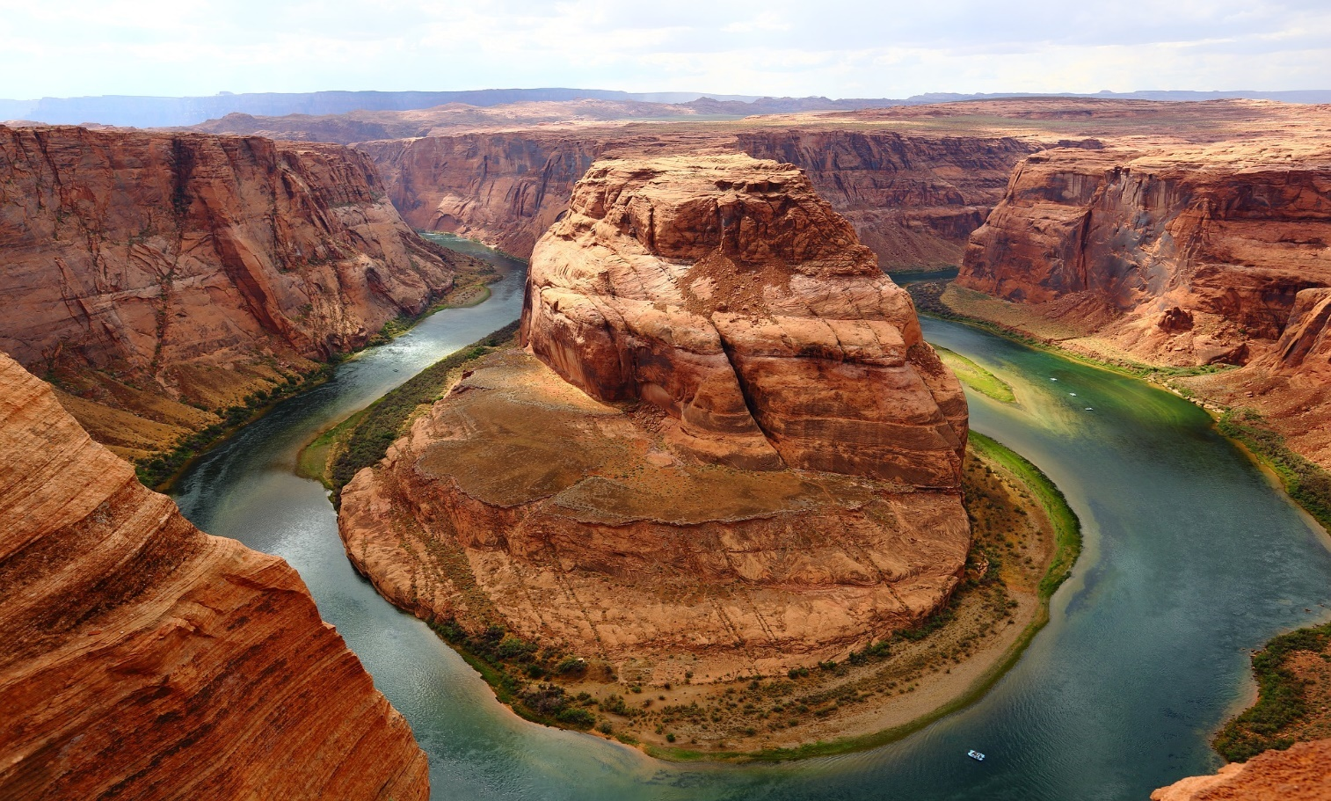
Canyons
Also known as a gorge, a canyon is similar to a valley, but it is often deeper and has narrower sides. Most canyons tend to form after many years of rivers cutting through layers of rock.

Slide 9
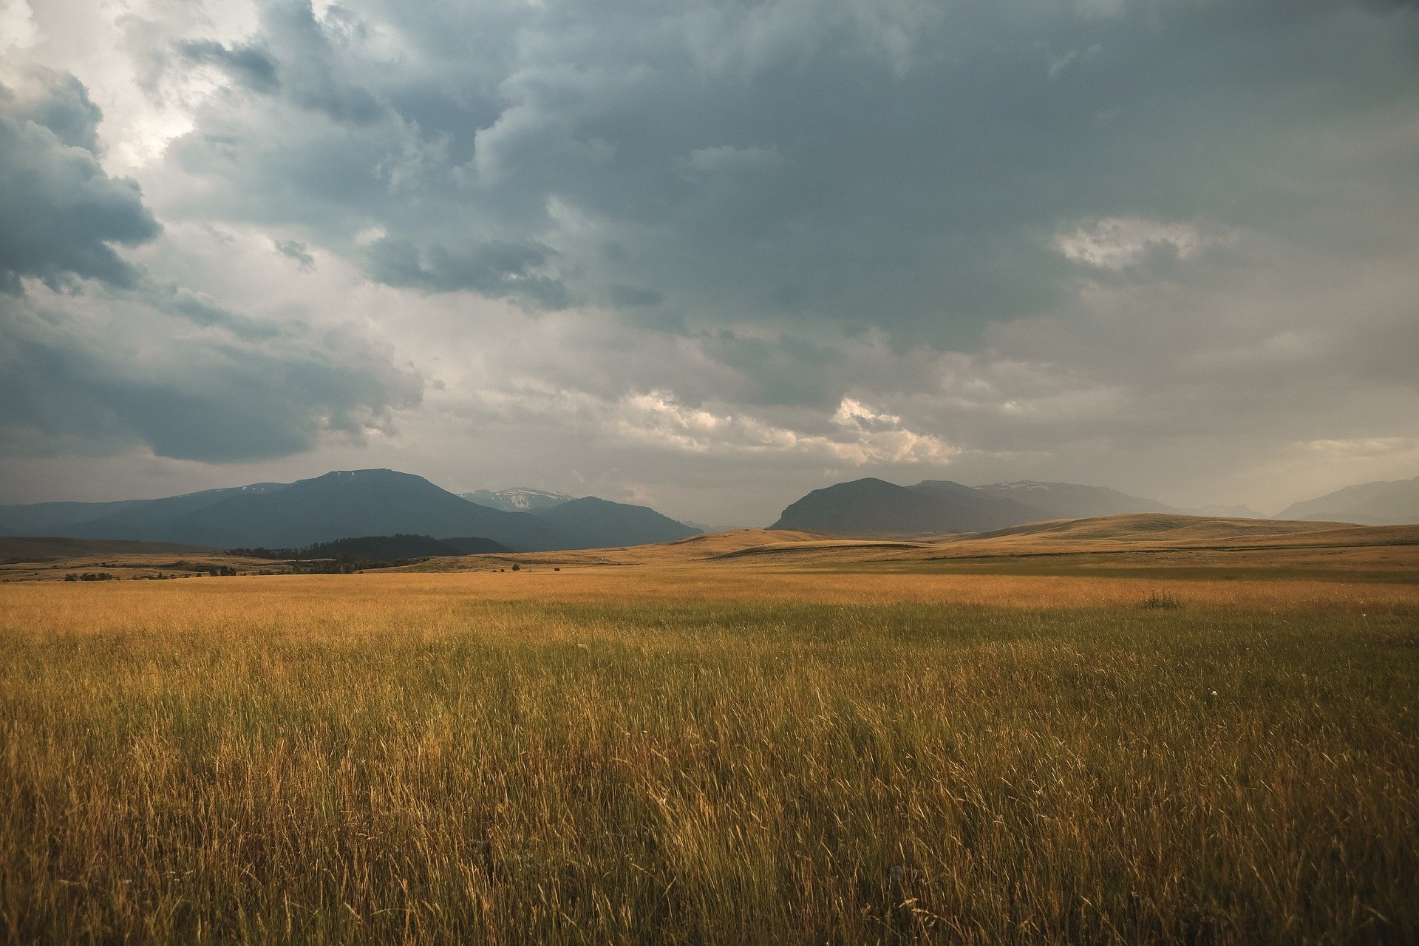
Plains
Plains are flat areas of land that have very little slopes, hills or any other types of landforms. They are often found in the centres of valleys or on plateaus.

Slide 10
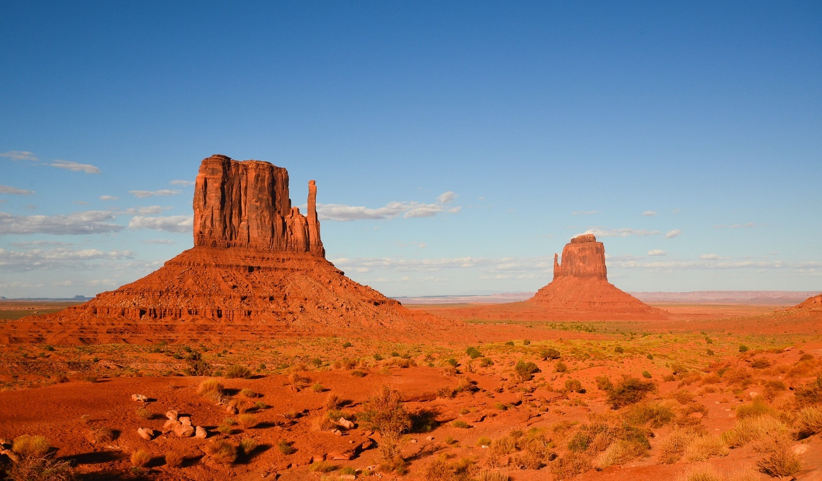
Plateaus
A plateau is a plain which is raised higher than the surrounding area. Plateaus have very steep cliffs around their edge.

Slide 11
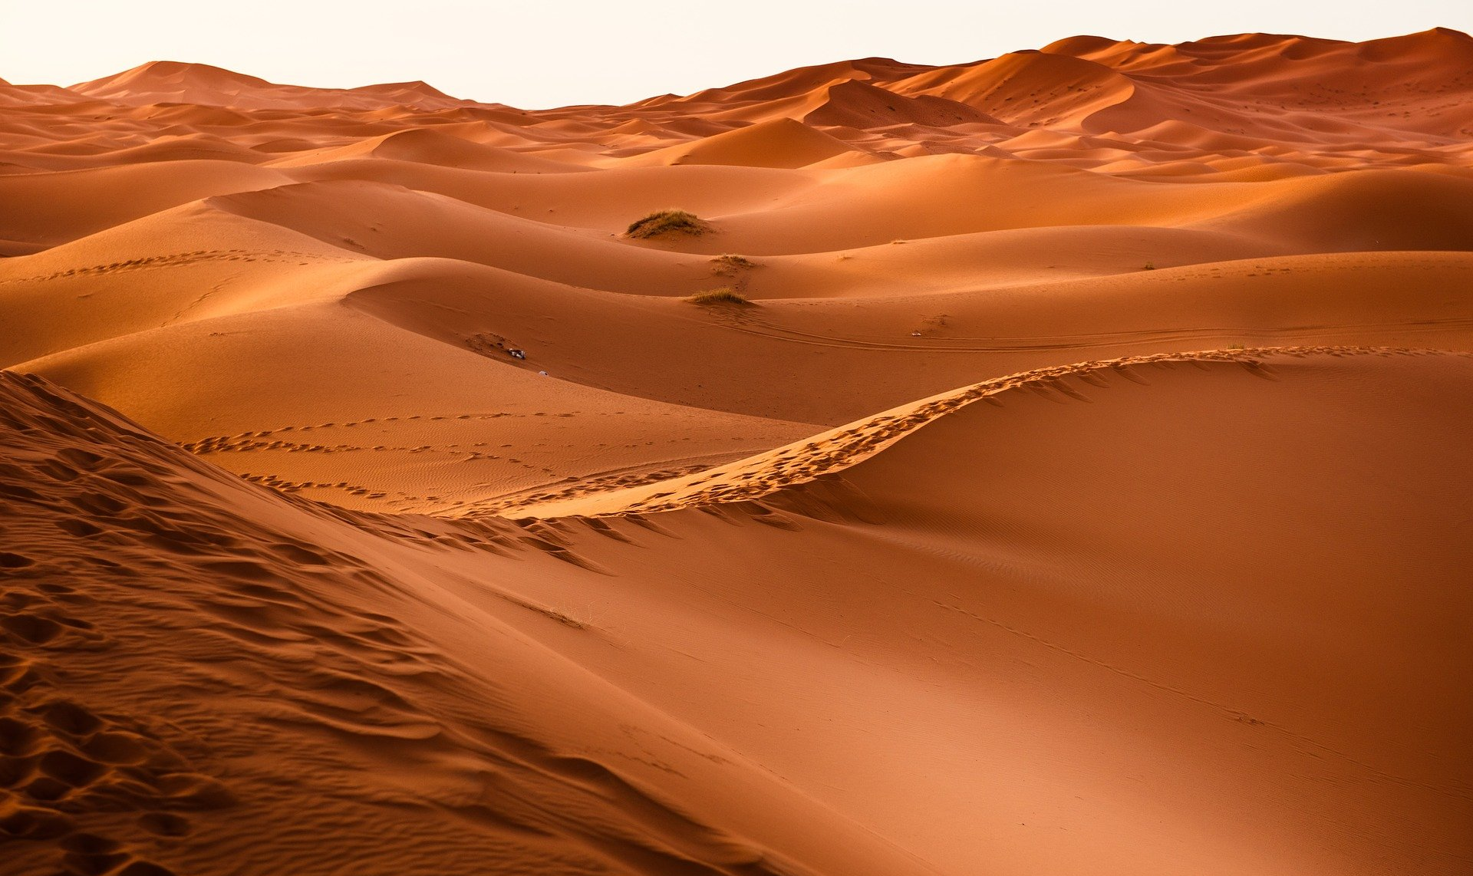
Deserts
Deserts are areas of land where there is little water. As a result, there are very few animals and plants around. With no plants to support the soil, wind erodes the land, creating sand dunes.

Slide 12
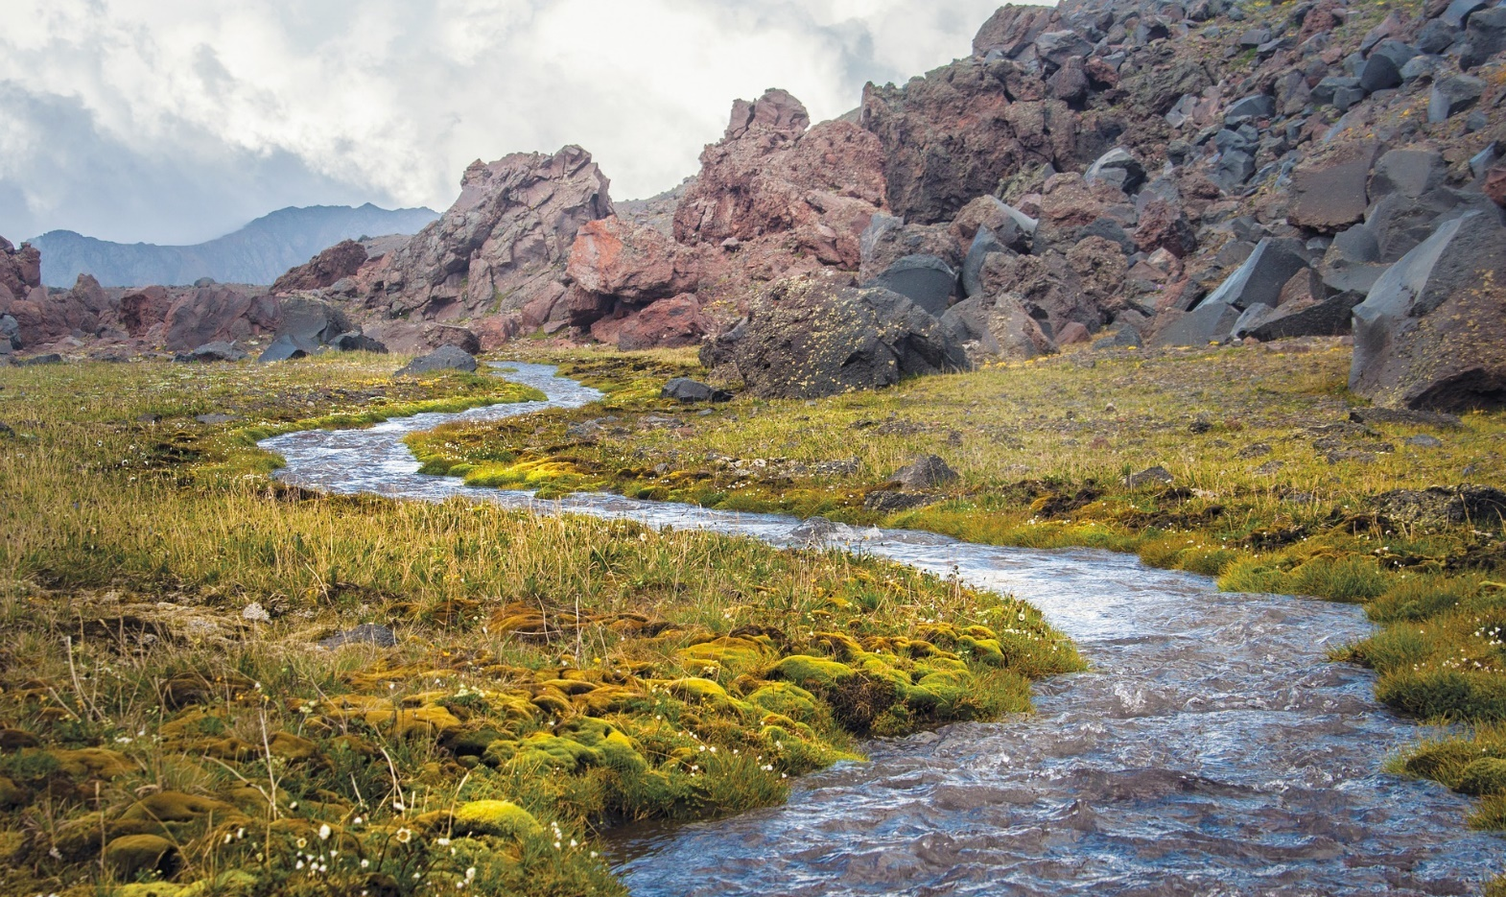
Rivers
Rivers are bodies of water that snake along the land. They are pulled downhill by gravity and flow into the ocean, a lake or other rivers. They come in a variety of sizes and can be shallow or deep.

Slide 13
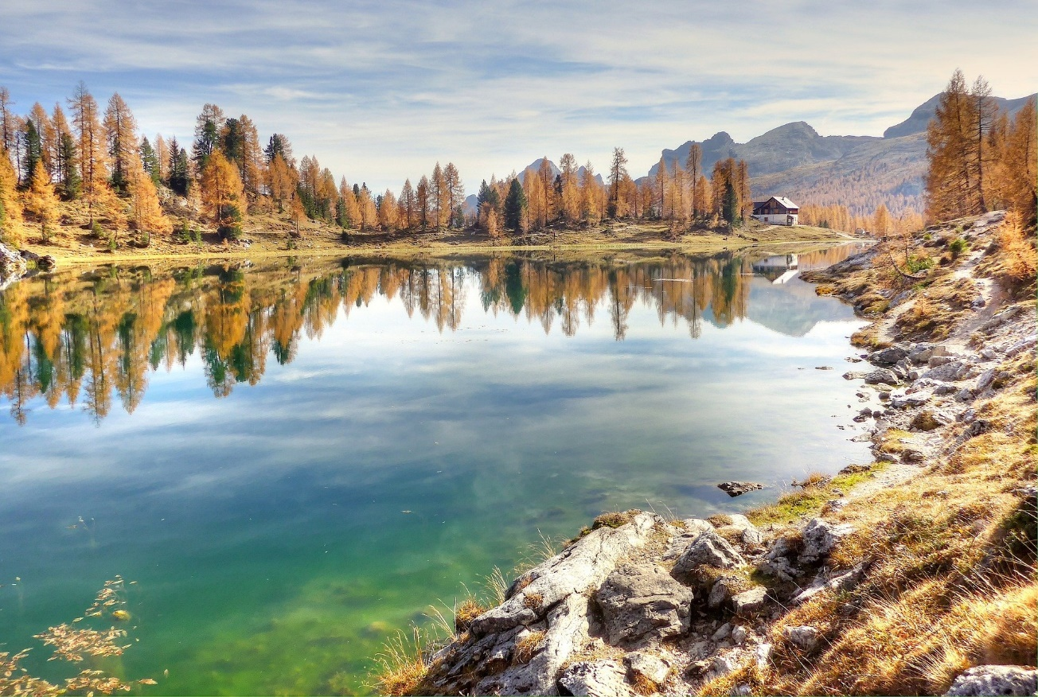
Lakes
A lake is a landlocked body of water. It can be made of slow moving water or still water. These lakes are fed water by rivers or rainfall.
A body of water that is smaller than a lake and shallow enough for the light to reach the bottom is known as a pond.

Slide 14
Islands
An island is an area of land surrounded by water. It is smaller than a continent.
A group of islands is known as an archipelago.

Slide 15
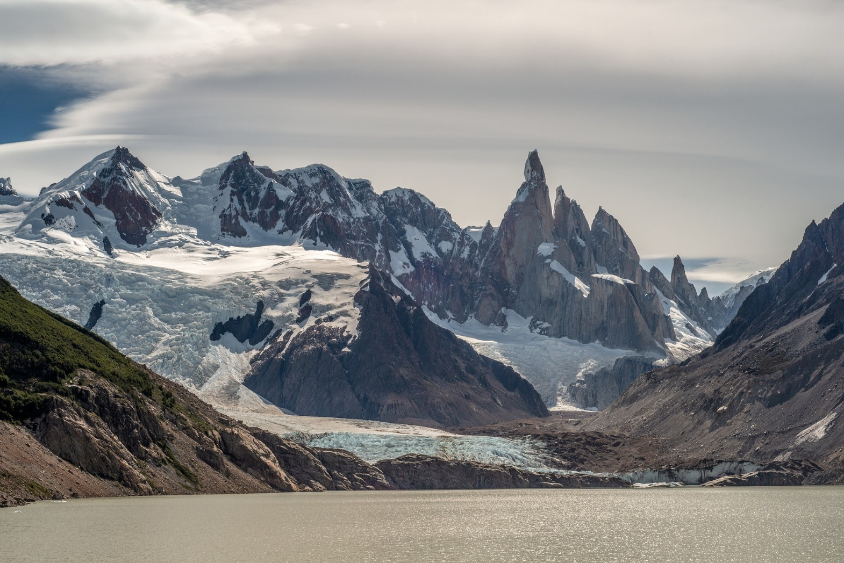
Glaciers
Glaciers are masses of slowly moving ice. They usually form on mountains after snow, rock, water and ice builds up. Pulled downwards by gravity, glaciers can flow down mountains like a river.

Slide 16
Finding Landforms Activity
Think about a place that you know well, it could be Australia, your state or your local area. What landforms can you find there?
Work with a partner or as a group to write down your answers.

