Slide 1
Instructions
Please make sure you view this PowerPoint in Presentation mode.
When you start the game, choosing the correct question word on each slide will enable you to move on to the next. If the wrong word is clicked on, you'll be unable to progress until you click the correct answer.

Slide 3
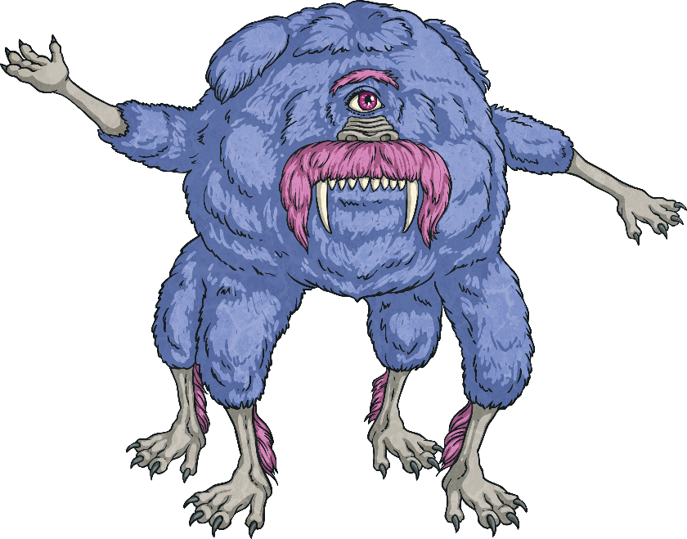
Do or Does?
We use ‘do’ with…
We use ‘does’ with…
I
he
you
she
we
it
they

Slide 4
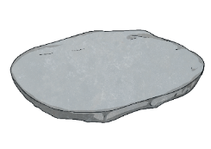
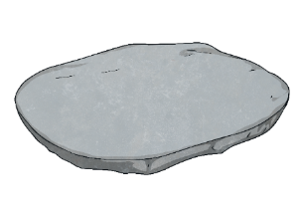
Rules of the Game
This game will help you revise the difference between ‘do’ and ‘does’.
You must help an alien, Niblut, choose the word and step on the right stone to avoid the lava. If you choose the wrong stone, you must go back to the beginning of the game.
Everyone can join in by shouting ‘The floor is lava!’ If that happens, everyone must make sure that they aren’t touching the floor.

Slide 5
Start Here
Hi there, my name is Niblut. I have to get across the river of lava. Would you help me step on the right stones?
Don’t get a question wrong because if you do, the floor turns to…
A
A
L
V
!
Start the Game

Slide 6
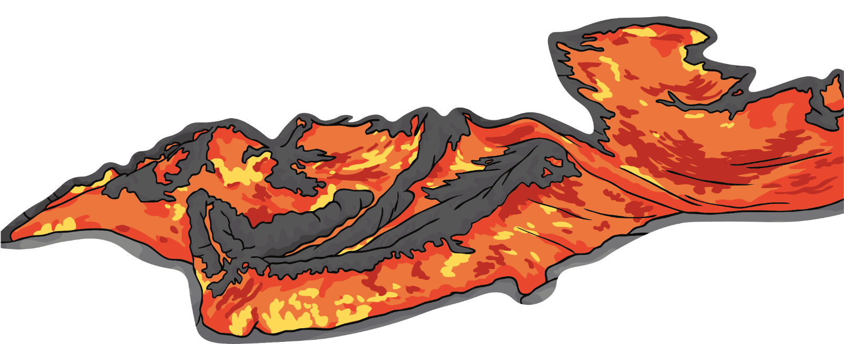
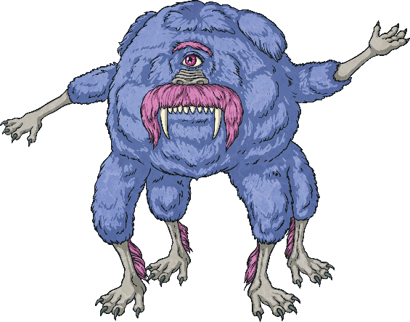
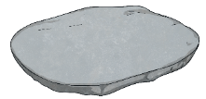
Step 1
you like chocolate?
Does
Do
Next step

Slide 7
Step 2
Where she live?
does
do
Next step

Slide 8
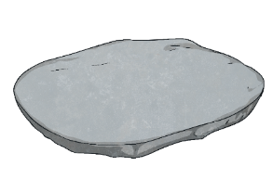
Step 3
She her homework every day.
do
does
Next step

Slide 9
Step 4
he go to bed early?
Do
Next step
Does

Slide 10
Step 5
we have homework today?
Do
Next step
Does

Slide 11
Step 6
Anna eat cereal for breakfast every day?
Do
Does
Next step

Slide 12
Step 7
What Alex and Yonas do after school?
do
does
Next step

Slide 13
Step 8
Malik and I have maths class today?
Does
Do
Next step

Slide 14
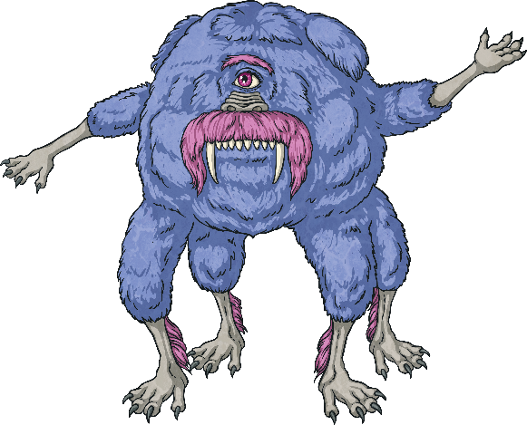
Step 9
What kind of ice cream you like?
does
do
Next step

Slide 15
Step 10
James exercise at the gym.
does
do
Next step

Slide 16
Step 11
Ori live in a big house?
Do
Does
Next step

Slide 17
Step 12
you and your friends watch a lot of films?
Does
Do

Slide 18
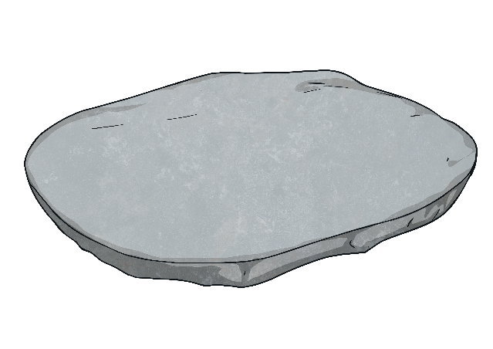
Congratulations!
We made it to the other side!

