Slide 2
Teacher Instructions
These speaking challenges are designed to get your students thinking creatively about common objects. For example, a frisbee could be used for throwing, but it could also be used as a plate, or as a hat!
Useful phrases to pre-teach:
It could be used as a…
People could use it to…
What if you used it as a…
It might be useful as a…

Slide 3
How many uses can you think of for a
frisbee?
Extra questions to investigate:
How does a frisbee work?
How was it invented?
How are they made, and what are they made from?

Slide 4
How many uses can you think of for a
tree branch?
Extra questions to investigate:
How is paper made?
Where, and how, was paper invented?

Slide 5
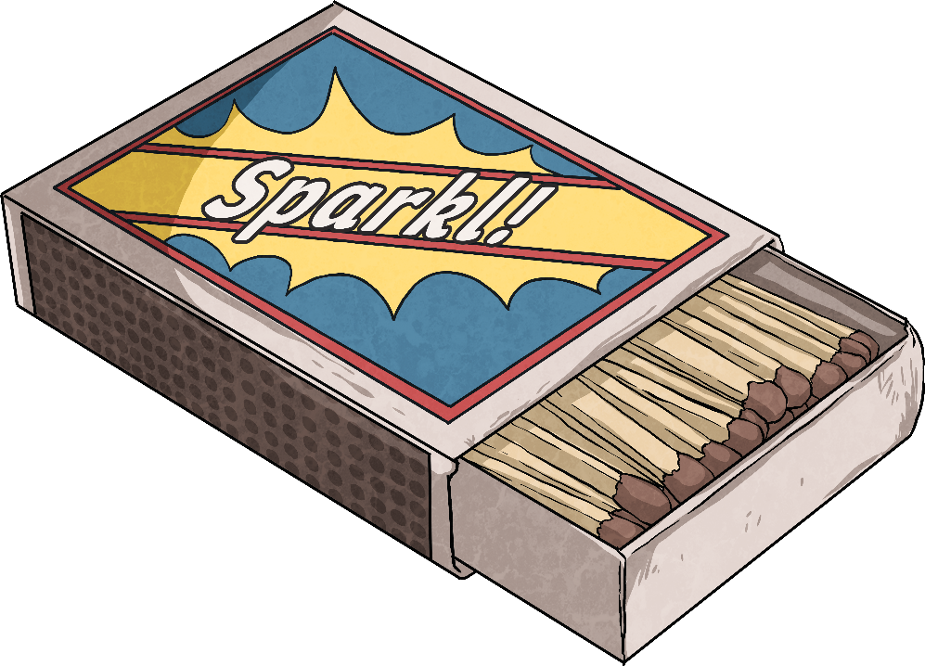
How many uses can you think of for a
matchbox?
Extra questions to investigate:
How does a match work?
How were matches invented?
How are they made, and what are they made from?

Slide 6
How many uses can you think of for a
paper clip?
Extra questions to investigate:
Where, and how, were paper clips invented?
How many are produced every year?

Slide 7
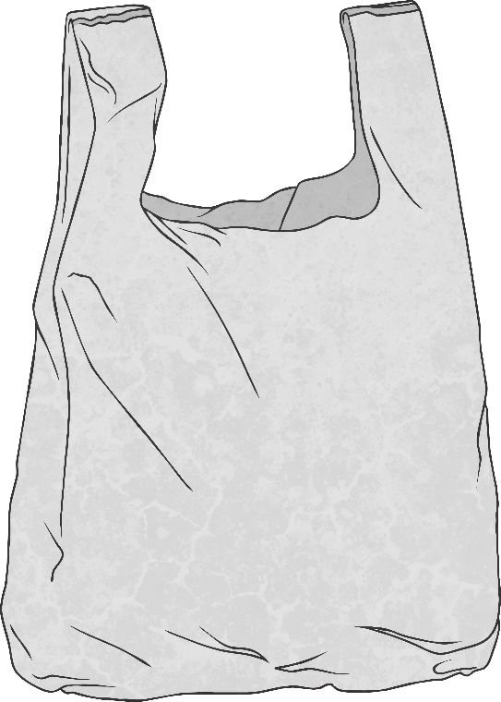
How many uses can you think of for a
plastic bag?
Extra questions to investigate:
Where, and how, were plastic bags invented?
How are they made?
How many plastic bags are made every year?

Slide 8
How many uses can you think of for a
tennis ball?
Extra questions to investigate:
How are tennis balls made?
What did tennis balls use to be made of?

Slide 9
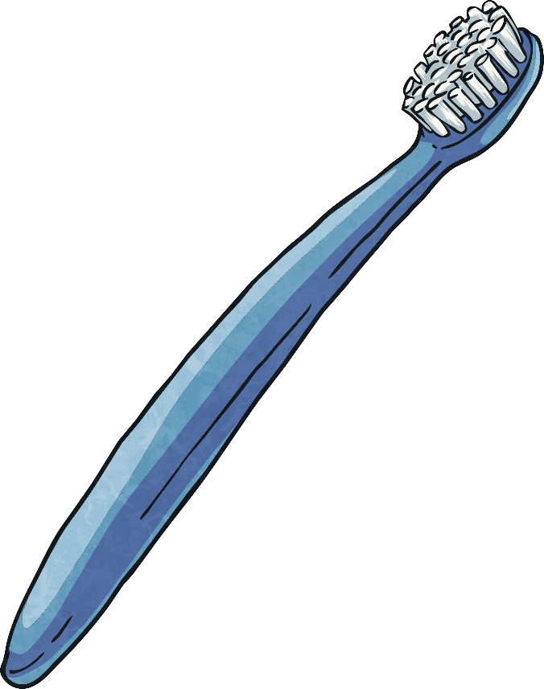
How many uses can you think of for a
toothbrush?
Extra questions to investigate:
Before toothbrushes, what did people use to use to clean their teeth?
What is a toothbrush made of?

