Slide 2
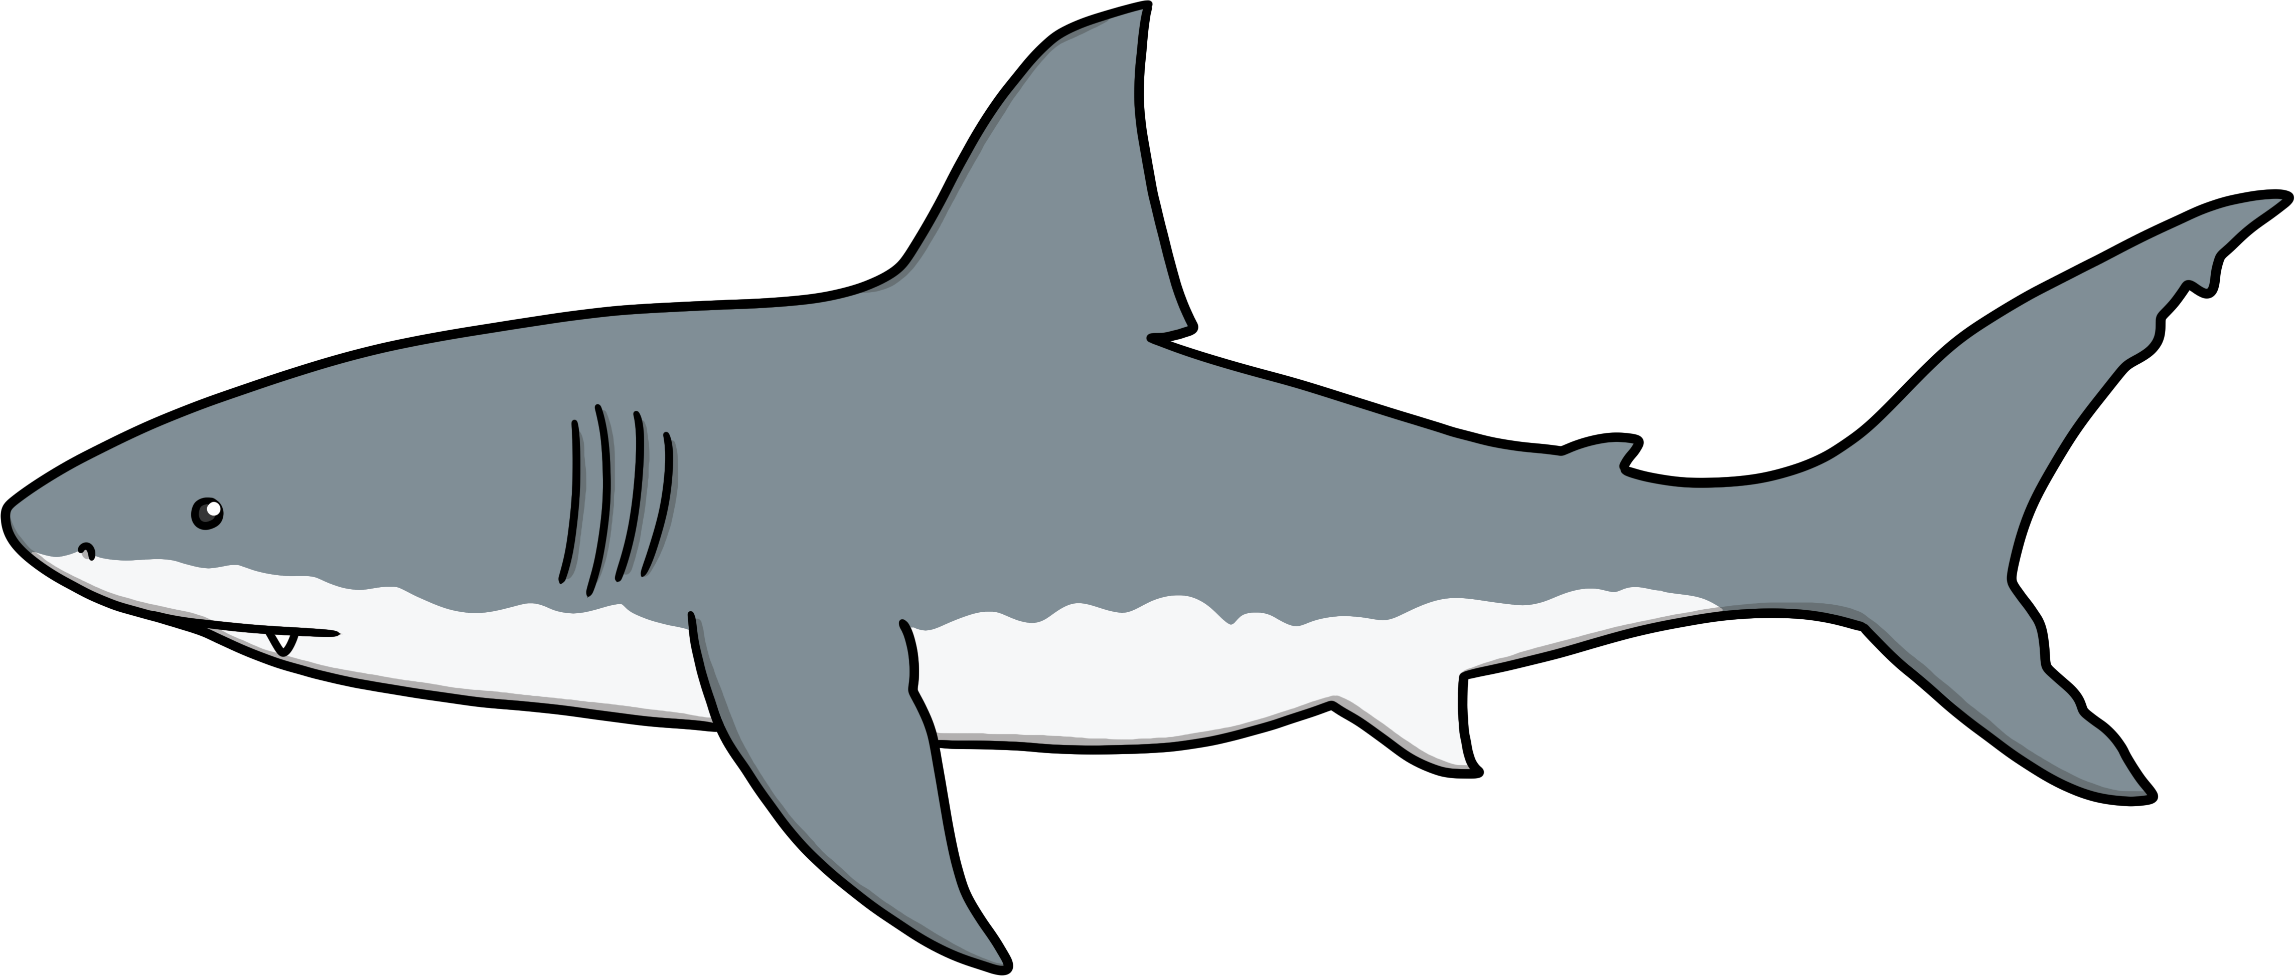
Would you rather…
…swim with sharks?
or
…swim with dolphins?

Slide 3
Would you rather…
…eat an ice cream?
or
…eat an ice lolly?

Slide 4
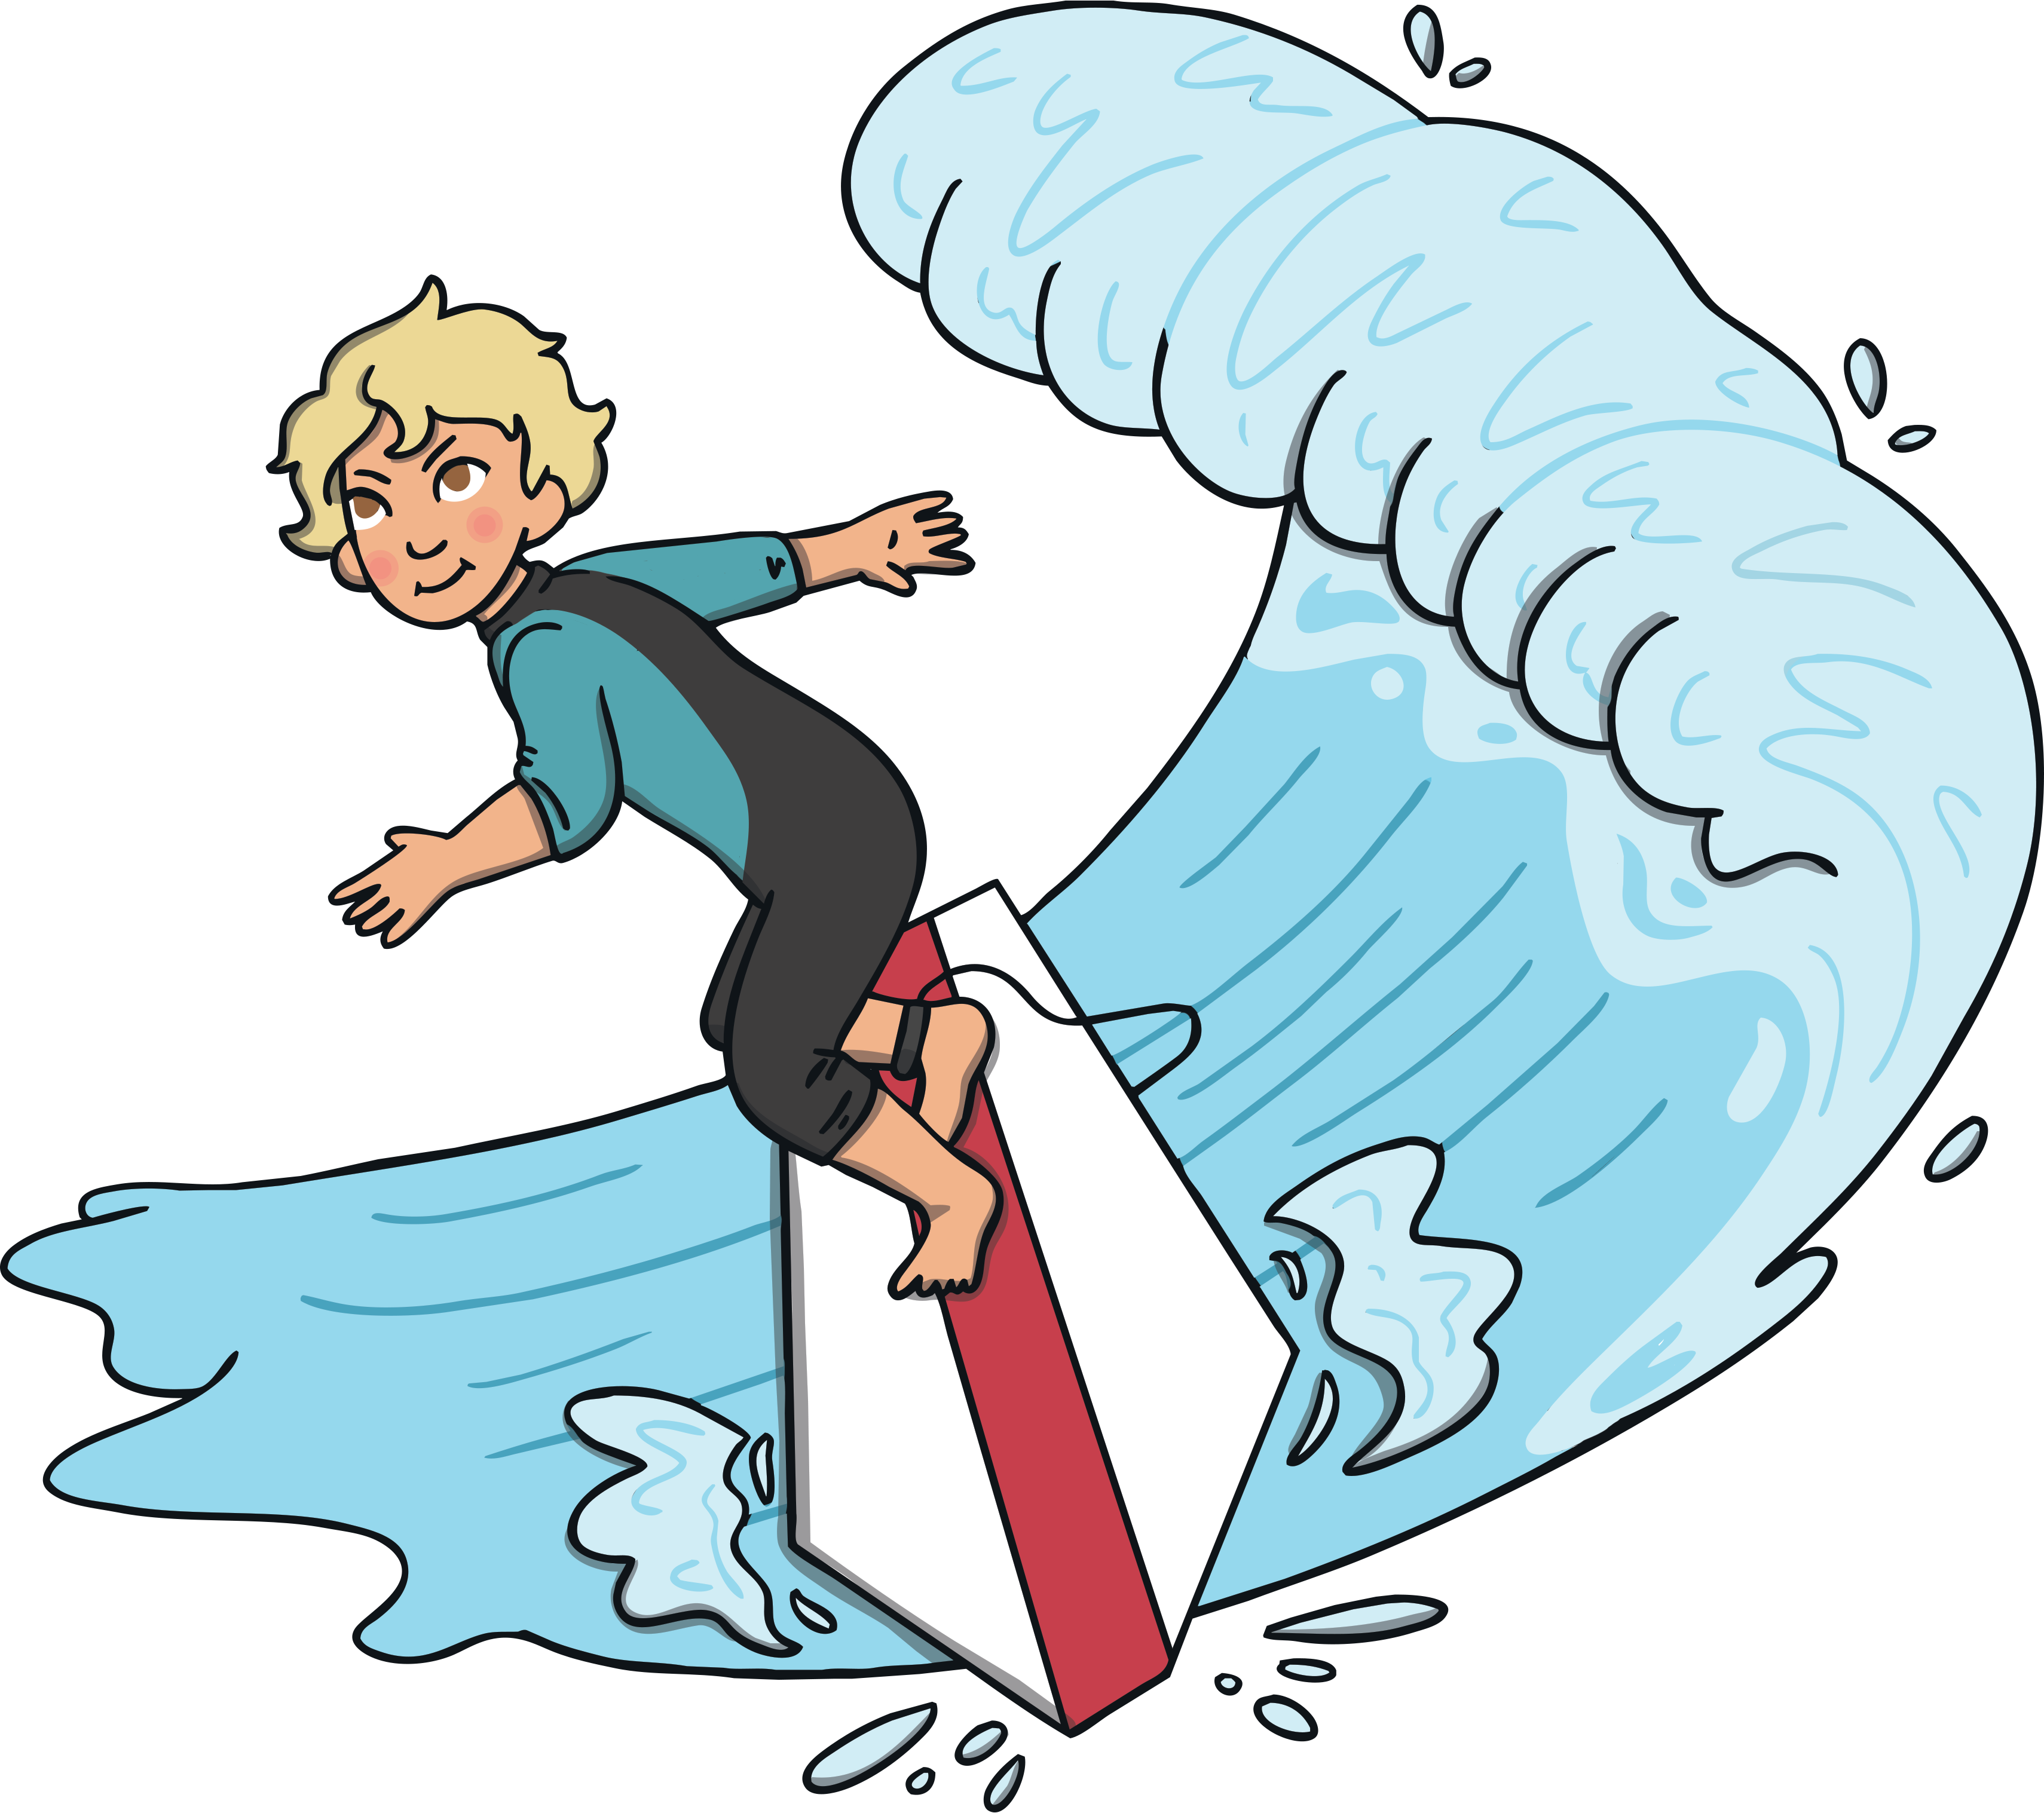
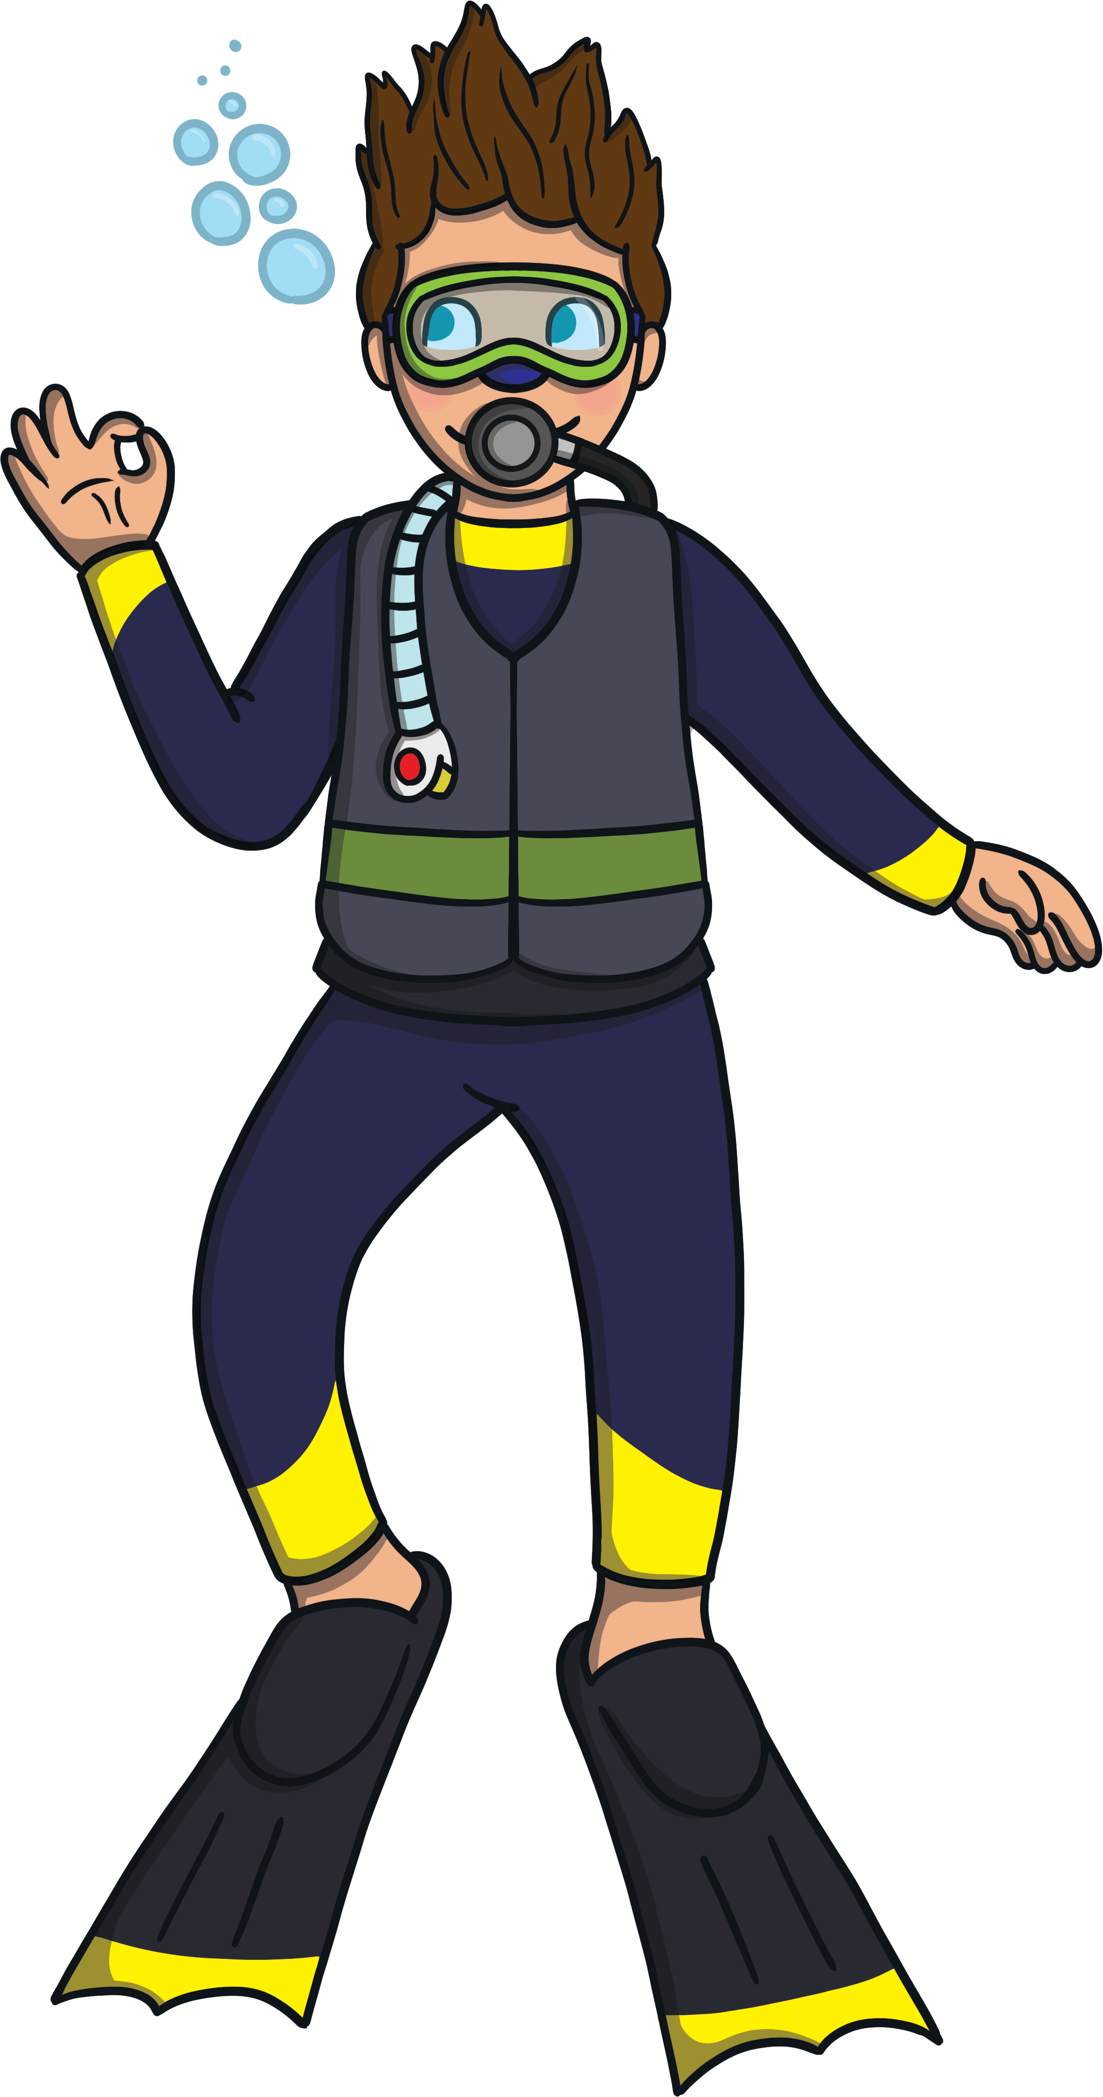
Would you rather…
…go surfing?
or
…go snorkeling?

Slide 5
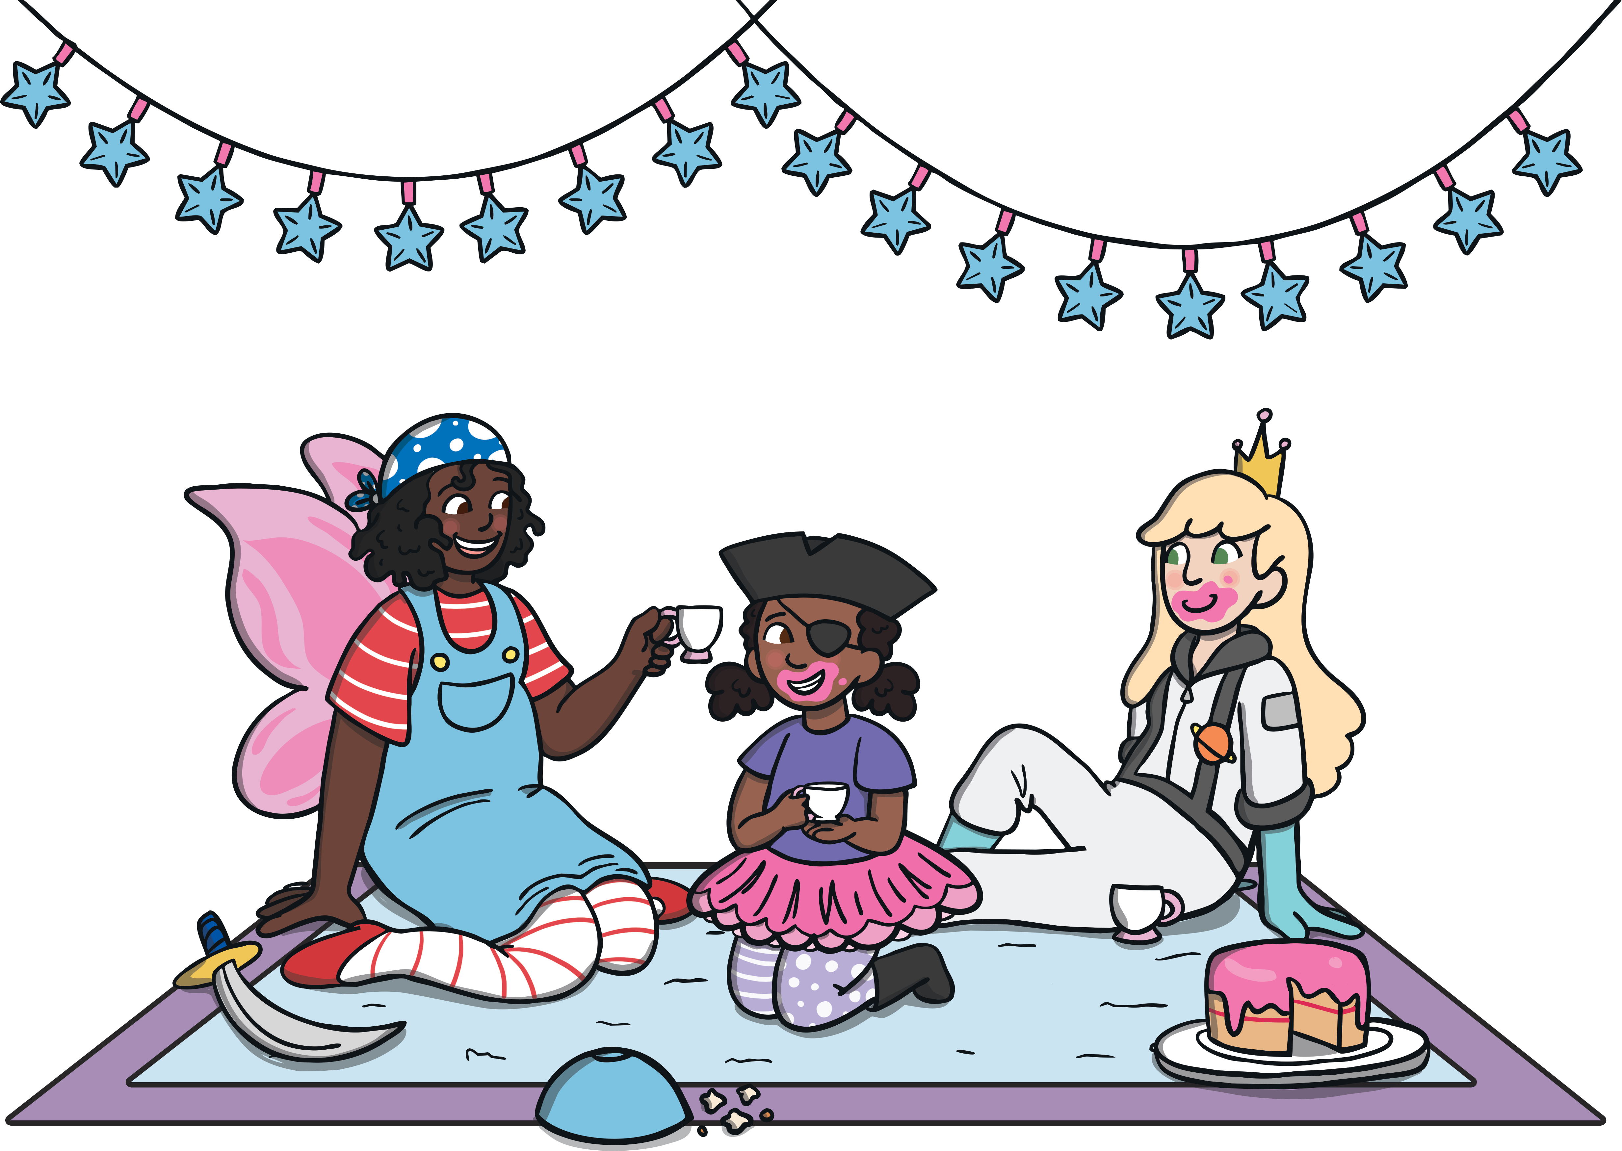
Would you rather…
…stay up late?
or
…get up early?

Slide 6
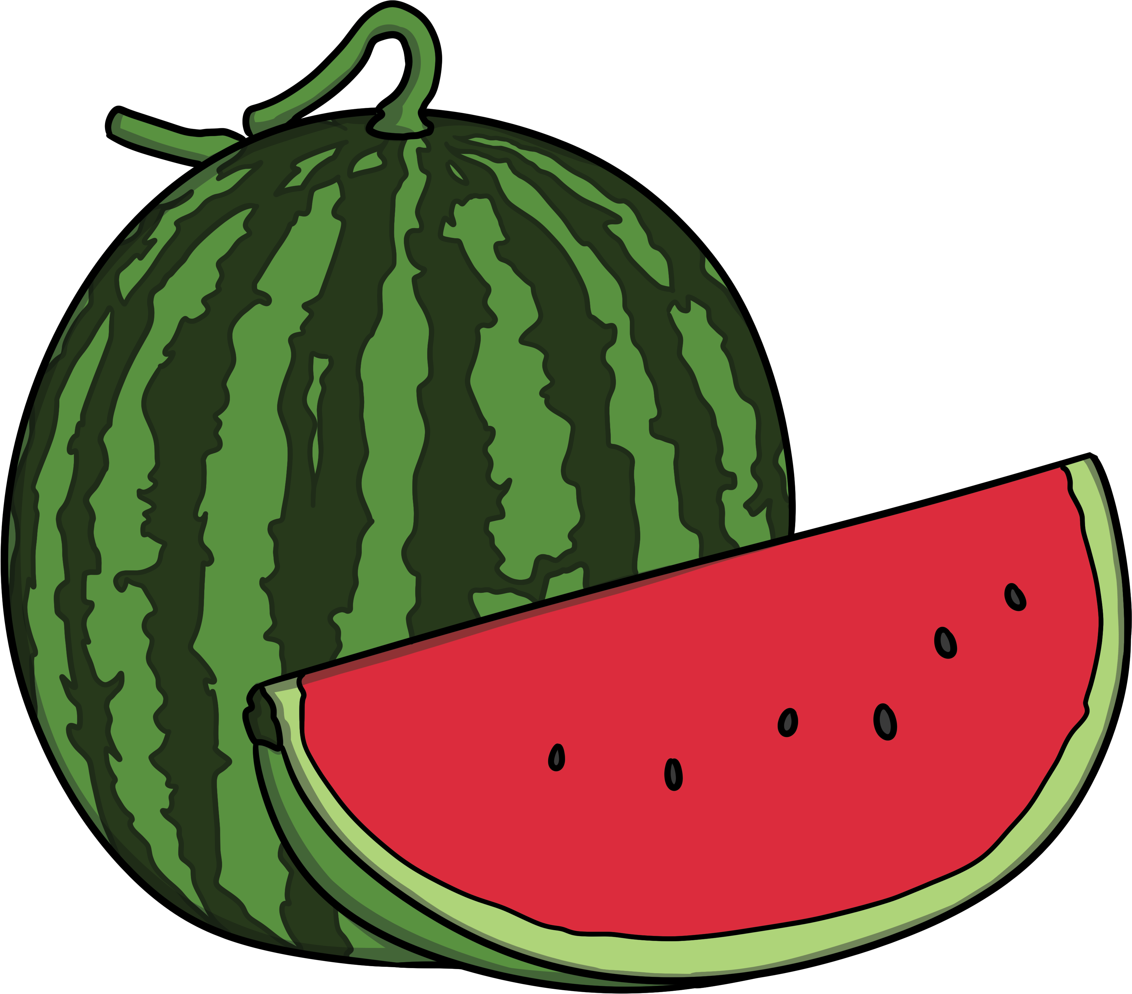
Would you rather…
…eat a slice of watermelon?
or
…eat a slice of pineapple?

Slide 7
Would you rather…
…go to the seaside?
or
…go to a lake?

Slide 8
Would you rather…
…swim in a river?
or
…swim in a pool?

Slide 9
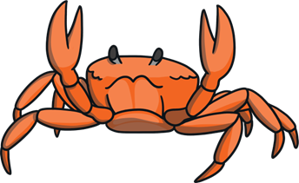
Would you rather…
…have a pet starfish?
or
…have a pet crab?

Slide 10
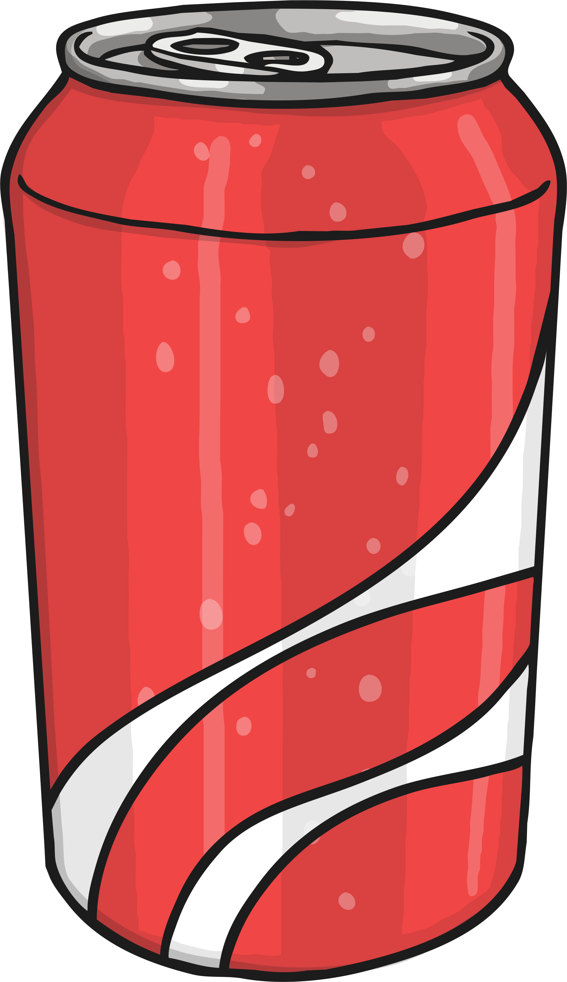
Would you rather…
…drink lemonade?
or
…have a fizzy drink?

Slide 11
Would you rather…
…stay in a house?
or
…go camping?

Slide 12
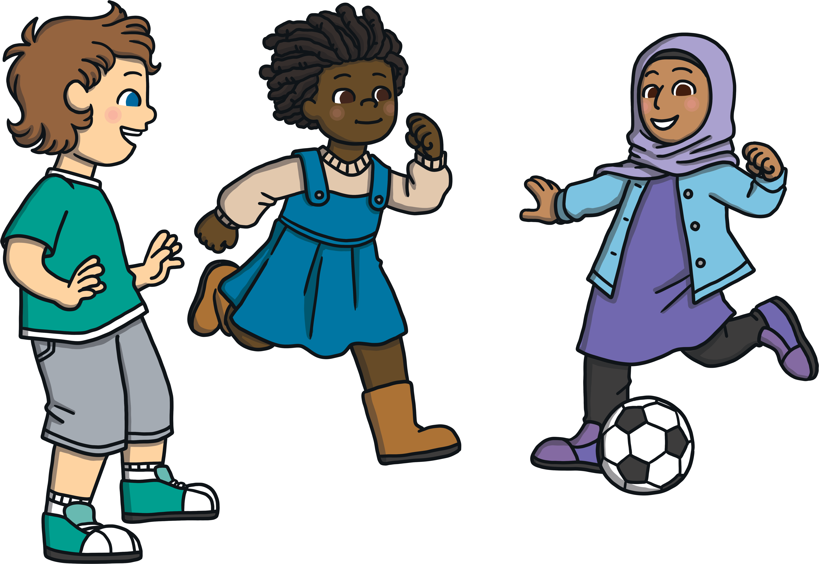
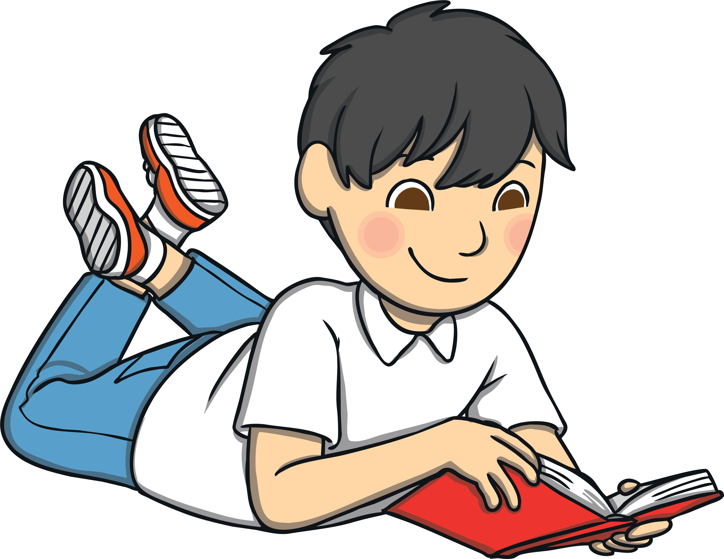
Would you rather…
…play football with your friends?
or
…read a book in the park?

Slide 13
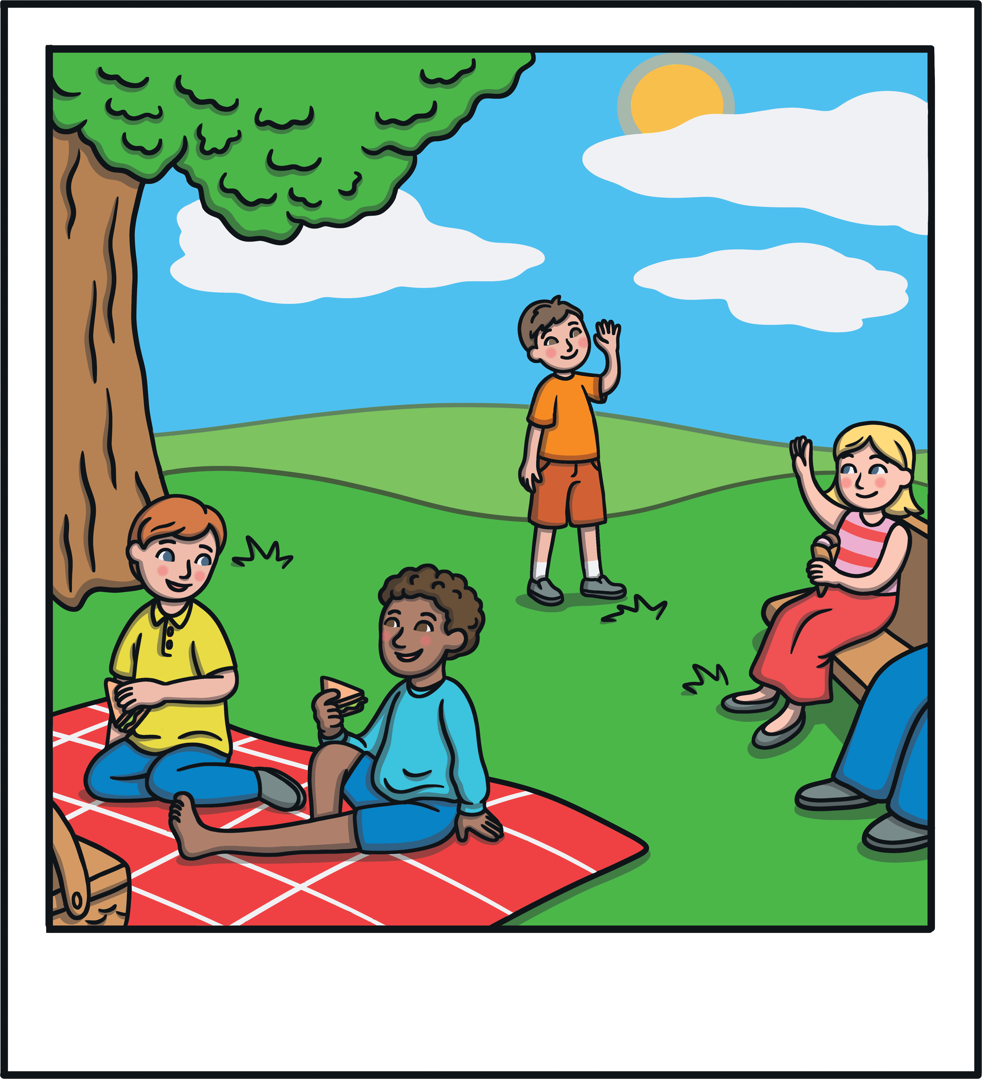
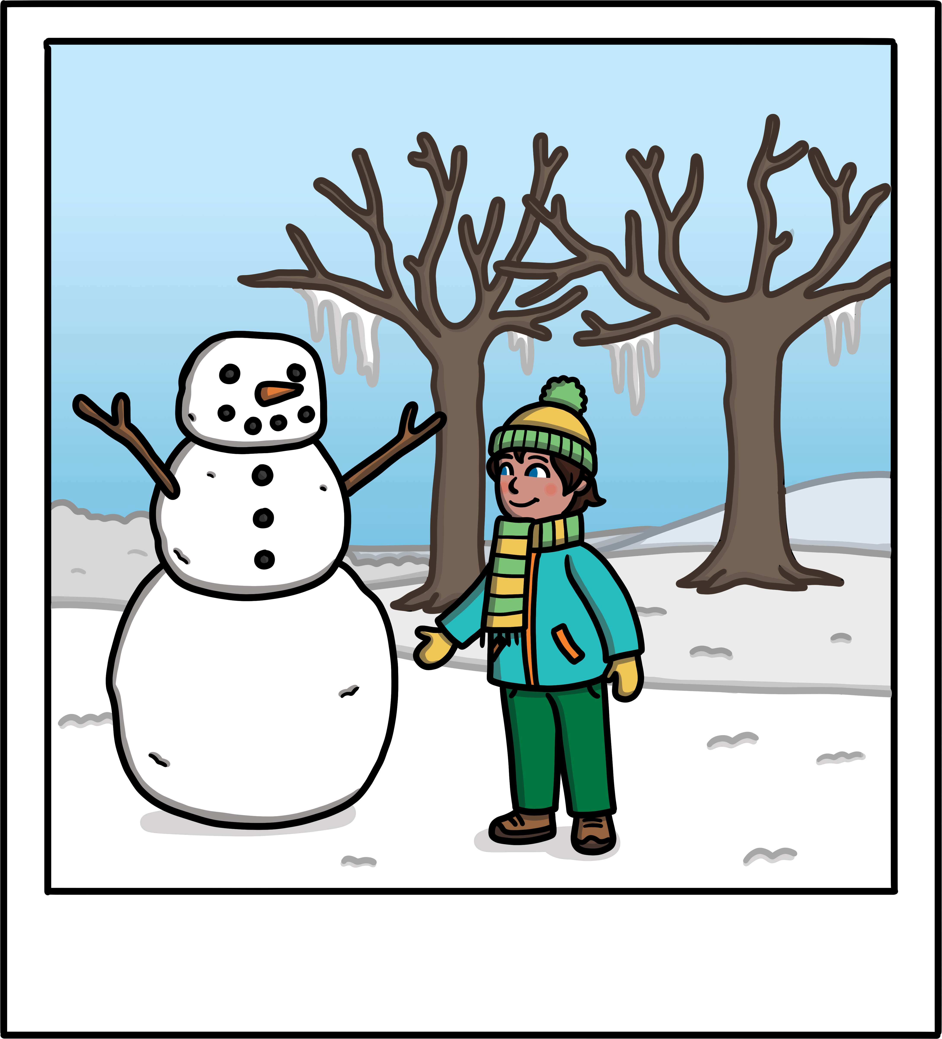
Would you rather…
…have 100 days of summer?
or
…have 100 days of snow?

