Slide 2
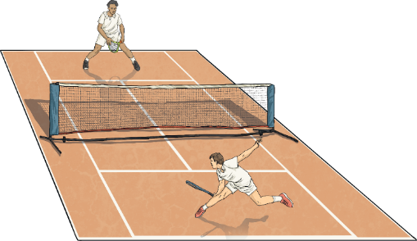
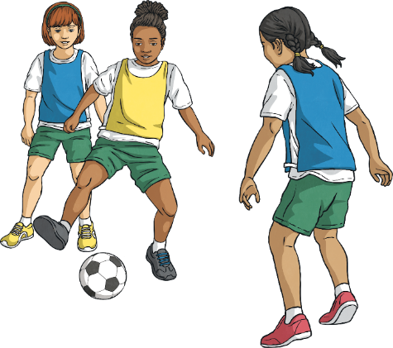
Present Continuous Picture Description
Take a look at each picture and see if you can describe what the person or people are doing using the present continuous tense.

Slide 3
What is she doing?

Slide 4
She is running.

Slide 5
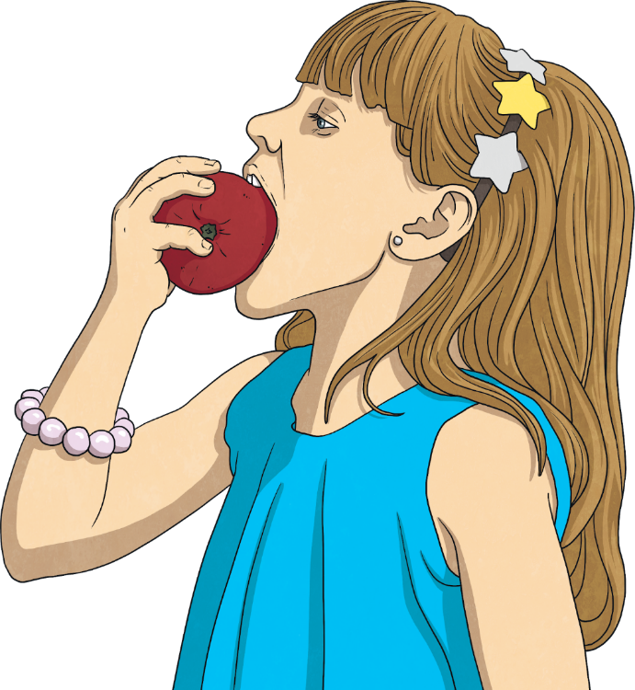
What is she doing?

Slide 6
She is eating an apple.

Slide 7
What are they doing?

Slide 8
They are playing football.

Slide 9
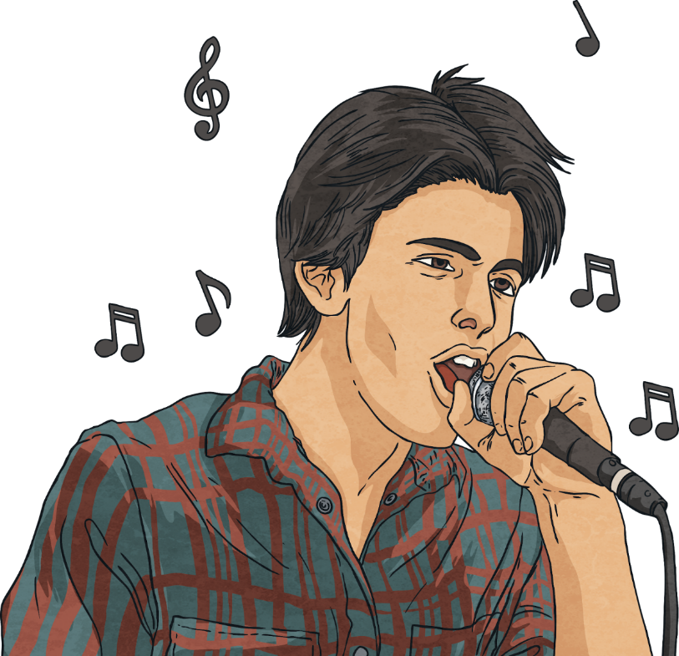
What is he doing?

Slide 10
He is singing a song.

Slide 11
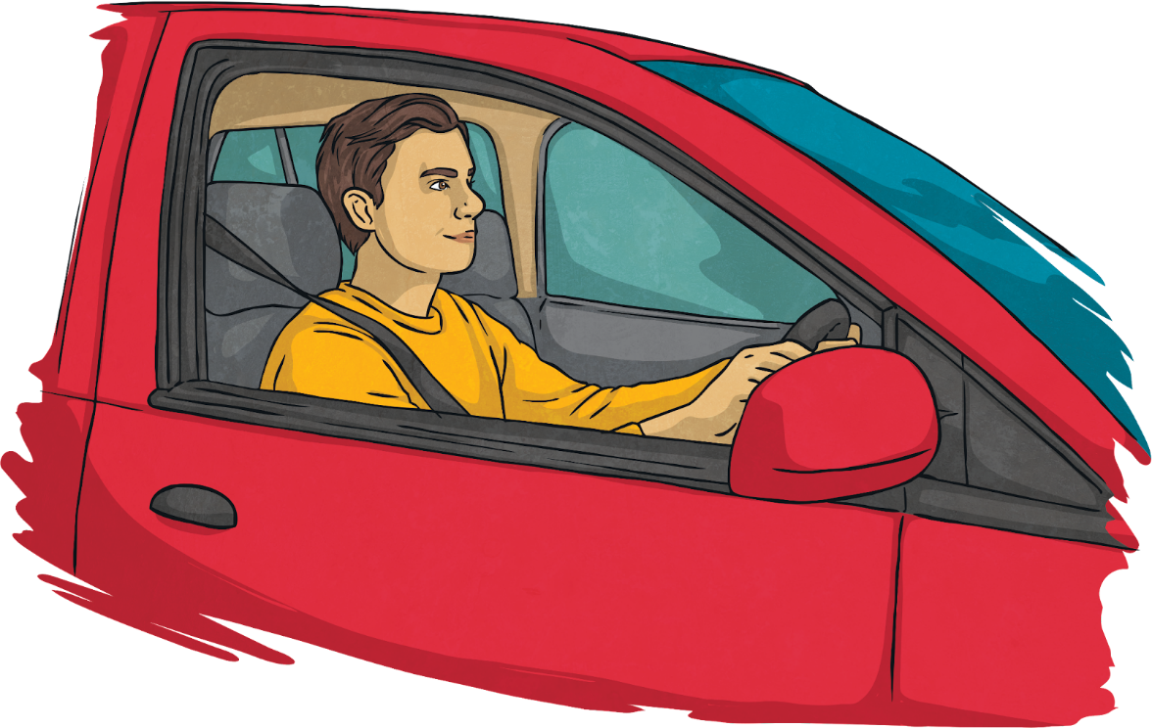
What is he doing?

Slide 12
He is driving a car.

Slide 13
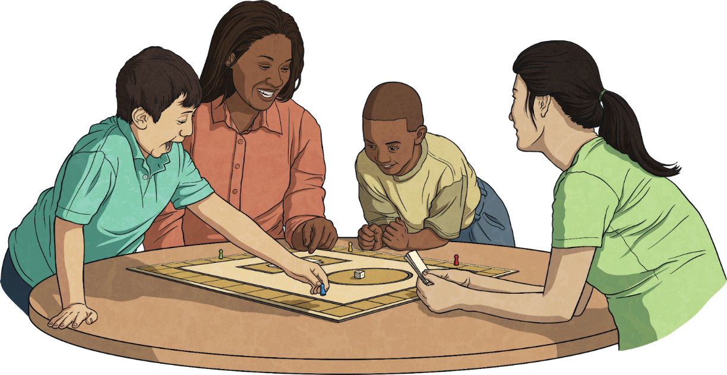
What are they doing?

Slide 14
They are playing a board game.

Slide 15
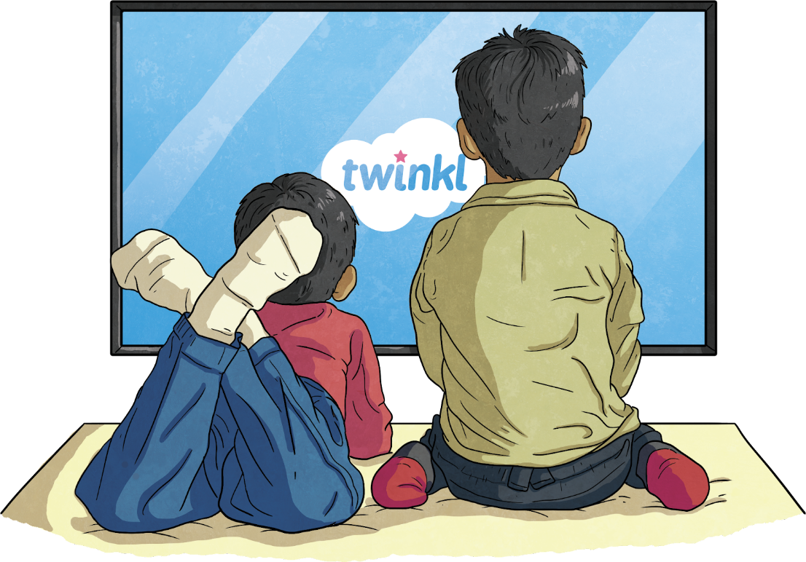
What are they doing?

Slide 16
They are watching TV.

Slide 17
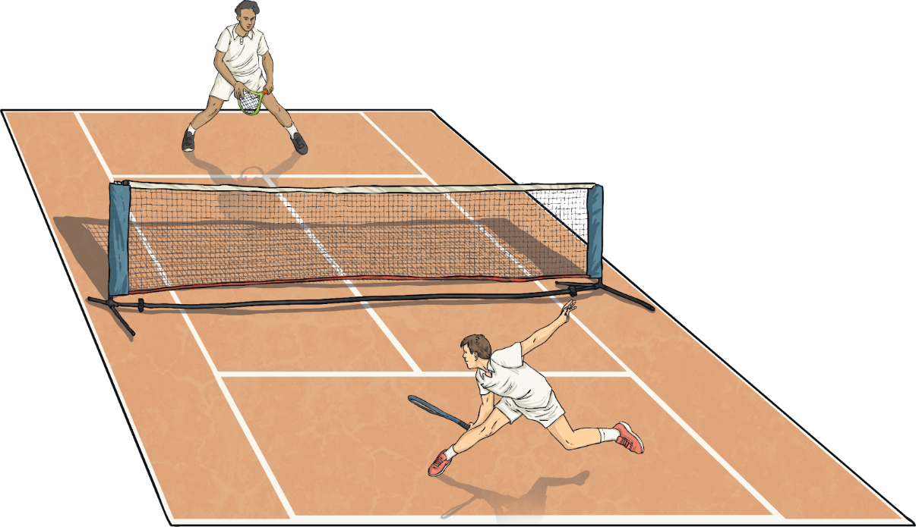
What are they doing?

Slide 18
They are playing tennis.

Slide 19
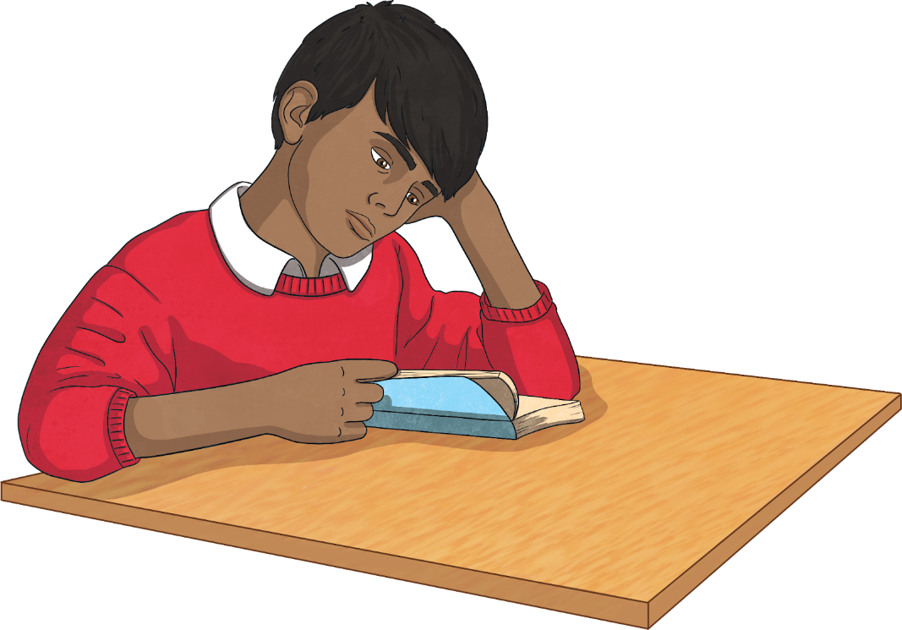
What is he doing?

Slide 20
He is reading.

Slide 21
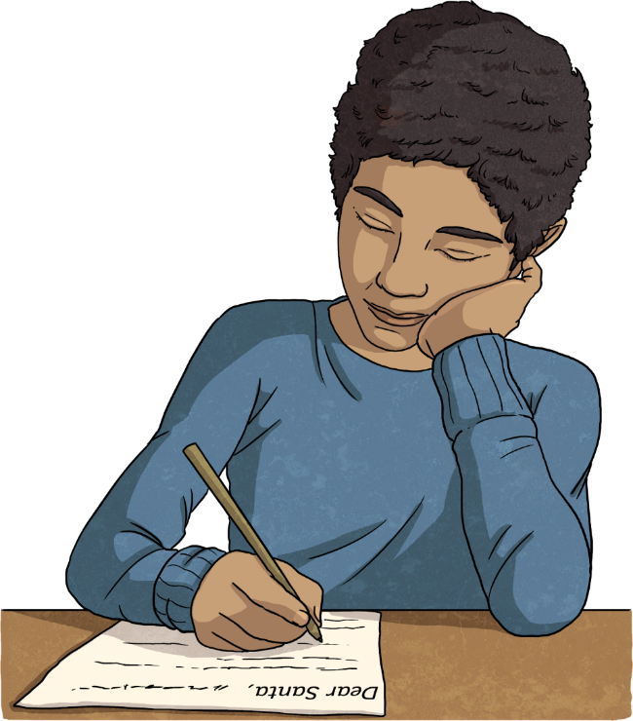
What is he doing?

Slide 22
He is writing a letter.

Slide 23
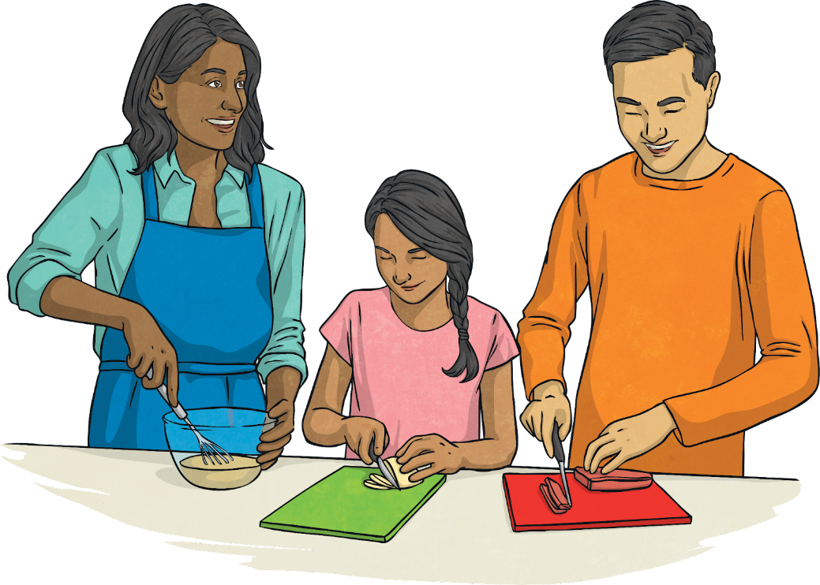
What are they doing?

Slide 24
They are cooking.

Slide 25
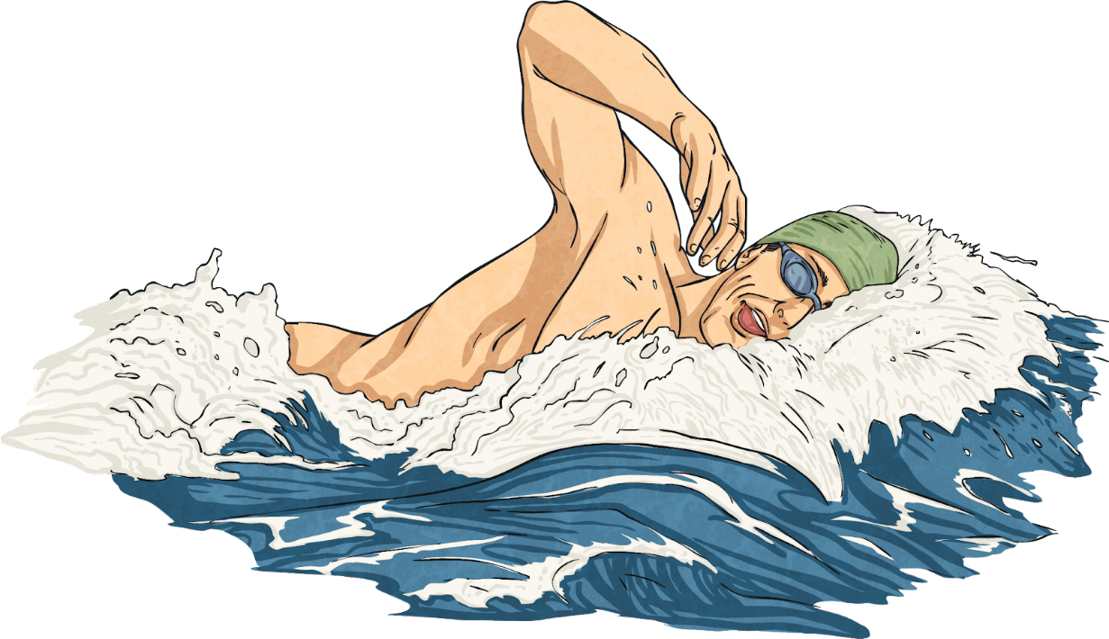
What is he doing?

Slide 26
He is swimming.

Slide 27
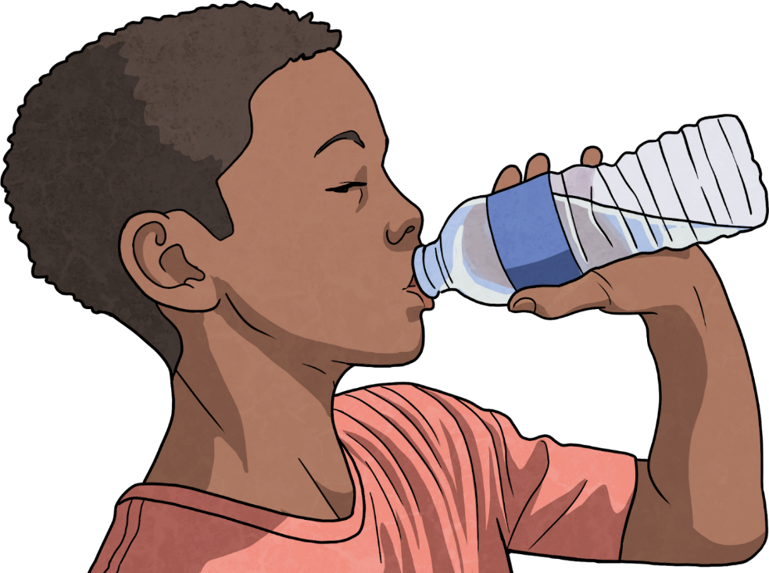
What is he doing?

Slide 28
He is drinking water.

Slide 29
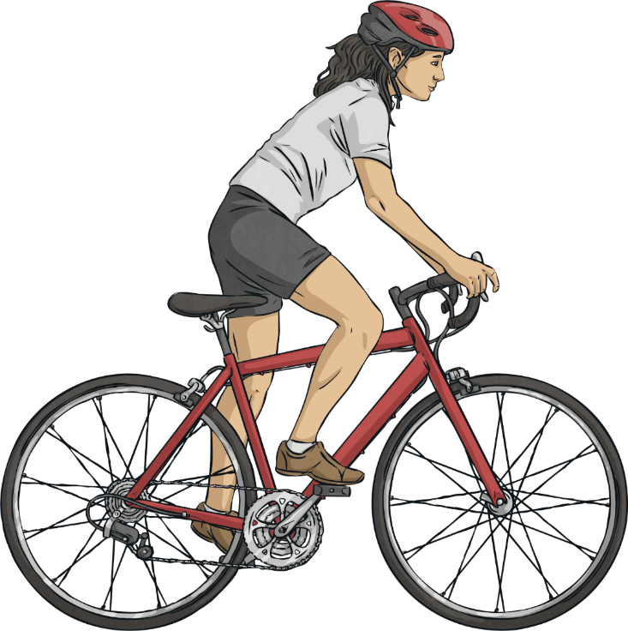
What is she doing?

Slide 30
She is riding a bike.

Slide 31
What is he doing?

Slide 32
He is sleeping.

Slide 33
What are they doing?

Slide 34
They are hiking.

Slide 35
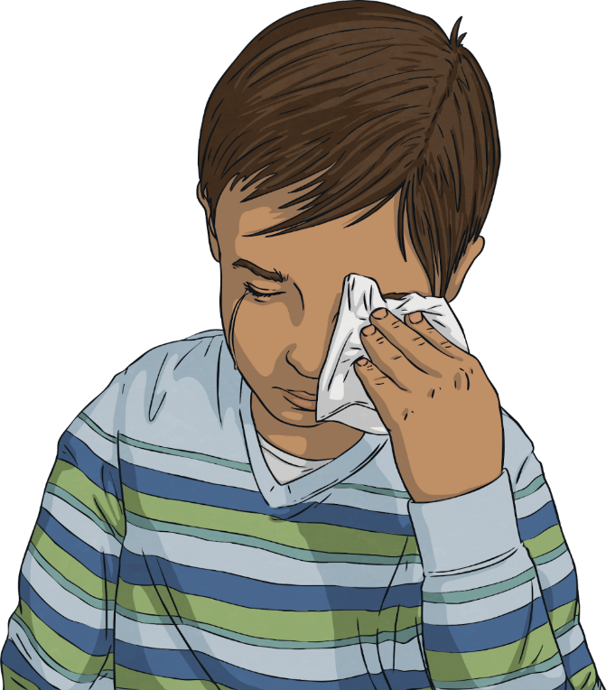
What is he doing?

Slide 36
He is crying.

Slide 37
What is she doing?

Slide 38
She is brushing her teeth.

Slide 39
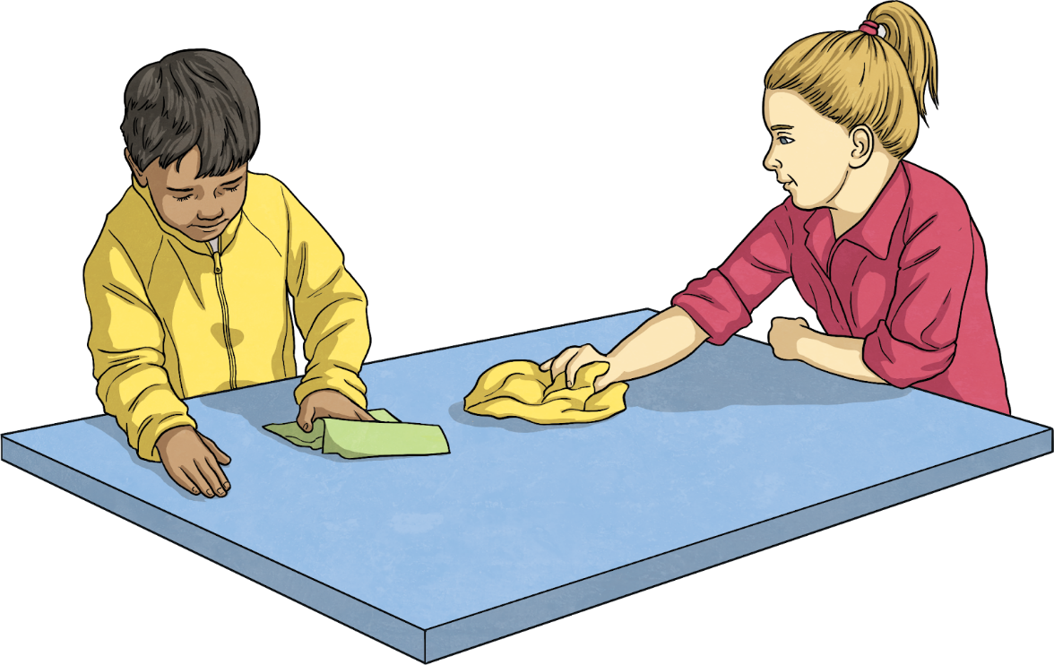
What are they doing?

Slide 40
They are cleaning.

