Slide 3
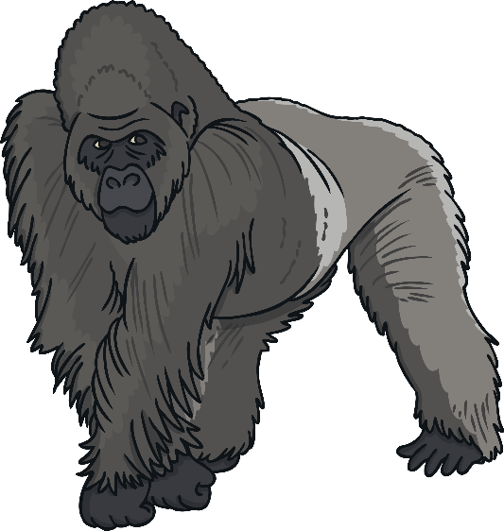
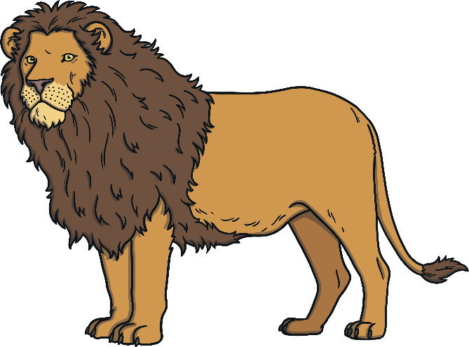
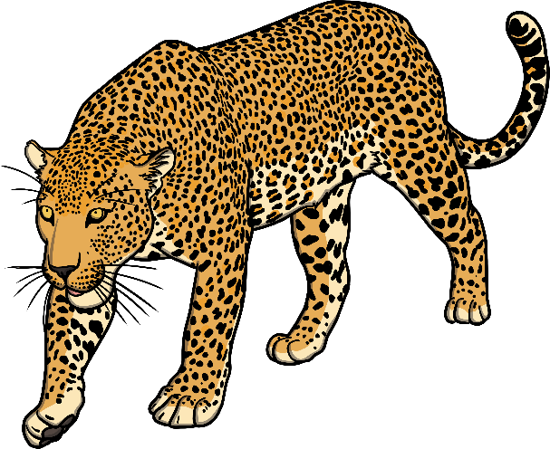
In the jungle there lots of dangerous animals.
are

Slide 4
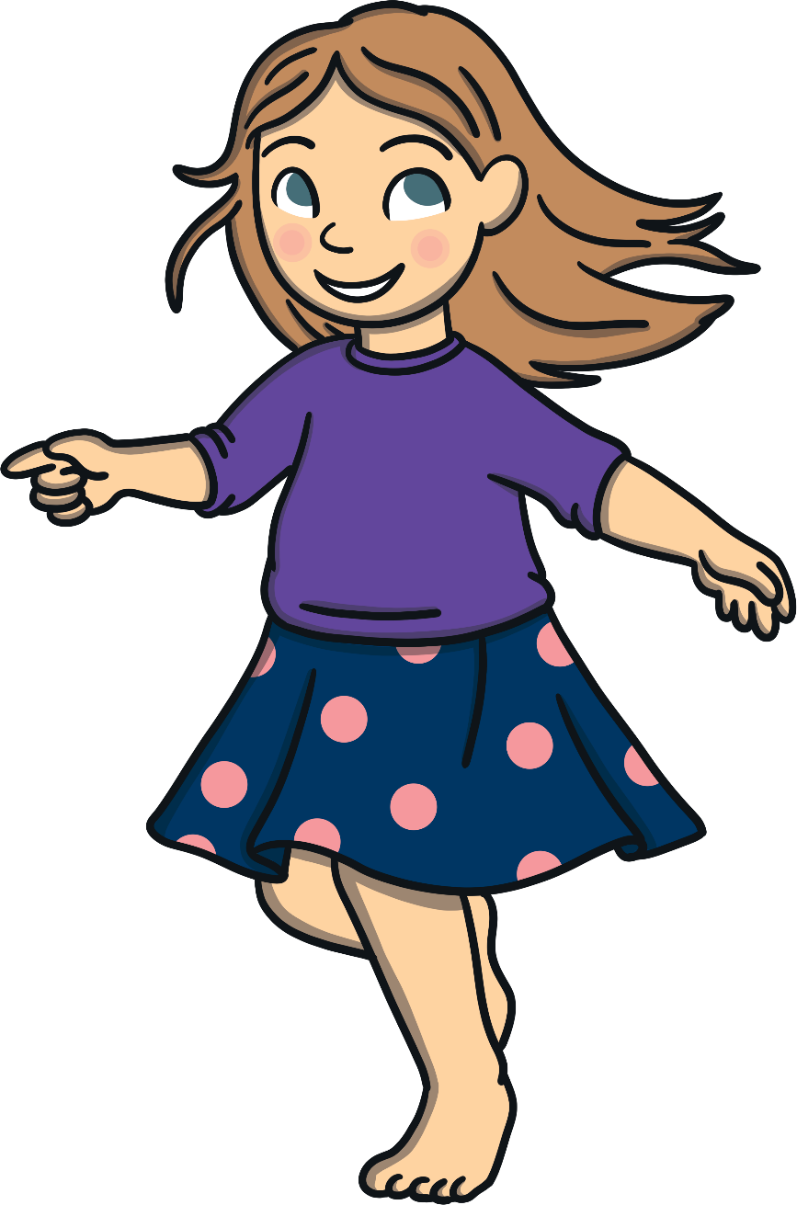
My best friend cccccccccccvery pretty.
is

Slide 5
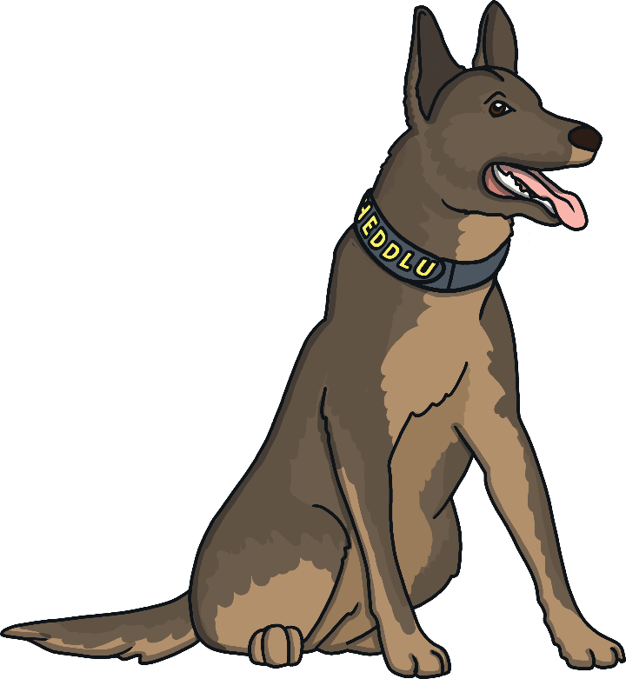
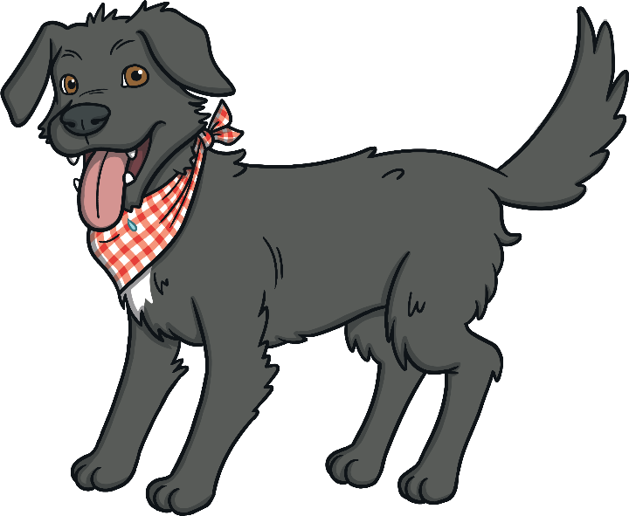
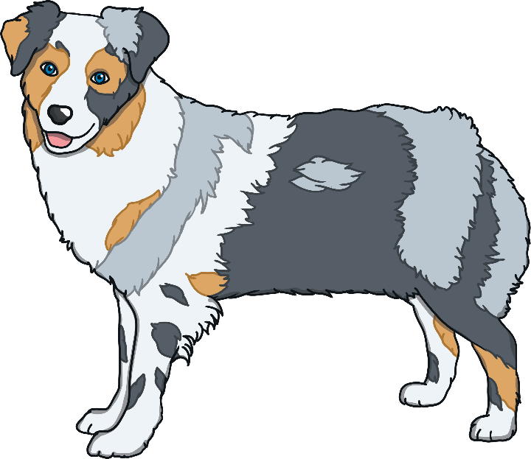
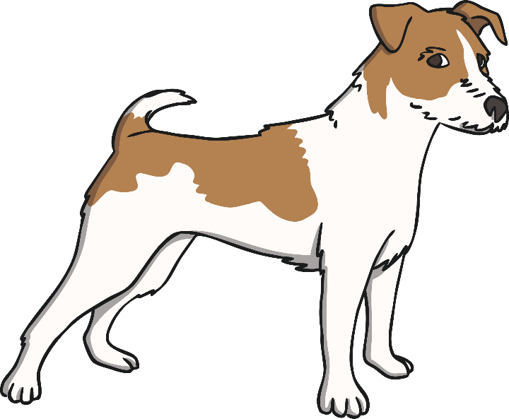
Thereccccccccccc many types of dogs.
are

Slide 6
Therecccccccccccmany flowers in the field.
are

Slide 7
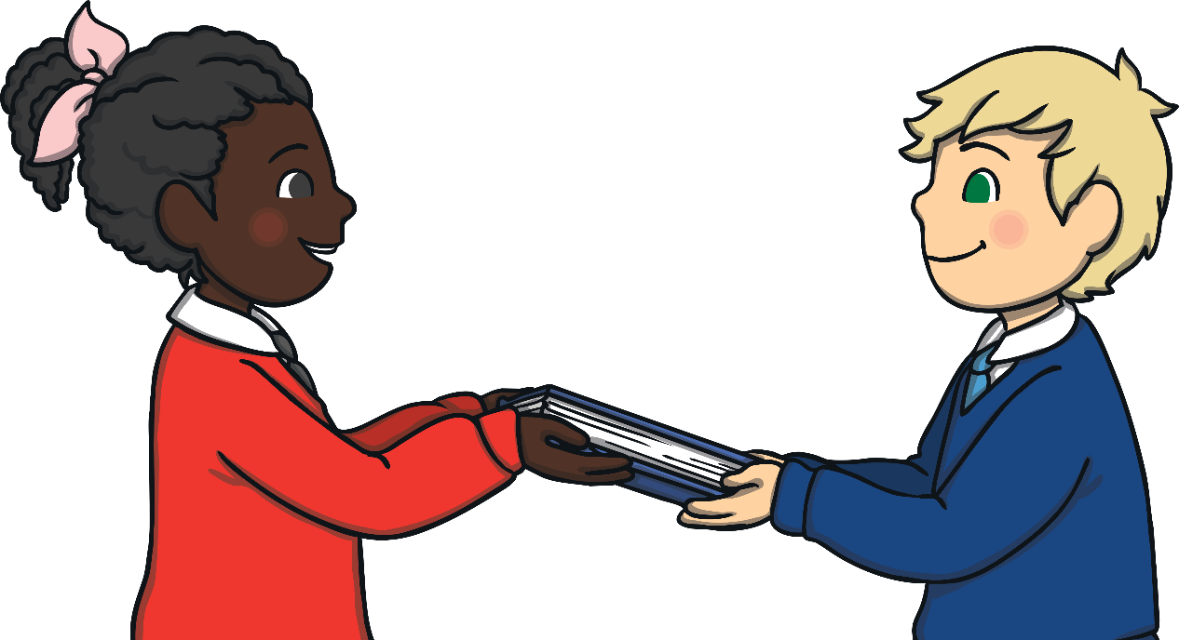
His friend cccccccccccvery kind.
is

Slide 8
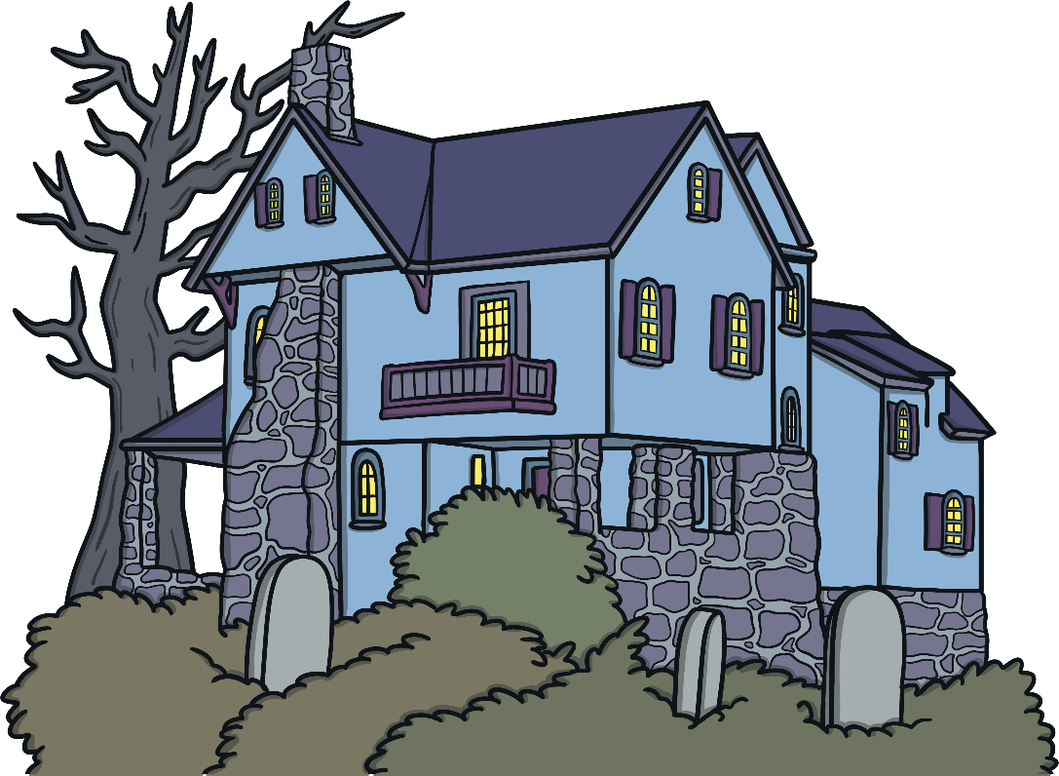
Thereccccccccccc a haunted house in this town.
is

Slide 9
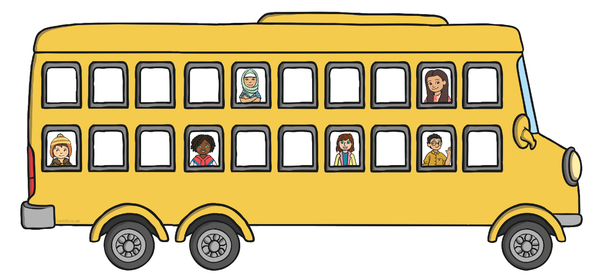
Thereccccccccccc six people on the bus.
are

Slide 10
Tomorrow there cccccccccccgoing to be a firework show.
is

Slide 11
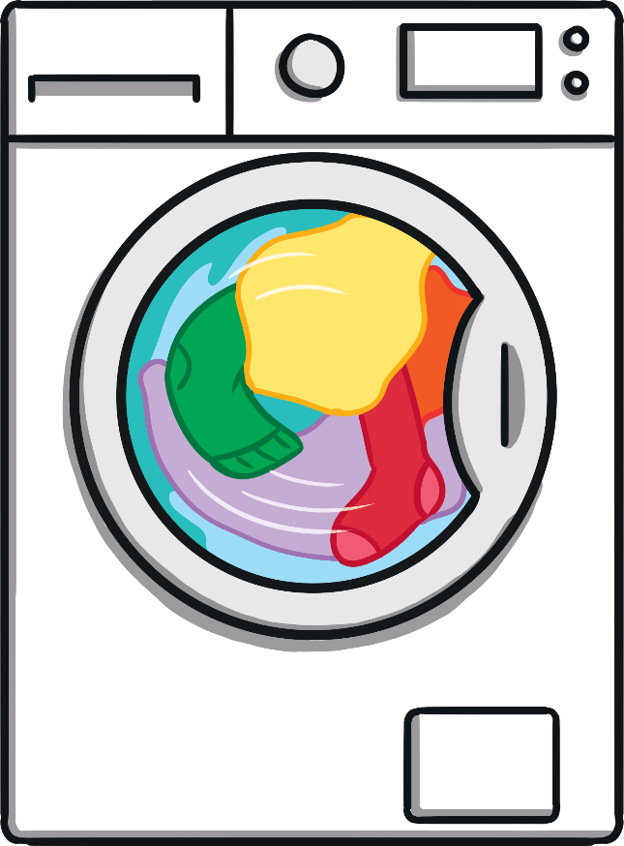
There cccccccccccclothes in the laundry machine.
are

Slide 12
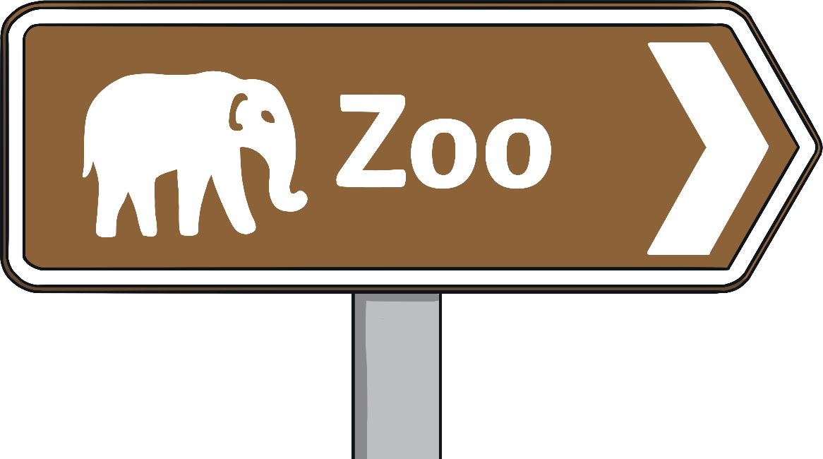
ccccccccccche going to the zoo today?
Is

Slide 13
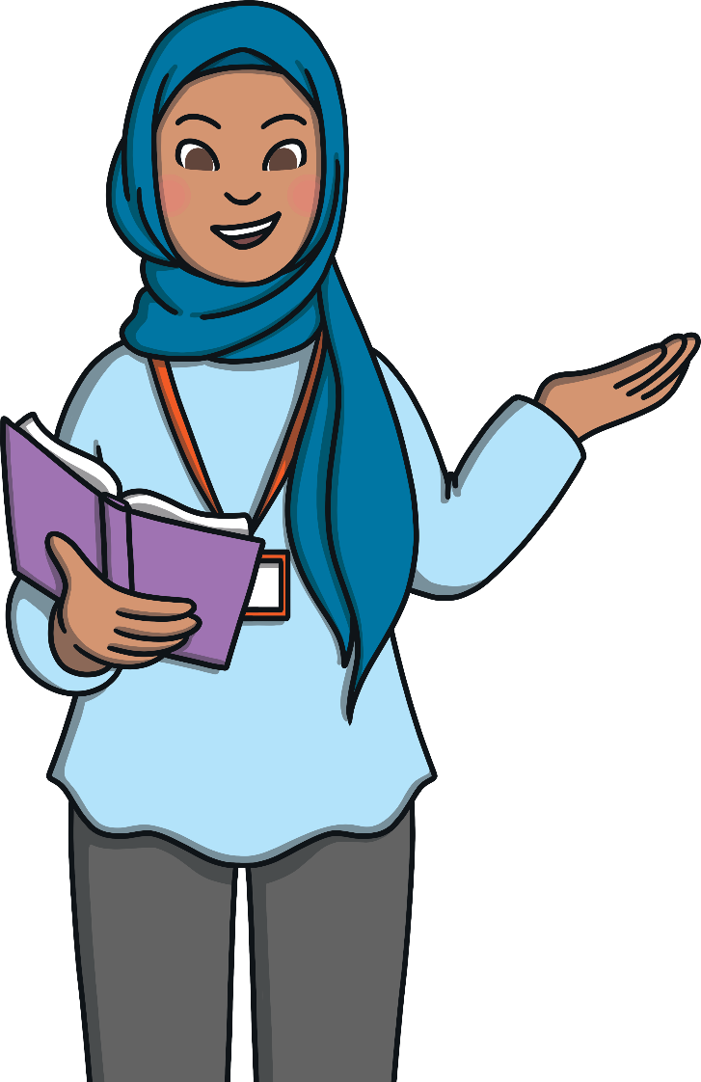
Whoccccccccccc your teacher?
is

Slide 14
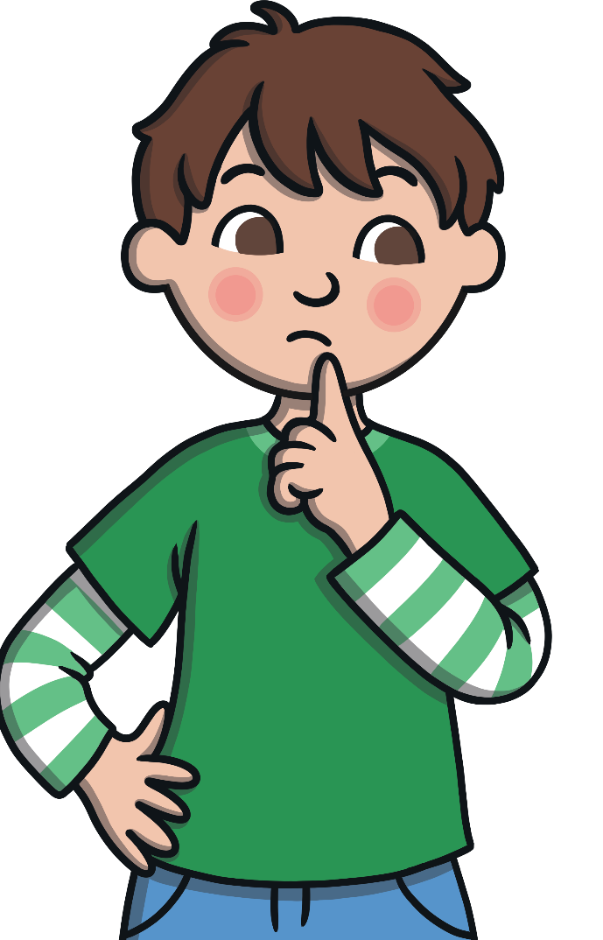
Whereccccccccccc you going?
are

Slide 15
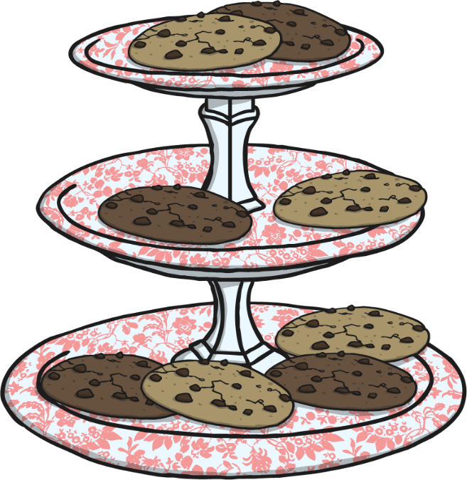
Thereccccccccccc lots of cookies left.
are

Slide 16
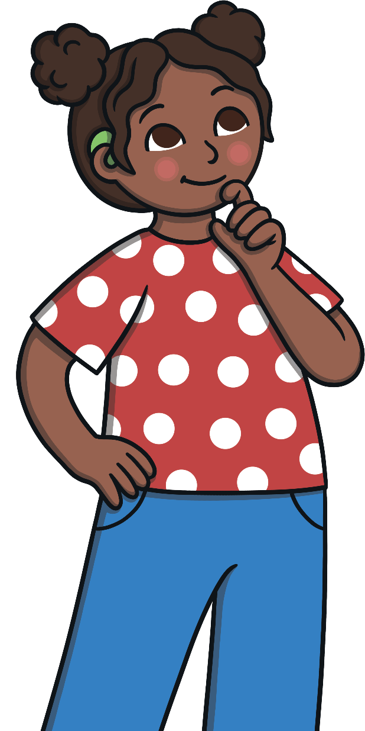
Whenccccccccccc he arriving?
is

Slide 17
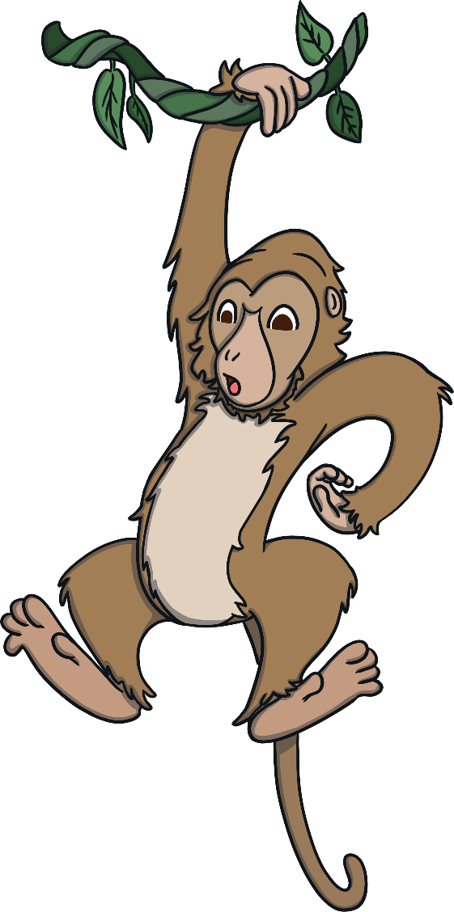
The monkeysccccccccccc swinging in the trees.
are

