Slide 2
Teacher notes
This resource is packed with five minute role play activities you can use with students of any age or ability. They start off easy and become more difficult as the PowerPoint goes on.
The objective is to keep the conversation going for as long as possible.
To support your students, you may want to introduce each role play with some questions, such as ‘what can you see?’ and ‘what do they want?’ and assigning roles.
After you’ve given students a few minutes to play out the conversation, ask for some feedback on how it went. They could even create their own scenarios or write down a short script.

Slide 3
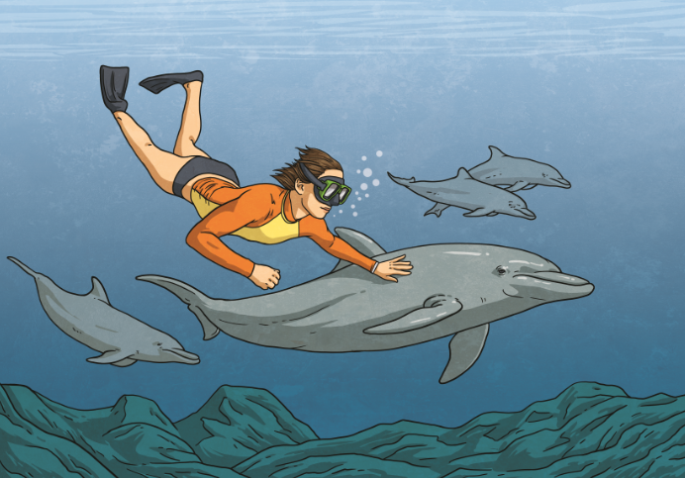
Let’s explore the ocean!

Slide 4
Let’s explore the ocean!
Hi! What’s your name?

Slide 5
Let’s explore the ocean!
Hi! What’s your name?
I’m Bubbles! So… where do you want to go?

Slide 6
Let’s explore the ocean!
Hi! What’s your name?
I’m Bubbles! So… where do you want to go?
…

Slide 7
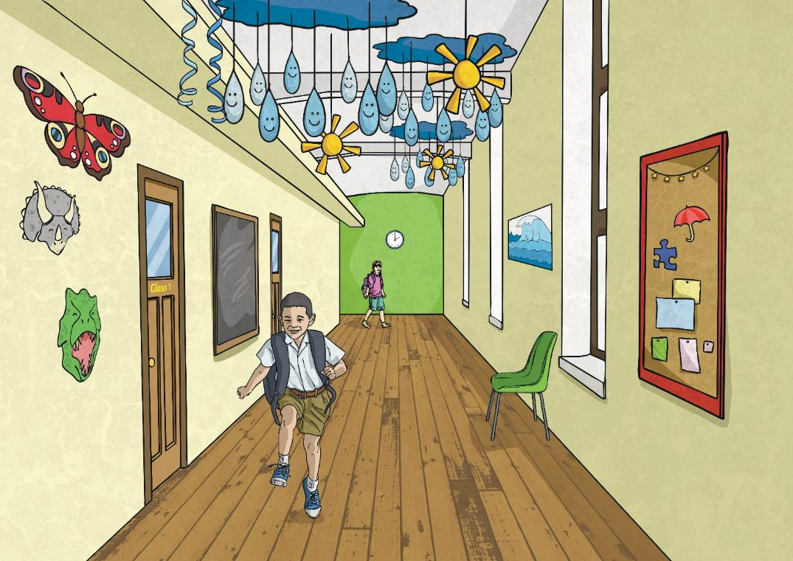
Let’s help a new student!

Slide 8
Let’s help a new student!
Hi, can you help me? I’m new here.

Slide 9
Let’s help a new student!
Hi, can you help me? I’m new here.
Sure, what do you need?

Slide 10
Let’s help a new student!
Hi, can you help me? I’m new here.
Sure, what do you need?
I’m really lost!

Slide 11
Let’s help a new student!
Hi, can you help me? I’m new here.
Sure, what do you need?
I’m really lost!
…

Slide 12
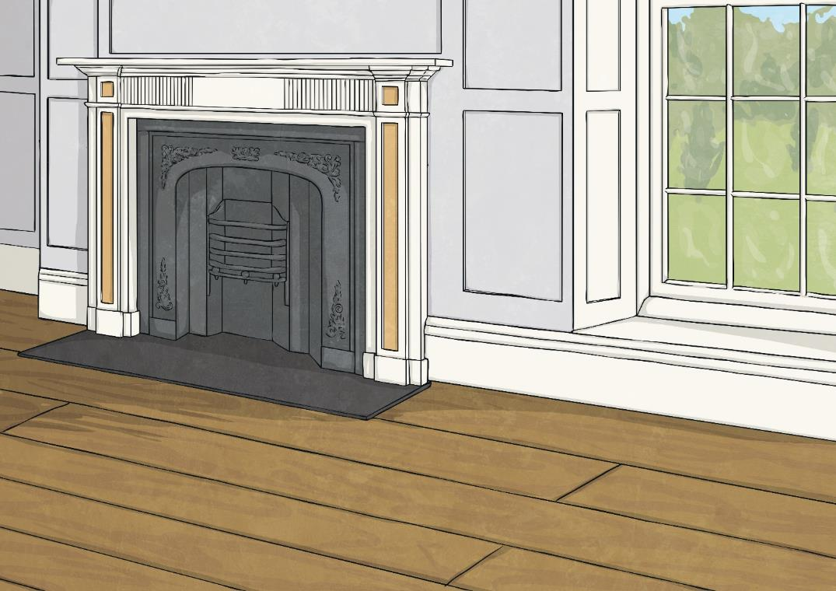
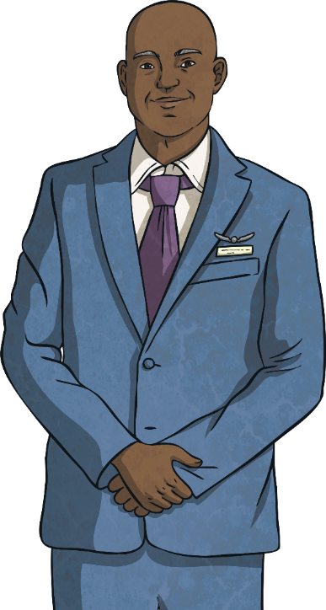
Let’s plan a celebrity party!

Slide 13
Let’s plan a celebrity party!
What would you like to do for your birthday this year?

Slide 14
Let’s plan a celebrity party!
What would you like to do for your birthday this year?
Let’s have a big, big party.

Slide 15
Let’s plan a celebrity party!
What would you like to do for your birthday this year?
Let’s have a big, big party.
OK. Where should we have it?

Slide 16
Let’s plan a celebrity party!
What would you like to do for your birthday this year?
Let’s have a big, big party.
OK. Where should we have it?
…

Slide 17
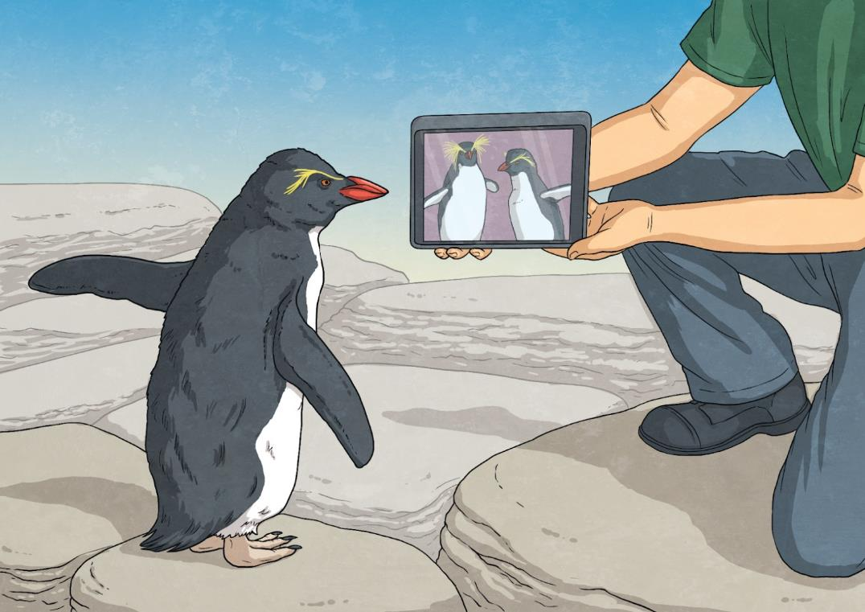
Let’s phone mum and dad!

Slide 18
Let’s phone mum and dad!
Hello, Pierre! How is university in the South Pole?

Slide 19
Let’s phone mum and dad!
Hello, Pierre! How is university in the South Pole?
Hi, mum and dad! It’s great!

Slide 20
Let’s phone mum and dad!
Hello, Pierre! How is university in the South Pole?
Hi, mum and dad! It’s great!
…

Slide 21
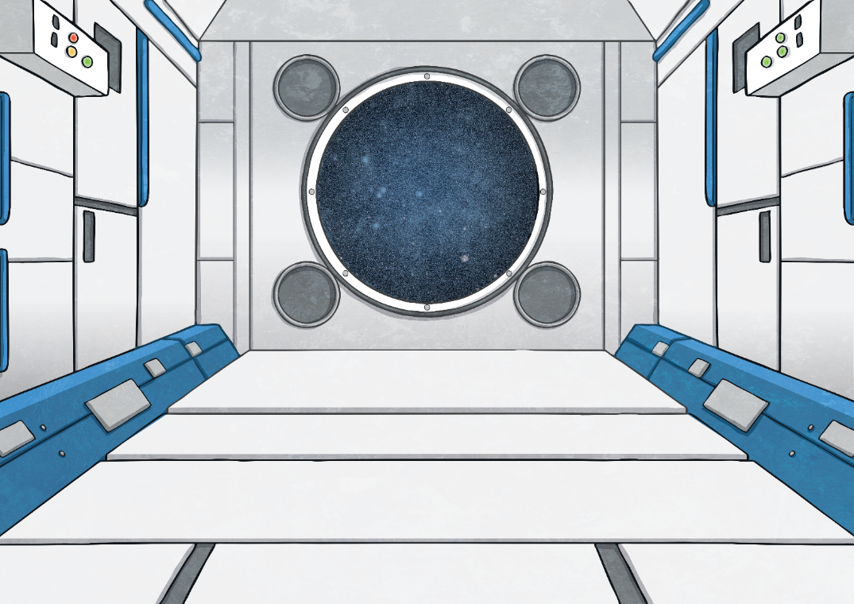
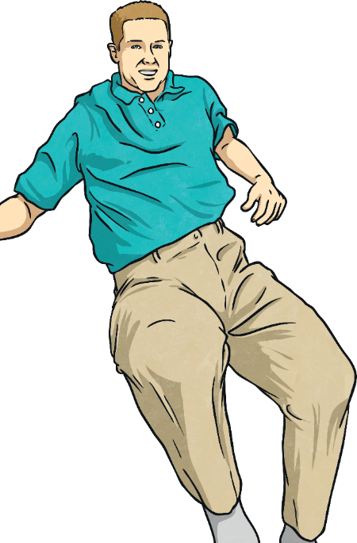
Let’s go to space!

Slide 22
Let’s go to space!
Hi, welcome!

Slide 23
Let’s go to space!
Hi, welcome!
Thanks, it’s great to be here. So, what’s your name?

Slide 24
Let’s go to space!
Hi, welcome!
Thanks, it’s great to be here. So, what’s your name?
…

Slide 25
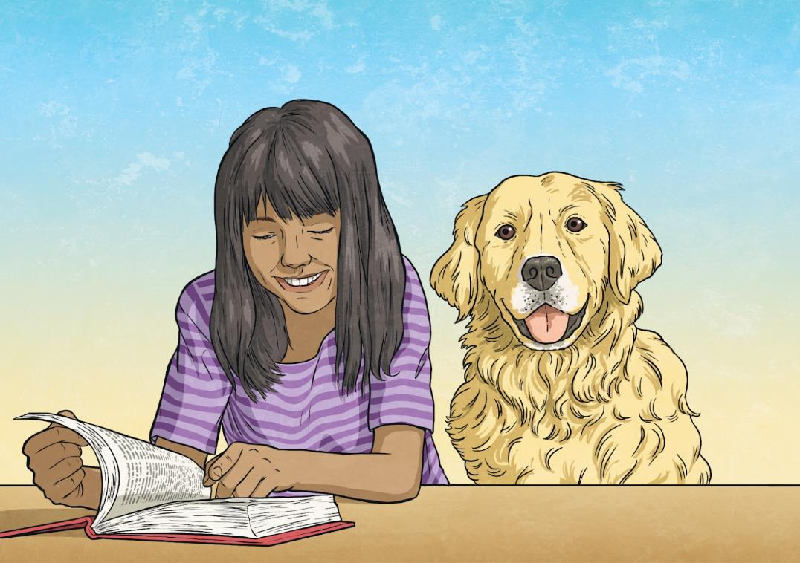
Let’s tell a story!

Slide 26
Let’s tell a story!
Please tell me a story!

Slide 27
Let’s tell a story!
Please tell me a story!
OK! One day there was a lovely dog called Flash.

Slide 28
Let’s tell a story!
Please tell me a story!
OK! One day there was a lovely dog called Flash.
Wait wait wait, did Flash look like me?!

Slide 29
Let’s tell a story!
Please tell me a story!
OK! One day there was a lovely dog called Flash.
Wait wait wait, did Flash look like me?!
…

Slide 30
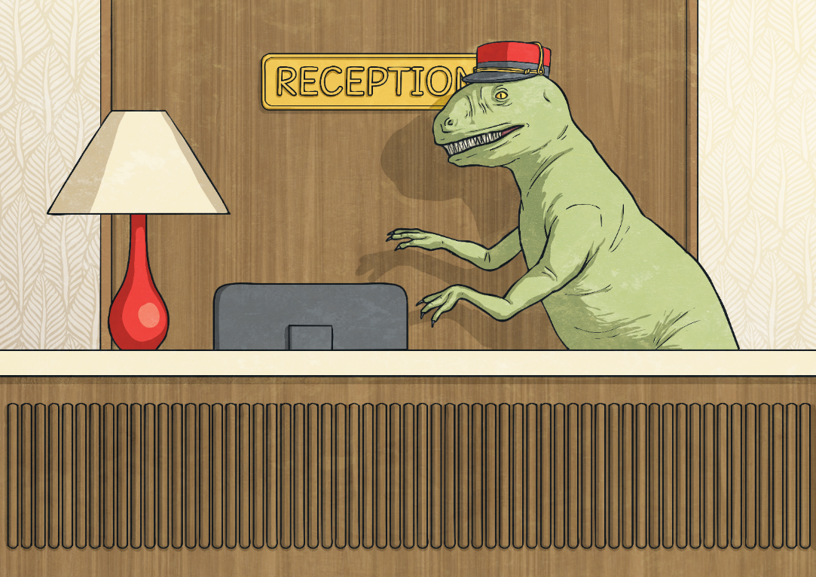
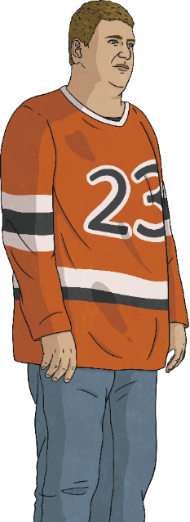
Let’s complain!

Slide 31
Let’s complain!
Did you sleep well last night?

Slide 32
Let’s complain!
Did you sleep well last night?
No, that was the worst night’s sleep of my life!

Slide 33
Let’s complain!
Did you sleep well last night?
No, that was the worst night’s sleep of my life!
I’m so sorry. What was the problem?

Slide 34
Let’s complain!
Did you sleep well last night?
No, that was the worst night’s sleep of my life!
I’m so sorry. What was the problem?
…

Slide 35
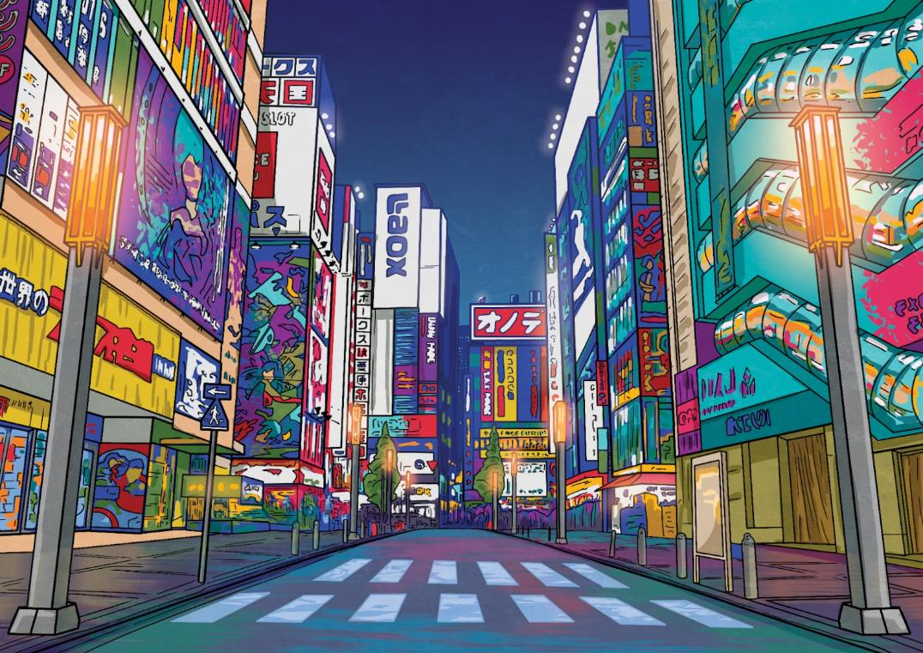
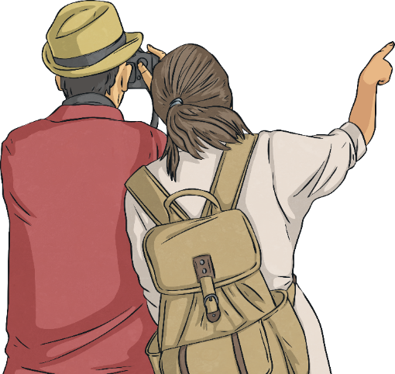
Let’s explore a new city

Slide 36
Let’s explore a new city
Wow, Tokyo is an incredible city to explore!

Slide 37
Let’s explore a new city
Wow, Tokyo is an incredible city to explore!
I agree. What do you want to do first?

Slide 38
Let’s explore a new city
Wow, Tokyo is an incredible city to explore!
I agree. What do you want to do first?
…

Slide 39
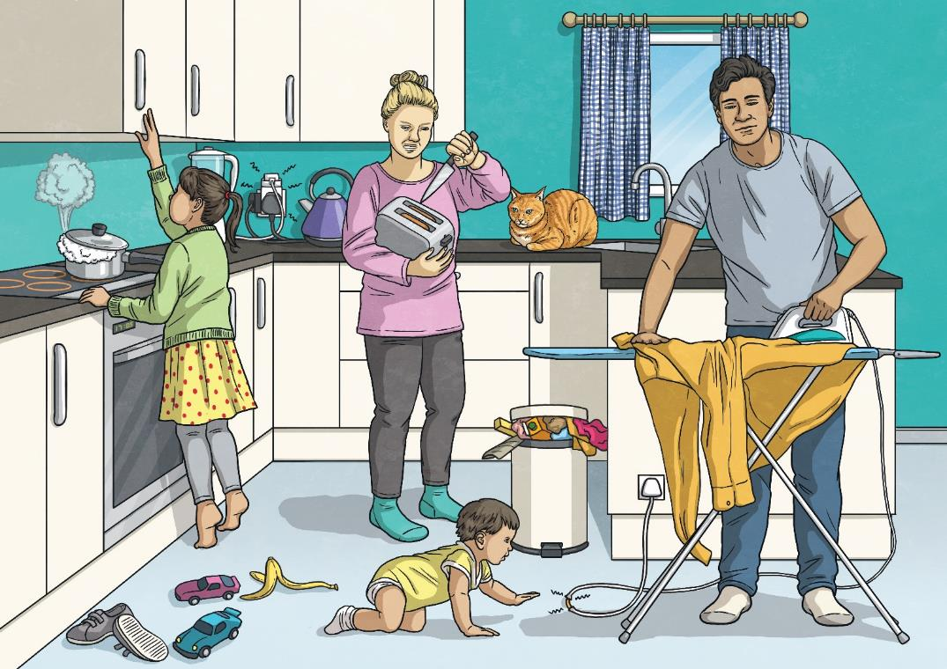
Let’s buy the milk!

Slide 40
Let’s buy the milk!
Did you drink all the milk again?

Slide 41
Let’s buy the milk!
Did you drink all the milk again?
I was thirsty!

Slide 42
Let’s buy the milk!
Did you drink all the milk again?
I was thirsty!
And look at the kitchen, it’s a mess!

Slide 43
Let’s buy the milk!
Did you drink all the milk again?
I was thirsty!
And look at the kitchen, it’s a mess!
…

Slide 44
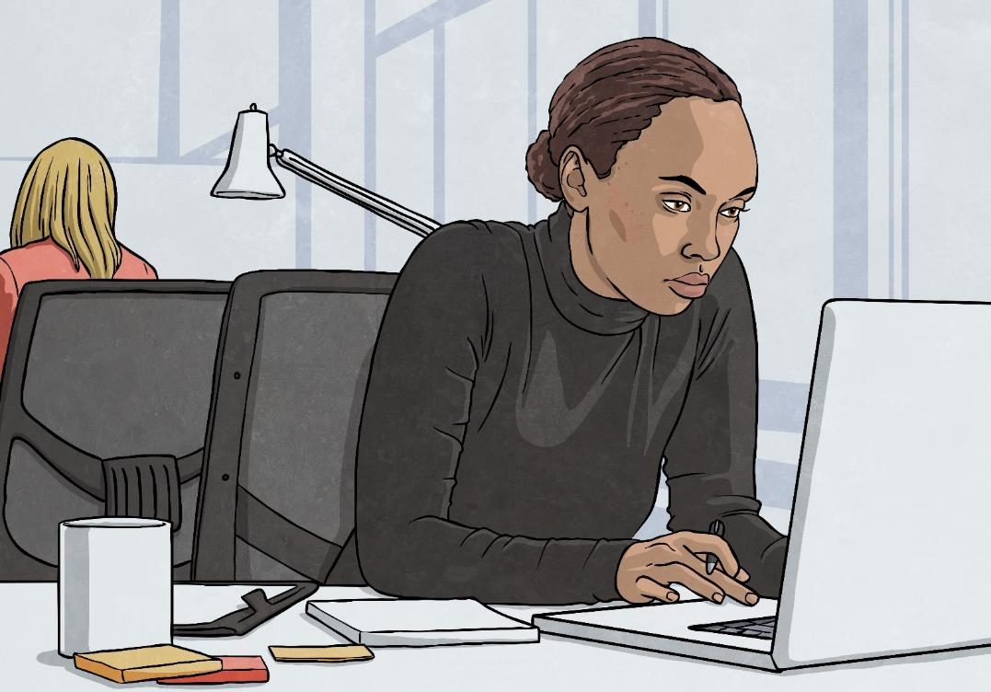
Let’s explain why you’re late!

Slide 45
Let’s explain why you’re late!
Hey! You’re late to work again!

Slide 46
Let’s explain why you’re late!
Hey! You’re late to work again!
Well, I have a good reason.

Slide 47
Let’s explain why you’re late!
Hey! You’re late to work again!
Well, I have a good reason.
It better be great - or you’re fired!

Slide 48
Let’s explain why you’re late!
Hey! You’re late to work again!
Well, I have a good reason.
It better be great - or you’re fired!
…

Slide 49
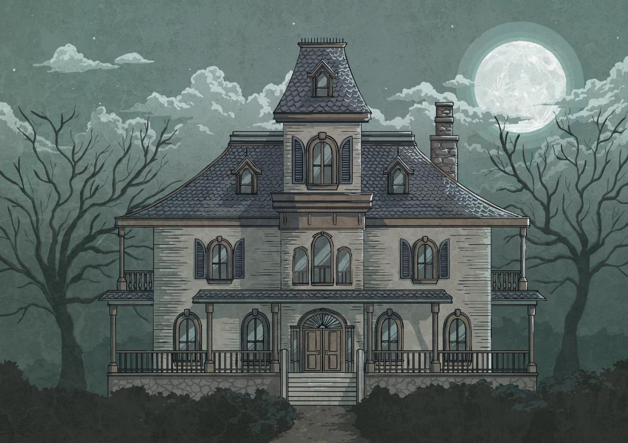
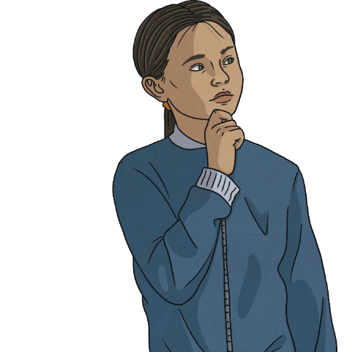
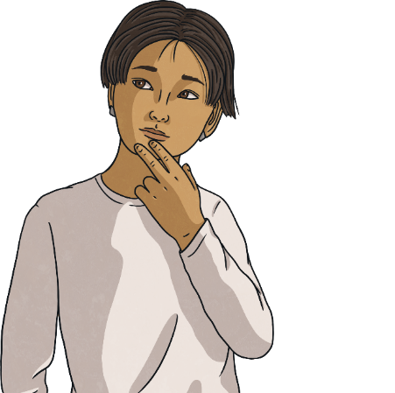
Let’s explore a haunted house!

Slide 50
Let’s explore a haunted house!
Did you hear that? It sounds like an owl.

Slide 51
Let’s explore a haunted house!
Did you hear that? It sounds like an owl.
It sounded like a person to me!

Slide 52
Let’s explore a haunted house!
Did you hear that? It sounds like an owl.
It sounded like a person to me!
Let’s go inside.

Slide 53
Let’s explore a haunted house!
Did you hear that? It sounds like an owl.
It sounded like a person to me!
Let’s go inside.
Are you bananas?!

Slide 54
Let’s explore a haunted house!
Did you hear that? It sounds like an owl.
It sounded like a person to me!
Let’s go inside.
Are you bananas?!
…

Slide 55
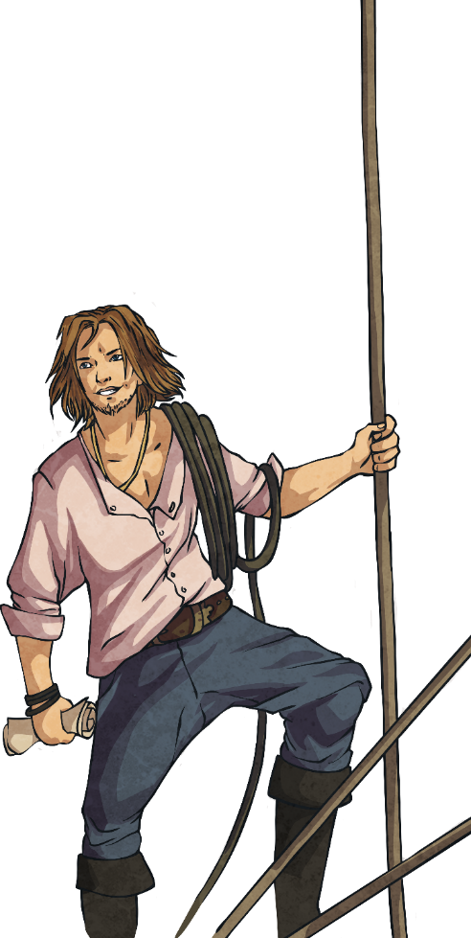
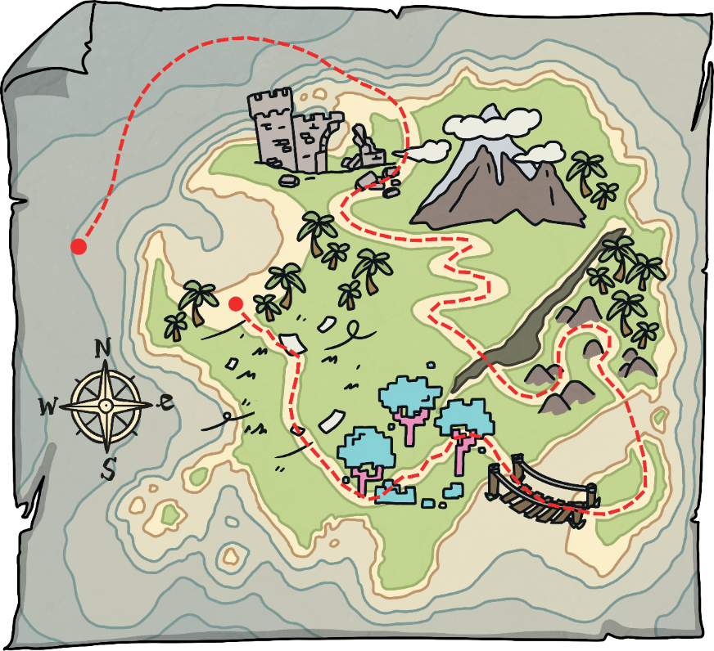
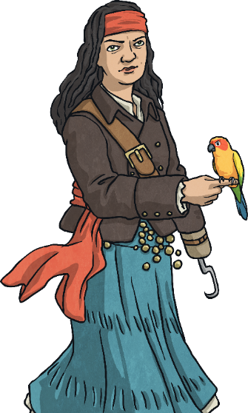
Let’s find the treasure!

Slide 56
Let’s find the treasure!
AGH! The map shows where the treasure is.

Slide 57
Let’s find the treasure!
AGH! The map shows where the treasure is.
I’ll get there first and the treasure will be mine!

Slide 58
Let’s find the treasure!
AGH! The map shows where the treasure is.
I’ll get there first and the treasure will be mine!
No, we said that we’d share!

Slide 59
Let’s find the treasure!
AGH! The map shows where the treasure is.
I’ll get there first and the treasure will be mine!
No, we said that we’d share!
…

Slide 60
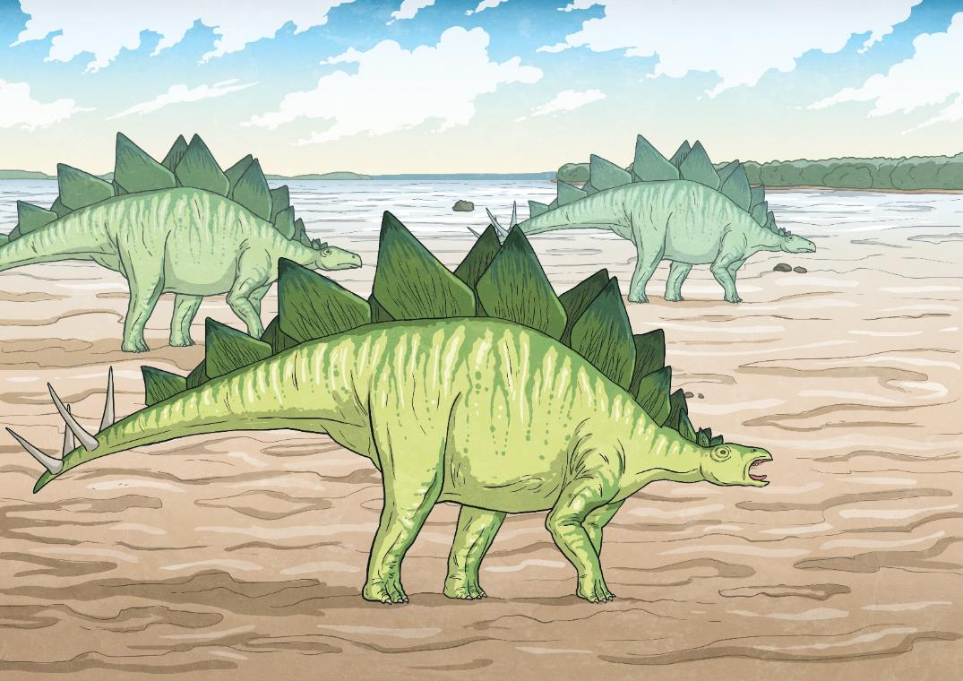
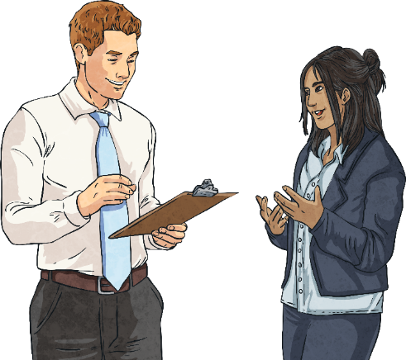
Let’s meet a dinosaur!

Slide 61
Let’s meet a dinosaur!
Wait, where are we?

Slide 62
Let’s meet a dinosaur!
Wait, where are we?
I think the time machine worked! We’re in the time of the dinosaurs!

Slide 63
Let’s meet a dinosaur!
Wait, where are we?
I think the time machine worked! We’re in the time of the dinosaurs!
…

Slide 64
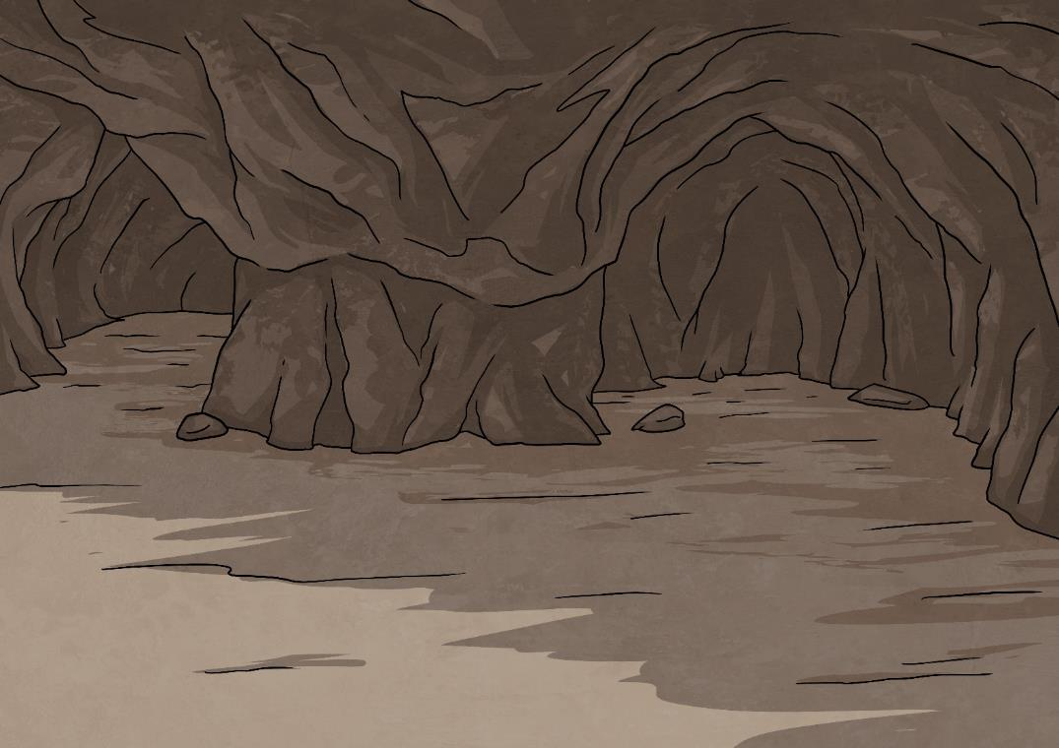
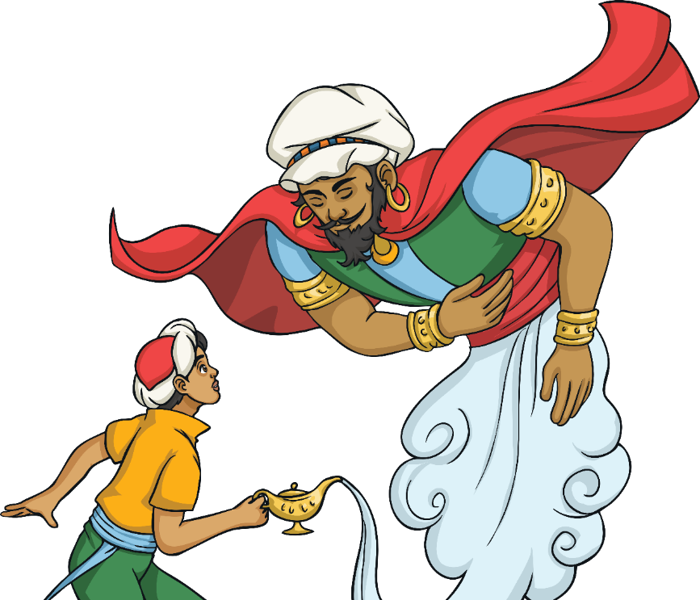
Let’s make a wish!

Slide 65
Let’s make a wish!
Wow! What… or who… are you?!

Slide 66
Let’s make a wish!
Wow! What… or who… are you?!
What do think? You polished a lamp and I appeared.

Slide 67
Let’s make a wish!
Wow! What… or who… are you?!
What do think? You polished a lamp and I appeared.
So you’re a genie?

Slide 68
Let’s make a wish!
Wow! What… or who… are you?!
What do think? You polished a lamp and I appeared.
So you’re a genie?
Yes! What are your wishes?

Slide 69
Let’s make a wish!
Wow! What… or who… are you?!
What do think? You polished a lamp and I appeared.
So you’re a genie?
Yes! What are your wishes?
…

Slide 70
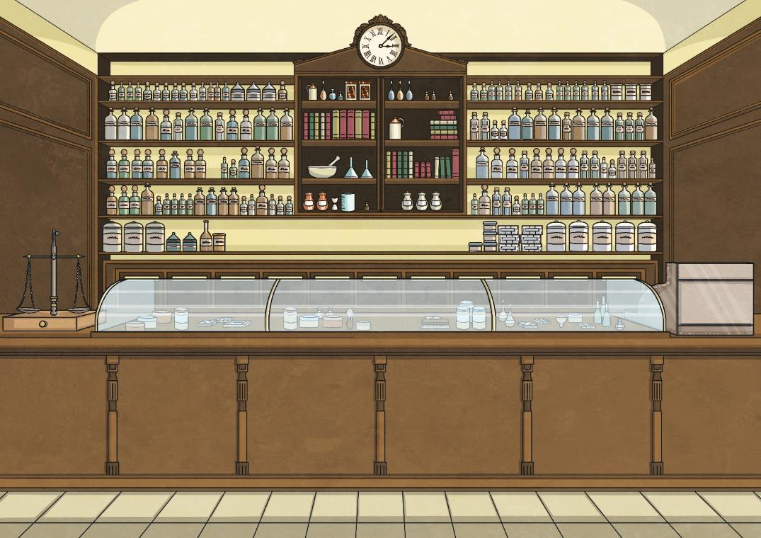
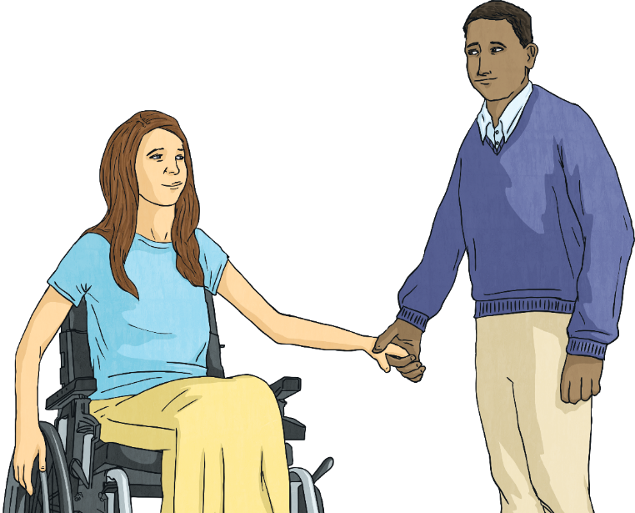
Let’s find something amazing!

Slide 71
Let’s find something amazing!
There’s so much stuff here!

Slide 72
Let’s find something amazing!
There’s so much stuff here!
Yeah, some of these things are beautiful. Look at this!

Slide 73
Let’s find something amazing!
There’s so much stuff here!
Yeah, some of these things are beautiful. Look at this!
What is it?

Slide 74
Let’s find something amazing!
There’s so much stuff here!
Yeah, some of these things are beautiful. Look at this!
What is it?
…

Slide 75
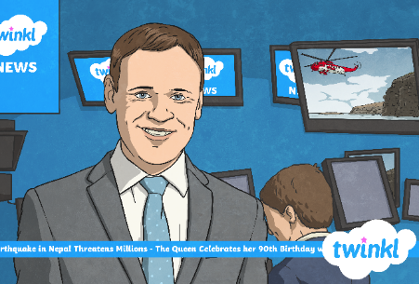
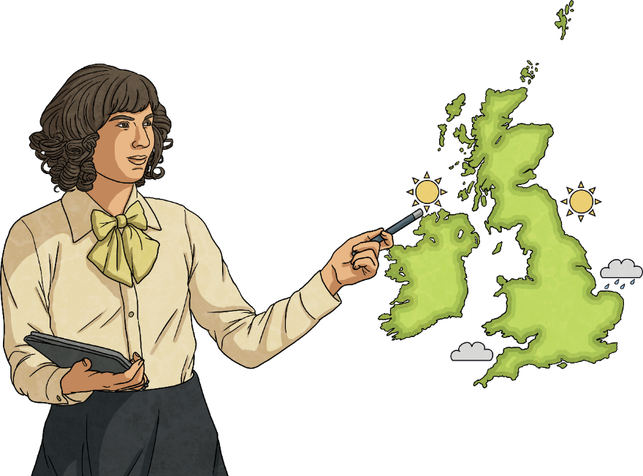
Let’s give the weather forecast!

Slide 76
Let’s give the weather forecast!
So, what is the weather going to look like this week?

Slide 77
Let’s give the weather forecast!
So, what is the weather going to look like this week?
Actually, we’re going to have some very unusual weather.

Slide 78
Let’s give the weather forecast!
So, what is the weather going to look like this week?
Actually, we’re going to have some very unusual weather.
…

Slide 79
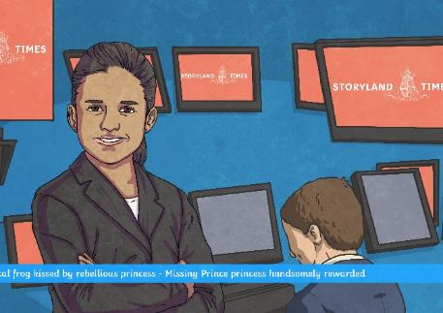
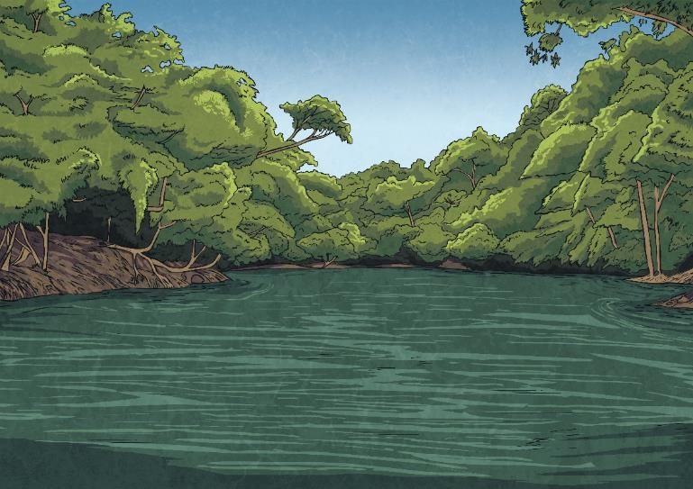
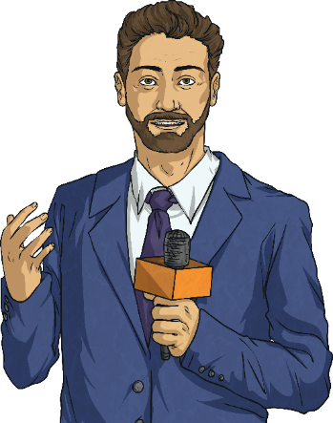
Let’s report the news!

Slide 80
Let’s report the news!
We have breaking news from the jungles of Brazil.

Slide 81
Let’s report the news!
We have breaking news from the jungles of Brazil.
Please, tell us more.

Slide 82
Let’s report the news!
We have breaking news from the jungles of Brazil.
Please, tell us more.
Well, you’re not going to believe this, but...

Slide 83
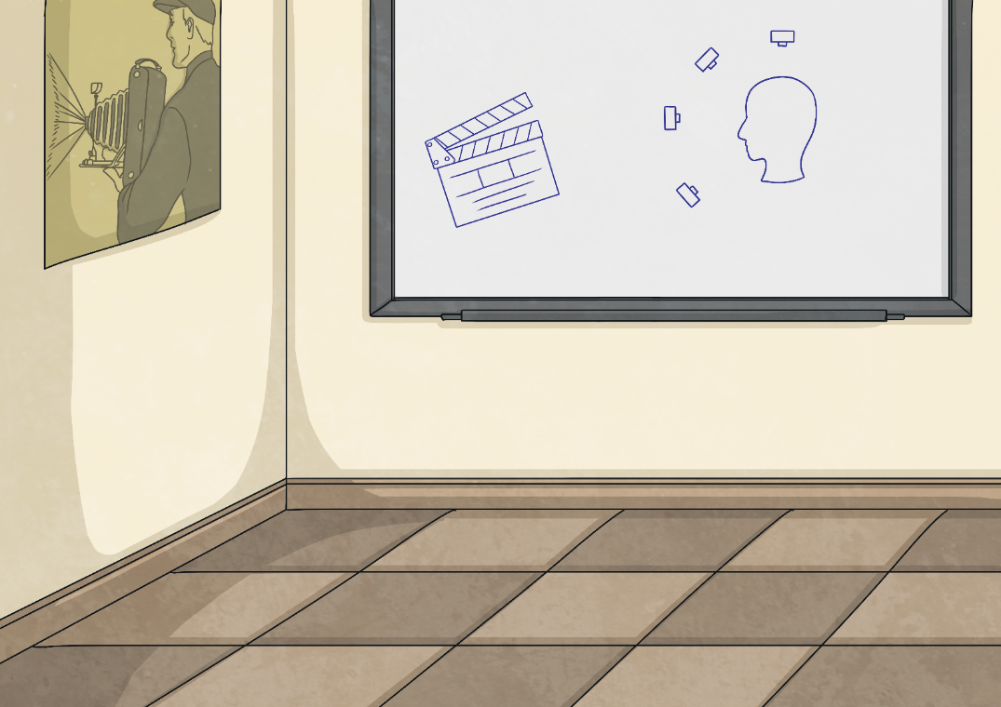
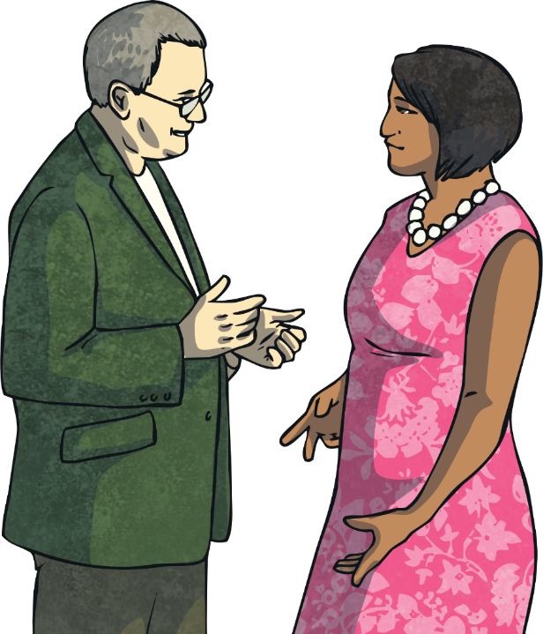
Let’s meet the teacher!

Slide 84
Let’s meet the teacher!
So, how is my child doing in English class?

Slide 85
Let’s meet the teacher!
So, how is my child doing in English class?
...

Slide 86
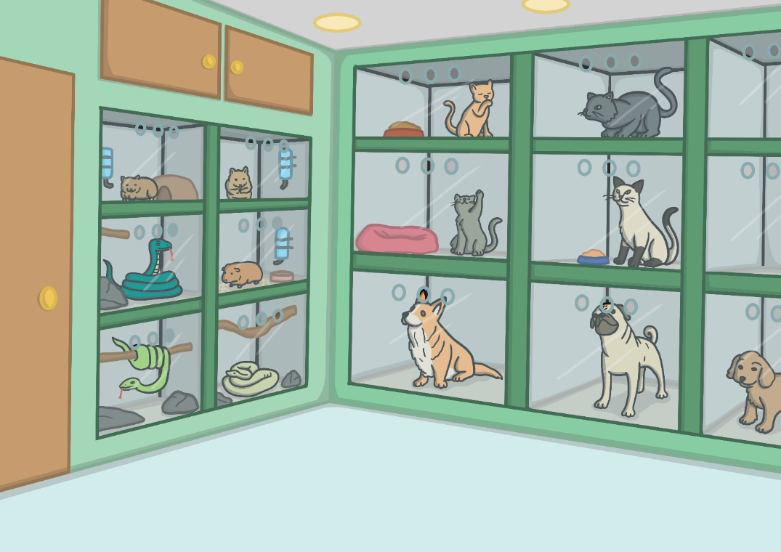
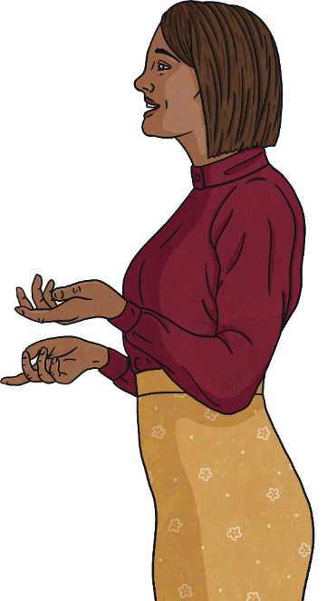
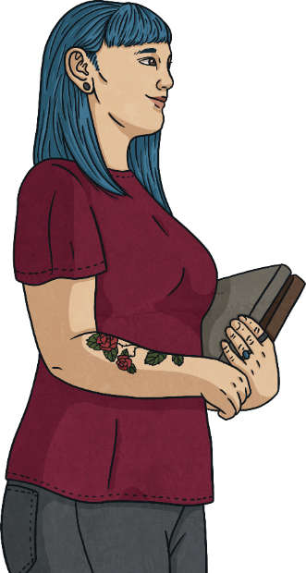
Let’s adopt a pet!

Slide 87
Let’s adopt a pet!
I’d like to adopt a pet.

Slide 88
Let’s adopt a pet!
I’d like to adopt a pet.
Great! What kind of pet are you looking for?

Slide 89
Let’s adopt a pet!
I’d like to adopt a pet.
Great! What kind of pet are you looking for?
...

Slide 90
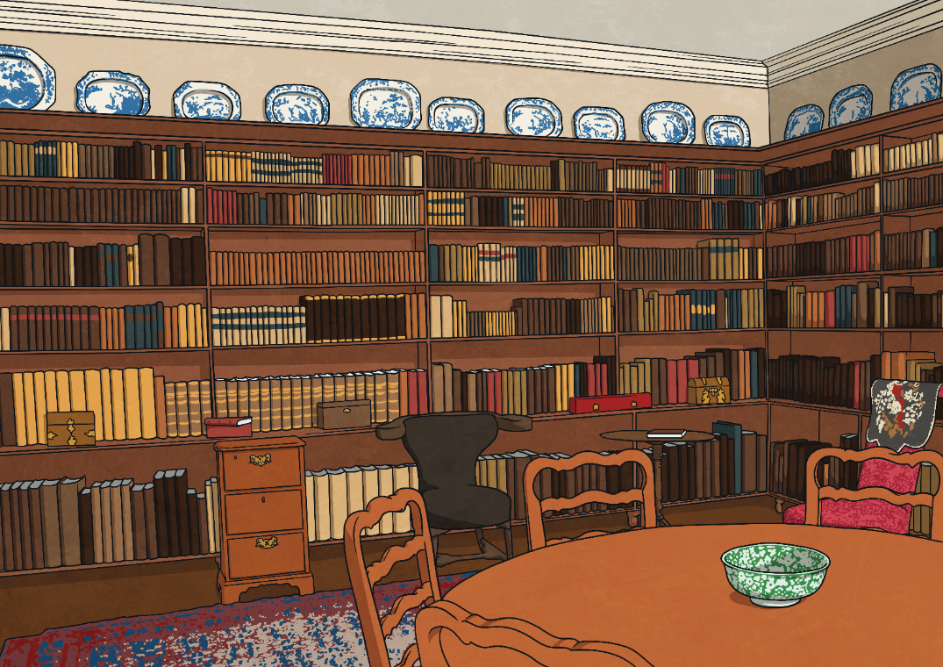
Let’s explore a secret room

Slide 91
Let’s explore a secret room
What’s that?

Slide 92
Let’s explore a secret room
What’s that?
I think it’s a door.

Slide 93
Let’s explore a secret room
What’s that?
I think it’s a door.
Where does it go?

Slide 94
Let’s explore a secret room
What’s that?
I think it’s a door.
Where does it go?
Let’s find out…

