Slide 3
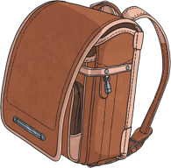
What do you see?
What colours do you see?
What are they wearing?
What objects do you see?
How do you think they are feeling?
What are people doing?
How is this similar or different to your classroom?

Slide 4
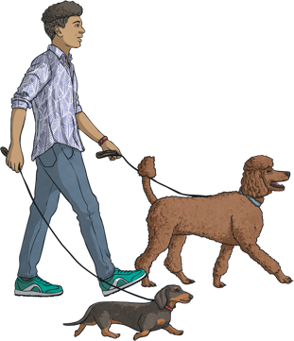
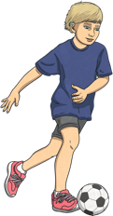
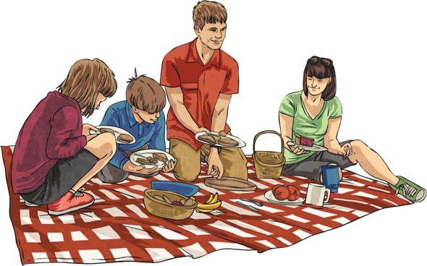
What do you see?
What colours do you see?
What are they wearing?
What objects do you see?
How do you think they are feeling?
What are people doing?
What do you like doing in the park?

Slide 5
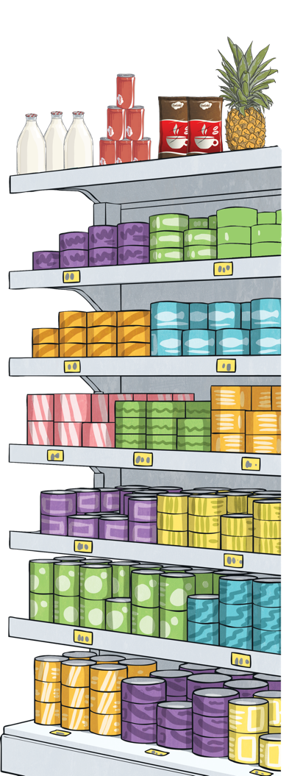
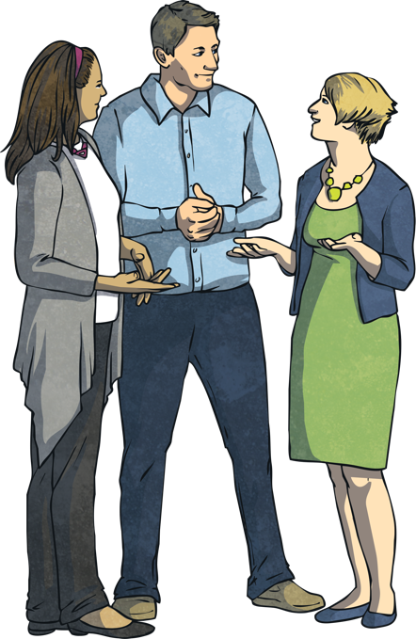
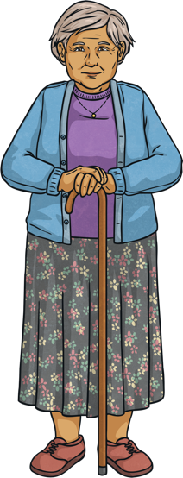
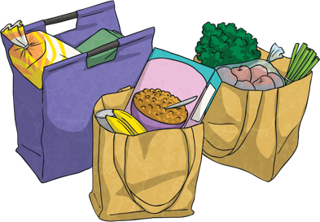
What do you see?
What colours do you see?
What are they wearing?
What objects do you see?
How do you think they are feeling?
What are people doing?
Do you enjoy shopping? Why or why not?

Slide 6
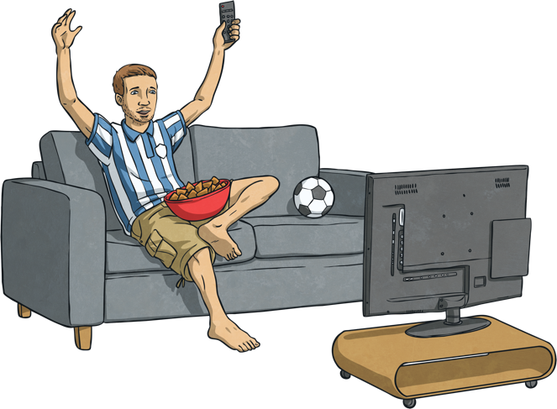
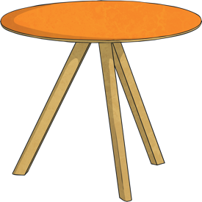
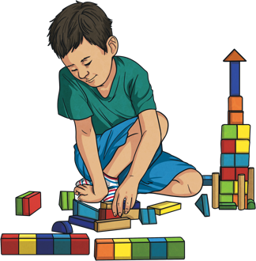
What do you see?
What colours do you see?
What are they wearing?
What objects do you see?
How do you think they are feeling?
What are people doing?
What do you do every day?

