Slide 2
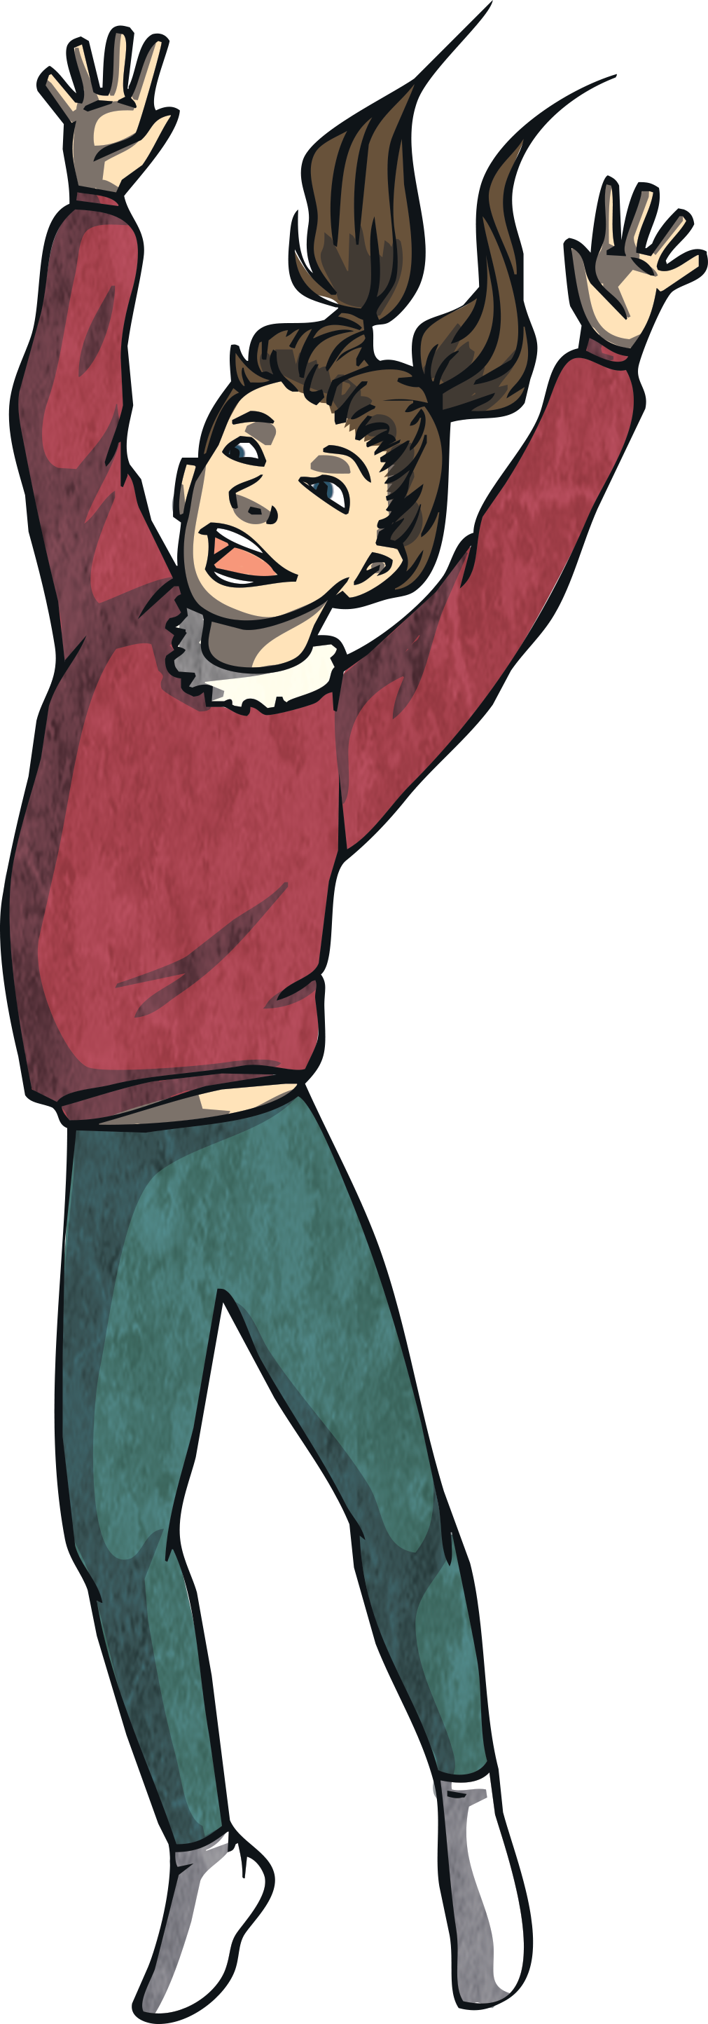
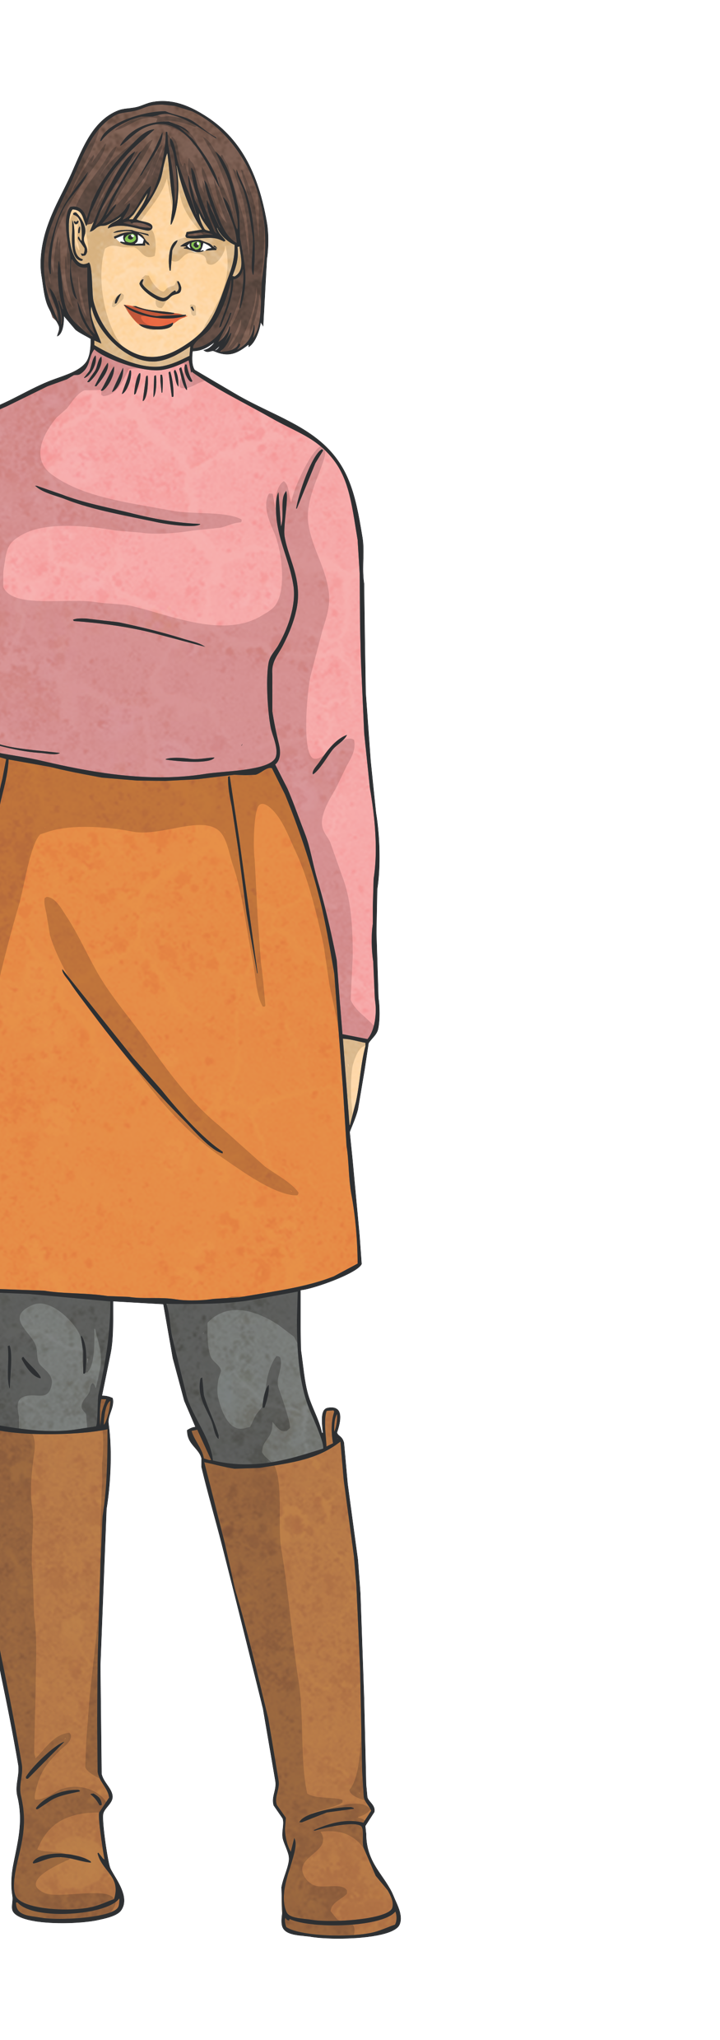
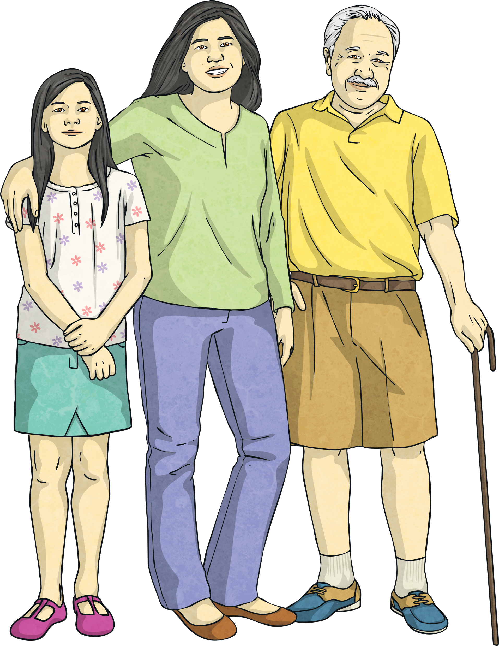
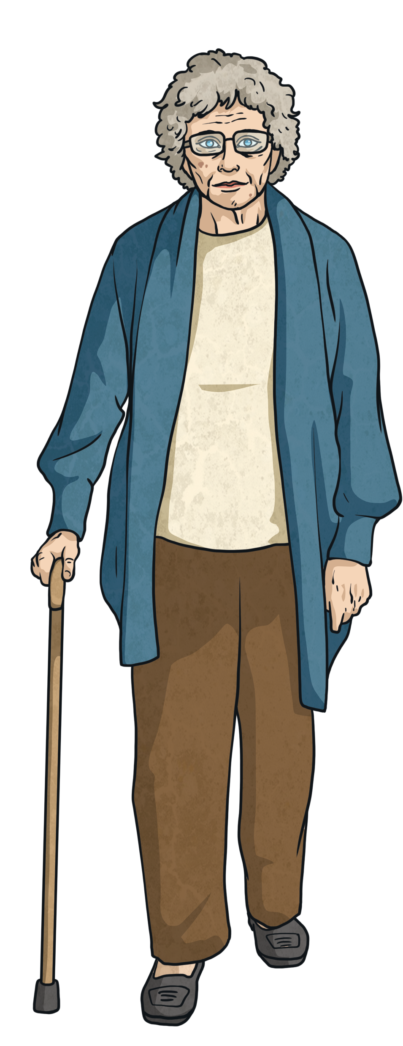
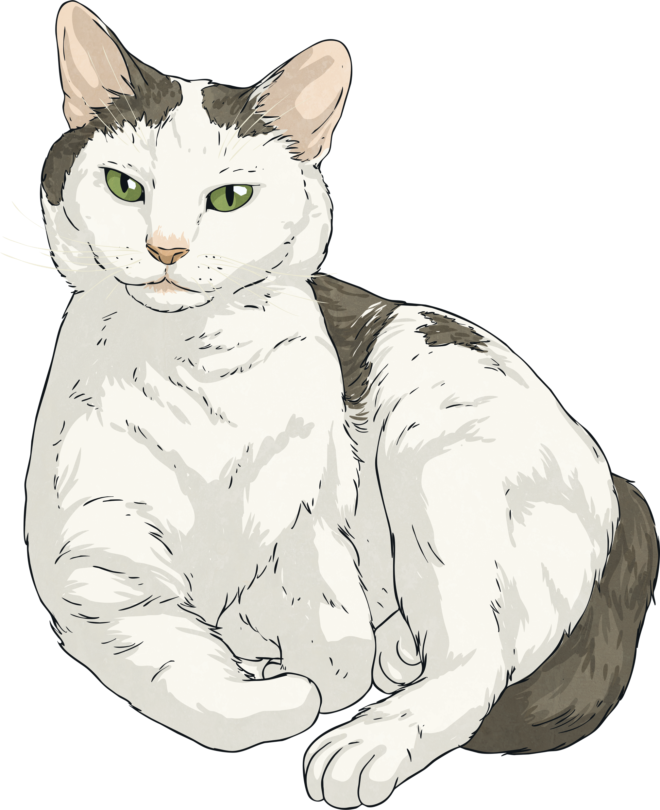
This is Mike. Mike is 70 years old. This is his retirement party.

Slide 3
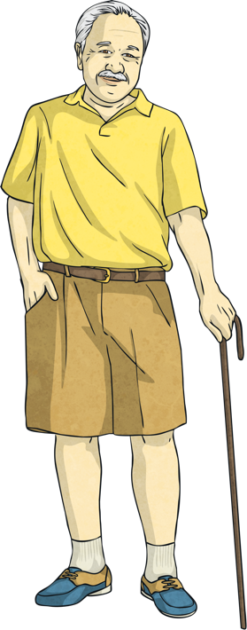
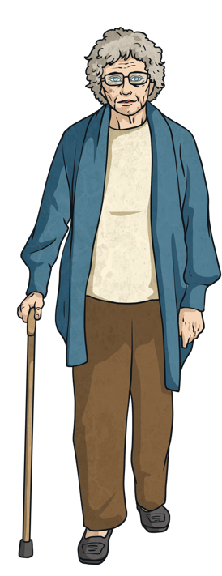
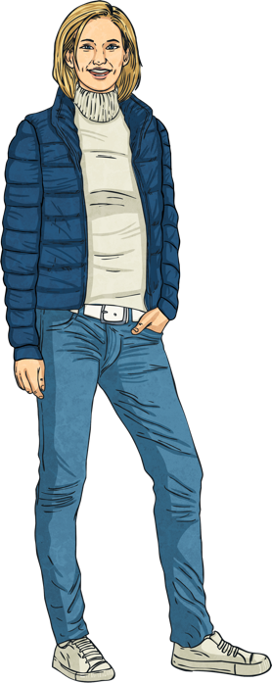
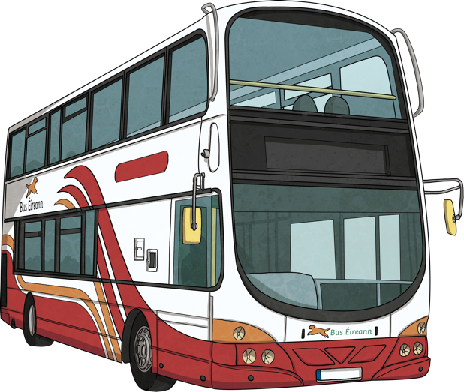
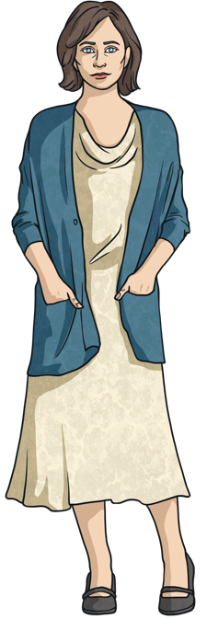
Mike was a bus driver for 50 years!
He met his wife at work. She was also a bus driver.
They have four children together.

Slide 4
Mike was a bus driver because his dad was a bus driver.
But he always had a secret dream job.
Can you guess what it was?

Slide 5
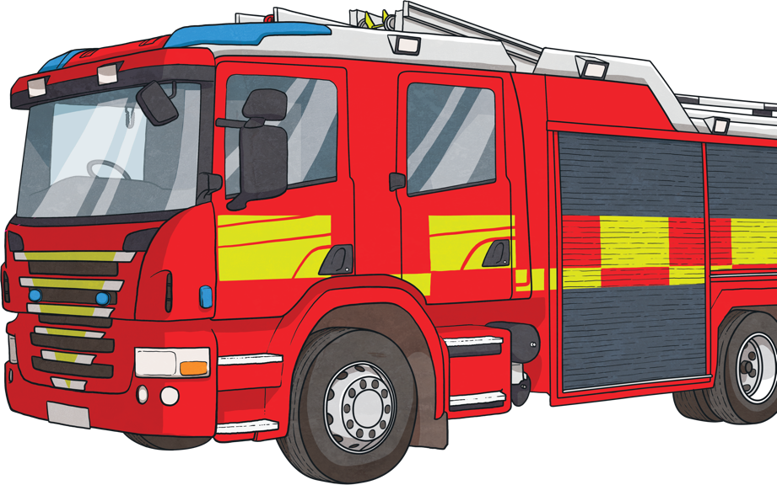
Mike wanted to be a firefighter! Is it possible for him to be a firefighter now?
No! He’s too old.

Slide 6
Age 70, Mike is thinking about what his life would have been like as a firefighter….

Slide 7
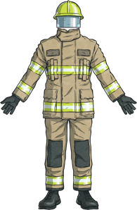
“If I had been a firefighter, I would have worn a firefighter’s uniform.”
See sentence
Is Mike imagining a present or a past situation?
?
?
Is he imagining a real or imaginary situation?

Slide 8
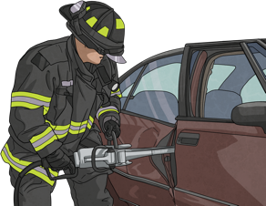
“If I had been a firefighter, I would have rescued people.”
See sentence
Is Mike imagining a present or a past situation?
?
?
Is he imagining a real or imaginary situation?

Slide 9
“If I had been a firefighter, I would have helped animals.”
See sentence
?
Did Mike rescue animals?
?
Was is possible now, or in the past?

Slide 10
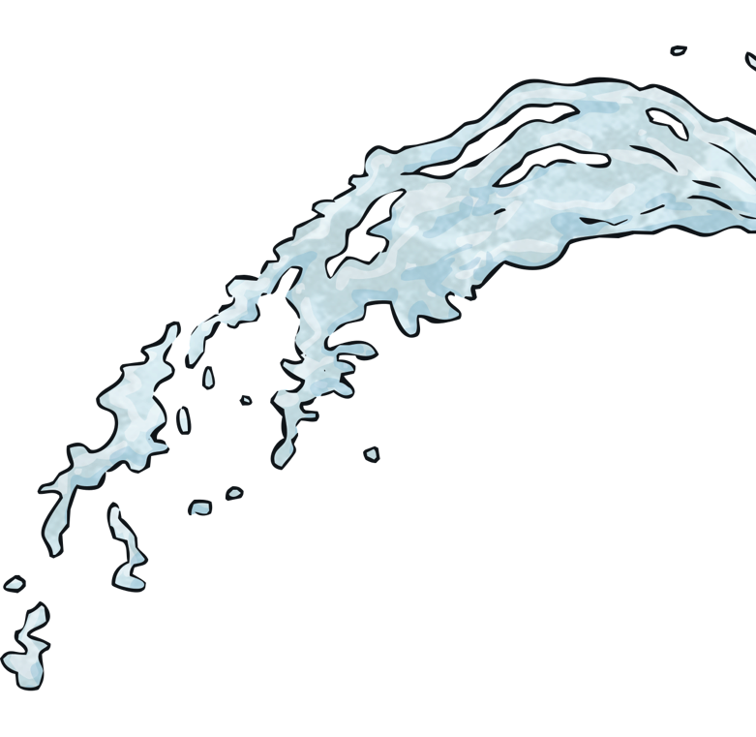
“If I had been a firefighter, I would have used a water hose.”
See sentence
?
Is Mike thinking about the past or the present?
Is Mike thinking about something imaginary, or something real?
?

Slide 11
“If I had been a firefighter, I would have got an award.”
See sentence
?
Is Mike thinking about the past or the present?
Is Mike thinking about something imaginary, or something real?
?

Slide 12
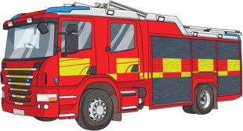
“If I had been a firefighter, I would have driven a fire truck.”
See sentence
?
Is Mike thinking about the past or the present?
Is Mike thinking about something imaginary, or something real?
?

Slide 13
But then Mike remembers something important…

Slide 14
“If I had been a firefighter, I wouldn’t have met my wife!”
See sentence

Slide 15
“If I had been a firefighter, I wouldn’t have had my children.”
See sentence

Slide 16
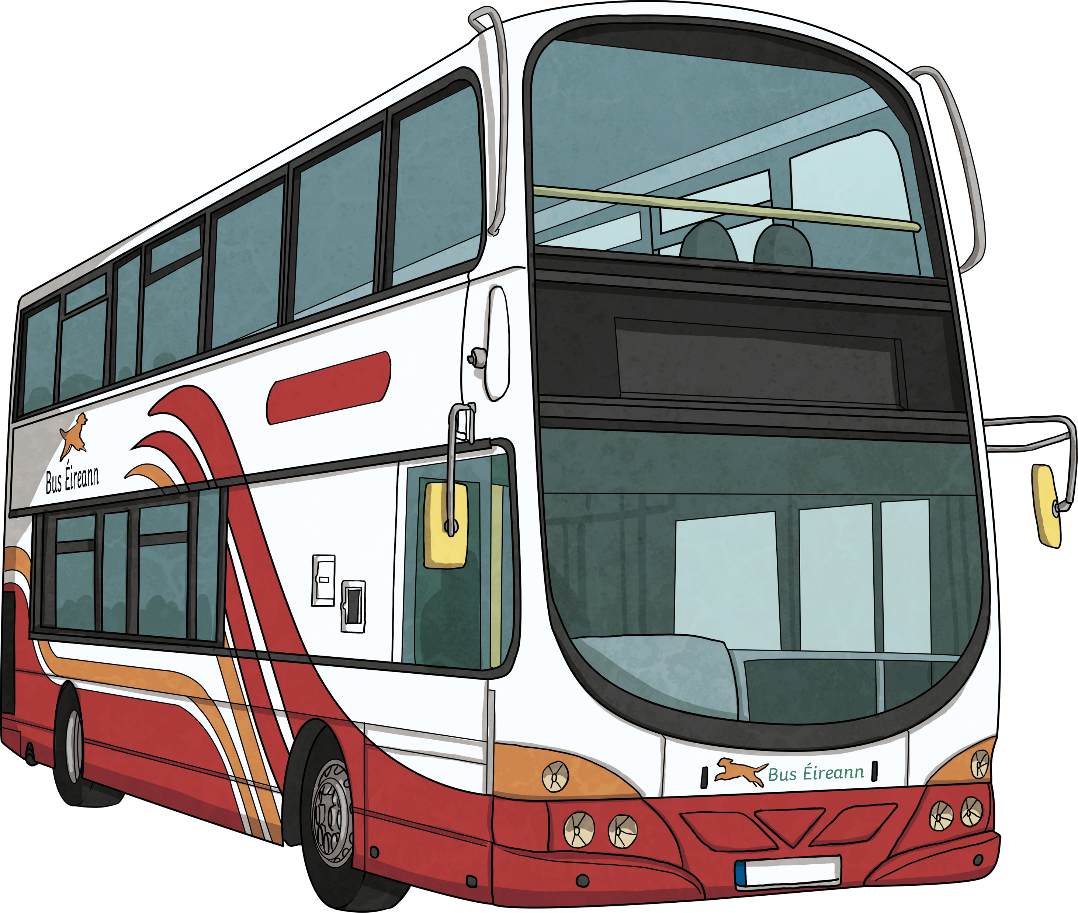
“If I had been a firefighter, I wouldn’t have travelled the city in my bus.”
See sentence

Slide 17
Mike hugged his wife and had a great retirement party.

Slide 18
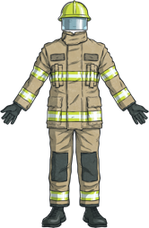
Can you remember the sentences?
“If I had been a firefighter, I would have worn a firefighter’s uniform.”
“If I had been a firefighter, I would have rescued people.”
“If I had been a firefighter, I would have helped animals.”
Help!
Help!
Help!

Slide 19
Can you remember the sentences?
“If I had been a firefighter, I would have used a water hose.”
“If I had been a firefighter, I would have got an award.”
“If I had been a firefighter, I would have driven a fire truck.”
Help!
Help!
Help!

Slide 20
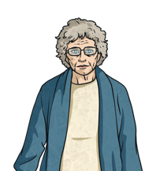
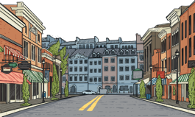
Can you remember the sentences?
“If I had been a firefighter, I wouldn’t have met my wife!”
“If I had been a firefighter, I wouldn’t have had my children.”
“If I had been a firefighter, I wouldn’t have travelled the city in my bus.”
Help!
Help!
Help!

Slide 21
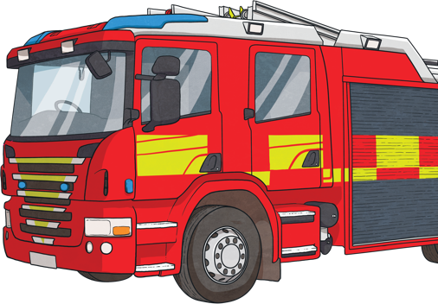
“If I had been a firefighter, I would have driven a fire truck.”
Meaning:
This is the 3rd conditional. We use it to talk about an imaginary past situation: something that didn’t happen.
Form:
If I had been a firefighter, I would have driven a fire truck.
I would have driven a fire truck if I had been a firefighter.
if + past perfect
would + have + past participle
would + have + past participle
if + past perfect

Slide 22
“If I had been a firefighter, I would have driven a fire truck.”
Pronunciation:
had = ‘d.
‘would have’ sounds like ‘would’uv’.
Negative and question forms:
If I hadn’t been a firefighter, I wouldn’t have met my wife.
If you hadn’t been a firefighter, would you have met your wife?
What would you have done if you hadn’t been a firefighter?
Extra points: When do we use a comma in the 3rd conditional form?
We use a comma between clauses when ‘If’ is at the beginning of the sentence. When ‘if’ is in the middle of the two clauses, no comma is needed.
reveal the answer

Slide 23
Use your ideas to complete these sentences. Be creative!
If I had been born 100 years ago,…
If I had been born in the times of the dinosaurs,…
If we had never discovered antibiotics…
If my grandparents had never met,...
If we had never invented cars,...
If my parents had named me something different,...
If I had never studied English,...
If humans had never been to the moon,...
If Captain Cook hadn’t travelled to Australia,...

