Slide 2
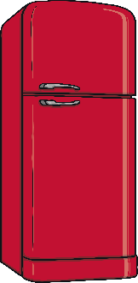
Vocabulary Check
Do you know these words?
Plate
Cake
Plant
Bowl
Bottle
Flour
Milkshake
Refrigerator
Coffee Machine

Slide 3
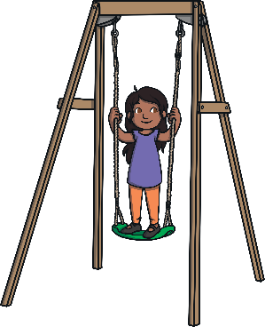
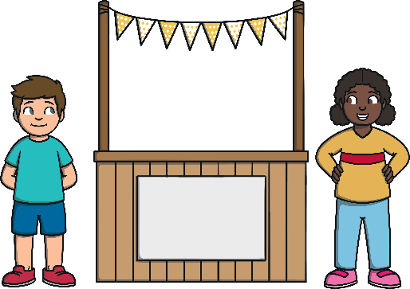
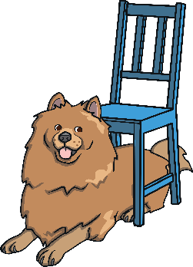
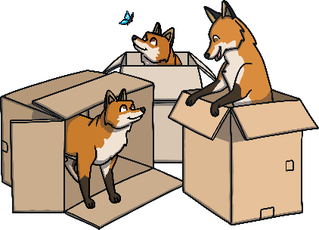
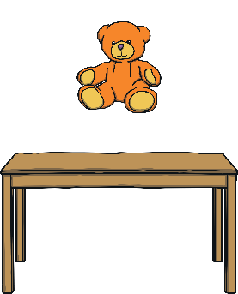
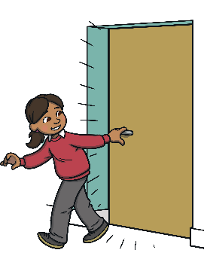
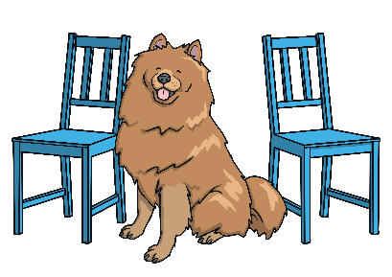
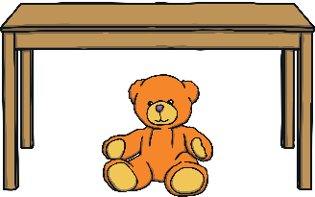
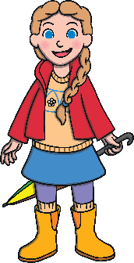
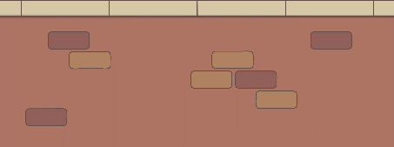
Prepositions Review
on
under
in
by
out of
above
below
between
behind
in front of
beside

Slide 4
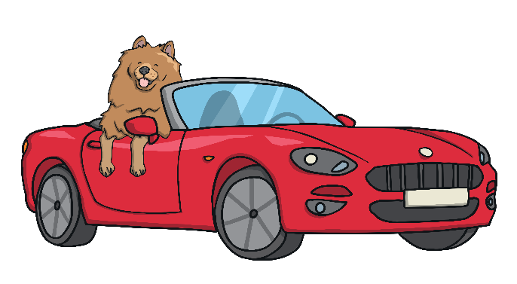
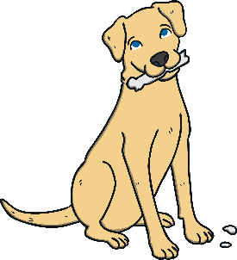
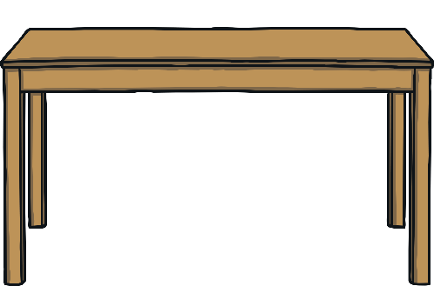
Practice
Can you complete the sentences?
The dog is the car.
The dog is in the car.
The dog is the table.
The dog is on the table.

Slide 5
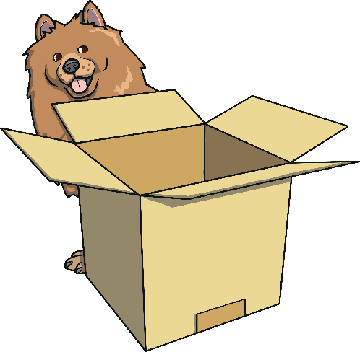
Practice
Can you complete the sentences?
The dog is the chair.
The dog is under the chair.
The dog is the box.
The dog is behind the box.

Slide 6
Practice
Can you complete the sentences?
The dog is the chairs.
The dog is between the chairs.
The cat is the yarn.
The cat is beside the yarn.

Slide 7
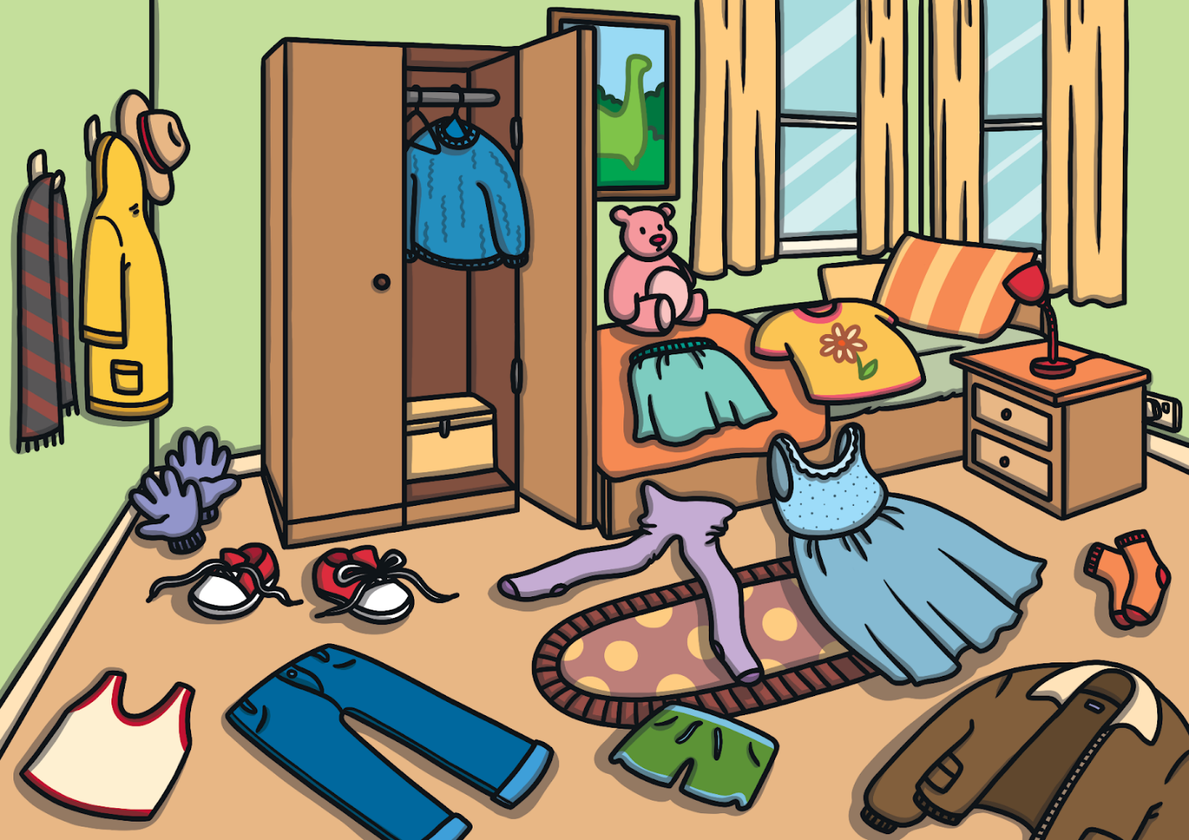
Practice
Discuss the picture and answer the questions.
Where is the blue sweater
What’s on the bed?
What’s behind the jeans?
How many items are on the floor?
Where are the red shoes?

Slide 8
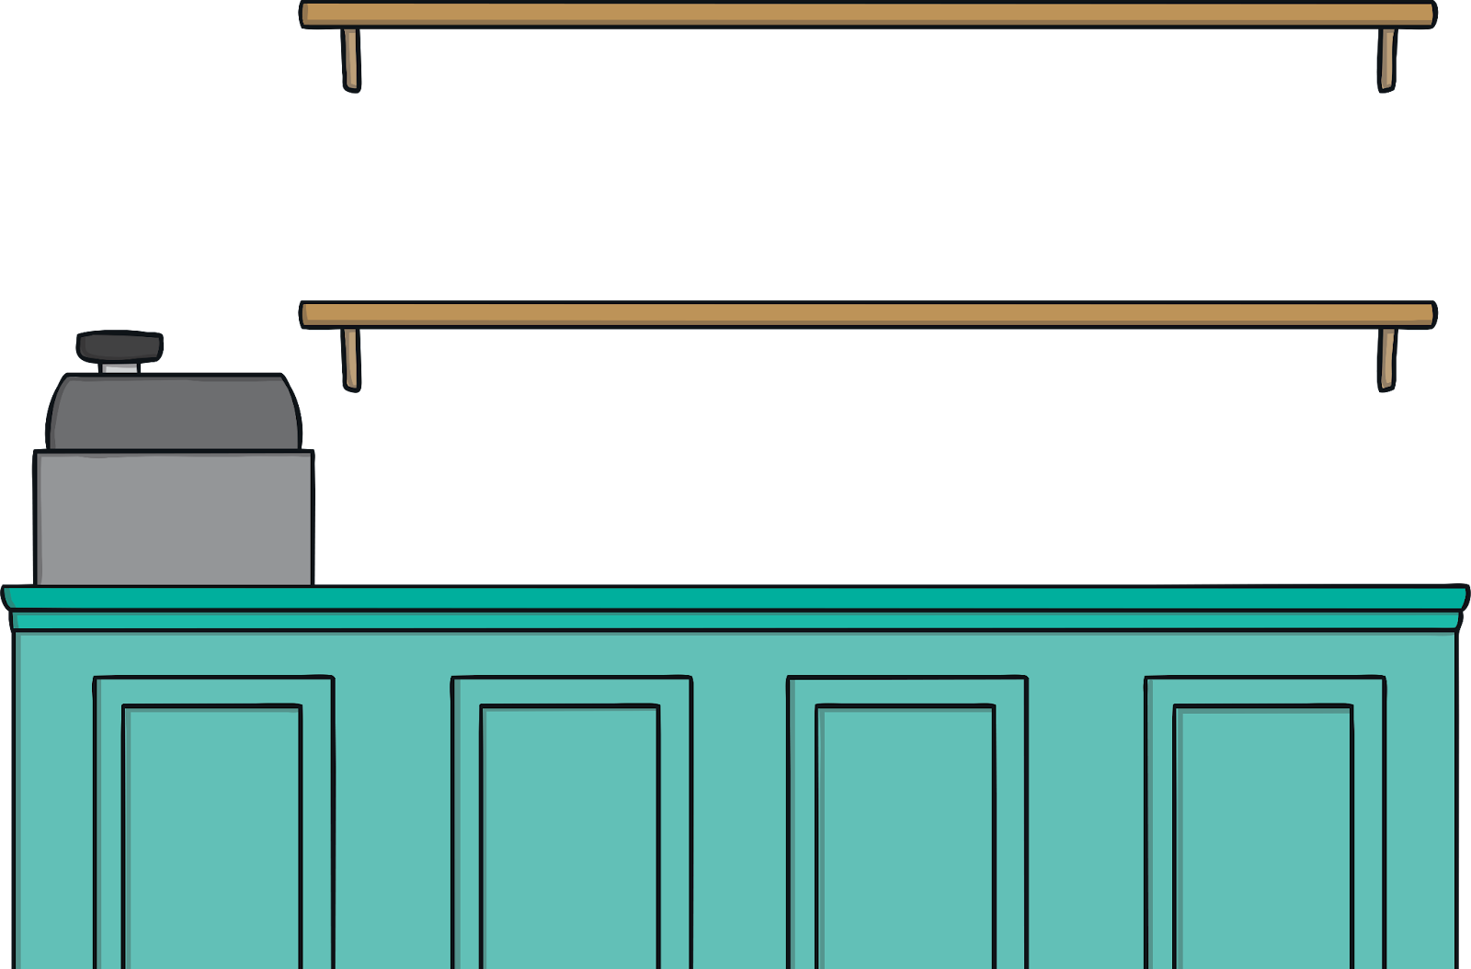
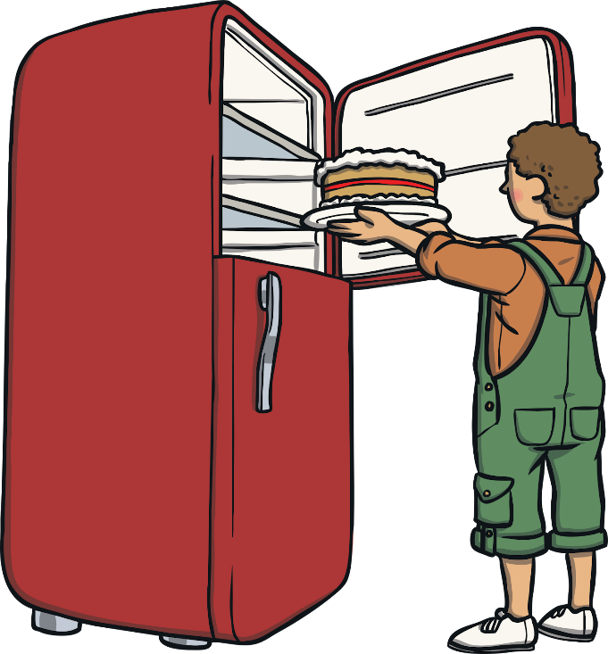
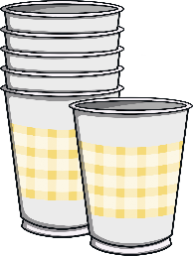
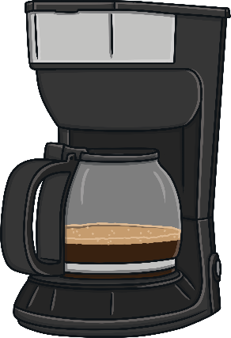
Practice
What can you see in the picture? Where are they?

Slide 9
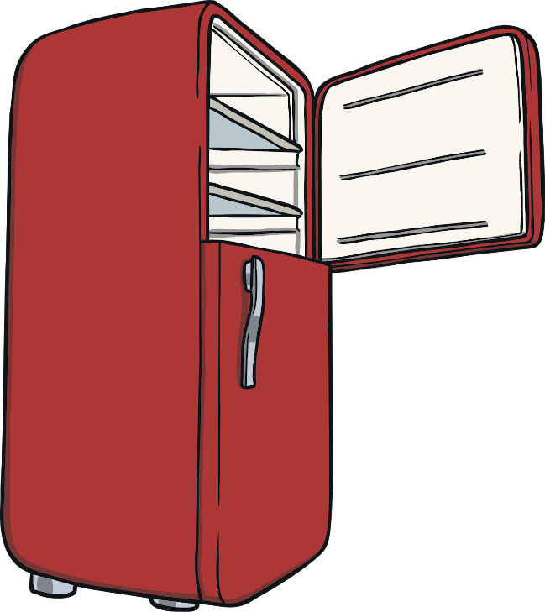
Practice
Has anything changed? What’s moved? Is anything missing?

