Slide 2
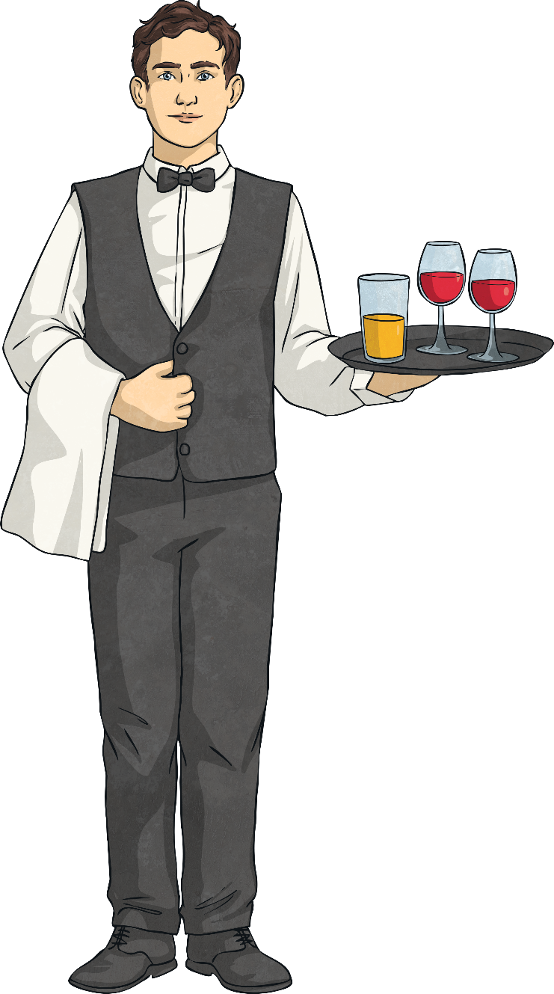
What’s your favourite restaurant and why?
Do you often go to restaurants?
What’s your favourite food to eat at a restaurant?
Do you think expensive restaurants are better than cheap restaurants?

Slide 3
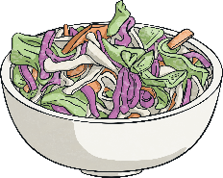
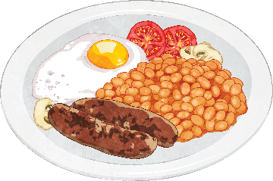
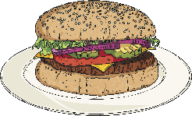
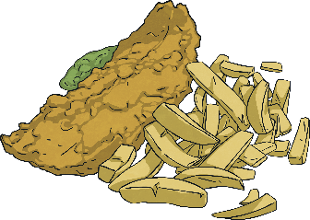
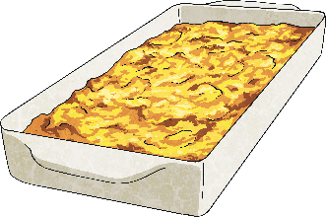
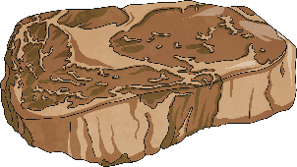
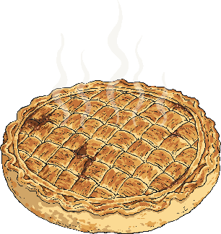
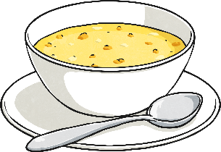
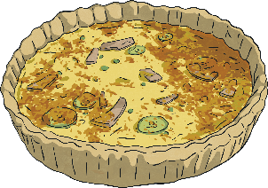
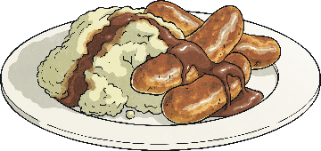
Match the food or drink to the picture.
Fish and chips
Steak
Full English breakfast
Vegetable Soup
Shepherds’ Pie
Burger and coleslaw
Chicken pie
Quiche
Sparkling water
Bangers and mash

Slide 4
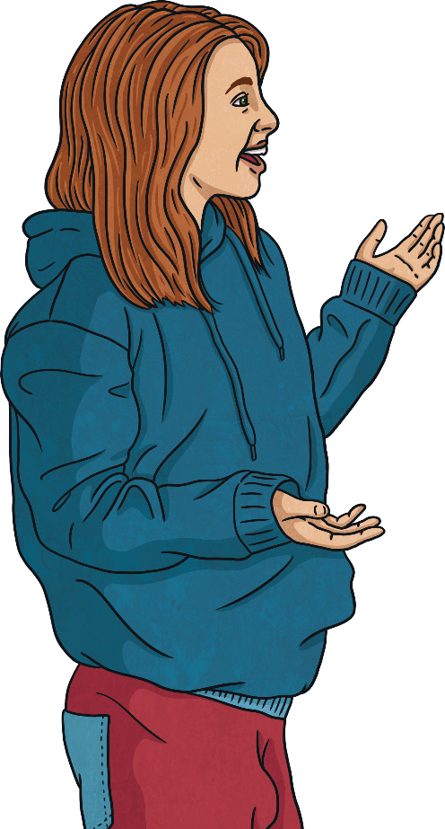
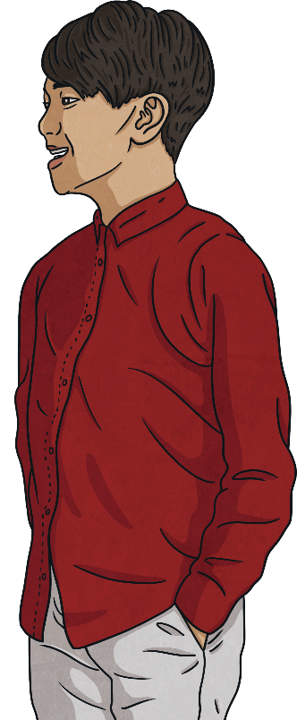
Which is better and why?
I want chips, please.
I would like chips, please.

Slide 5
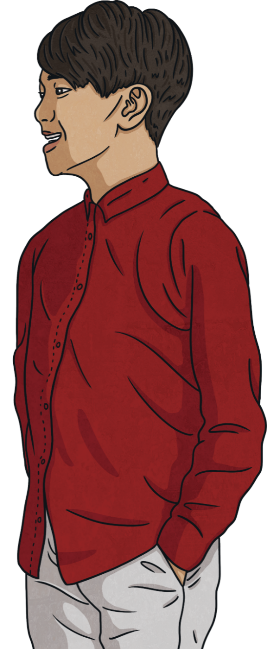
Which is better and why?
I want chips, please.
I would like chips, please.
‘I would like chips’ is better. It is polite. We can also say ‘I’d like chips’.

Slide 6
Being polite
Rude
Polite
I want chips.
What do you want?
Do you want anything else?
No.
I would like chips, please. I’d like chips, please.
What would you like?
Would you like anything else?
No, thank you.

Slide 7
Practice the conversation
Waiter: Good afternoon, welcome to the Twinkle Star Restaurant. Customer: Hi, I’d like a table for four, please. Waiter: Certainly, right this way. Here’s the menu. Customer: Thanks.
Waiter: Are you ready to order? Customer: Yes, I think so. Waiter: What would you like? Customer: I’d like fish and chips, please.
Waiter: Would you like anything to drink? Customer: Yes, I’d like some sparkling water, please.
Waiter: Would you like anything for dessert? Customer: No thank you. I’d like the bill, please. Waiter: Certainly. Customer: Thank you so much. Keep the change!

Slide 8
What’s missing?
Waiter: Good afternoon, welcome to the Twinkle Star Restaurant. Customer: Hi, I’d like a table for four, please. Waiter: Certainly, right this way. Here’s the menu. Customer: Thanks.
Waiter: Are you ready to order? Customer: Yes, I think so. Waiter: What would you like? Customer: I’d like fish and chips, please.
Waiter: Would you like anything to drink? Customer: Yes, I’d like some sparkling water, please.
Waiter: Would you like anything for dessert? Customer: No thank you. I’d like the bill, please. Waiter: Certainly. Customer: Thank you so much. Keep the change!

Slide 9
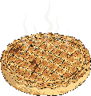
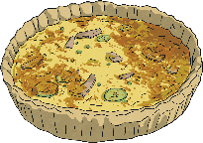
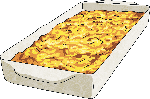
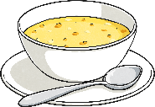
Make your own conversation.
Spin the wheel to choose what to order, then add your own ideas for drinks or dessert.

Slide 10
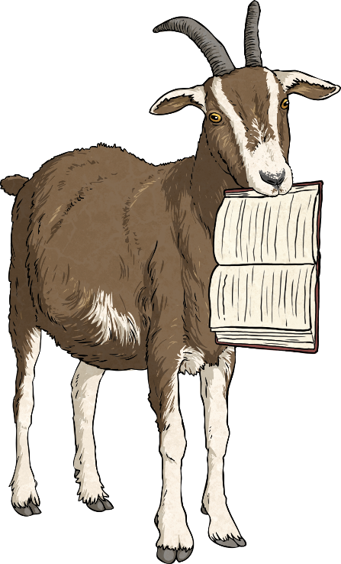
Gary the Goat made some mistakes!
Can you correct them?
Hello, I want a table for two.
What do you want?
Hello, I’d like a table for two, please.
What would you like?
I like chips, please.
I’d like chips, please / I would like chips, please.
Would you like anything more?
Would you like anything for desert?
Would you like anything else?
Would you like anything for dessert?
You would like water?
I would like soup vegetable, please.
Would you like water?
I would like vegetable soup, please.

