Slide 2
Vocabulary
What actions do you see?
Walk
?
?
Run
?
Make a cake

Slide 3
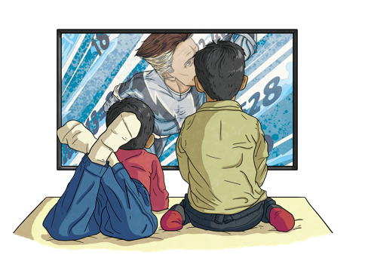
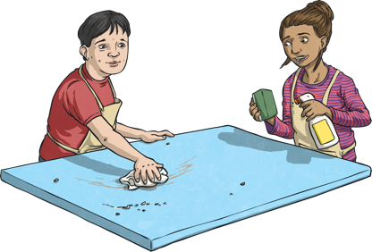
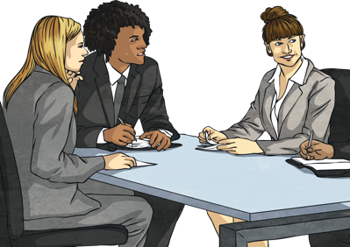
Vocabulary
What actions do you see?
Watch TV
?
?
Clean the house
?
Work

Slide 4
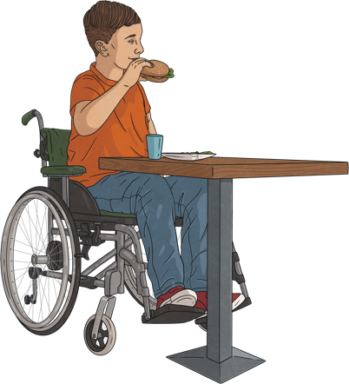
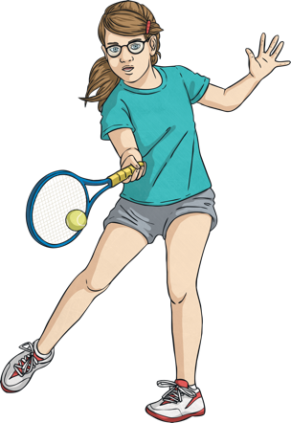
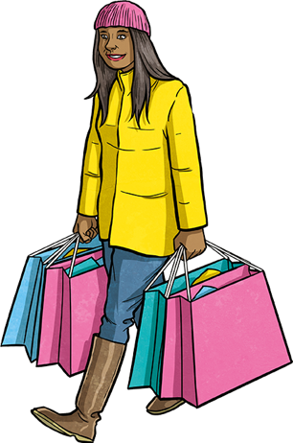
Vocabulary
What actions do you see?
Have lunch
?
?
Play tennis
?
Shop

Slide 5
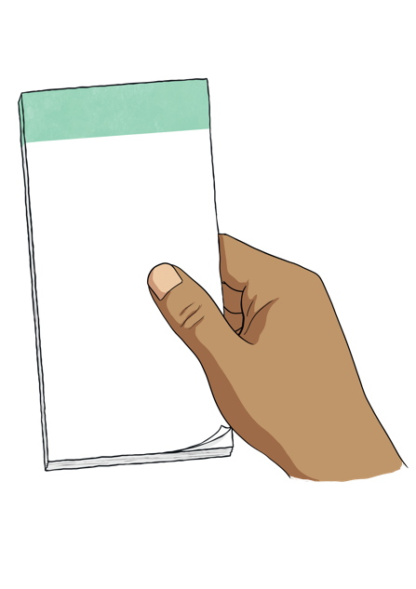
Vocabulary
What actions do you see?
Bread
Apple
Milk
?
?
Help
Need

Slide 6
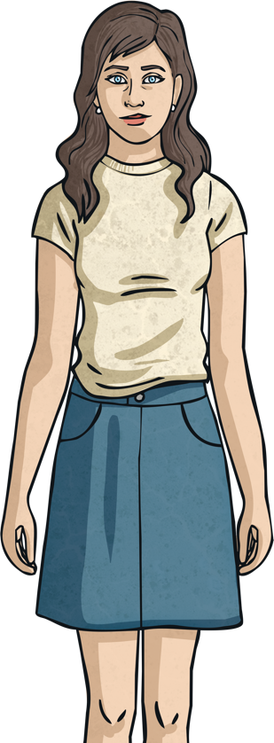
This is Olivia
Where does
she live?
Use your imagination…
Who does she
live with?
How old
is she?

Slide 7
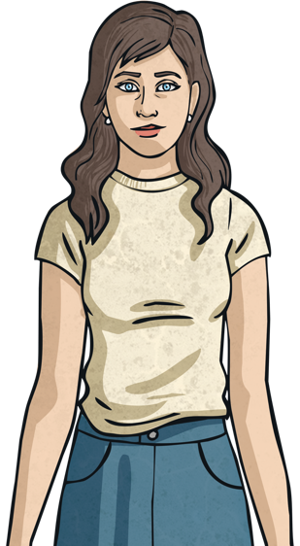
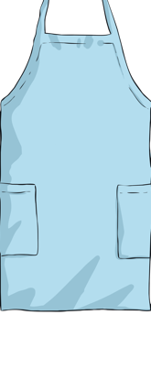
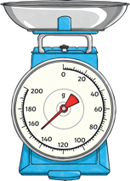
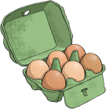
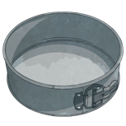
Hi! I’m Olivia
Today is my sister’s birthday.
I need to make her birthday cake.
There’s just one problem.
My cakes are always very bad!
Let’s see what happens...

Slide 8
Oh no!
This cake
isn’t good
Maybe my
friends
can help me

Slide 9
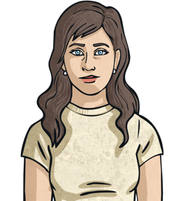
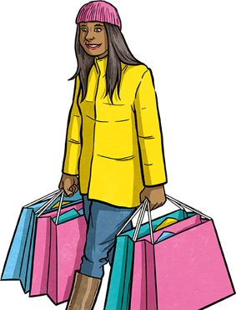
Sorry, I’m shopping
right now.
Hello Sam.
I need your help, now!

Slide 10
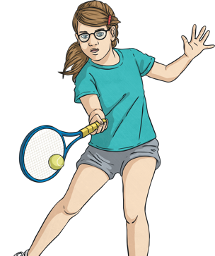
Sorry, I’m playing
tennis right now.
Hello Rosie.
I need your help, now!

Slide 11
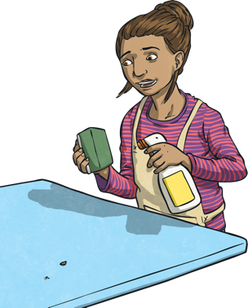
Sorry, I’m cleaning
my house right now.
Hello Kim.
I need your help, now!

Slide 12
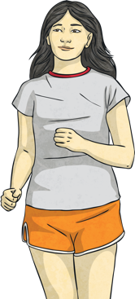
Sorry, I’m running in
the park right now.
Hello Margo.
I need your help, now!

Slide 13
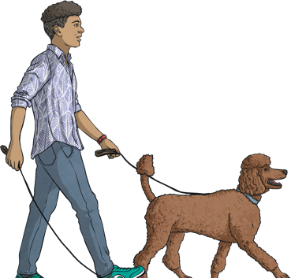
Sorry, I’m walking
my dog right now.
Hello Finn.
I need your help, now!

Slide 14
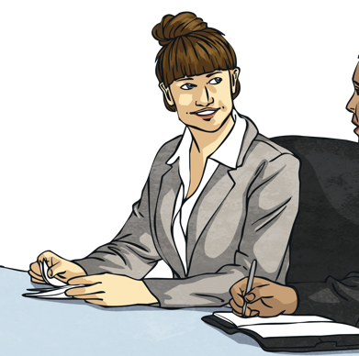
Sorry, I’m working
right now.
Hello Angel.
I need your help, now!

Slide 15
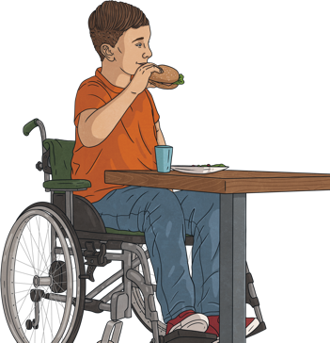
Sorry, I’m having
lunch now.
Hello Jacob.
I need your help, now!

Slide 16
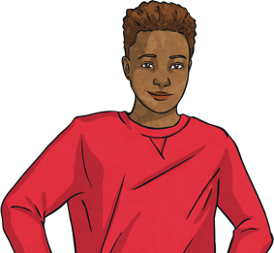
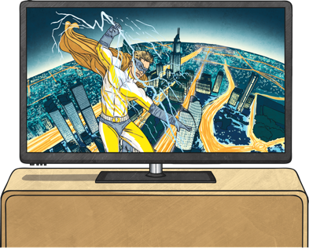
I’m watching TV
right now, but OK!
I’m coming to your house now..
Thank you, Emma.
Hello Emma.
I need your help, now!

Slide 17
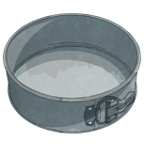
Let’s see the cake...

Slide 18
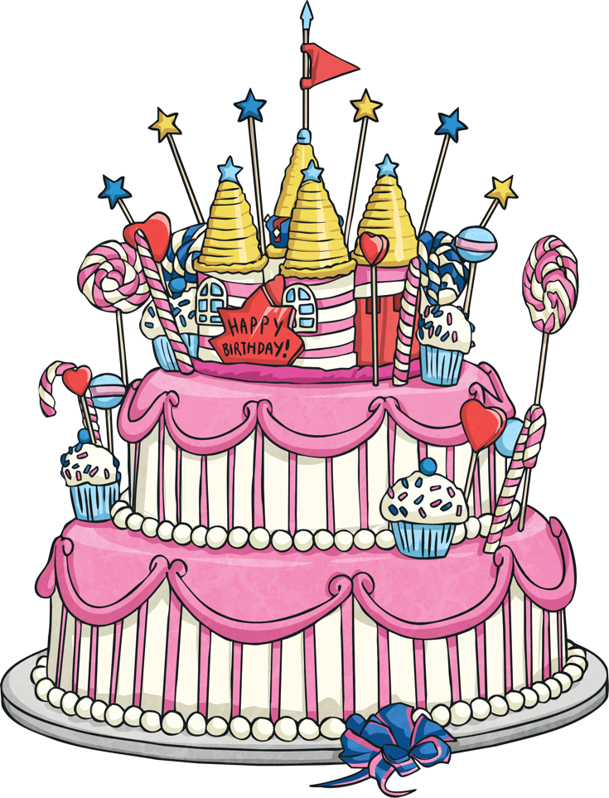
What do you think?

Slide 19
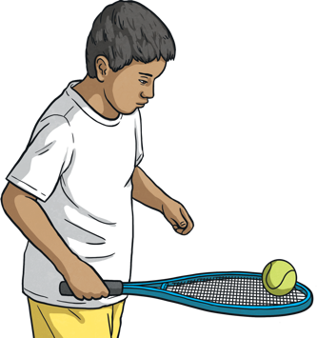
Language Analysis: The present continuous
I’m playing tennis right now
When is the action happening? Every day or now?
What is the subject of the sentence?
What two verbs can you see?
This is the present continuous. To make the present continuous, we need ‘be’ and the verb with ‘ing’
How can you make the sentence into a question?
What is the short answer?
How can you make the sentence into a negative?

Slide 20
Language Analysis: The present continuous
Complete the sentences.
Remember we always need ‘be’ and the verb with ‘ing’.
Positive: I’ play tennis. Negative: I’m play tennis. Question: I play tennis? Short answers: Yes, I / No, I’ .
Positive: You’ play tennis. Negative: You play tennis. Question: you play tennis? Short answers: Yes, you / No, you .
Positive: She’ play tennis. Negative: She play tennis. Question: she play tennis? Short answers: Yes, she / No, she .
I
You We They
He She It

Slide 21
Language Analysis: The present continuous
I
You We They
He She It
Affirmative: I’m playing tennis. Negative: I’m not playing tennis. Question: Am I playing tennis? Short answers: Yes, I am. / No, I’m not.
Affirmative: You’re playing tennis. Negative: You aren’t playing tennis. Question: Are you playing tennis? Short answers: Yes, you are. / No, you aren’t.
Affirmative: She’s playing tennis. Negative: She’s playing tennis. Question: Is she playing tennis? Short answers: Yes, she is. / No, she isn’t.

Slide 22
Check!
What’s the difference?
I’m watching TV right now
I watch TV every day

Slide 23
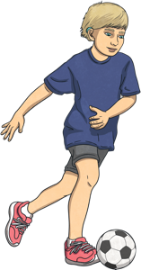
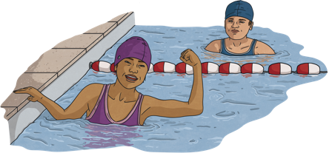
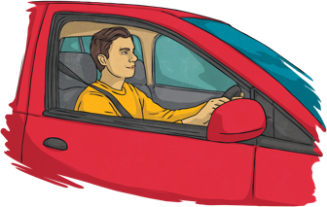
Your turn!
These sentences are false. Can you make true sentences?
He isn’t playing tennis.
He’s playing football.
He’s playing tennis.
They’re walking.
She’s walking to the office.
He’s driving a train.
She’s eating a pizza.

Slide 24
Let’s play!
Close your eyes.
One student makes a sound.
Try and guess the action from the sound.
zzzzzzzzzzzzzzzzzzz
Are you sleeping?
Yes, I am!

