Slide 1
Disclaimer/s
We hope you find the information on our website and resources useful.
Animations
This resource has been designed with animations to make it as fun and engaging as possible. To view the content in the correct formatting, please view the PowerPoint in ‘slide show mode’. This takes you from desktop to presentation mode. If you view the slides out of ‘slide show mode’, you may find that some of the text and images overlap each other and/or are difficult to read.
To enter slide show mode, go to the slide show menu tab and select either from beginning or from current slide.
You may wish to delete this slide before beginning the presentation.

Slide 3
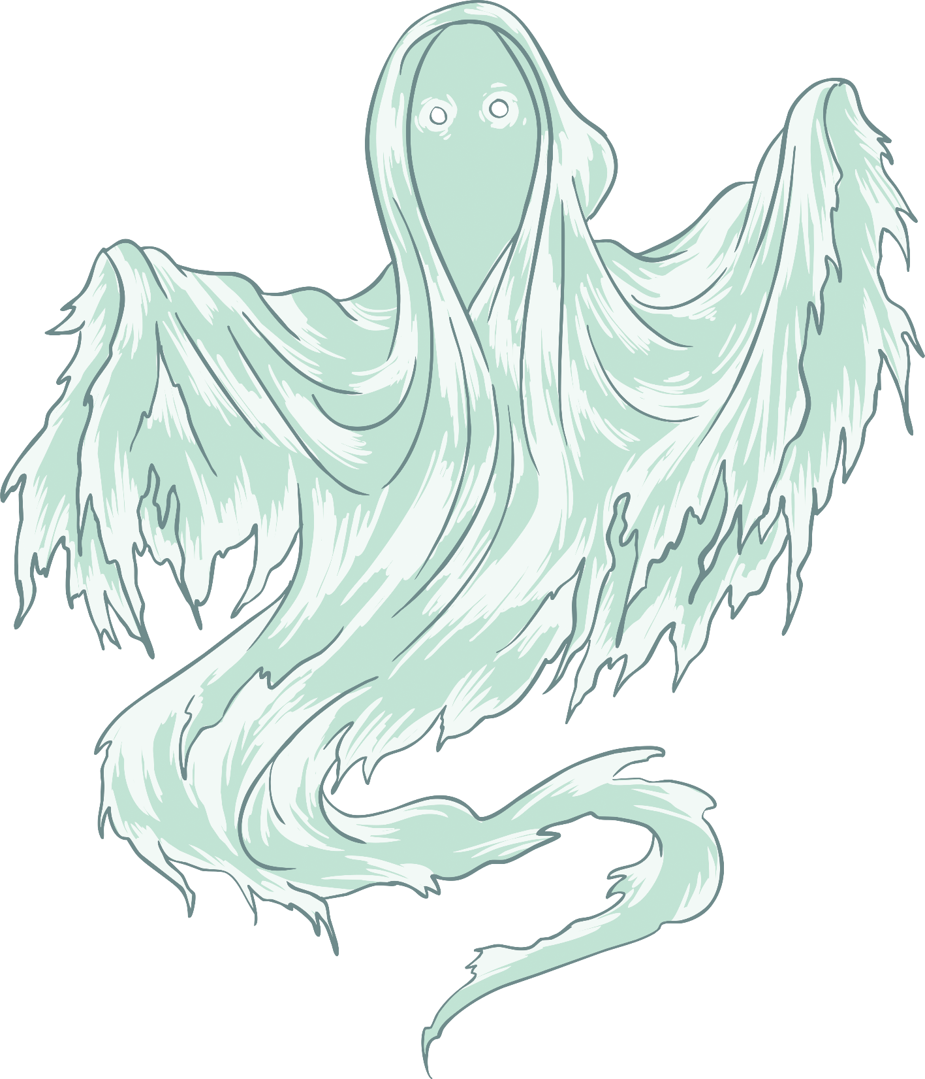
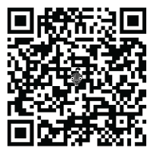
Warmer
Ask your partner or group:
If you have an Apple device, use the QR code to download the leARn and Explore app, and find the haunted house. How would you describe it?
Do you believe in ghosts? Why or why not?
What do you think ghosts look like?
How would you feel if you saw a ghost?

Slide 4
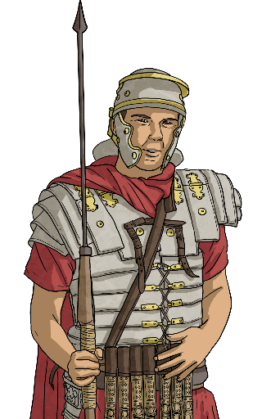
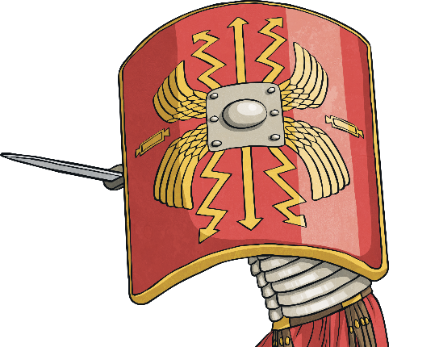
Vocabulary
Stunned
Stare
Roman soldier
Sword
Sword

Slide 5
Gist
The name of the story is:
‘The Soldier Who Walks The Road’
What do you think happens in this story?
Make three predictions, then read the story to check your predictions.

Slide 6
The Soldier Who Still Walks the Road
Let me tell you a true story. Many years ago, I had an aunt. My aunt, who was very old, lived in an isolated house far from the town.
One day, she became sick, so I went to stay with her while she was getting better. While I was staying there, I did all the housework.
One night, I was doing the washing-up when I saw something move out of the corner of my eye.

Slide 7
The Soldier Who Still Walks the Road
I turned around and saw something incredible. A Roman soldier was walking through the kitchen. He was carrying a sword and shield, and looking straight ahead.
While he was walking past me, I suddenly felt very, very cold. I simply stared at him as he disappeared into the wall.

Slide 8
The Soldier Who Still Walks the Road
I ran into my aunt’s room, but she was sleeping. Since she was getting better from her illness, I decided not to wake her up.
That night, I couldn’t sleep. I lay awake in my bed thinking about the Roman soldier. I was still lying awake when the clock struck 7 a.m.

Slide 9
The Soldier Who Still Walks the Road
In the morning, I told my aunt about the Roman soldier. “Ahhh, you saw the soldier! I often see him. But don’t worry, he won’t hurt you. He just walks in and walks out, always on the same path.”
I stayed with my aunt for three more weeks but I didn’t see the Roman soldier again.

Slide 10
The Soldier Who Still Walks the Road
One night, many years later, I was having dinner with a friend and he mentioned ghosts, so I told him the story of the Roman soldier.
“Where did this happen?” he asked me. I told him. “Well, that explains it!” he said. “Many years ago there was a Roman road that ran through that village - and that house.”
I was stunned. “I guess that the Roman soldier still walks the same road...” I said.

Slide 11
Were your predictions about the story correct?
?
?
?

Slide 12
Can you use these words to tell the story again?
true story aunt isolated house | one day sick better | housework washing-up corner of my eye
aunt’s room illness | cold wall | something incredible Roman soldier sword and shield
night awake clock | morning aunt don’t worry path | three weeks again
 | stunned | dinner friend ghosts

