Slide 2
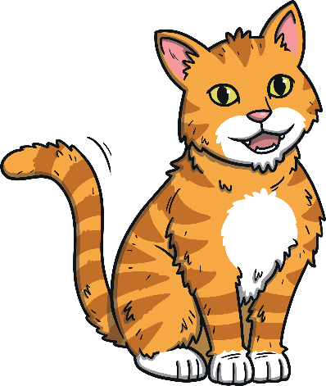
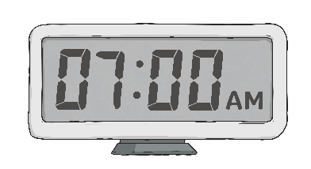
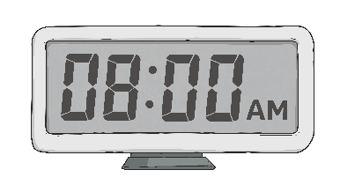
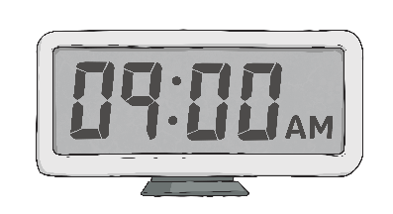
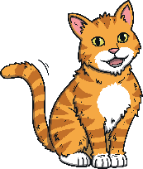
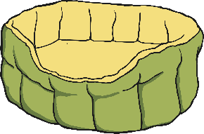
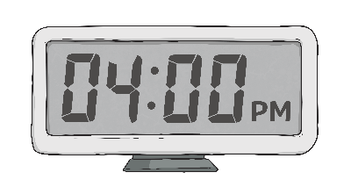
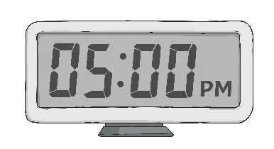
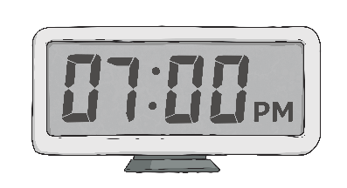
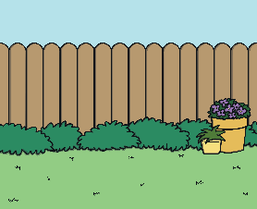
Larry the Cat
What does Larry do every day?
Larry wakes up at 7 o’clock.
Larry eats his breakfast at 8 o’clock.
Larry drinks water from the sink at 9 a.m.
Larry watches the birds at 4 p.m.
Larry goes to sleep at 5 p.m.
Larry plays at 7 p.m.

Slide 3
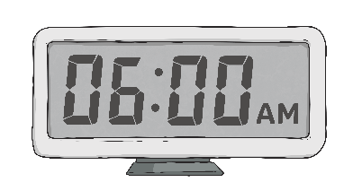
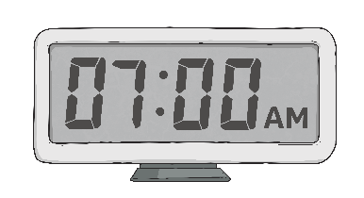
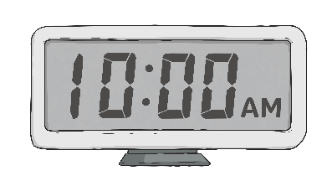
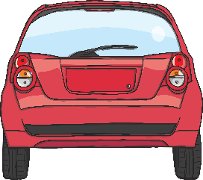
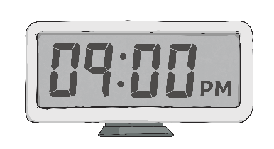
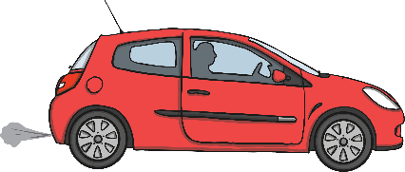
Sid the Spy
What does he do every day?
Sid drinks a cup of coffee at 6 o’clock.
Sid drives to work at 7 a.m.
Sid hides and waits at 10 o’clock.
Sid hides and waits behind a tree at 4 o’clock.
Sid hides and waits behind his car at 9 o’clock.
Sid drives home at 10 o’clock.

Slide 4
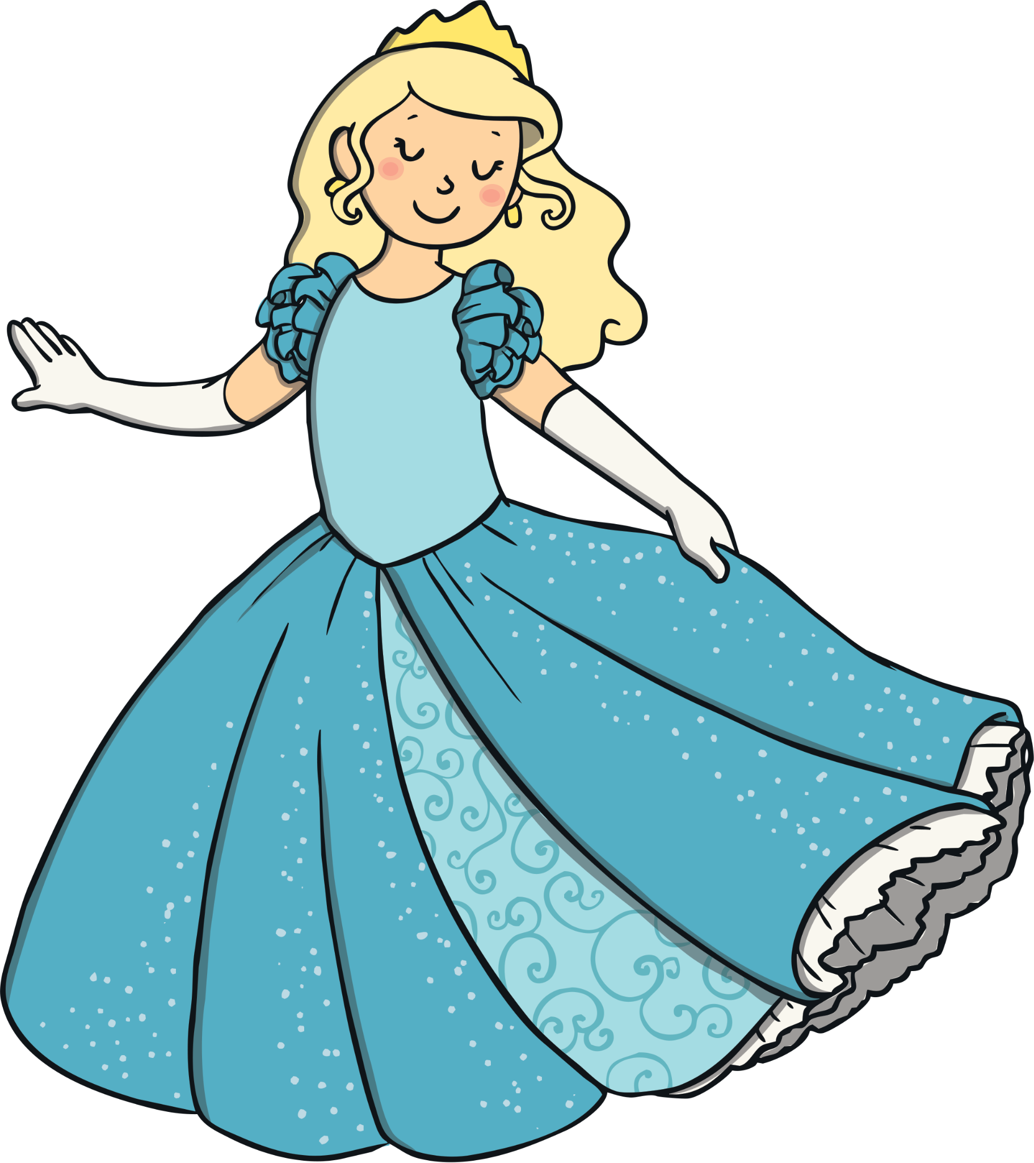
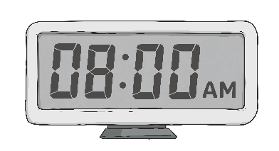
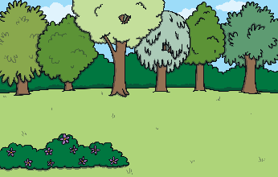
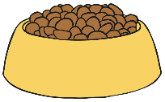
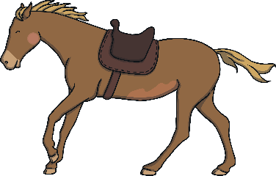
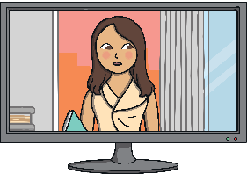
The Princess
What does she do every day?
The Queen reads the newspaper at 8 o’clock.
The Queen walks in the garden at 9 o’clock.
The Queen feeds her dogs at 10 o’clock.
The Queen gives people medals at 4 o’clock.
The Queen rides her horse at 5 p.m.
The Queen watches her favourite programme on TV.

Slide 5
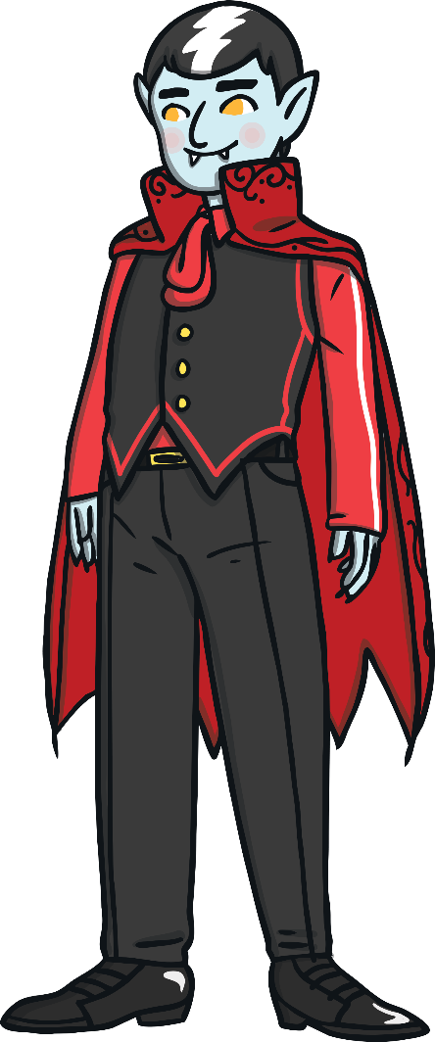
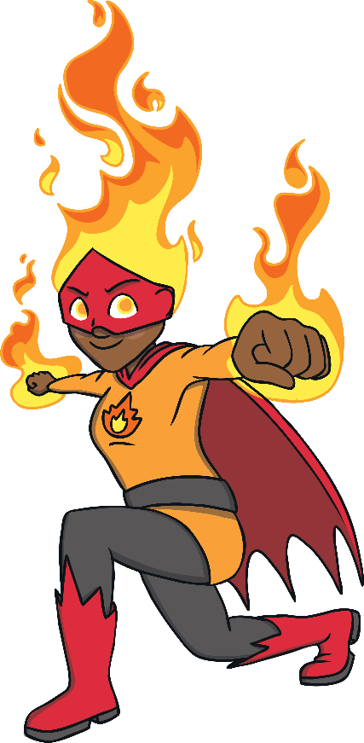
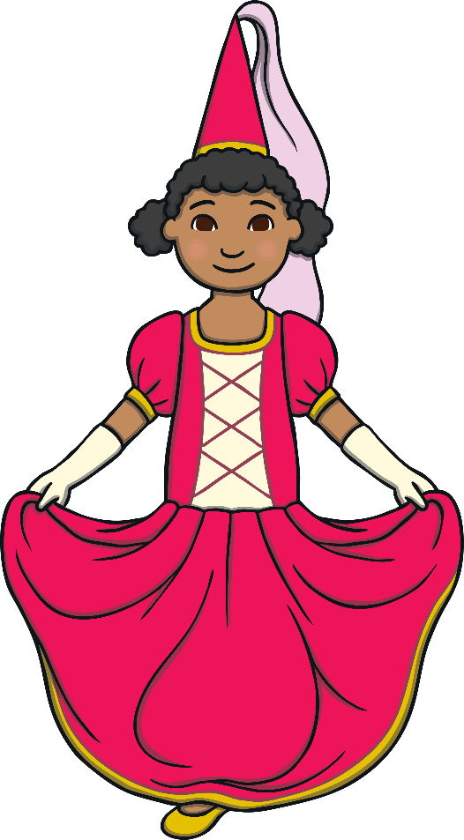
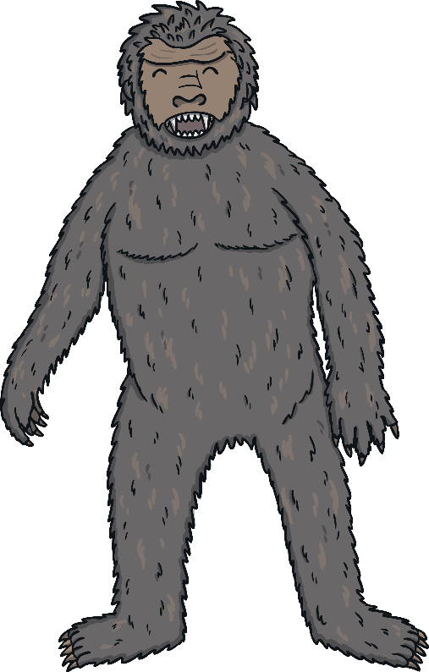
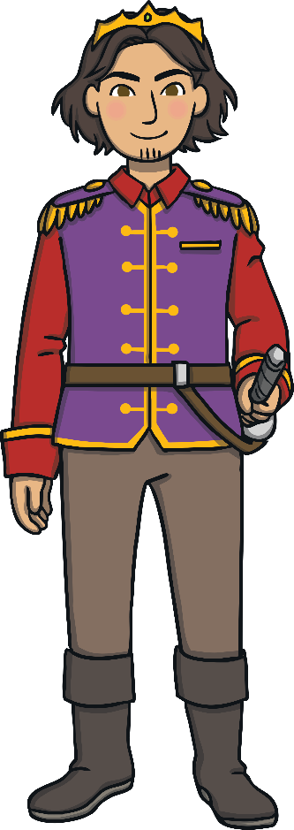
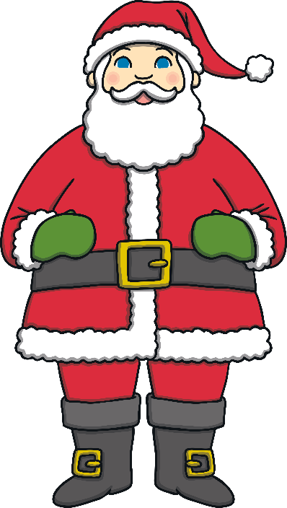
Choose a character by spinning the wheel.
Then describe what they do every day.

