Slide 2
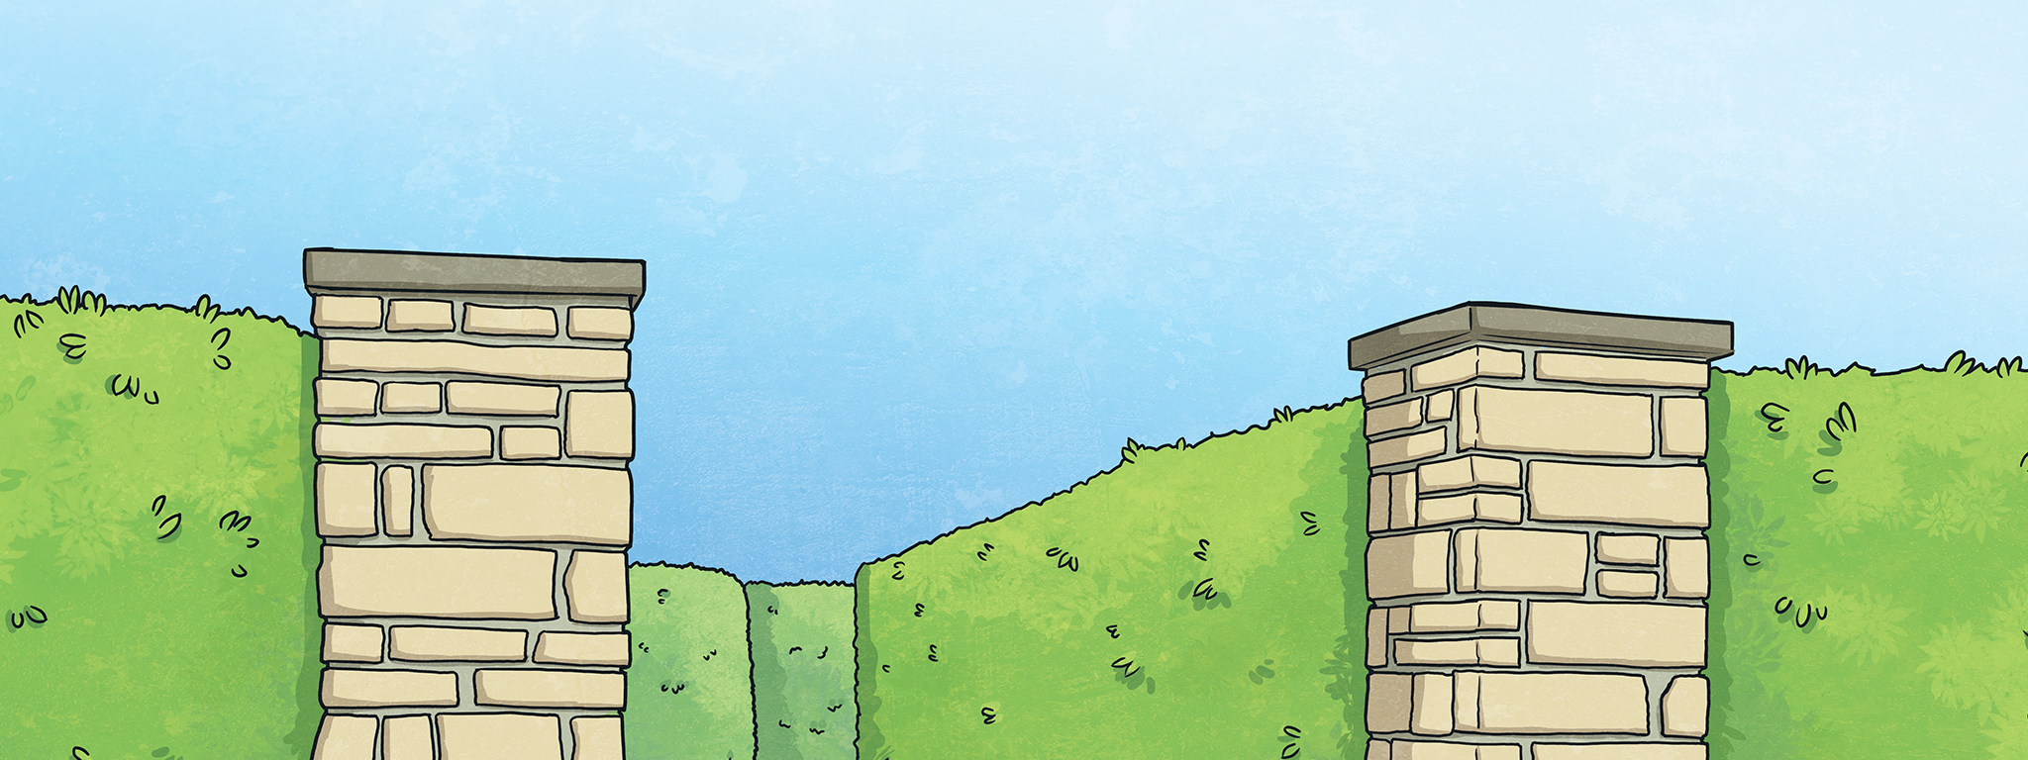
Can you find the centre of the maze?
Choose the correct answer to the question to go the right way.
If you make a mistake, you might get lost!

Slide 3
Back at the beginning!
Click here to start again.

Slide 4
What’s your name?
My name’s Georgina.
(Turn left.)
I’m fine, thanks.
(Turn right.)

Slide 5
How old are you?
I’m Ken.
(Straight ahead.)
I’m ten.
(Turn left.)
I have three brothers. (Turn right.)

Slide 6
Where are you from?
I’m from Italy. (Straight ahead.)
My favourite colour is red. (Turn right.)

Slide 7
How many brothers and sisters do you have?
I have one brother and one sister.
(Turn right.)
My sister’s name is Chloe.
(Turn left.)

Slide 8
What’s your favourite food?
Pizza.
(Straight ahead.)
Yellow.
(Turn left.)
Milk. (Turn right.)

Slide 9
What time is it?
I like ice cream. (Straight ahead.)
It’s 7 o’clock.
(Turn right.)

Slide 10
How do you spell ‘dog’?
I like dogs. (Straight ahead.)
I don’t have a dog. (Turn left.)
D-O-G. (Turn right.)

Slide 11
What do you do?
I’m happy. (Straight ahead.)
I’m a student. (Turn right.)

Slide 12
What do you have for breakfast?
I have pasta. (Straight ahead.)
I have cereal. (Turn left.)
I have a burger. (Turn right.)

Slide 13
Can you speak English?
Yes, I can. (Straight ahead.)
Yes, I do.
(Turn left.)
Yes, I am. (Turn right.)

Slide 14
What’s your phone number?
It’s 24 Main Street.
(Turn left.)
It’s 204 561.
(Turn right.)

Slide 15
When’s your birthday?
It’s on the 17th of January. (Straight ahead.)
I live in a big house.
(Turn right.)

Slide 16
Oh no! A dead end!
Click here to start again.

Slide 17
Congratulations! You found the centre of the maze!

