Slide 2
?
this
Start Timer
Start Timer
Next
Use Timer
Show Answer

Slide 3
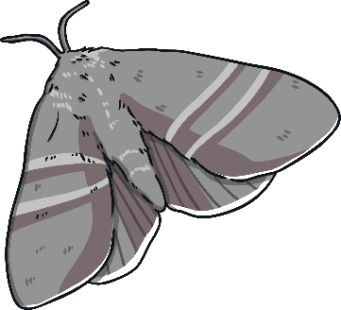
moth
Start Timer
Start Timer
Next
Use Timer
Show Answer

Slide 4
thun
Start Timer
Show Answer
Start Timer
Use Timer
Next

Slide 5
keth
Start Timer
Show Answer
Start Timer
Use Timer
Next

Slide 6
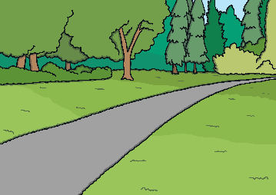
path
Start Timer
Start Timer
Next
Use Timer
Show Answer

Slide 7
thip
Start Timer
Show Answer
Start Timer
Use Timer
Next

Slide 8
foth
Start Timer
Show Answer
Start Timer
Use Timer
Next

Slide 9
thick
Start Timer
Start Timer
Next
Use Timer
Show Answer

Slide 10
wuth
Start Timer
Show Answer
Start Timer
Use Timer
Next

Slide 11
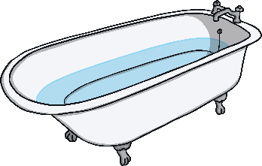
bath
Start Timer
Start Timer
Next
Use Timer
Show Answer

