Slide 2
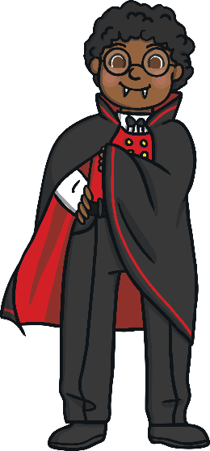
fang
Start Timer
Start Timer
Use Timer
Show Answer
Next

Slide 3
theng
Start Timer
Start Timer
Show Answer
Use Timer
Next

Slide 4
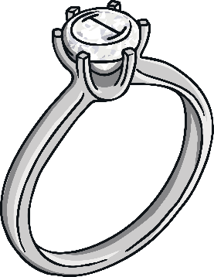
ring
Start Timer
Start Timer
Use Timer
Show Answer
Next

Slide 5
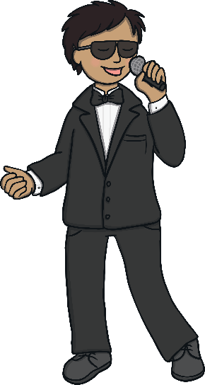
song
Start Timer
Start Timer
Use Timer
Show Answer
Next

Slide 6
zung
Start Timer
Start Timer
Show Answer
Use Timer
Next

Slide 7
quing
Start Timer
Start Timer
Show Answer
Use Timer
Next

Slide 8
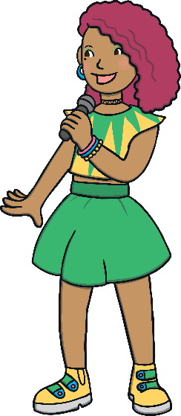
singer
Start Timer
Start Timer
Use Timer
Show Answer
Next

Slide 9
wings
Start Timer
Start Timer
Use Timer
Show Answer
Next

Slide 10
thaing
Start Timer
Start Timer
Show Answer
Use Timer
Next

Slide 11
things
Start Timer
Start Timer
Use Timer
Show Answer
Next

