Slide 2
web
Start Timer
Start Timer
Use Timer
Show Answer
Next

Slide 3
wex
Start Timer
Start Timer
Next
Use Timer
Show Answer

Slide 4
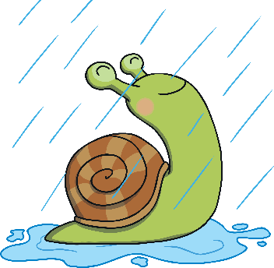
wet
Start Timer
Start Timer
Use Timer
Show Answer
Next

Slide 5
waff
Start Timer
Start Timer
Next
Use Timer
Show Answer

Slide 6
wag
Start Timer
Start Timer
Use Timer
Show Answer
Next

Slide 7
wob
Start Timer
Start Timer
Next
Use Timer
Show Answer

Slide 8
wax
Start Timer
Start Timer
Use Timer
Show Answer
Next

Slide 9
wup
Start Timer
Start Timer
Next
Use Timer
Show Answer

Slide 10
win
Start Timer
Start Timer
Use Timer
Show Answer
Next

Slide 11
wib
Start Timer
Start Timer
Next
Use Timer
Show Answer

