Slide 2
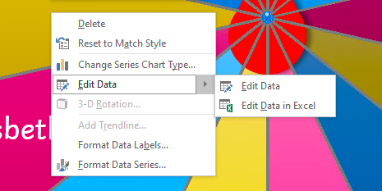
Instructions
This randomiser wheel is completely editable. You can use it in a number of different ways. Put in the names of your students, and then spin the wheel to choose participants of a game or to nominate a student to give an answer. Fill it with different topics, and spin the wheel to choose one to talk about. Or complete the wheel with vocabulary, to challenge your students to use one in a sentence.
To start and stop the randomiser wheel, press the red button.
To change the text on the wheel:
Right click on the wheel.
Select ‘Edit Data' from the menu that appears.
Change the text.
Close the menu.

Slide 3
