Slide 3
In this lesson, we will…
1 Learn some new words
2 Read a conversation
3 Learn about the past simple
4 Talk about what we did last weekend

Slide 4
Discussion
What is your favourite day of the week? Why?
Do you enjoy the weekend? Why or why not?

Slide 5
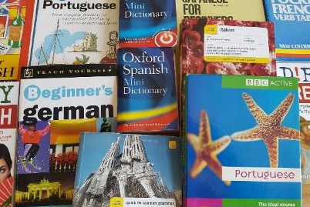
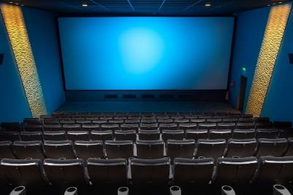
Vocabulary
Read the sentences below and add the missing word. Then match them to the correct photos. (Click to reveal)
I a book.
I read a book.
I and relax.
I stay at home and relax.
I to watch a film.
I go to the cinema to watch a film.
I for a test.
I study for a test.

Slide 6
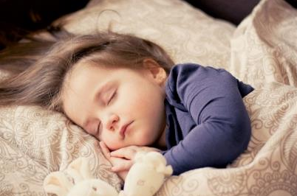
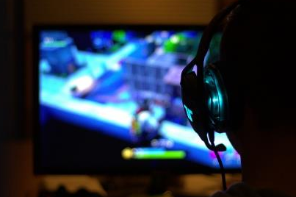
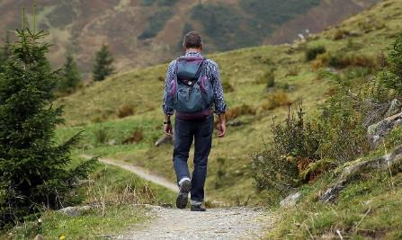
Vocabulary
Read the sentences below and add the missing word. Then match them to the correct photos. (Click to reveal)
I to free my mind.
I go hiking to free my mind.
I because I love dramas.
I watch TV because I love dramas.
I on my Playstation.
I play video games on my Playstation.
I when I am tired.
I sleep when I am tired.

Slide 7
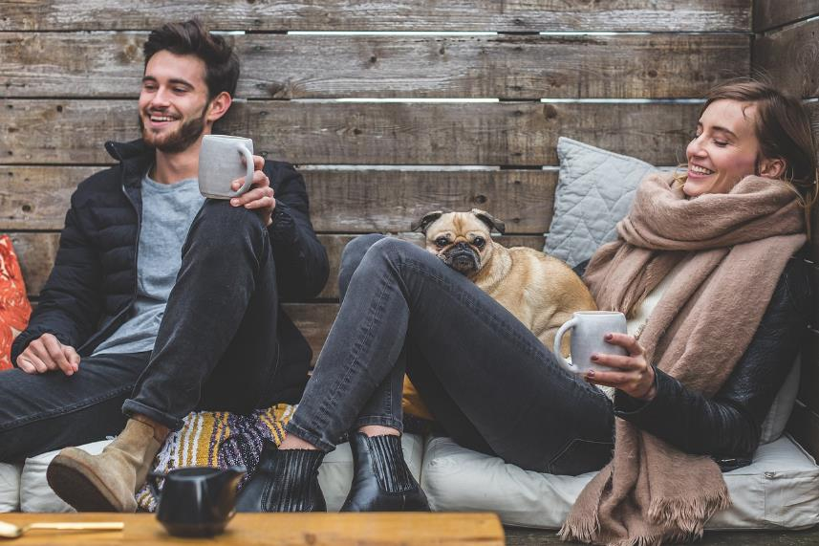
Tom and Sarah are talking about what they did last weekend.
What do you think they did?

Slide 8
Hey Sarah, nice to see you! What did you do last weekend?
Hey Tom! I was so tired, so I stayed at home last weekend! I slept a lot and played video games. How about you?
I had so much energy, so I didn’t stay at home! I went hiking on Saturday and on Sunday I went to the cinema. I also studied.
Wow! I read some books, but I didn’t study much this weekend.

Slide 9
Can you remember who…
Stayed at home?
Sarah
(Click to reveal)
Didn’t stay at home?
Tom
Studied?
Tom
Read some books?
Sarah
Slept a lot?
Sarah
Played video games?
Sarah
Went to the cinema?
Tom

Slide 10
With your partner or teacher, practise the conversation.
Hey _____ , nice to see you! What did you do last weekend?
Hey _____ ! I was so tired, so I (stay at home) last weekend! I (sleep) a lot and (play) video games. How about you?
I had so much energy, so I (don’t stay) at home! I (go) hiking on Saturday and on Sunday I (go) to the cinema. I also (study).
Wow! I (read) some books, but I (don’t study) much this weekend.

Slide 11
When we talk about an action in the past, we use the past simple. The past simple uses the past tense form of a verb.
Grammar Time
I cook
I cooked
I play video games
I played video games

Slide 12
There are different types of verbs in English. Some are regular verbs. Regular verbs just need a -d, -ed, or -ied added to become past tense:
Grammar Time
love
loved
play
played
study
studied
We only add a ‘d’ if the verb ends in an ‘e’. We remove ‘y’ if a word ends in a consonant + y (like ‘dy’) and add ‘ied’.

Slide 13
The other verbs are irregular verbs. Irregular verbs become past tense in different ways.
Grammar Time
read
read
but now it sounds like ‘red’
go
went
sleep
slept
You need to remember each one, as they don’t share the same rules.

Slide 14
Talking about the past in the negative is easier, as the verbs don’t change:
Grammar Time
I watched TV
I didn’t watch TV
He played video games
He didn’t play video games
They slept
They didn’t sleep

Slide 15
Look at these sentences. How do we make them past tense? (Click to reveal)
Grammar Time
I sleep
I slept
He watches TV
He watched TV
They study hard
They studied hard
I go hiking
I went hiking

Slide 16
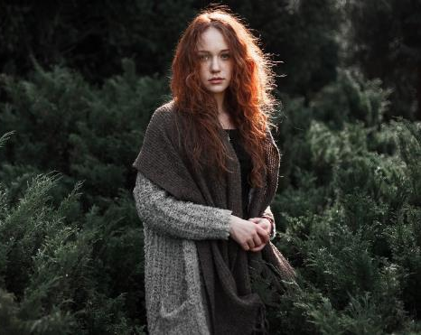
With your partner or teacher, make sentences about the woman.
Look at what the woman did last weekend.
Saturday
Sunday
go to the cinema
stay at home
sleep
watch tv
study
… on Sunday.
She went…
She didn’t…

Slide 17
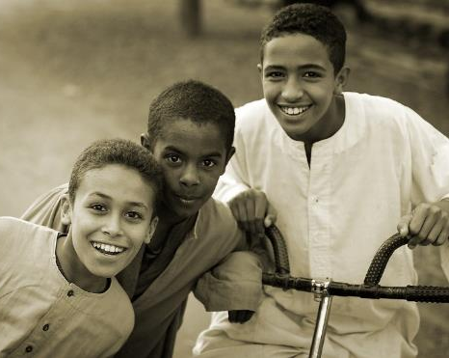
With your partner or teacher, make sentences about the children.
Look at what the children did last weekend.
Saturday
Sunday
go hiking
play video games
read
study
… on Sunday.
They went…
They didn’t…

Slide 18
You are going to talk to your partner about what they did at the weekend.
Talking Time
For a few minutes, write down some things you did.
Think about both Saturday and Sunday.

Slide 19
Tell your partner about your family and friends’ routines.
Talking Time
What did you do…
I played…
I slept…

Slide 20
Look at the sentences below. Can you spot the mistakes? (Click to reveal)
Final Activity
I goed hiking.
I went hiking.
She sleeped.
She slept.
I plaied video games.
I played video games.

