Slide 1
Disclaimer
We hope you find the information on our website and resources useful.
Animations
This resource has been designed with animations to make it as fun and engaging as possible. To view the content in the correct formatting, please view the PowerPoint in ‘slide show mode’. This takes you from desktop to presentation mode. If you view the slides out of ‘slide show mode’, you may find that some of the text and images overlap each other and/or are difficult to read.
To enter slide show mode, go to the slide show menu tab and select either from beginning or from current slide.
You may wish to delete this slide before beginning the presentation.

Slide 2
Disclaimer
We hope you find the information on our website and resources useful.
ESL acronym
This resource has been made for the purpose of teaching English language learners. We know that students can be learning English in many different places, in many different ways and at age, so we try to keep these resources as general as possible.
There are many acronyms associated with English language teaching. These include (but are not limited to) ELT, TEFL, EFL, ELL, EAL and ESOL. While the term ESL may not fully represent the linguistic backgrounds of all students, it is the most widely recognised term for English language teaching globally. Therefore, we use the term ‘ESL’ in the names of our resources to make them easy to find but they are suitable for any student learning to speak English.
You may wish to delete this slide before beginning the presentation.

Slide 3
Teacher Instructions
Each slide has a topic for a six word story. Show the slides to your students and give them some time to write their six word stories. When everyone has finished, students can share their ideas with the class.
You may wish to delete this slide before beginning the presentation.

Slide 5
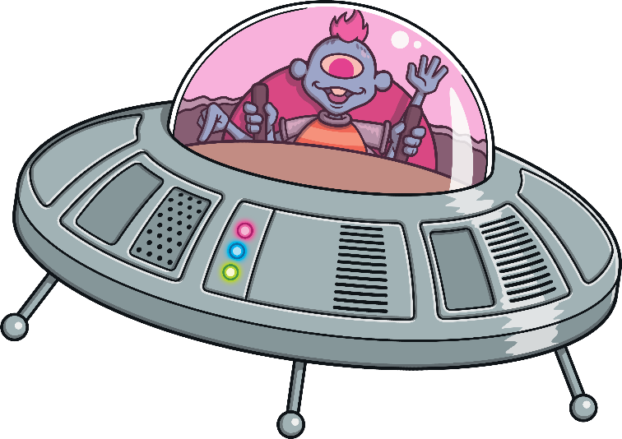
Write a story about…
An alien invasion!

Slide 6
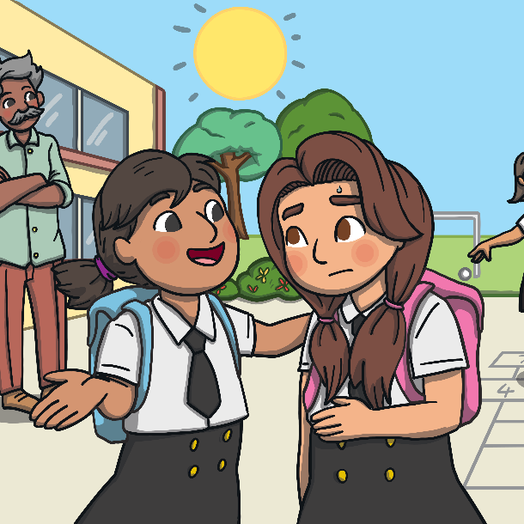
Write a story about…
Your school!

Slide 7
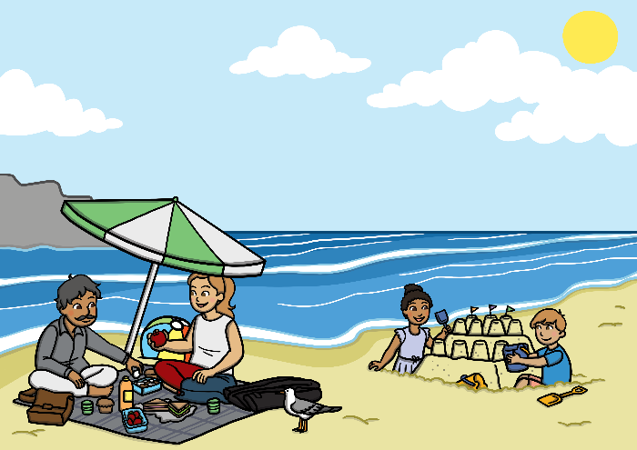
Write a story about…
The best holiday you’ve ever had!

Slide 8
Write a story about…
Dinosaurs!

Slide 9
Write a story about…
Your English teacher!

Slide 10
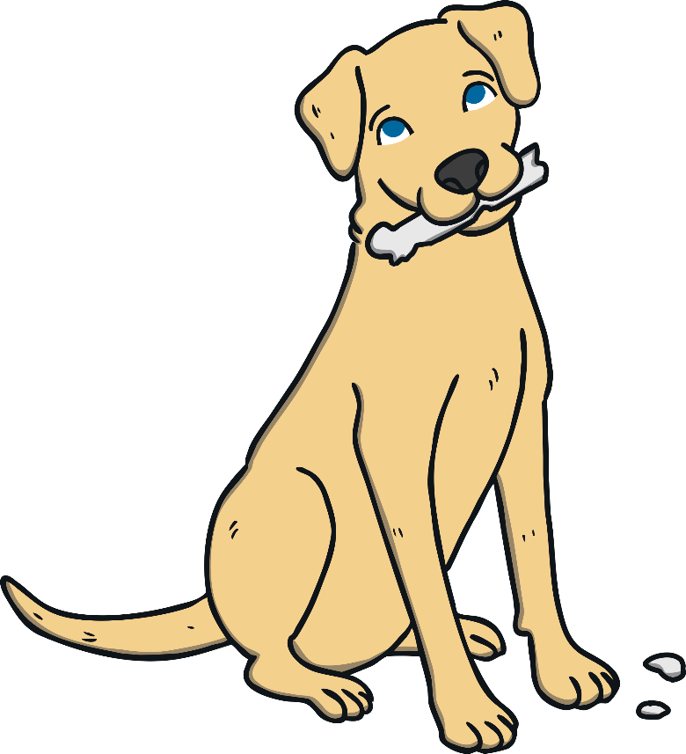
Write a story about…
Dogs!

Slide 11
Write a story about…
Cats!

Slide 12
Write a story about…
Your best friend!

Slide 13
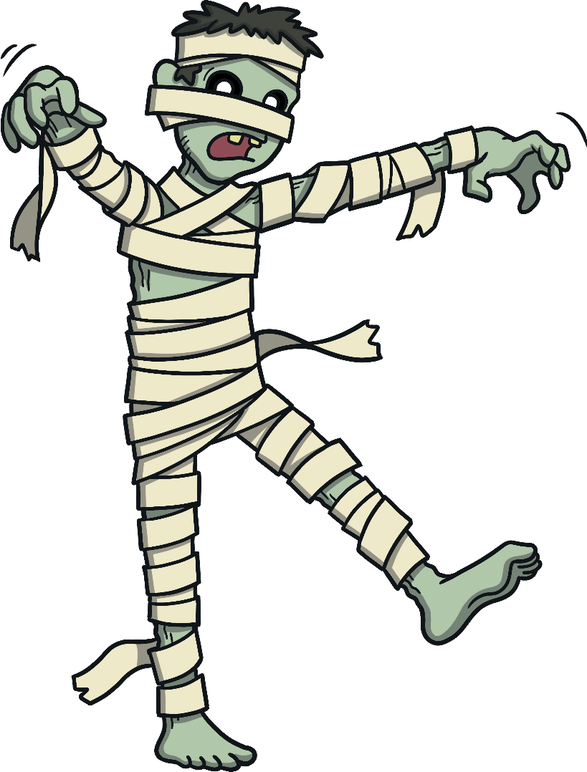
Write a story about…
Halloween!

Slide 14
Write a story about…
Christmas!

Slide 15
Write a story about…
Winter!

Slide 16
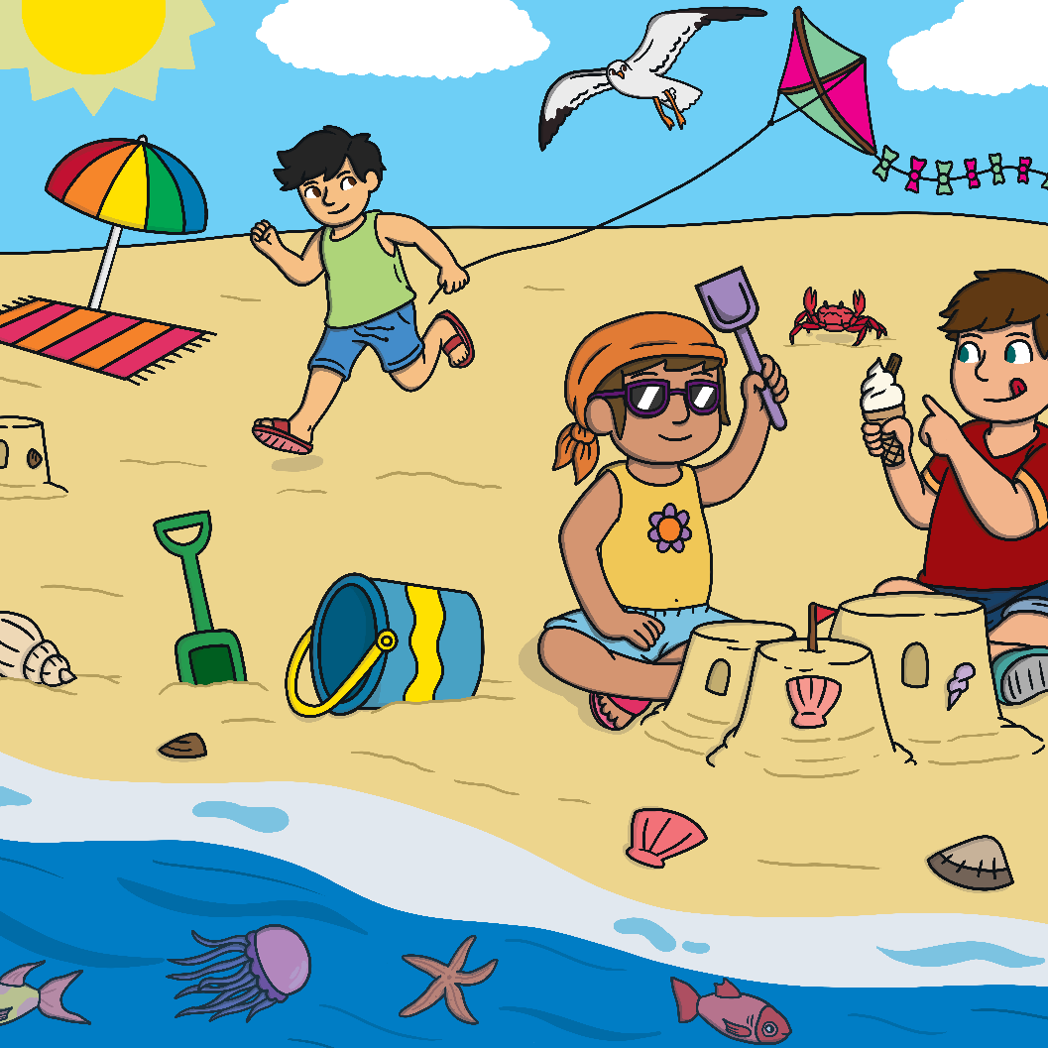
Write a story about…
Summer!

Slide 17
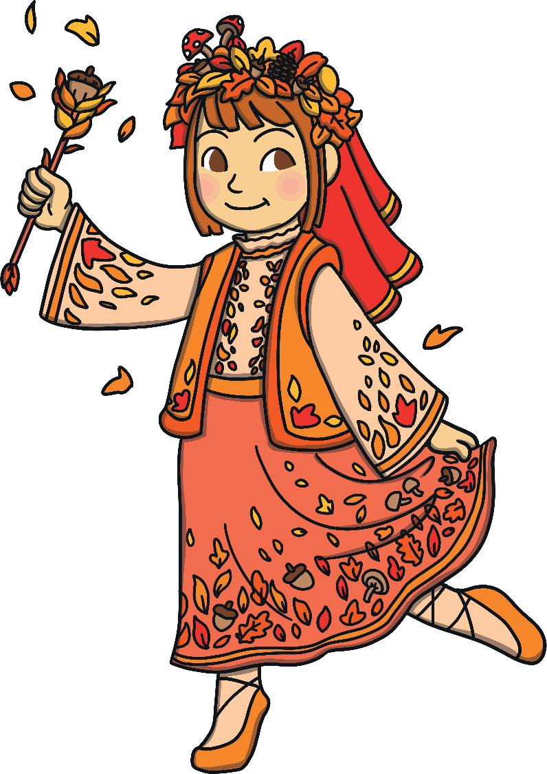
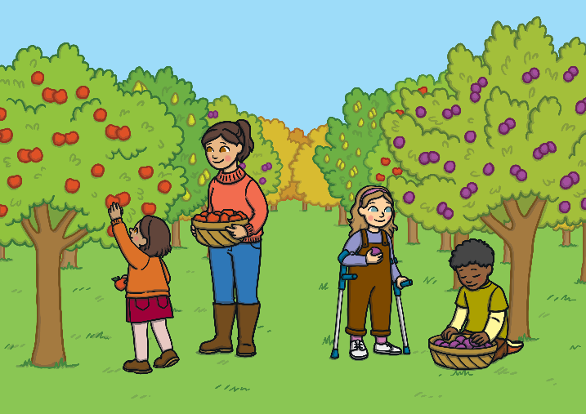
Write a story about…
Autumn!

Slide 18
Write a story about…
Spring!

Slide 19
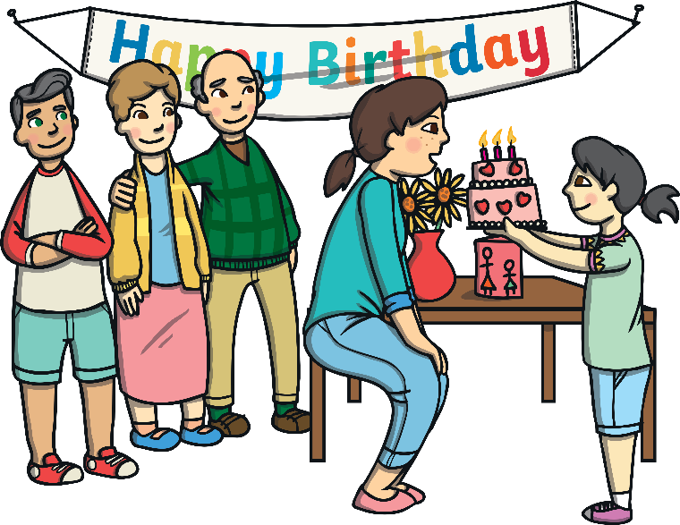
Write a story about…
Your birthday!

Slide 20
Write a story about…
Your favourite pop star!

Slide 21
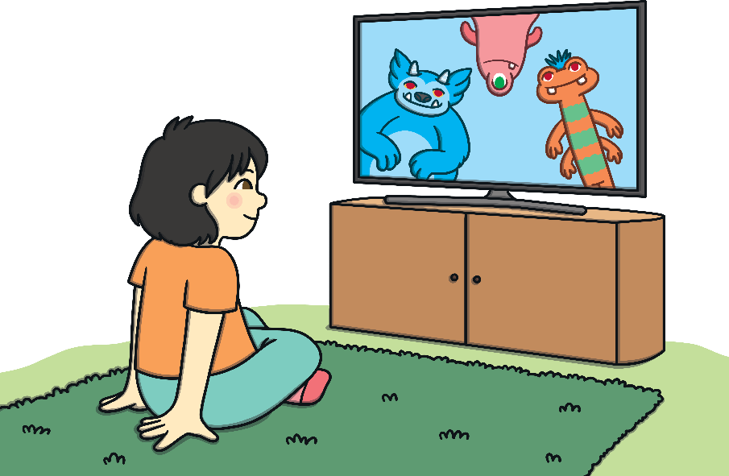
Write a story about…
Your favourite cartoon character!

Slide 22
Write a story about…
Your favourite toy!

Slide 23
Write a story about…
Your favourite sport!

Slide 24
Write a story about…
A party!

Slide 25
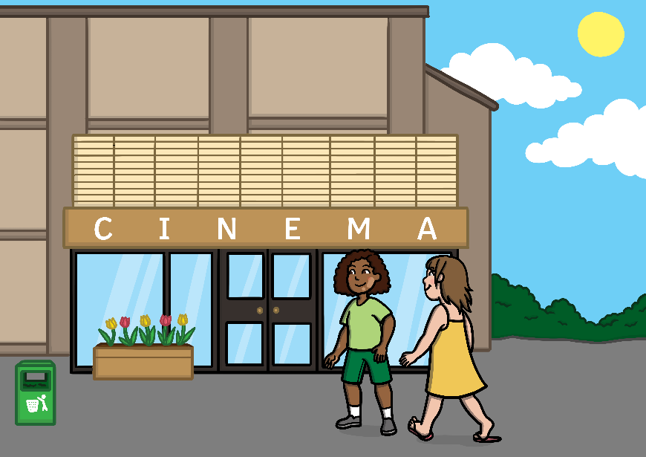
Write a story about…
The cinema!

Slide 26
Write a story about…
Your favourite food!

Slide 27
Write a story about…
Your family!

Slide 28
Write a story about…
The weekend!

Slide 29
Write a story about…
The beach!

