Slide 3
Warm Up Questions
How old are you?
What’s your favourite school subject?
What food do you like to eat at home?
How do you travel to school?
What’s the weather like today?

Slide 4
Simple Future
We use the simple future to predict what will happen in the future.
We can also use the simple future to talk about promises, refusals, requests and offers.
(subject + will/will not + infinitive)
I will go to university when I’m 18 years old./ When I’m 18 years old, I will go to university.
The weather will not be sunny tomorrow. / Tomorrow, the weather will not be sunny.
My brother will help me with my homework.
I will not go to the cinema with you.
We can form questions like this:
Contractions of ‘will’ and ‘will not’ are ‘ll’ and ‘won’t’
(Question word) + will/will not + subject + infinitive)
I will drink milk this evening. / I’ll drink milk this evening.
We’ll study maths next month. / We won’t study maths next month.
What will the weather be like on Sunday?
Will you go on holiday next year?
When will David clean the house?

Slide 5
Example Conversation
Practice reading the conversation
How old will you be in 2030?
I’ll be 15. What about you?
I’ll be 17.
Cool! And where will you live?
I’ll live in Los Angeles. What about you?
I’ll live in Tokyo.
Wow, amazing!

Slide 6
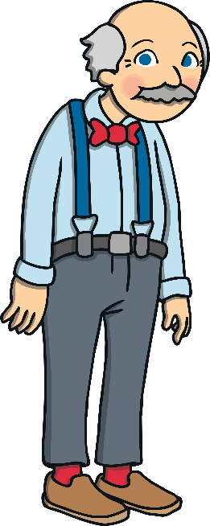
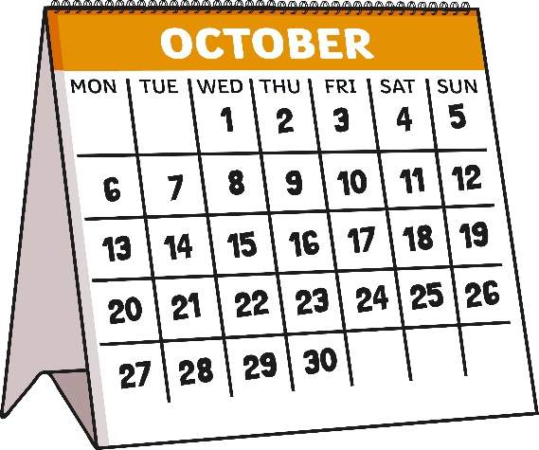
What will happen in the future?
Can you make a sentence with ‘will’ and these images?
Grandpa Trevor will drink a chocolate milkshake on Saturday. / On Saturday, Grandpa Trevor will drink a chocolate milkshake.
Grandpa Trevor
chocolate milkshake
on Saturday
Click to reveal the sentence.

Slide 7
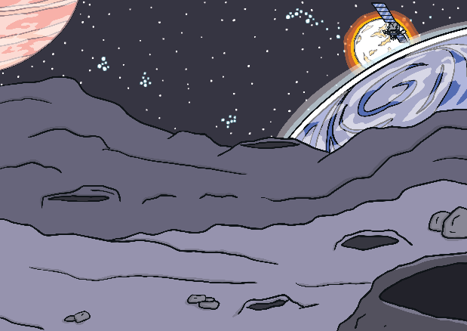
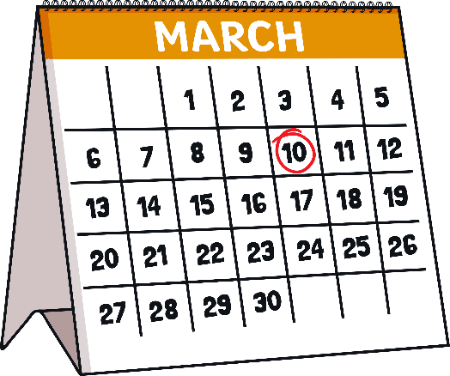
What will happen in the future?
Can you make a sentence with ‘will’ and these images?
Harry the astronaut will go to space on March 10th. / On March 10th, Harry the astronaut will go to space.
Harry the astronaut
Space
March 10th
Click to reveal the sentence.

Slide 8
Your Turn
Spin the wheels and make a funny sentence!

Slide 9
Predict the future!
Answer the questions with your own ideas.
How old will you be in 2050?
Will you go to university?
What subjects will you study next year?
How will people travel in 100 years’ time?
When will aliens visit Earth?

Slide 10
What do you think?
Aliens will visit Earth in 2065.
Humans will travel by space-planes in the future.
Students won’t go to school in the future, they will learn at home.

