Slide 2
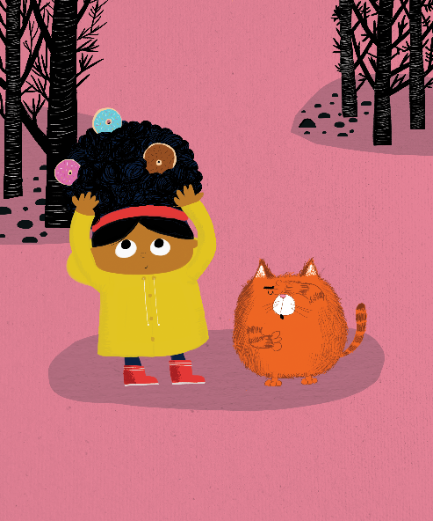
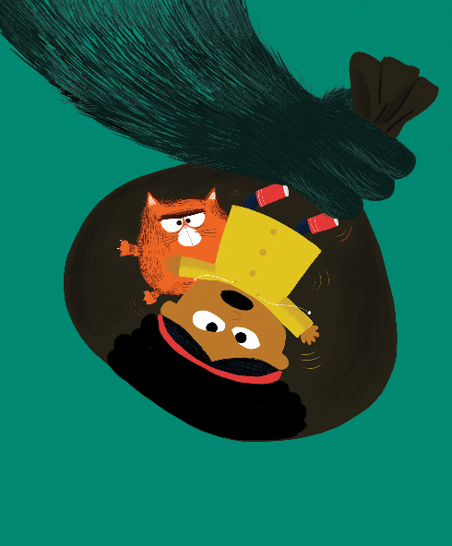
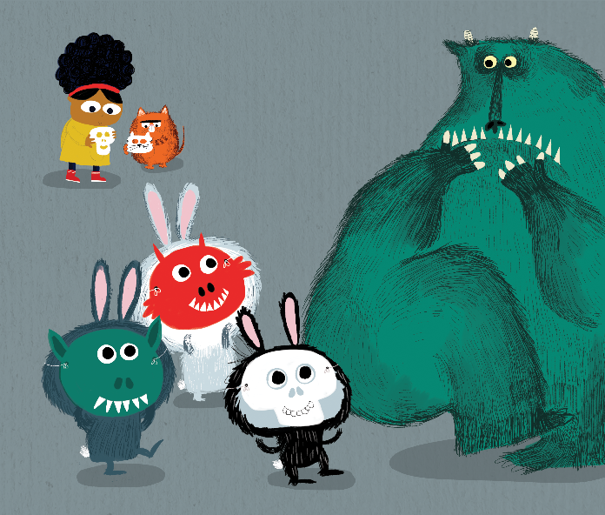
Which picture shall we read today?

Slide 3
Vocabulary
Prediction
Inference

Slide 4
Inference
Why do you think Fatcat is covering his eyes?
Back to Picture
Answers
Back to Menu

Slide 5
Vocabulary
What two words could you use to describe how Billy’s hair might feel with doughnuts in it?
Back to Picture
Answers
Back to Menu

Slide 6
Prediction
What else could be in Billy’s hair?
Back to Picture
Answers
Back to Menu

Slide 7
Answers
Answers
I think Fatcat is covering his eyes because he can’t believe that Billy has doughnuts in her hair so he doesn’t want to look.
Inference
‘Sticky’ and ‘gooey’ are two words that could be used to describe how Billy’s hair might feel with doughnuts in it.
Vocabulary
I think that Billy could have drink cartons and sweets in her hair.
Prediction
Back to Picture
Back to Menu
To End Slide

Slide 8
Vocabulary
Inference
Retrieval

Slide 9
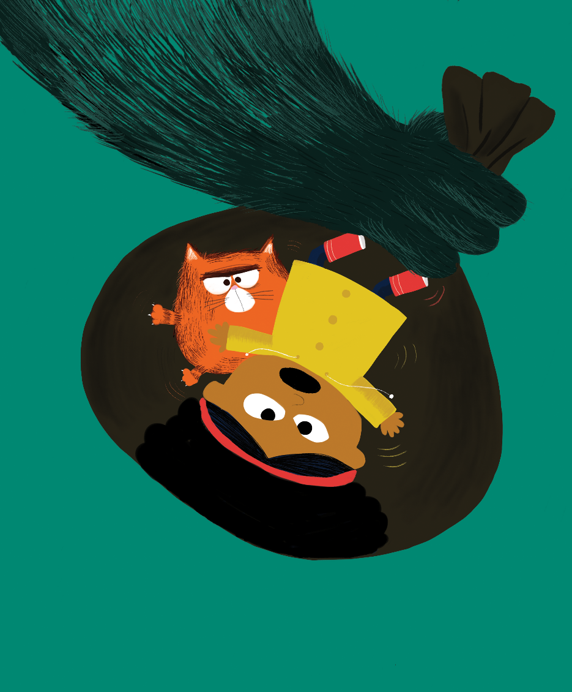
Retrieval
What can you see in this picture?
Back to Picture
Answers
Back to Menu

Slide 10
Vocabulary
What two words could you use to describe the hand that is holding the bag in this picture?
Back to Picture
Answers
Back to Menu

Slide 11
Inference
How do you think that Billy and Fatcat are feeling in this picture?
Back to Picture
Answers
Back to Menu

Slide 12
Answers
Answers
I can see Billy and Fatcat in a bag. I can see a blue hand holding the bag.
Retrieval
‘Blue’ and ‘hairy’ are two words that could be used to describe the hand that is holding the bag in this picture.
Vocabulary
I think that Fatcat might feel scared in the bag because it looks dark. I think that Billy feels annoyed because she looks like she is cross and shouting to be let out!
Inference
Back to Picture
Back to Menu
To End Slide

Slide 13
Inference
Vocabulary
Retrieval

Slide 14
Retrieval
What can you see in this picture?
Back to Picture
Answers
Back to Menu

Slide 15
Inference
How do you think the Beast might be feeling in this picture?
Back to Picture
Answers
Back to Menu

Slide 16
Vocabulary
What two words could you use to describe the rabbits in this picture?
Back to Picture
Answers
Back to Menu

Slide 17
Answers
Answers
I can see Billy, Fatcat, the Beast and three rabbits.
Retrieval
I think that the Beast might be feeling afraid or worried in this picture because he is frightened of the rabbits wearing scary masks.
Vocabulary
‘Funny’ and ‘scary’ are two words that could be used to describe the rabbits in this picture.
Inference
Back to Picture
Back to Menu
To End Slide

