Slide 2
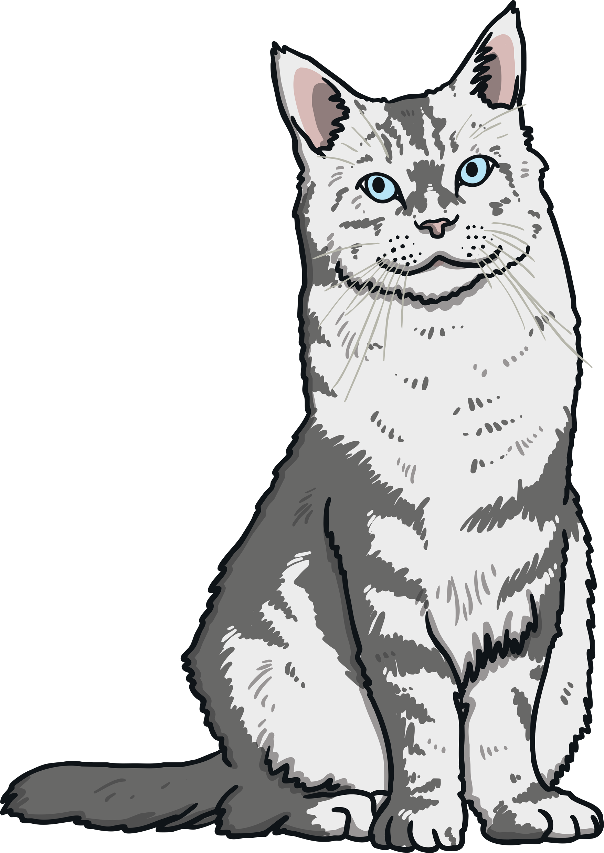
There is / There are
Look at the picture below.
Which sentence is correct?
There is a cat.
There are a cat.
There is a cat.
Click the picture to find out!
‘There is a cat’ is correct. Do you know why?

Slide 3


Why do we use ‘There is’ or ‘There are’?
‘There is a cat’ is the correct answer because there is only one cat.
There is…
This is used for a singular noun. This means there is only one cat.
There are…
This is used for plural nouns. There are two or more cats.

Slide 4
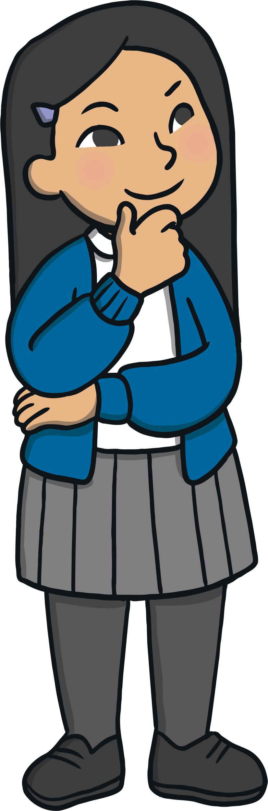
There is / There are
Look at the pictures on the following slides.
Say a sentence about what you can see, using one of these sentence
starters:
There is…
There are…
Maybe you can write the sentence down too?
Go to the next slide after each picture to see if you are right.

Slide 5
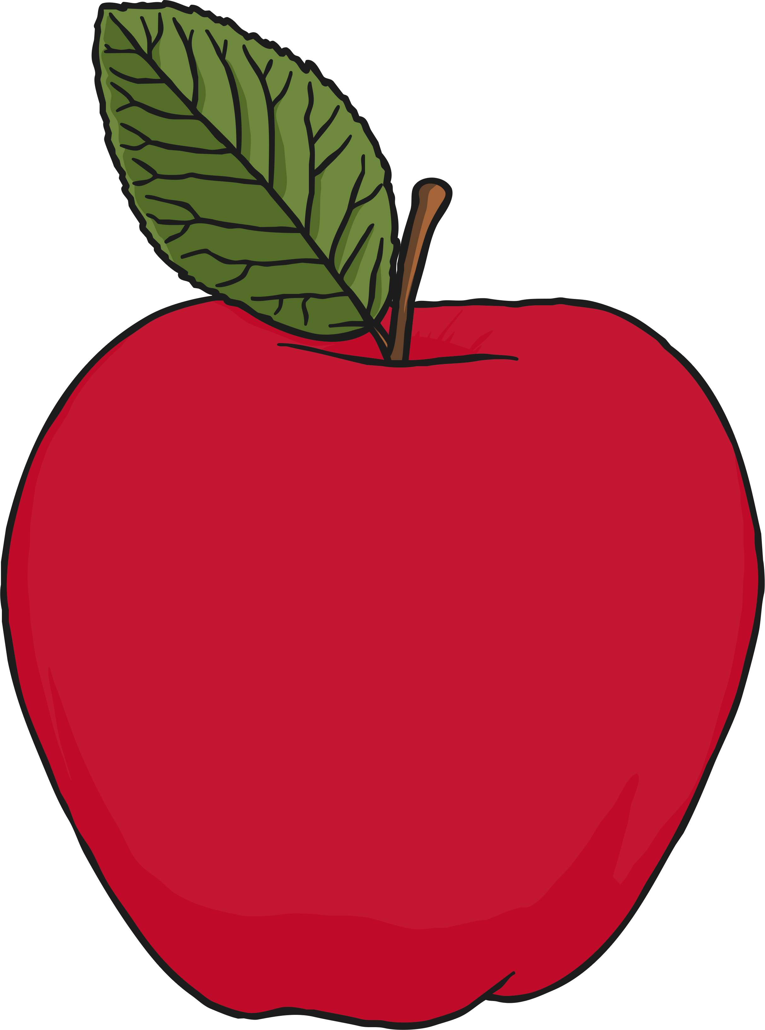
There is / There are

Slide 6
There is / There are
There are apples.
You could also say: There are some apples.

Slide 7
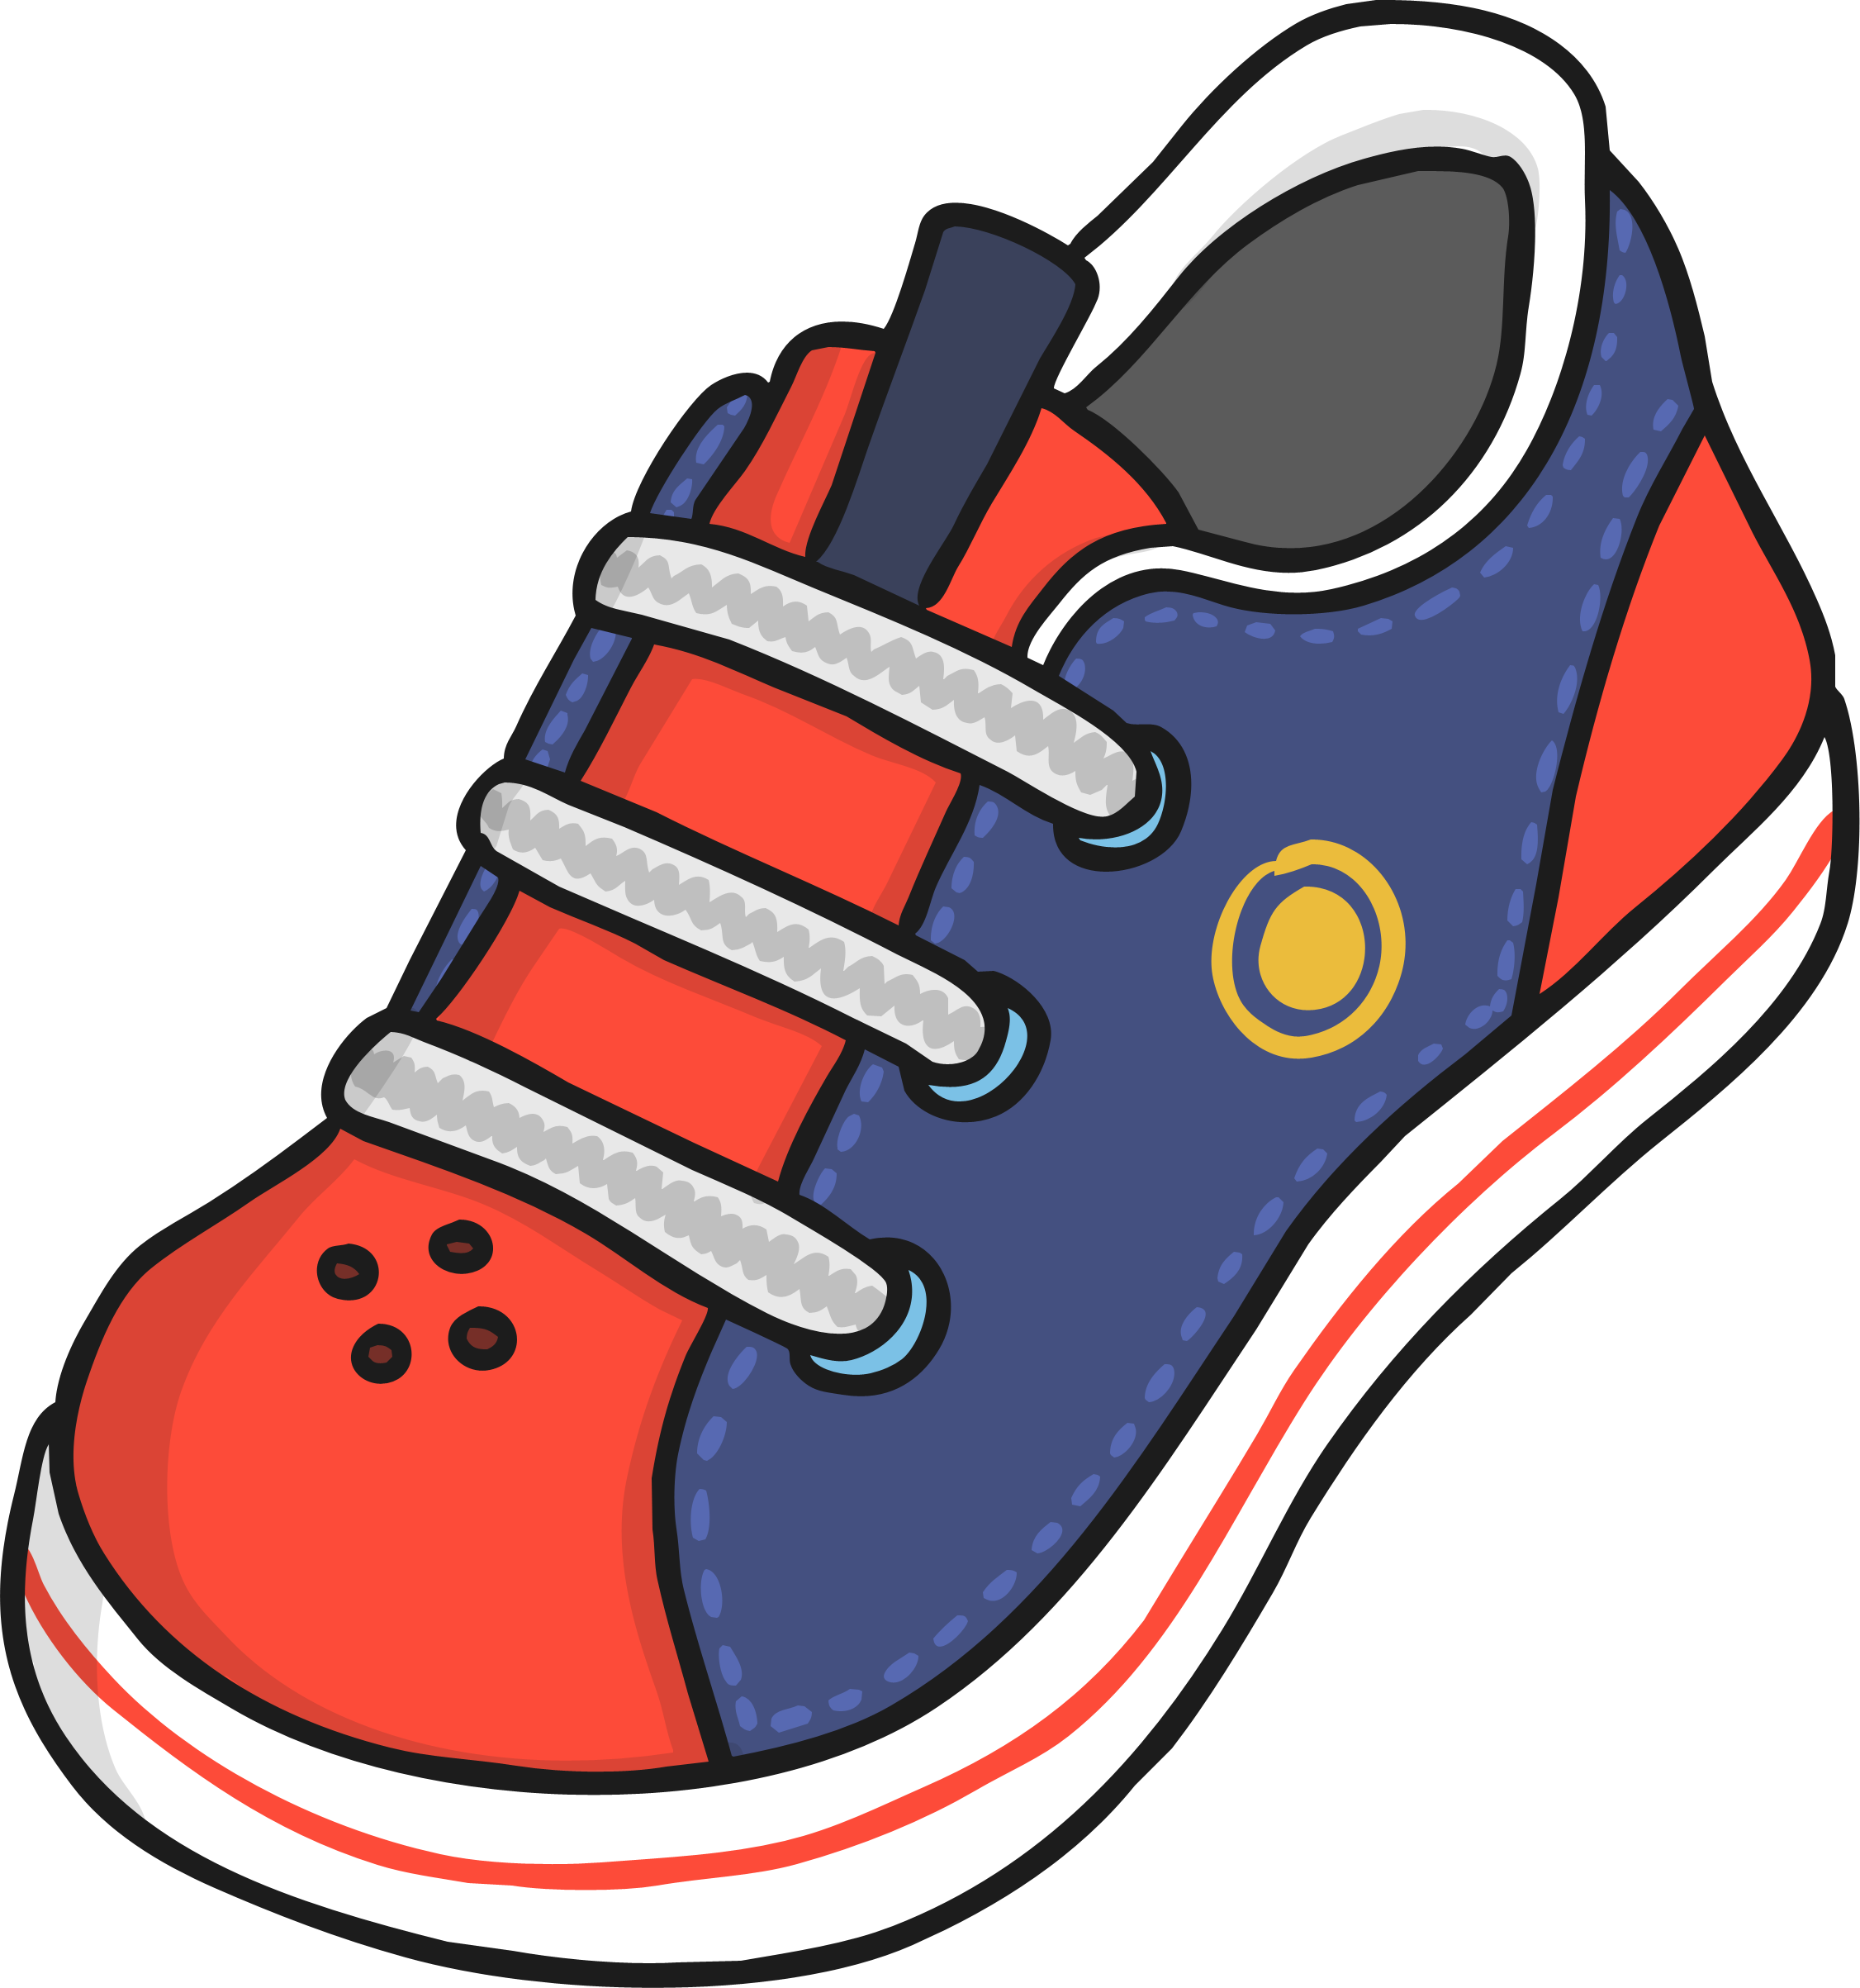
There is / There are

Slide 8
There is / There are
There is a shoe.

Slide 9

There is / There are

Slide 10
There is / There are
There is a police car.

Slide 11

There is / There are

Slide 12

There is / There are
There are flowers.
You could also say: There are some flowers.

Slide 13

There is / There are

Slide 14
There is / There are
There is a cup.

Slide 15
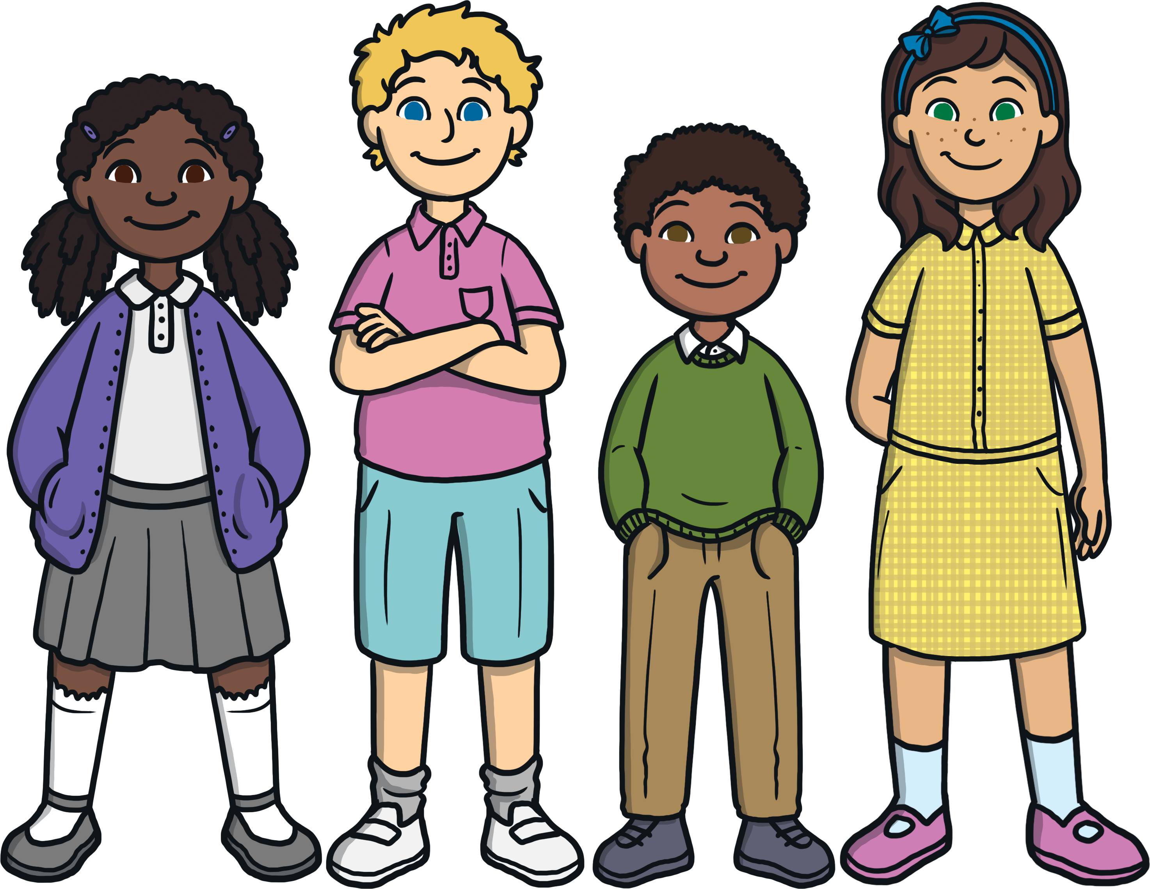
There is / There are

Slide 16
There is / There are
There are children.
You could also say: There are some children.

Slide 17
There is / There are

Slide 18
There is / There are
There are birds.
You could also say: There are some birds.

Slide 19
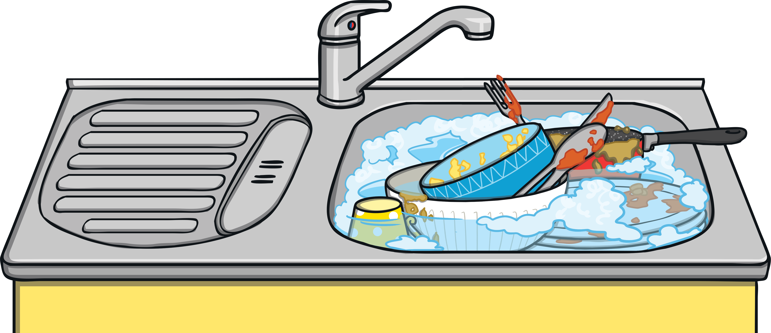
Extra Challenge
Maisie says, “There is dishes in the sink.”
Is she right or wrong?
Click to find out!
Maisie is wrong. There are dishes in the sink.

