Slide 2
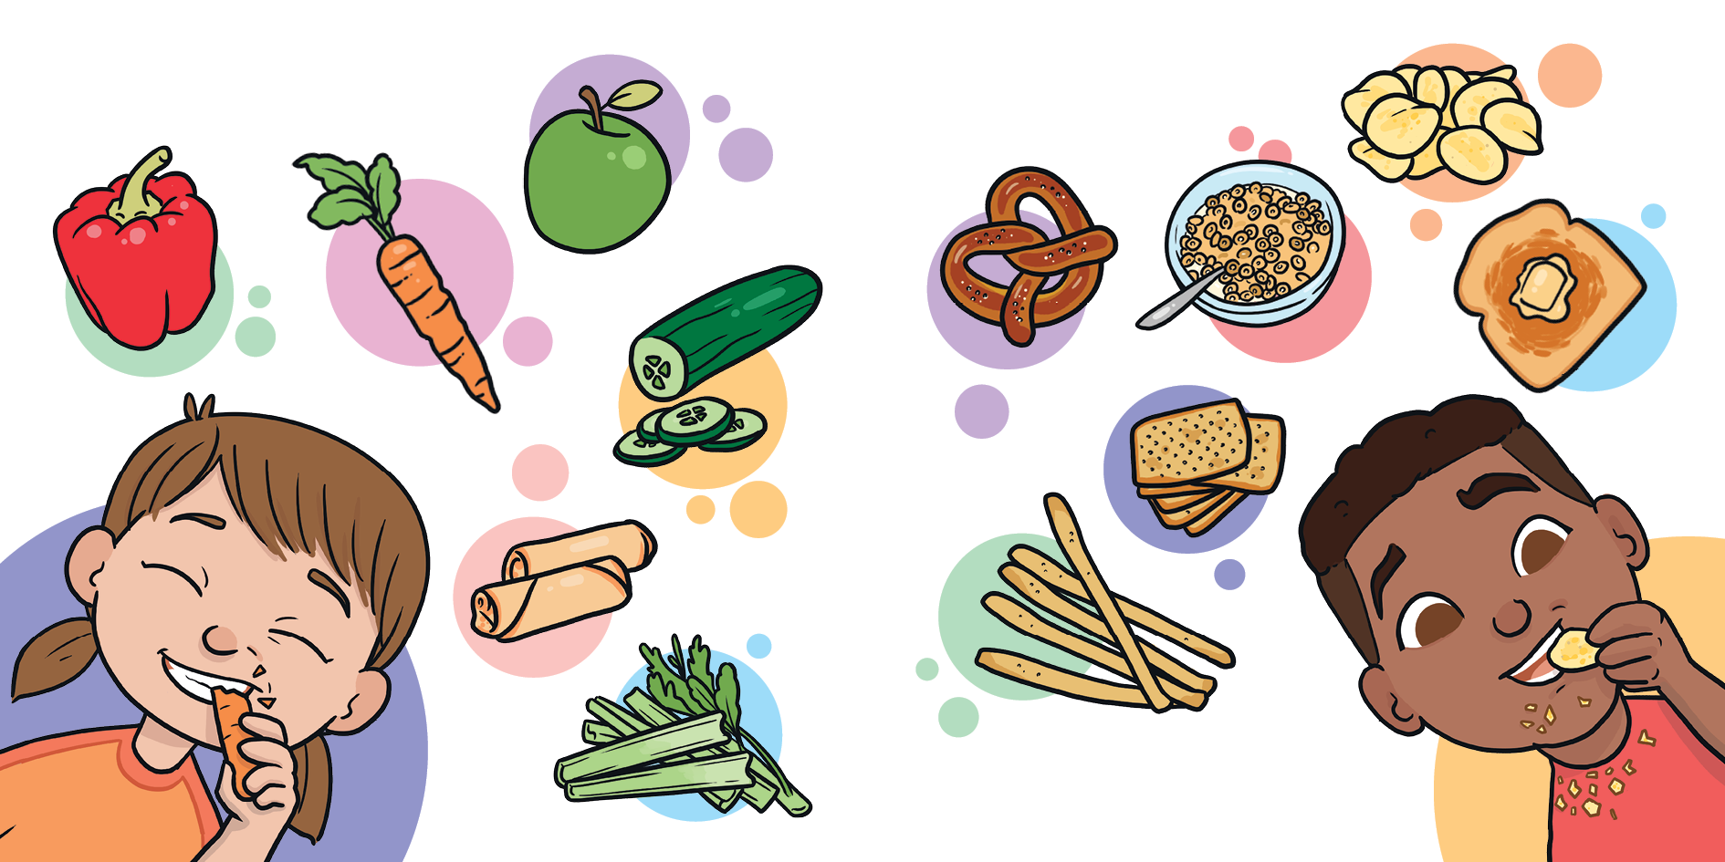
crunchy food
crispy food
munch, munch, munch

Slide 3
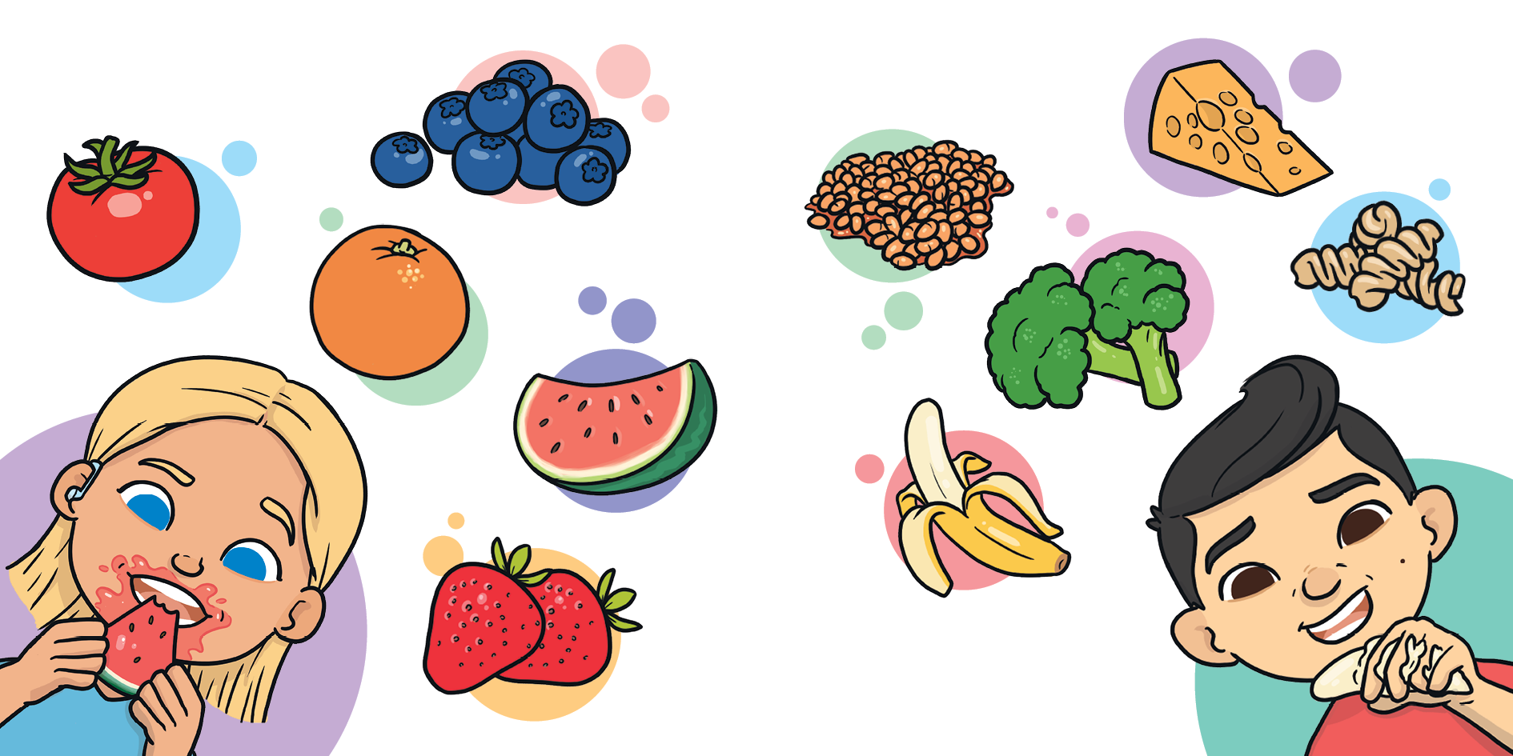
juicy food
squishy food
What’s for lunch?

Slide 4
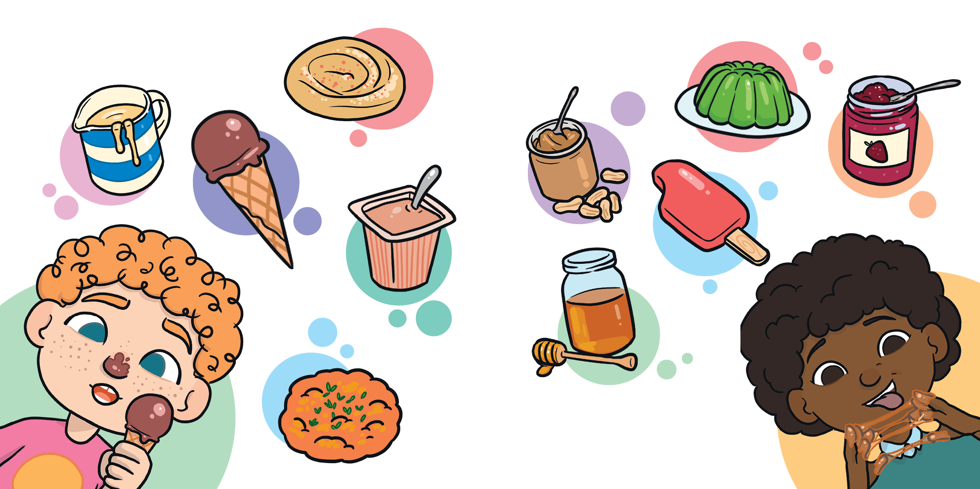
creamy food
sticky food
gnaw, gnaw, gnaw

Slide 5
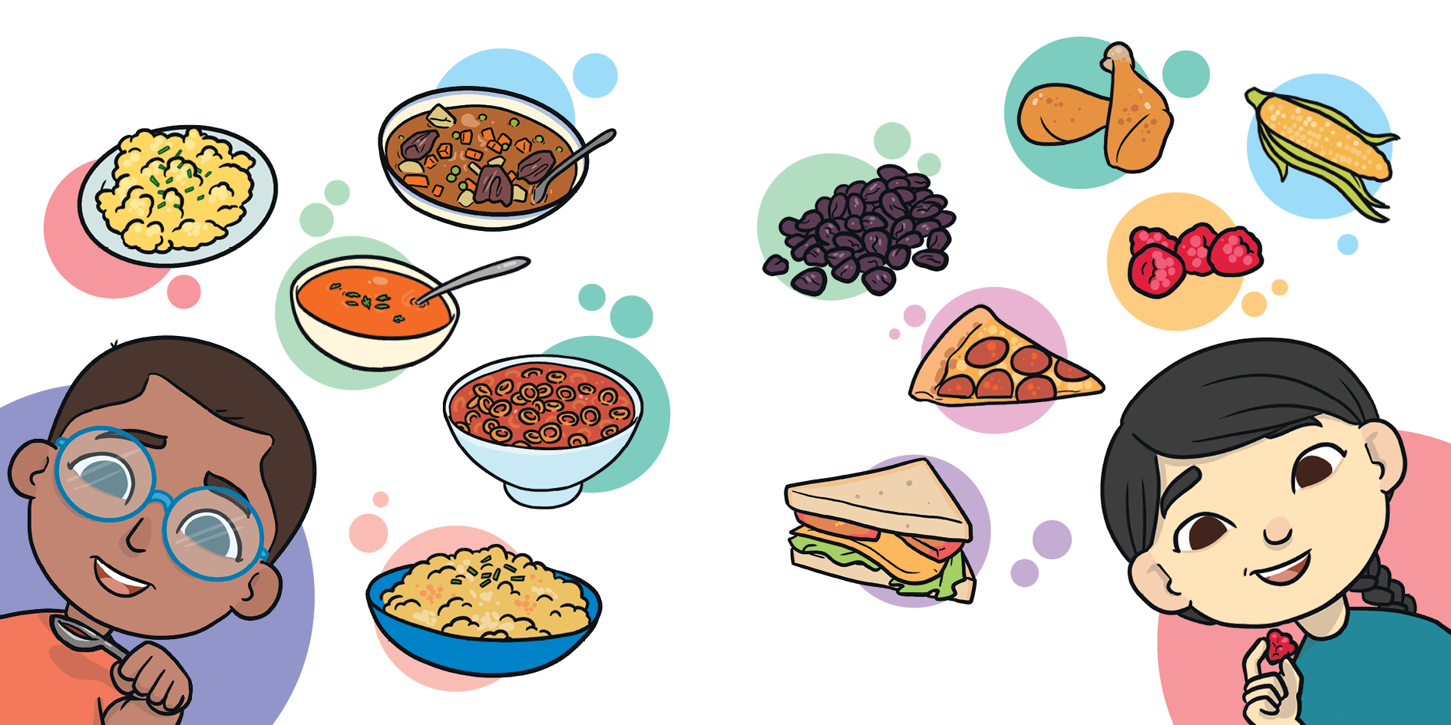
spoon food
finger food
May I have more?

Slide 6
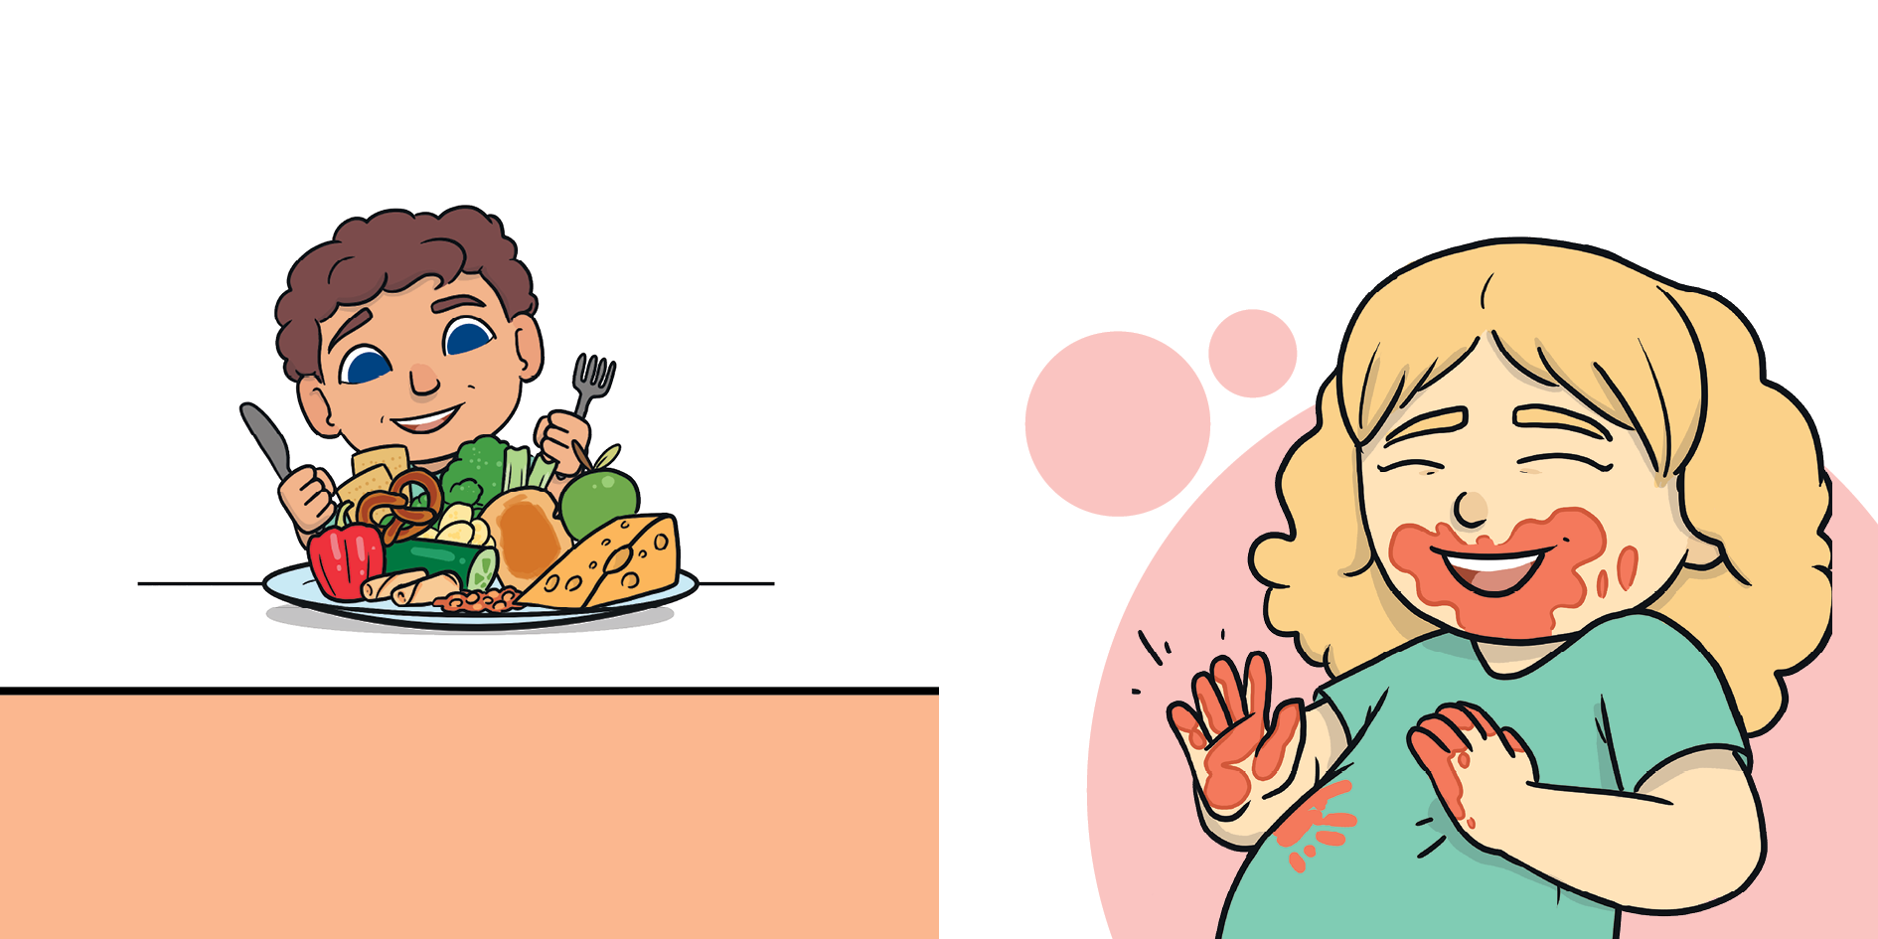
Now, it’s time for me to eat.
What’s your favourite kind of food to put inside your tummy?
yummy, yummy, yummy

