Slide 1
Disclaimer/s
We hope you find the information on our website and resources useful.
Animations
This resource has been designed with animations to make it as fun and engaging as possible. To view the content in the correct formatting, please view the PowerPoint in ‘slide show mode’. This takes you from desktop to presentation mode. If you view the slides out of ‘slide show mode’, you may find that some of the text and images overlap each other and/or are difficult to read.
To enter slide show mode, go to the slide show menu tab and select either from beginning or from current slide.
You may wish to delete this slide before beginning the presentation.

Slide 3
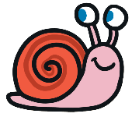
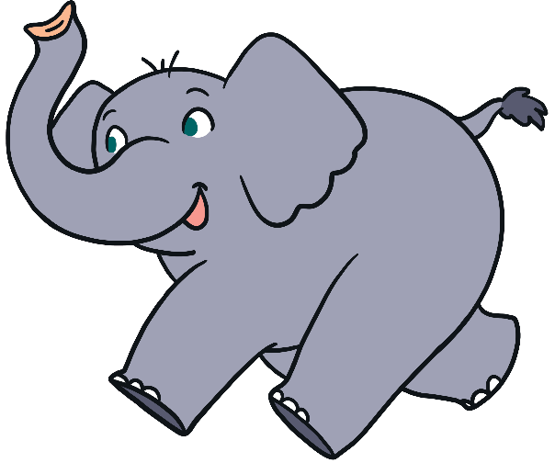
Instructions
Choose the word that is the opposite of what the picture is showing you.
See if you can get them all correct!

Slide 4
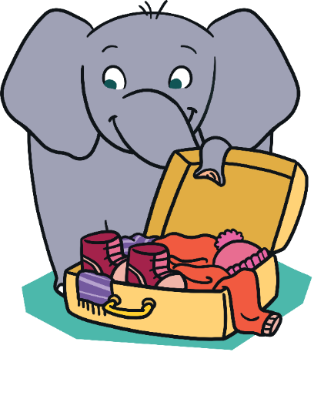
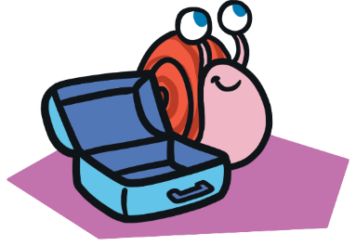
What Is the Opposite?
empty
low
full
smile

Slide 5
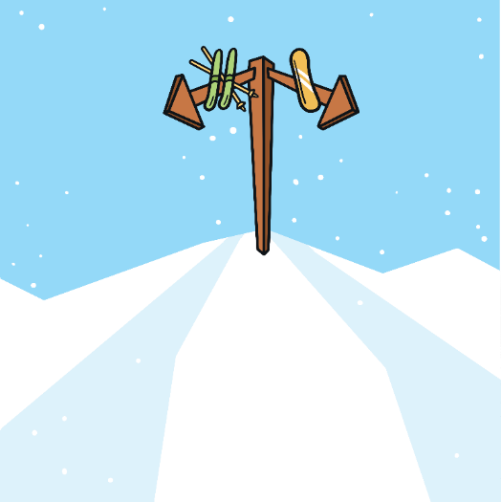
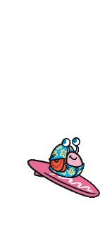
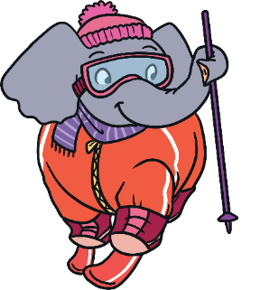
What Is the Opposite?
push
down
right
left

Slide 6
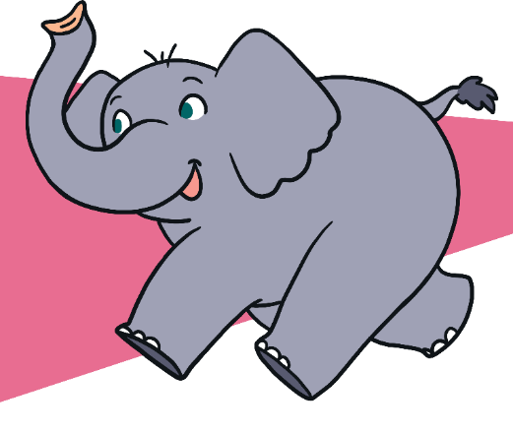
What Is the Opposite?
dry
small
big
pull

Slide 7
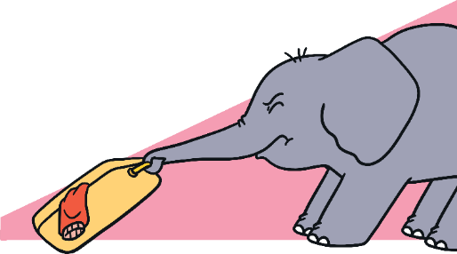
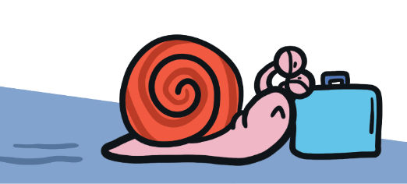
What Is the Opposite?
pull
frown
push
right

Slide 8
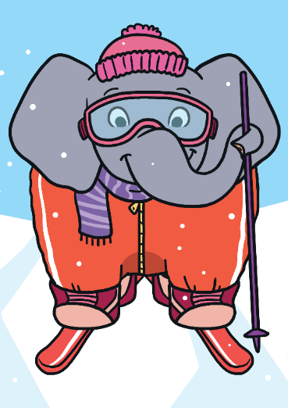
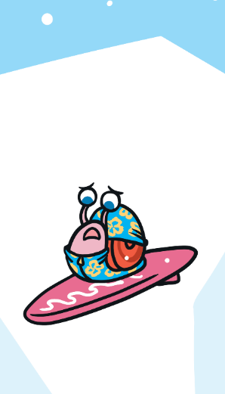
What Is the Opposite?
high
wet
smile
frown

Slide 9
What Is the Opposite?
full
big
small
night

Slide 10
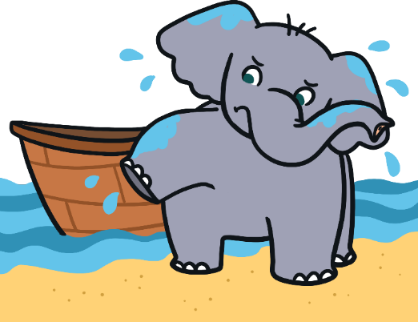
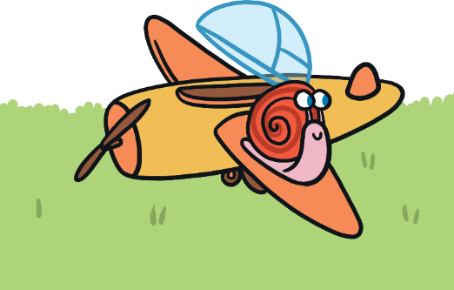
What Is the Opposite?
dry
tall
wet
day

Slide 11
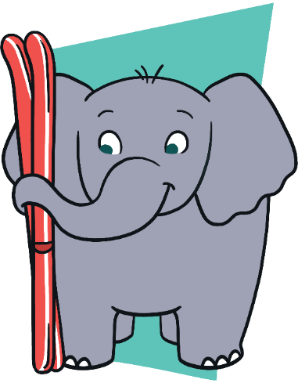
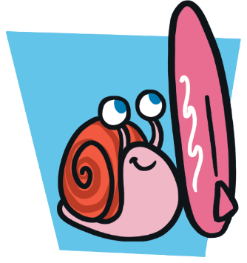
What Is the Opposite?
up
push
short
tall

Slide 12
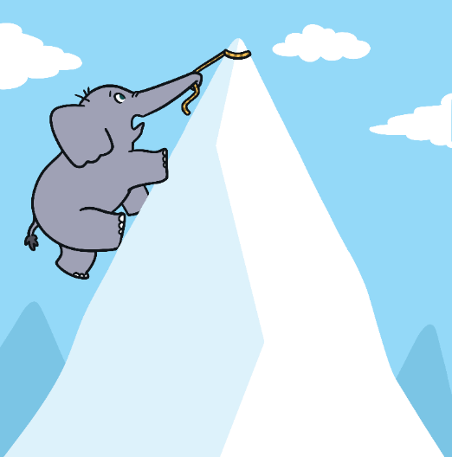
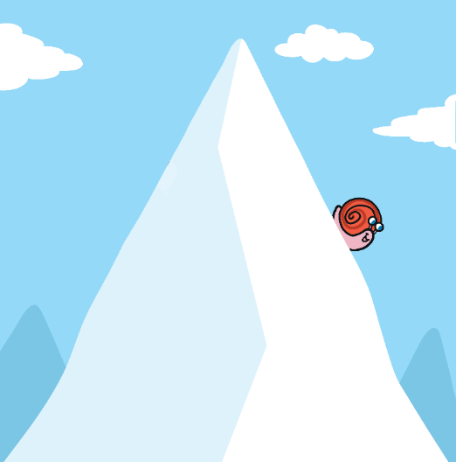
What Is the Opposite?
down
short
up
smile

Slide 13
What Is the Opposite?
day
low
empty
full

Slide 14
What Is the Opposite?
right
small
left
wet

Slide 15
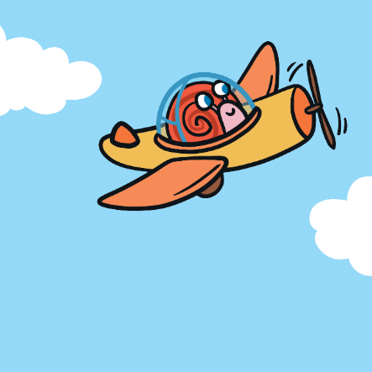
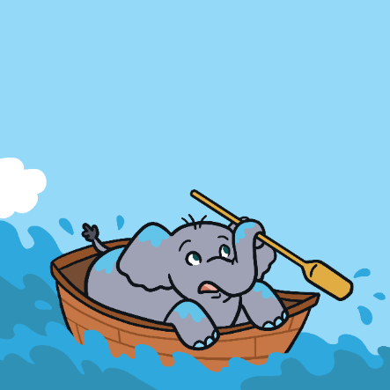
What Is the Opposite?
night
low
high
empty

Slide 16
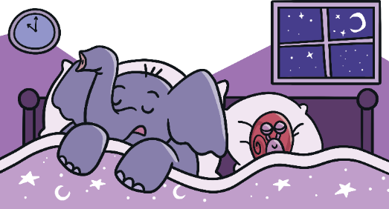
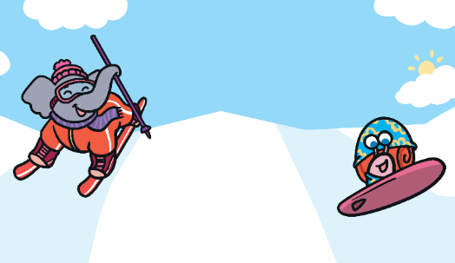
What Is the Opposite?
up
big
night
day

Slide 17
What Is the Opposite?
left
short
tall
night

Slide 18
What Is the Opposite?
wet
high
dry
small

Slide 19
What Is the Opposite?
up
push
pull
frown

Slide 20
What Is the Opposite?
smile
tall
frown
full

Slide 21
What Is the Opposite?
big
right
down
up

Slide 22
What Is the Opposite?
night
down
day
short

Slide 23
What Is the Opposite?
high
pull
low
empty

