Slide 2
fern
Start Timer
Start Timer
Use Timer
Show Answer
Next

Slide 3
zerd
Start Timer
Show Answer
Start Timer
Use Timer
Next

Slide 4
river
Start Timer
Start Timer
Use Timer
Show Answer
Next

Slide 5
ersh
Start Timer
Show Answer
Start Timer
Use Timer
Next

Slide 6
kerb
Start Timer
Start Timer
Use Timer
Show Answer
Next

Slide 7
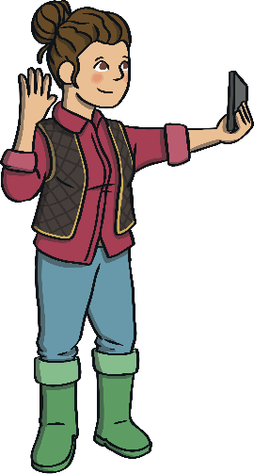
farmer
Start Timer
Start Timer
Use Timer
Show Answer
Next

Slide 8
werb
Start Timer
Show Answer
Start Timer
Use Timer
Next

Slide 9
pether
Start Timer
Show Answer
Start Timer
Use Timer
Next

Slide 10
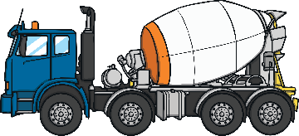
mixer
Start Timer
Start Timer
Use Timer
Show Answer
Next

Slide 11
nerm
Start Timer
Show Answer
Start Timer
Use Timer
Next

