Slide 1
Disclaimers
We hope you find the information on our website and resources useful.
Animations
This resource has been designed with animations to make it as fun and engaging as possible. To view the content in the correct formatting, please view the PowerPoint in ‘slide show mode’. This takes you from desktop to presentation mode. If you view the slides out of ‘slide show mode’, you may find that some of the text and images overlap each other and/or are difficult to read.
To enter slide show mode, go to the slide show menu tab and select either from beginning or from current slide.
Social Media
This resource/information is not intended to encourage social media use and we cannot accept any responsibility for pupils that sign up to social media sites after using this resource/information.
You may wish to delete this slide before beginning the presentation.

Slide 3
What Is Cyberbullying?
Someone deliberately posts a nasty or embarrassing photo of you on social media without your permission.
Unkind comments on social media.
Cyberbullying is any form of bullying which takes place online and causes harm or distress to a person or group of people.
Can you think of any examples of cyberbullying?
Prank phone calls.
Being rude or unkind to someone in an online game.
Receiving unkind or inappropriate emails or text messages.
Have any of these examples happened to you or a friend?

Slide 4
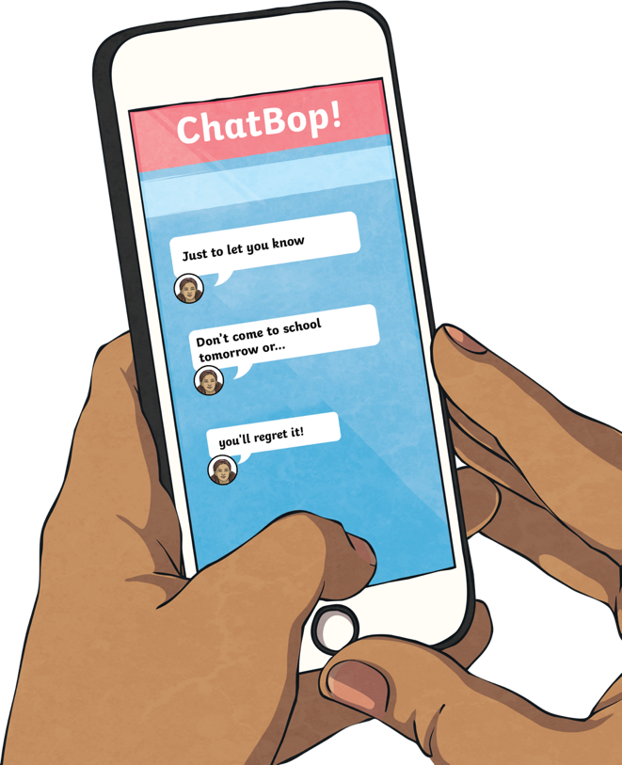
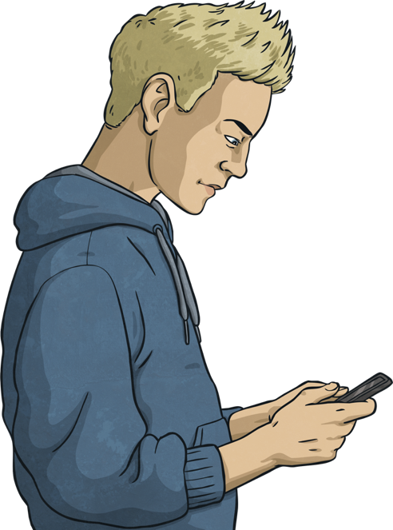
Types of Cyberbullying:
Text Messages
Sending abusive, nasty or threatening text messages to someone is a type of cyberbullying.
This could include sharing these texts with other people who might join in with the bullying.

Slide 5
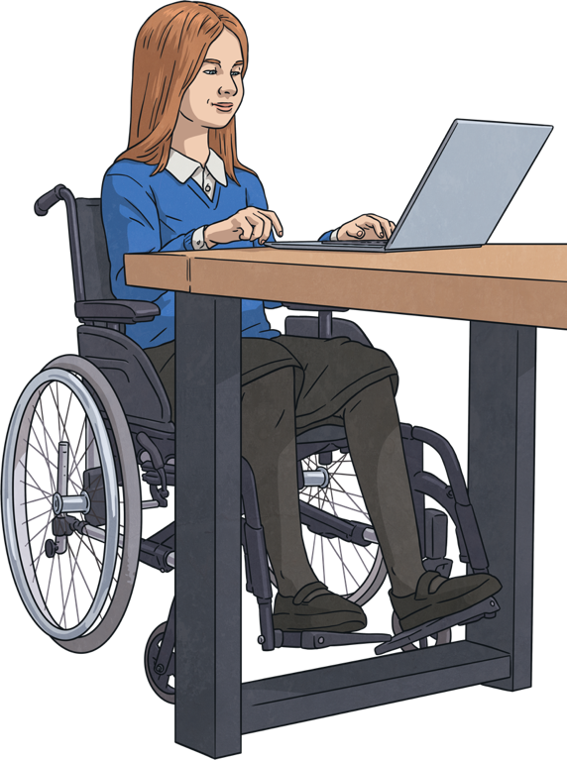
Types of Cyberbullying:
Sharing
Creating and sharing images or videos that upset or embarrass someone is cyberbullying.
These videos or images could be shared using different devices, such as mobile phones, tablets or laptops.
They could also be shared through a variety of platforms, such as messages, online chat groups or social media.

Slide 6
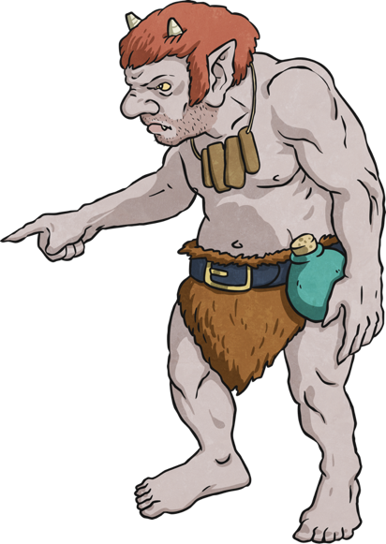
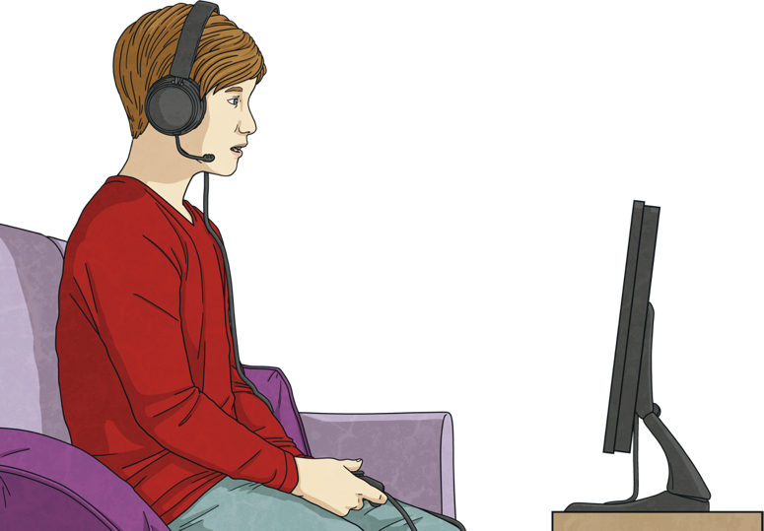
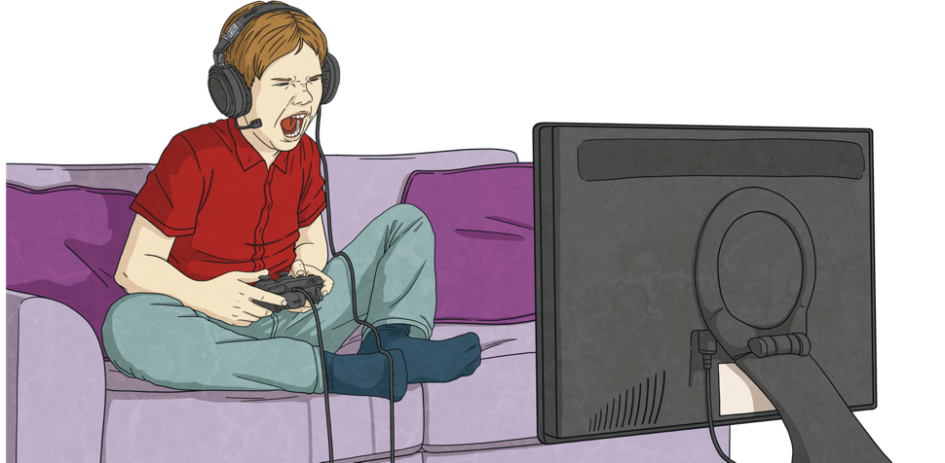
Types of Cyberbullying:
Trolling
Trolling is posting or sending upsetting or threatening messages online about someone else. This could be on social networking sites or online game chats.
Trolls are usually anonymous and sometimes start arguments deliberately to encourage others to join in.

Slide 7
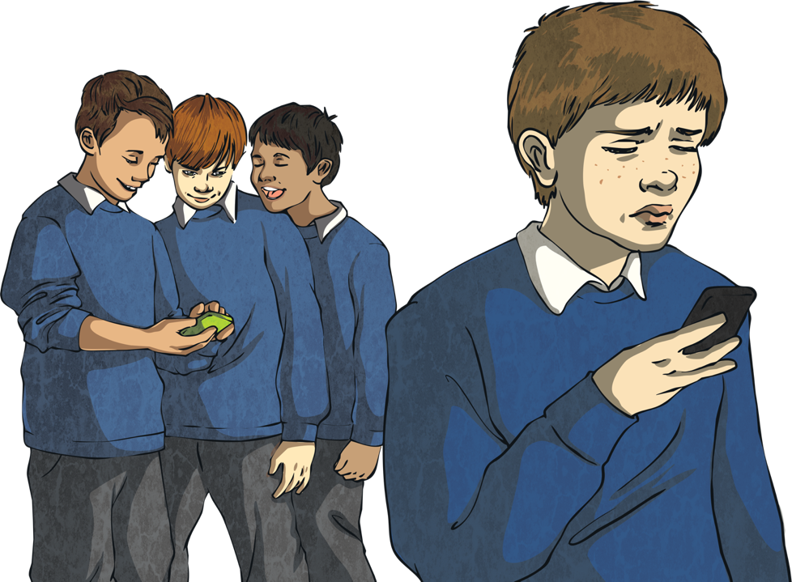
Types of Cyberbullying:
Exclusion
Choosing to exclude, leave someone out deliberately or block someone from an online game, chat or mobile phone chat group is cyberbullying.
This can greatly affect a victim as the people excluding them were usually their friends in the first place.

Slide 8
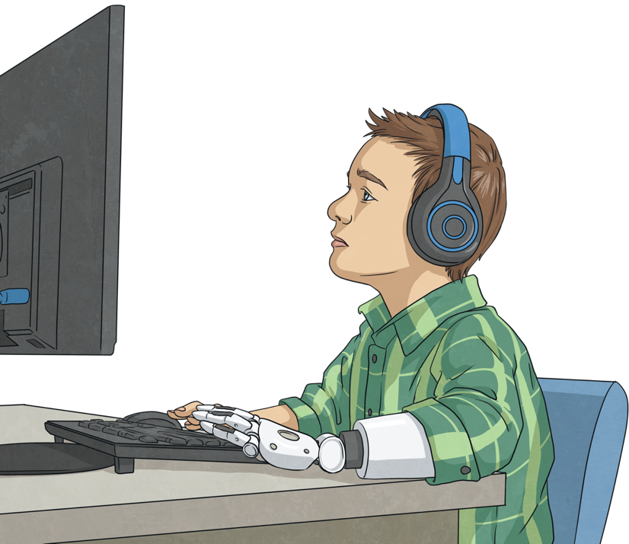
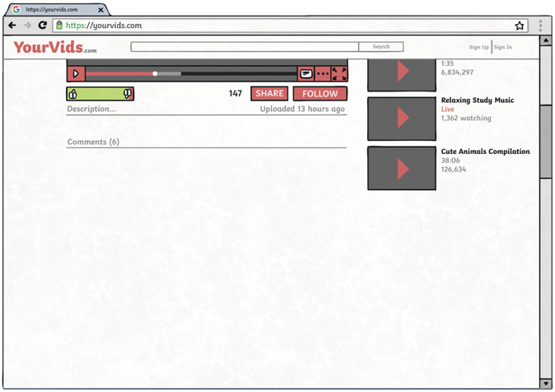
Types of Cyberbullying:
Faking
!
!
Creating a fake account or logging into someone else’s account in order to embarrass them, cause trouble or post bad things using someone else’s name is cyberbullying.
*****
*****
Accessing and using someone else’s online chat, gaming or social media account to post mean or upsetting content is cyberbullying and could create real harm to the victim, even if it was ‘just a joke’.

Slide 9
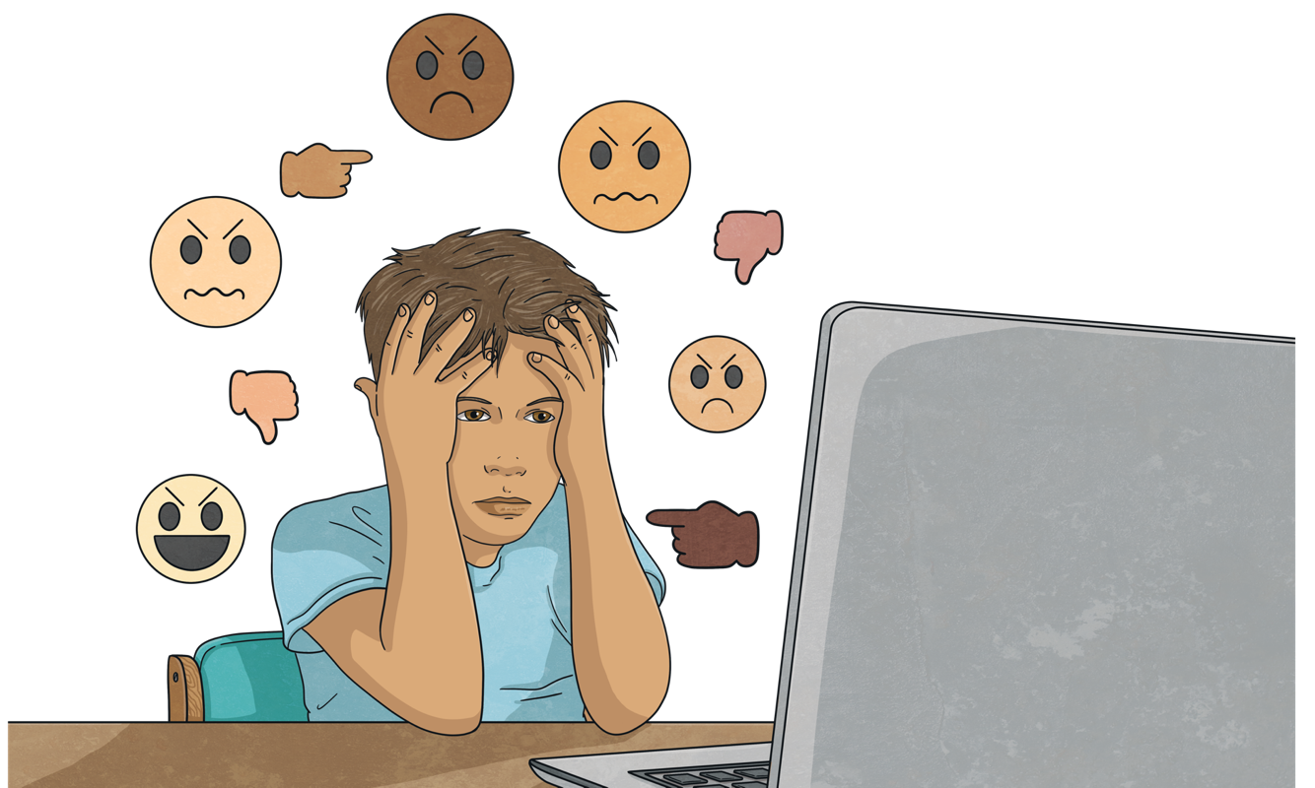
Types of Cyberbullying:
Hating
Posting messages that are deliberately hurtful or expressing you dislike in response to people’s online content is cyberbullying.
This could be one hurtful message about someone’s online photo or expressing constant dislike to someone’s online work.

Slide 10
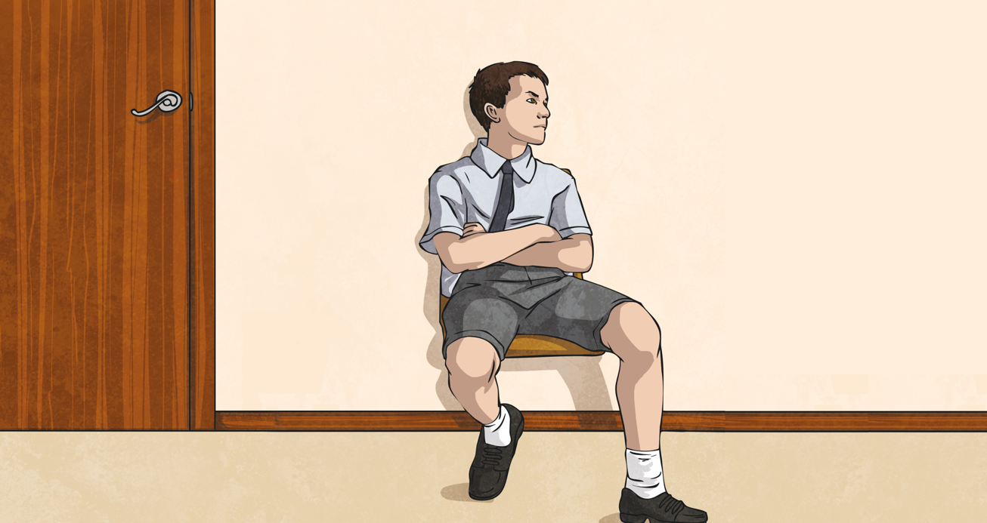
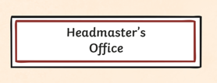
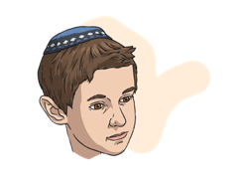
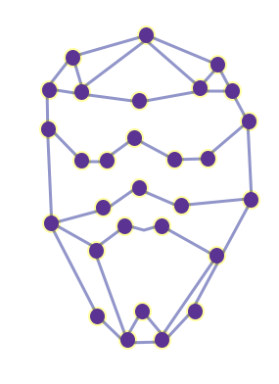
Types of Cyberbullying:
Deepfakes
Images, videos or audio files that have been digitally altered to cause someone upset or harm is a type of cyberbullying.
Digitally altered images, videos or audio files may show people doing things that have never happened.

Slide 11
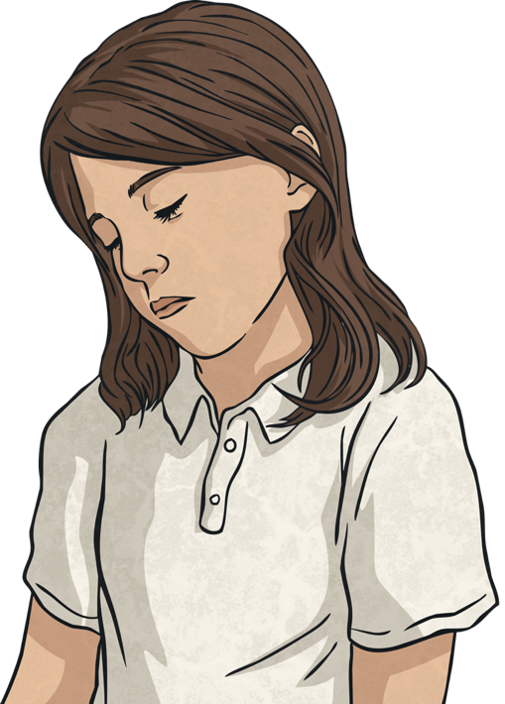
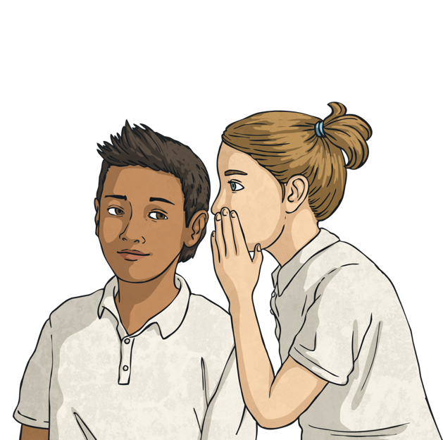
Types of Cyberbullying:
Shaming
Setting up a private group or website to talk badly about someone else and spread rumours is cyberbullying.
These rumours can cause hurt and distress to the victim.

Slide 12
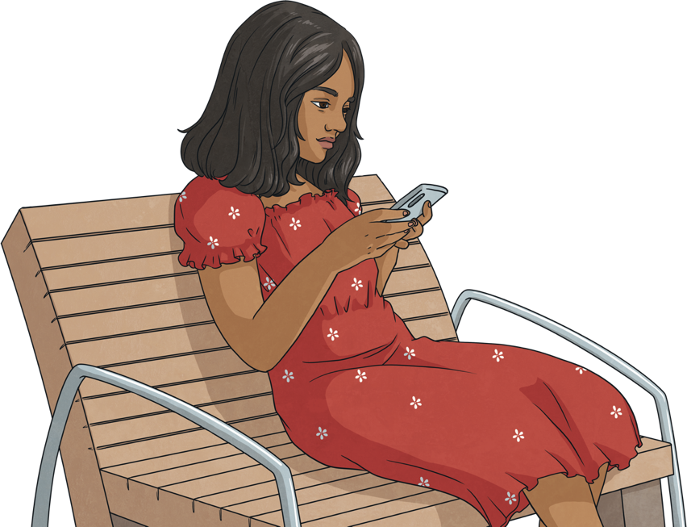
Types of Cyberbullying:
Flaming
Repeatedly sending messages, images or comments to someone else to hurt or anger them is a type of cyberbullying.
This could occur in online games, chat or mobile phone chat groups and often contains insulting or intimidating language.

Slide 13
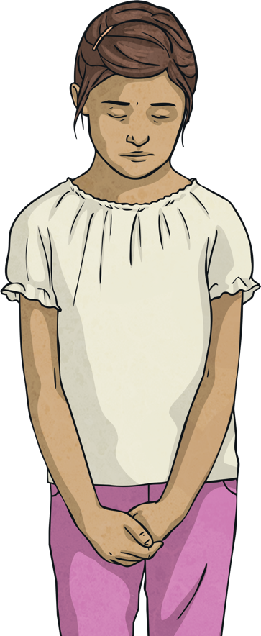
Effects of Cyberbullying
If you are a victim of cyberbullying, you might:
Anyone anywhere can be affected by cyberbullying. It can feel like there is no escape from it and can cause a lot of upset.
feel bad about yourself;
start spending more time alone;
worry about parents or other family members looking at your device;
find excuses to stay away from school;
be left out of social events or see less of your friends;
lose your appetite or feel like you need to change yourself to try and fit in;
feel a range of emotions, such as anger, sadness and loneliness.

Slide 14
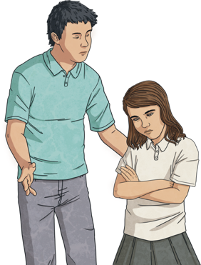
What to Do If You’re a Victim of CyberBullying
What could you do if you or someone you know is being cyberbullied?
Anyone anywhere can be affected by cyberbullying. It can feel like there is no escape from it and can cause a lot of upset.
REPORT
SAVE
BLOCK
Report via the online site that you experience it on, then tell a trusted adult about it and ask for help.
Keep evidence, take screenshots.
Block the person or group of people responsible.
Don’t keep it to yourself! People want to help you and make it better.

Slide 15
Anti-Bullying Week
The Anti-Bullying Alliance organises anti-bullying week.
There is a different theme each year.
In 2023, Anti-Bullying Week runs from the 13th to 17th November.
‘Make a Noise About Bullying’.
The theme for 2023 is,

