Slide 3
Discussion Questions
1
What is your favourite holiday?
2
Which season is Christmas in your country?
3
Do you like Christmas trees? Why or why not?

Slide 4
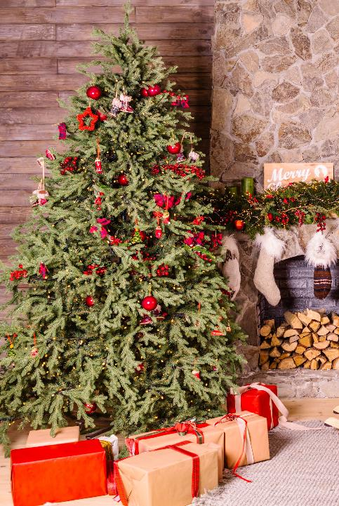
Look at the Picture
How many things can you say in English?
1
Do you think this is in summer or winter? Why or why not?
2

Slide 5
Name Three
Pick a number, and try to think of three things in the category
1
2
Christmas food
Christmas colours
3
4
Christmas activities
Christmas greetings

Slide 6
Look at the Picture
What do you see? Finish the sentences.
Santa Claus wears a ________ suit.
red
red
Click to Reveal the Answer
blue

Slide 7
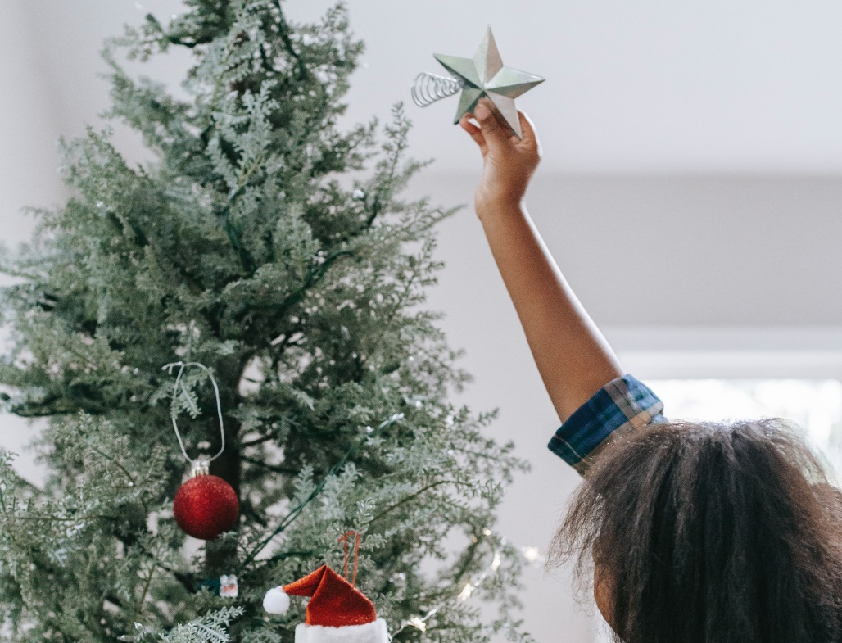
Look at the Picture
What do you see? Finish the sentences.
My daughter likes to decorate the Christmas ________ .
shopping
Click to Reveal the Answer
tree
tree

Slide 8
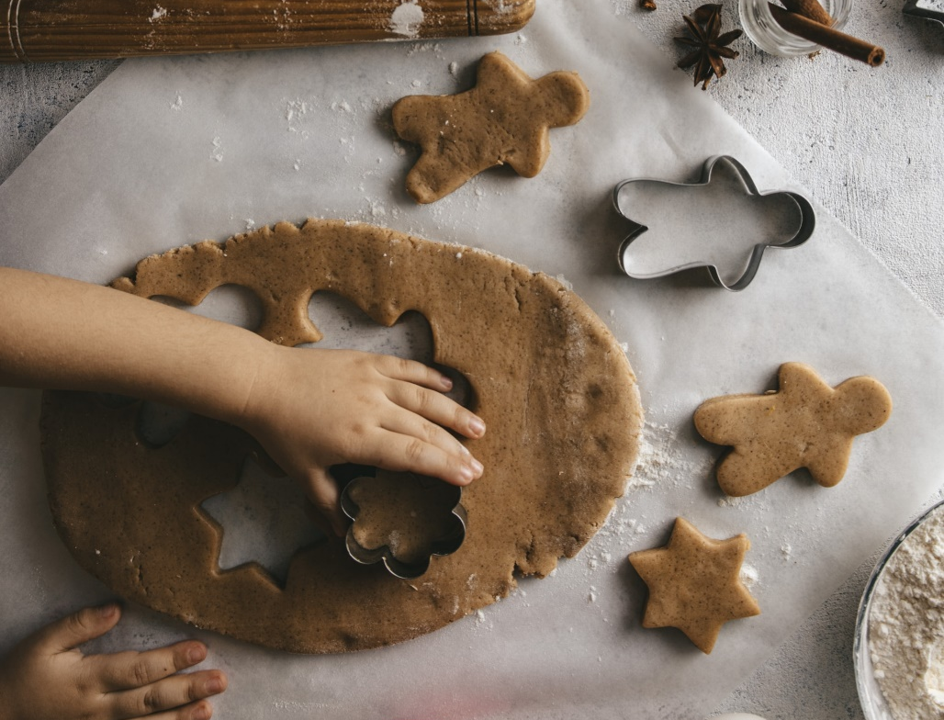
Look at the Picture
What do you see? Finish the sentences.
She always ____________ delicious gingerbread biscuits.
making
Click to Reveal the Answer
bakes
bakes

Slide 9
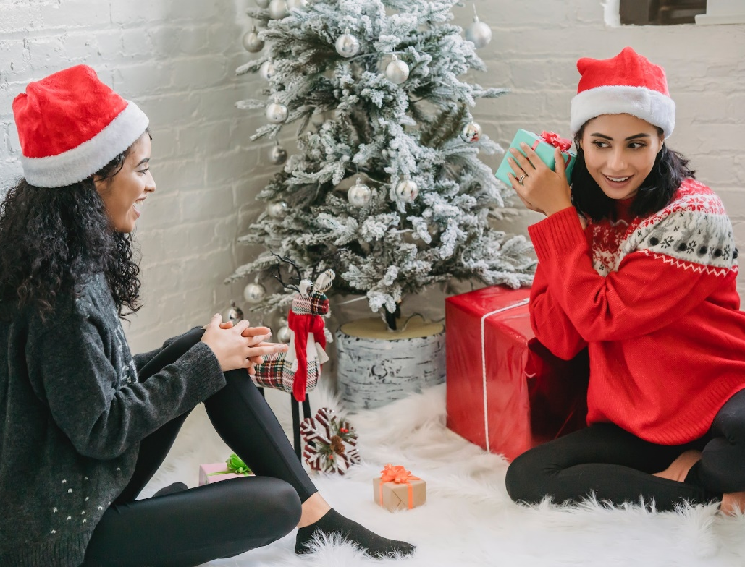
Look at the Picture
What do you see? Finish the sentences.
I like to give and get Christmas ___________ .
presents
presents
Click to Reveal the Answer
shopping

Slide 10
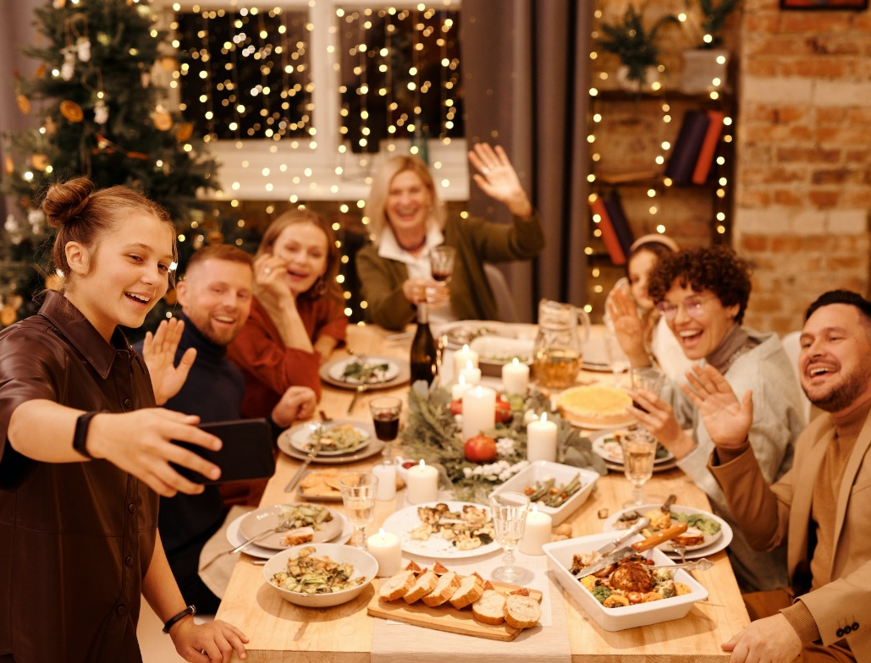
Look at the Picture
What do you see? Finish the sentences.
My _________ loves Christmas.
family
family
Click to Reveal the Answer
sing

Slide 11
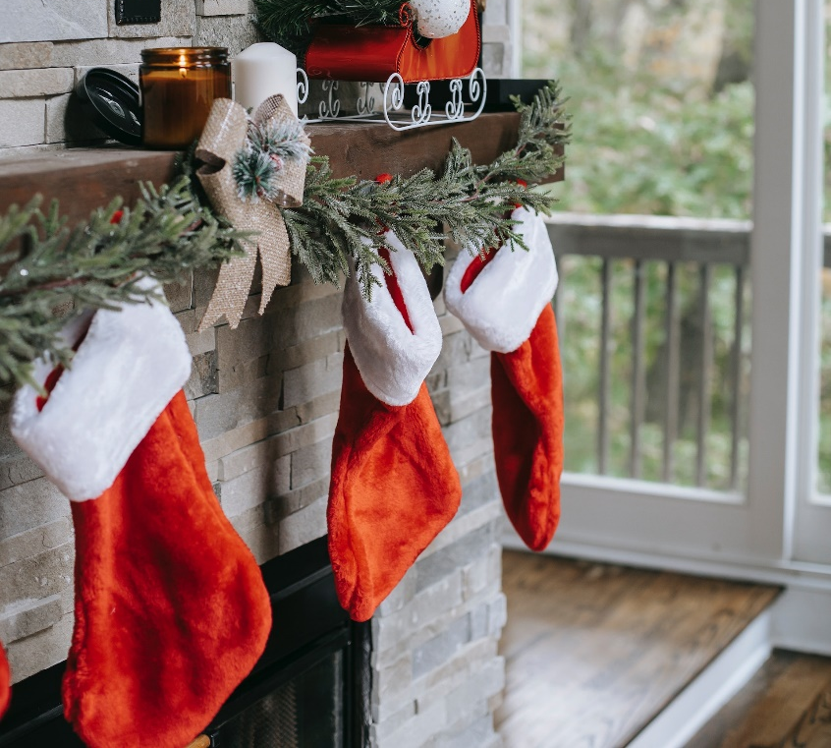
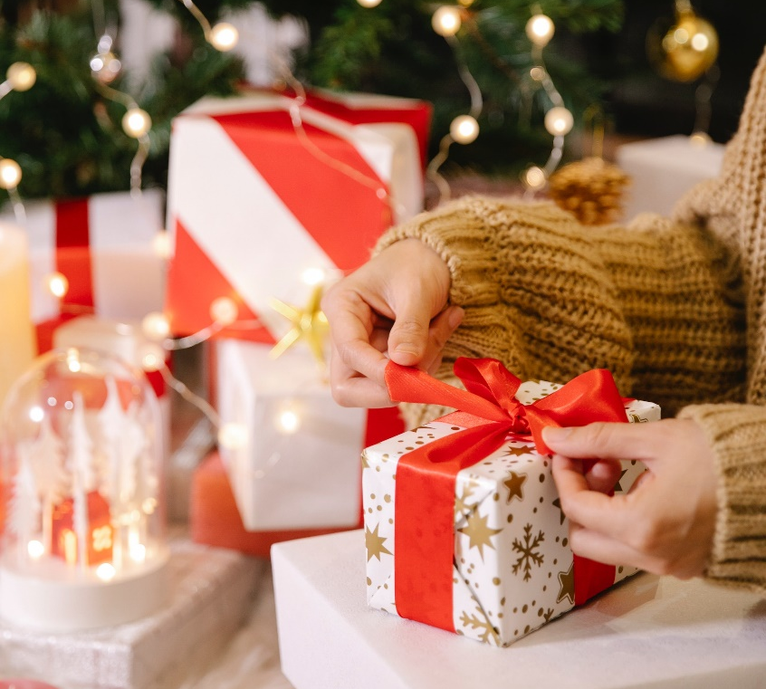
Would you rather?
hang stockings?
put presents under the tree?
or

Slide 12
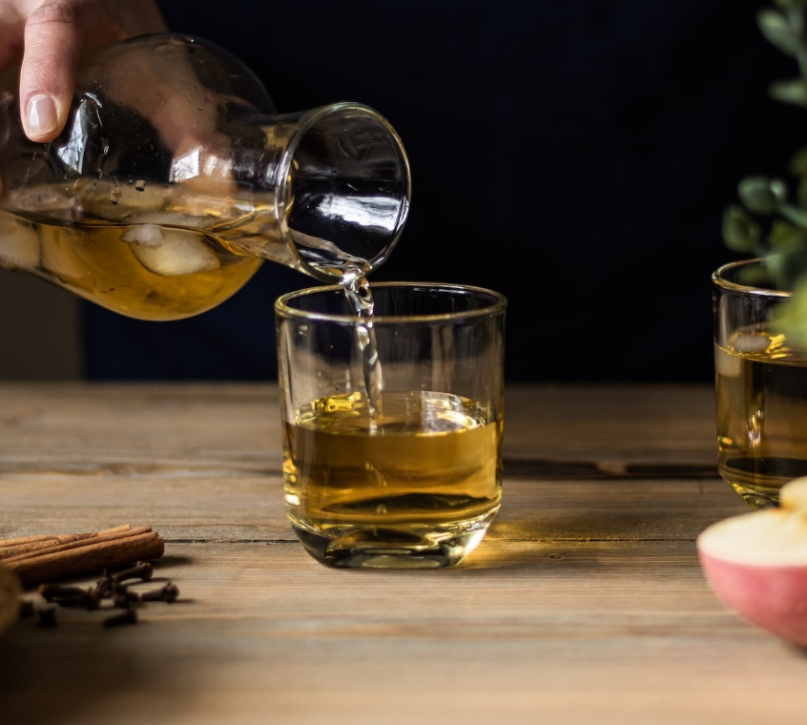
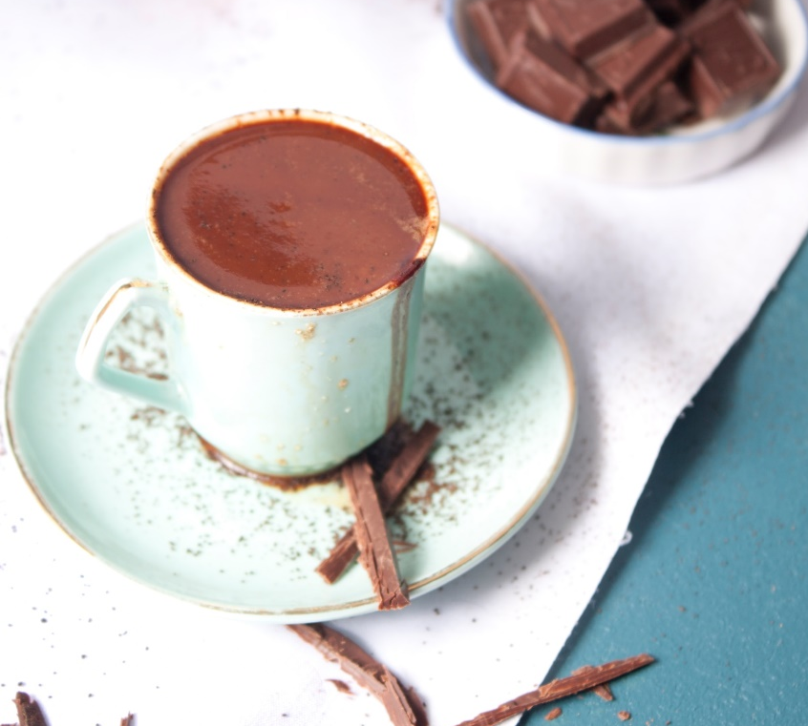
Would you rather?
drink apple juice?
or
drink hot chocolate?

Slide 13
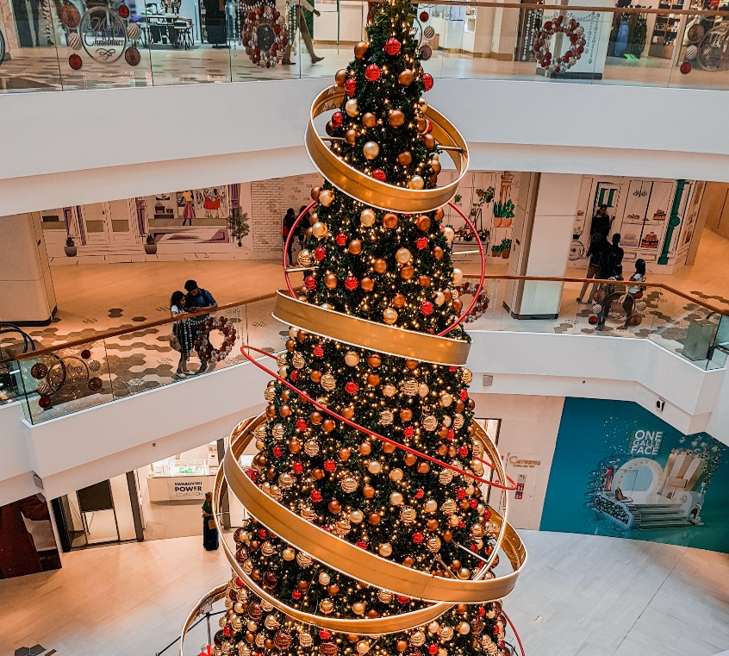
Would you rather?
buy presents at a shopping mall?
or
buy presents online?

Slide 14
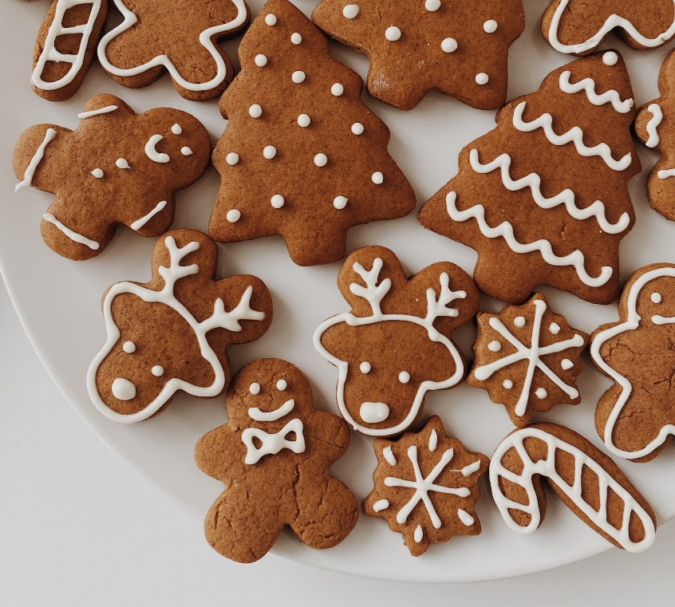
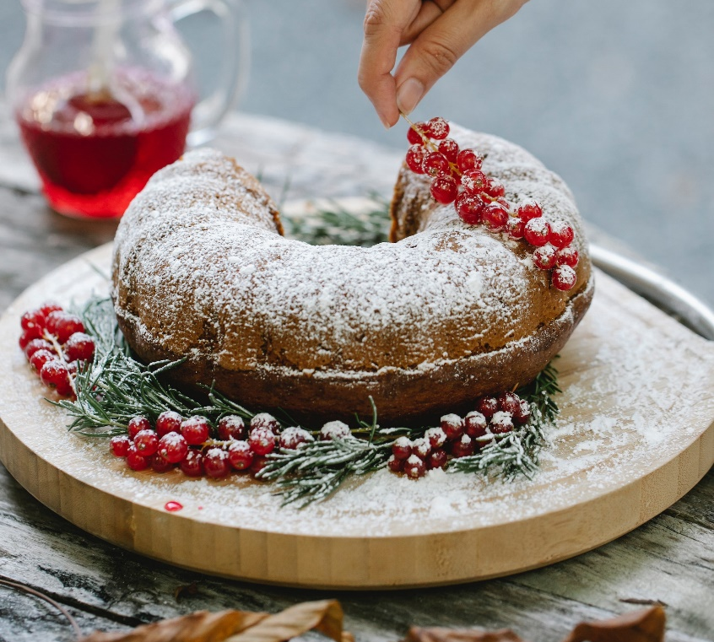
Would you rather?
eat gingerbread biscuits?
or
eat Christmas cake?

Slide 15
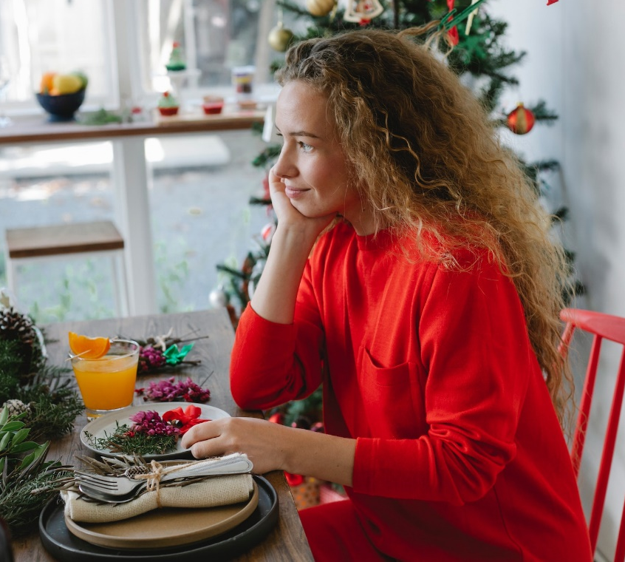
Would you rather?
wear red on Christmas morning?
wear green on Christmas morning?
or

Slide 16
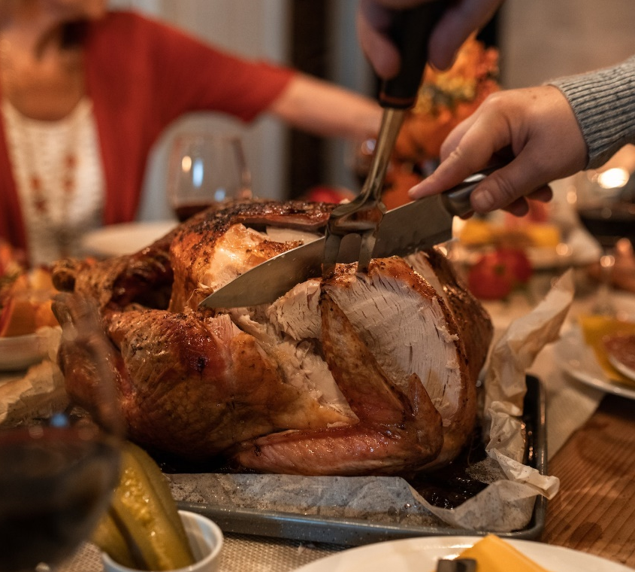
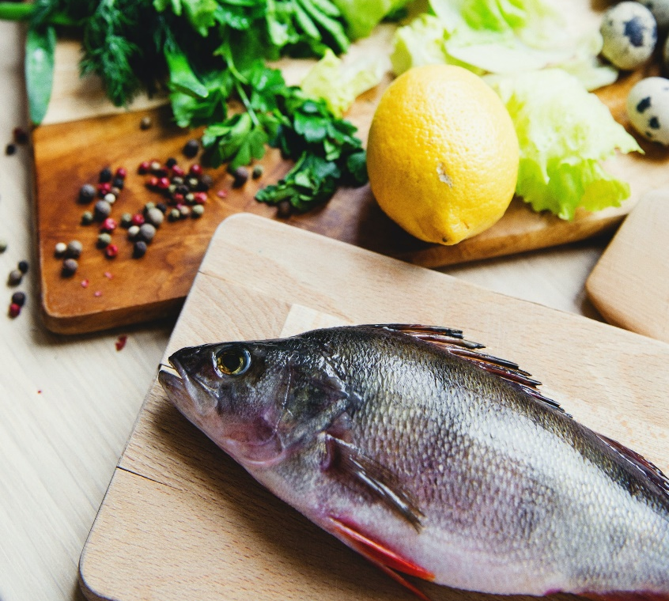
Would you rather?
eat turkey for Christmas dinner?
eat something different?
or

Slide 17
Spin the Wheel
Spin the wheel and make sentences using the Christmas vocabulary.
Spin here!

