Slide 2
Disclaimer
We hope you find the information on our website and resources useful.
ESL Disclaimer
This resource has been made for the purpose of teaching English language learners. We know that students can be learning English in many different places, in many different ways and at age, so we try to keep these resources as general as possible.
There are many acronyms associated with English language teaching. These include (but are not limited to) ELT, TEFL, EFL, ELL, EAL and ESOL. While the term ESL may not fully represent the linguistic backgrounds of all students, it is the most widely recognised term for English language teaching globally. Therefore, we use the term ‘ESL’ in the names of our resources to make them easy to find but they are suitable for any student learning to speak English.

Slide 4
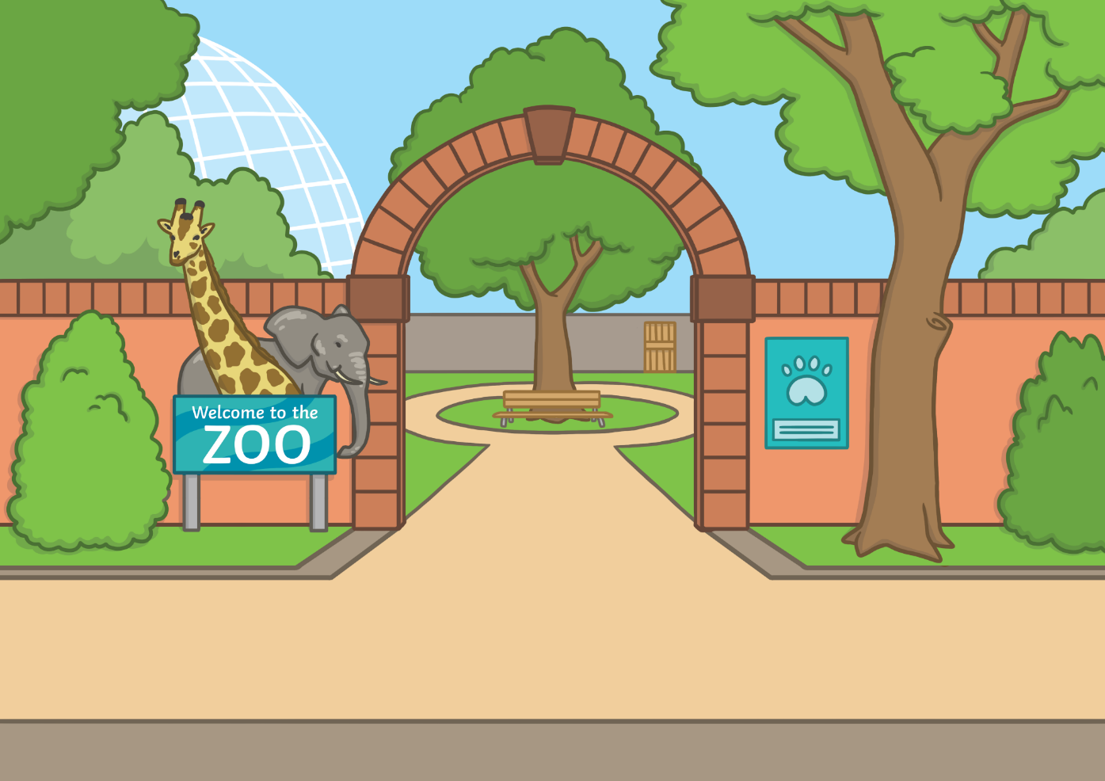
I’m going to the zoo!

Slide 5
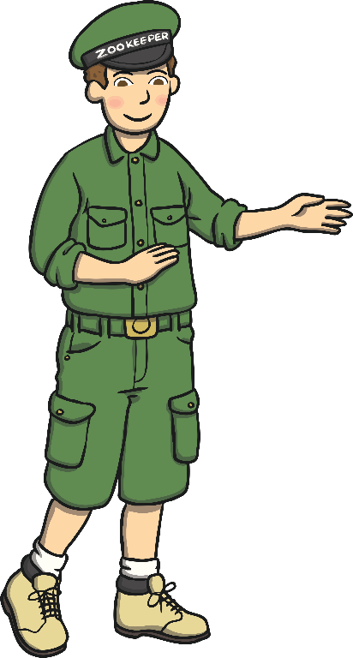
Welcome!
I work at the zoo.
I’m a zookeeper.

Slide 6
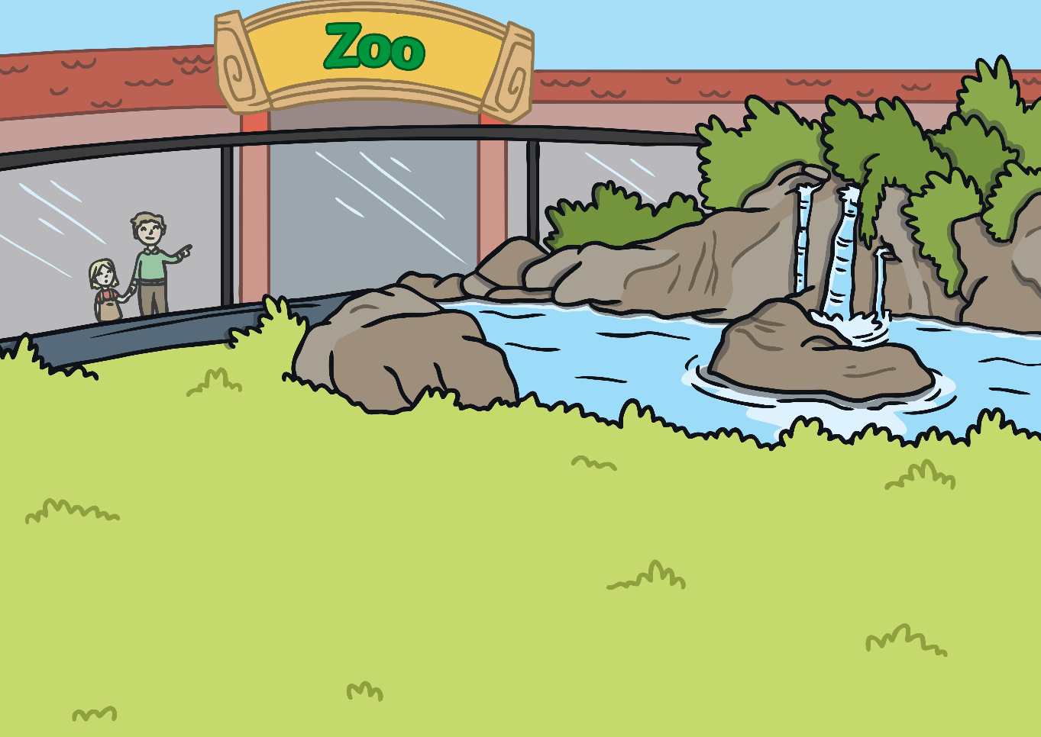
tiger

Slide 7
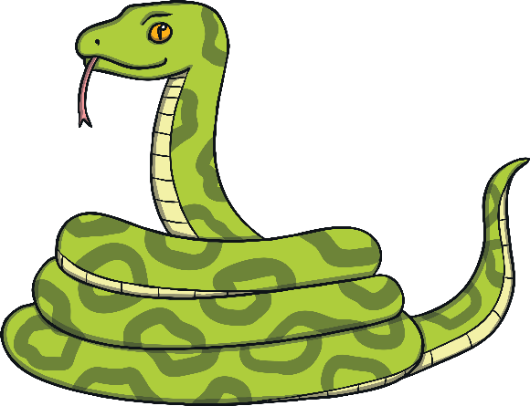
snake

Slide 8
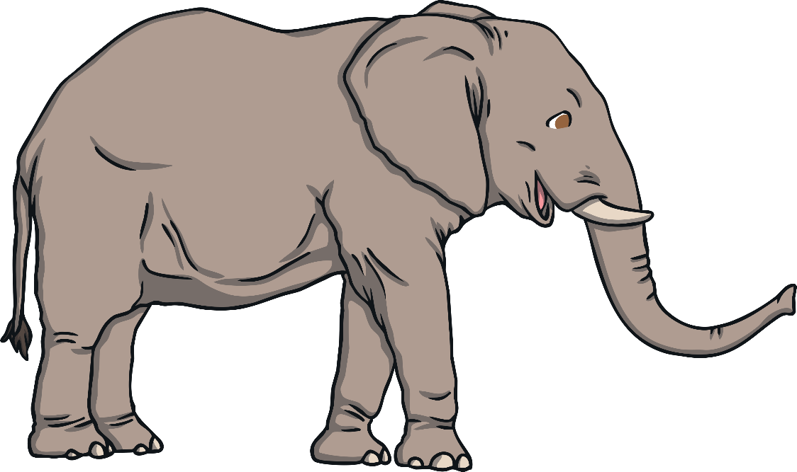
elephant

Slide 9
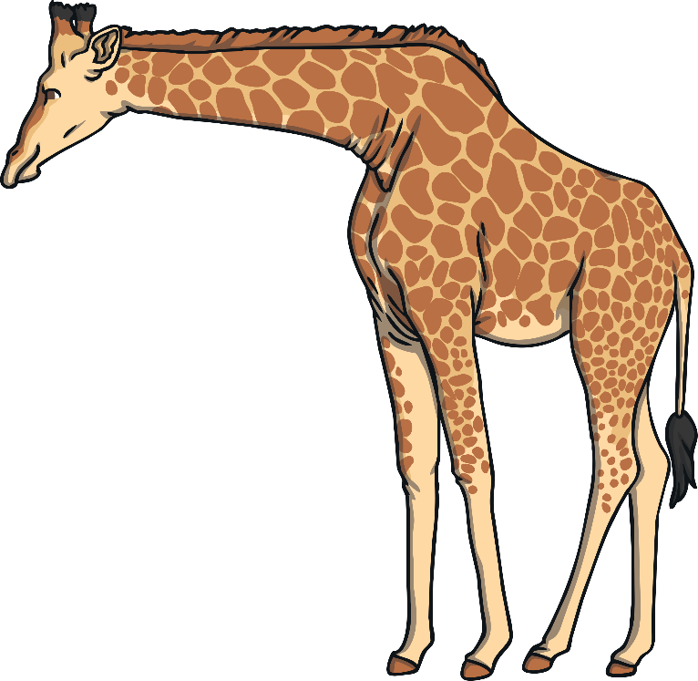
giraffe

Slide 10
cheetah

Slide 11
rhino

Slide 12
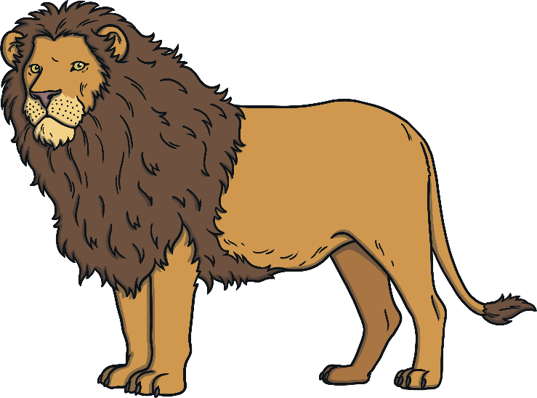
lion

Slide 13
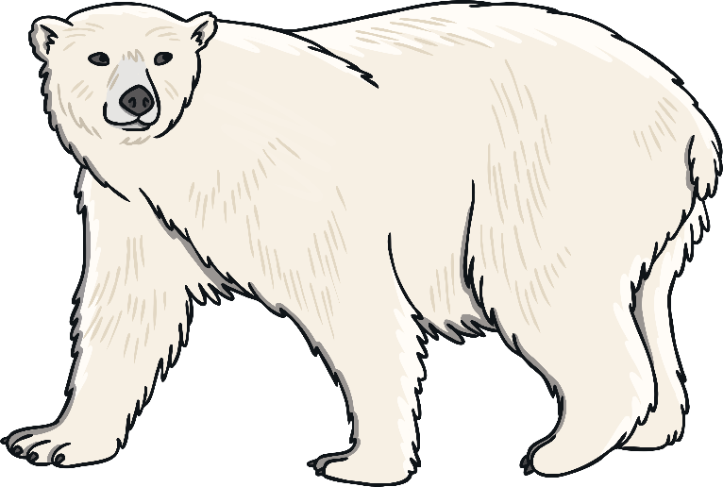
polar bear

Slide 14
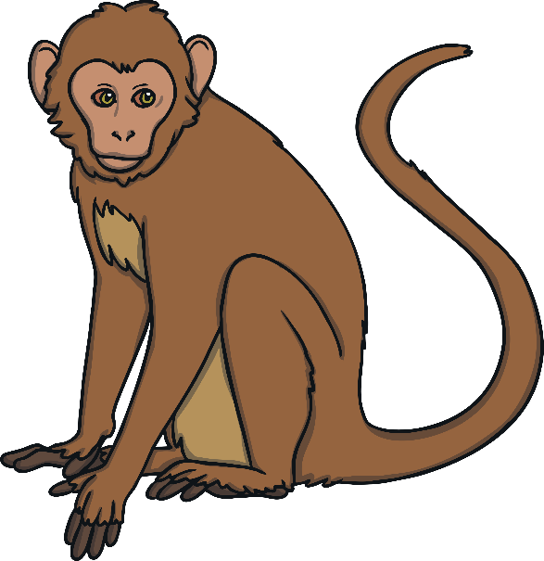
monkey

Slide 15
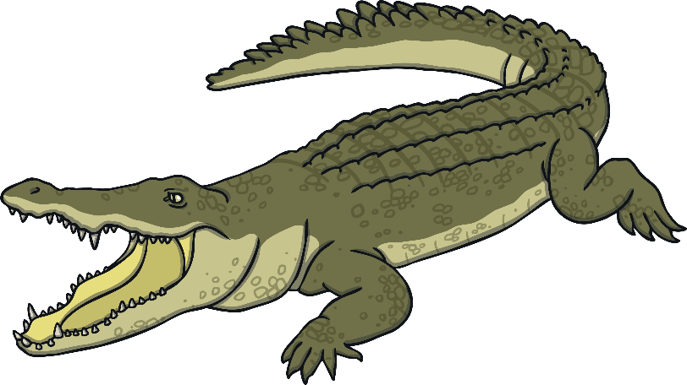
crocodile

Slide 16
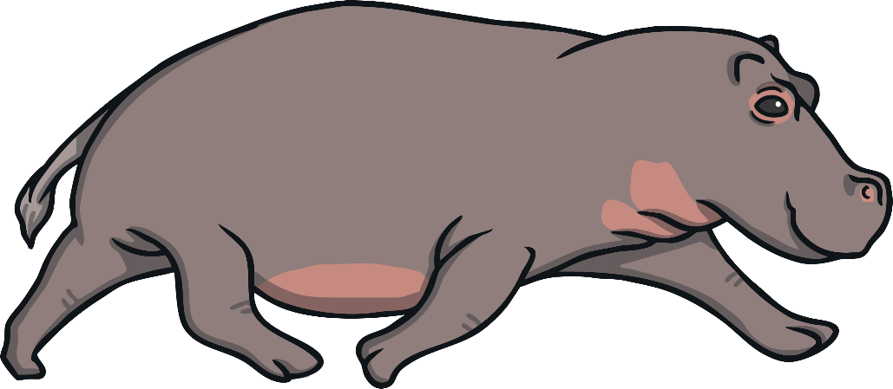
hippo

Slide 17
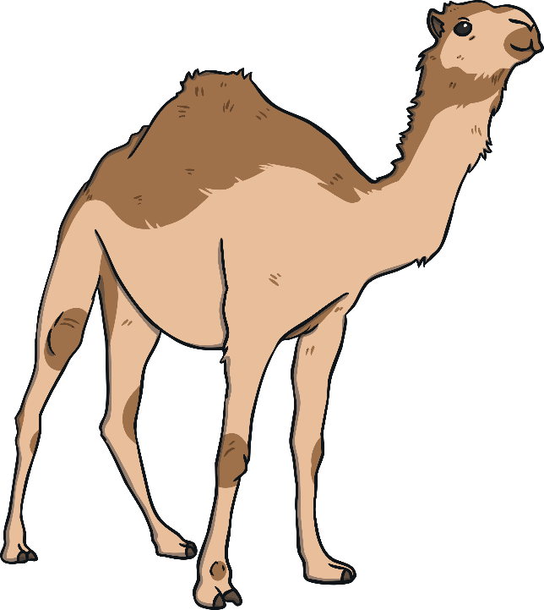
camel

Slide 18
What can you see?
I see a .
giraffe
giraffe P
camel O
camel

Slide 19
What can you see?
I see a .
elephant
crocodile
elephant O
crocodile P

Slide 20
What can you see?
I see a .
lion
lion P
hippo O
hippo

Slide 21
What can you see?
I see a .
monkey O
monkey
cheetah P
cheetah

Slide 22
What can you see?
I see a .
tiger
tiger P
lion O
lion

Slide 23
What can you see?
I see a .
monkey
monkey P
polar bear O
polar bear

Slide 24
What can you see?
I see a .
rhino
rhino P
snakeO
snake

Slide 25
What can you see?
I see a .
camel O
camel
polar bear P
polar bear

Slide 26
What can you see?
I see a .
elephant
elephant P
rhino O
rhino

Slide 27
What can you see?
I see a .
giraffe O
giraffe
camel P
camel

Slide 28
What can you see?
I see a .
monkey O
monkey
snake P
snake

Slide 29
What can you see?
I see a .
rhino O
rhino
hippo P
hippo

Slide 30
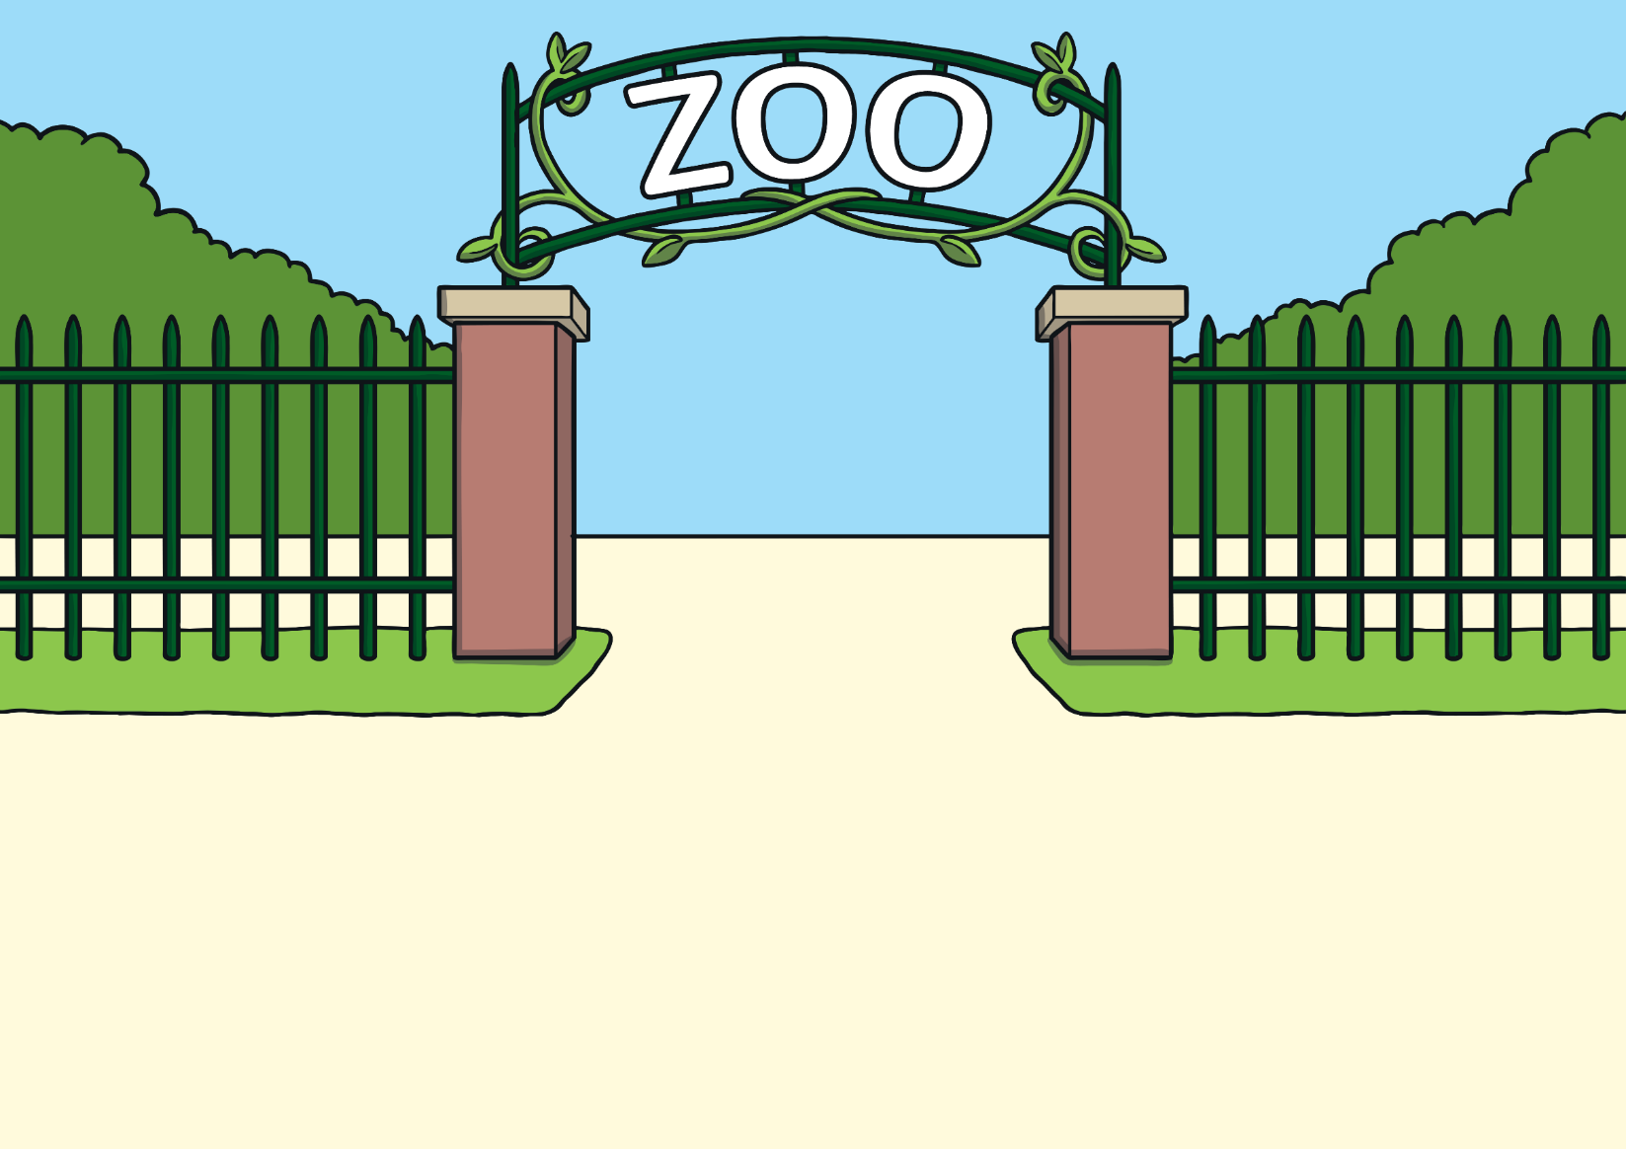
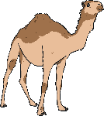
Name the zoo animals
Click on the image to check your answer.
elephant
rhino
hippo
giraffe
cheetah
lion
polar bear
snake
tiger
monkey
camel
crocodile

Slide 31
Correct the mistakes.
I see a giraffe.
I see an elephant.
I see a lion.
I see a cheetah.
I see a snake.
I see a crocodile.

