Slide 5
Look at the Pictures. Match the Words to the Pictures.
Afternoon
Afternoon
Evening
Evening
Night
Night
Morning
Morning
Click to reveal answer

Slide 6
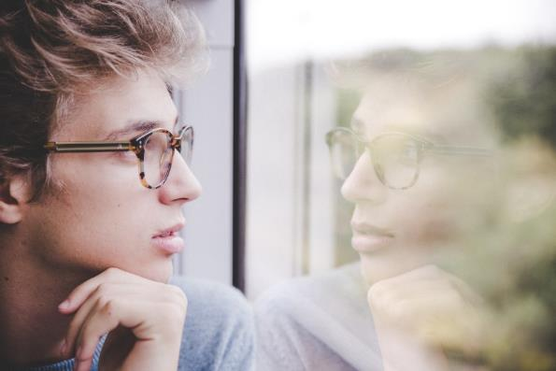
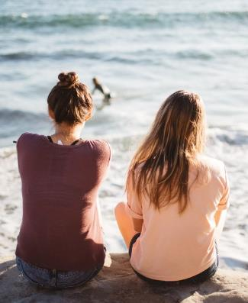
Subject Pronouns
You
I
We

Slide 7
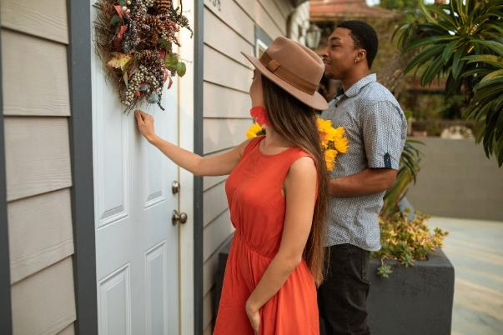
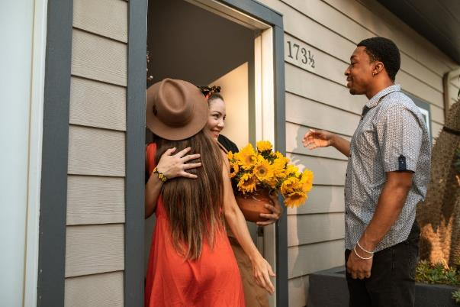
Click the Correct Answer.
Hello!
Hello!
Goodbye!
Goodbye!
Hint: It’s a greeting.
Click to reveal answer

Slide 8
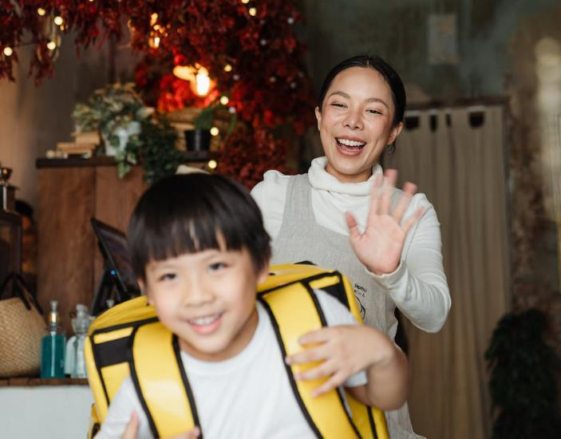
Click the Correct Answer.
Hello!
Hello!
Goodbye!
Goodbye!
Hint: It’s a farewell.
Click to reveal answer

Slide 9
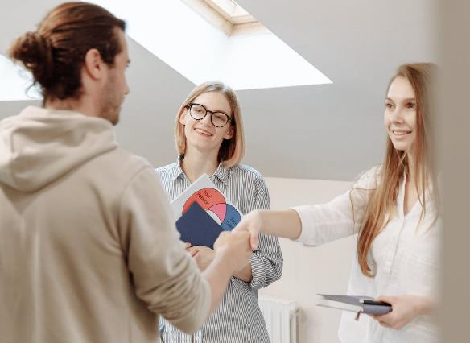
Role Play
J: Hello! My name is Jasmine. What’s your name?
H: Hi Jasmine! I’m Harry, nice to meet you!
J: Nice to meet you! See you later.
H: Yeah. Bye!

Slide 10
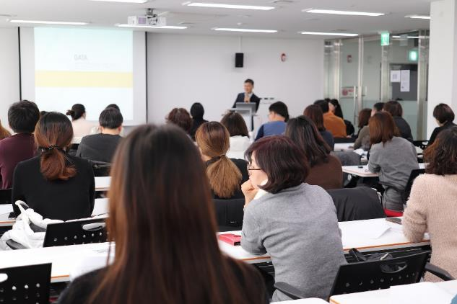
Role Play
T: Good morning, students! It’s time for English class.
S: Good morning!
T: Welcome! Class starts at
9 o’clock.

Slide 11
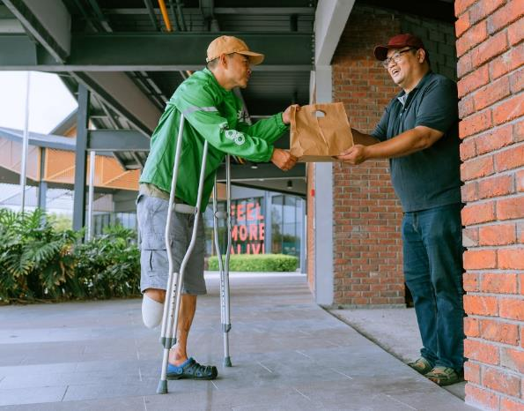
Role Play
D: Good afternoon. Are you Ken?
K: Hi! Yes.
D: Here’s your lunch.
K: Thanks. Bye!
D: You’re welcome. Goodbye!

Slide 12
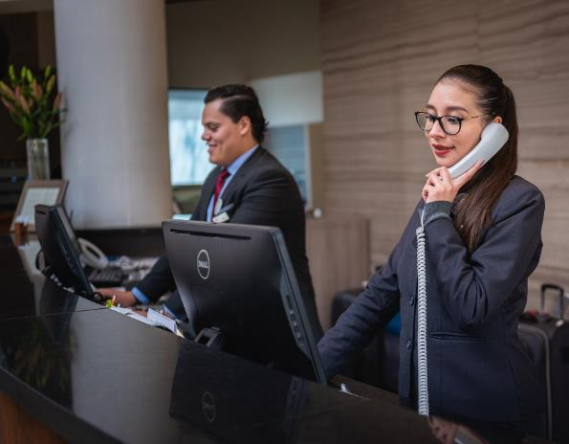
Role Play
R: Good evening! How are you?
G: Hello. I’m fine, thanks.
R: Please come to reception.
G: Okay! See you soon.
R: Thanks. See you soon. Bye!

Slide 13
Put the Greetings and Farewells into the Correct Columns in the Table.
Greetings
Farewell
Hello
See you later
Good evening
Goodbye
Hi
Good night
Nice to meet you
See you soon
Good afternoon
Bye
Good morning
Hello
Goodbye
Hi
See you soon
Bye
Good afternoon
Good evening
Good night
Nice to meet you
Good morning
See you later
Click to reveal answer

Slide 14
Fill in the Gaps
J: ! My name is Jasmine. What’s your name?
Hello
H: Hi Jasmine! I’m Harry, !
nice
to
meet
you
J: Nice to meet you! !
See
you
later
H: Yeah. Bye!
Click to reveal answer

Slide 15
Role Play
T: students! It’s time for English class.
Good
morning
S: Good morning!
T: Welcome! Class starts at 9 o’clock.
Click to reveal answer

Slide 16
Role Play
D: . Are you Ken?
Good
afternoon
K: Hi! Yes.
D: Here’s your lunch.
K: Thanks. Bye!
D: You’re welcome. !
Goodbye
Click to reveal answer

Slide 17
Role Play
R: Good evening! How are you?
G: Hello. I’m fine, thanks.
R: Please come to reception.
G: Okay! .
See
you
soon
R: Thanks. See you soon. Bye!
Click to reveal answer

Slide 18
Correct the mistakes.
Hi! I meet you nice!
Hi! Nice to meet you!
Goodbye! Seeing soon you!
Goodbye. See you soon!
Good knighting!
Good night!
Click to reveal answer

