Slide 4
How did you plan your most recent holiday?
Think about the following:
aeroplane tickets
hotel bookings
group tours
restaurant reservations
transport tickets
1
How much did you have to plan beforehand? What bookings did you make?
2
Who did you need to talk to in order to make the bookings?
3
What things could you do online? Did you have to make any bookings by telephone?

Slide 5
Where would you use the following phrases?
restaurant
hotel
train
group tour
airport
1
Restaurant
I’d like to reserve a table for three, please.
2
Train
Can I buy four tickets from Berlin to Munich?
3
Airport
How much do I need to pay for extra baggage?
4
Group tour
We’d love to do the Sights of London tour, please.
5
Hotel
We’d like to reserve two rooms on the 24th.

Slide 6
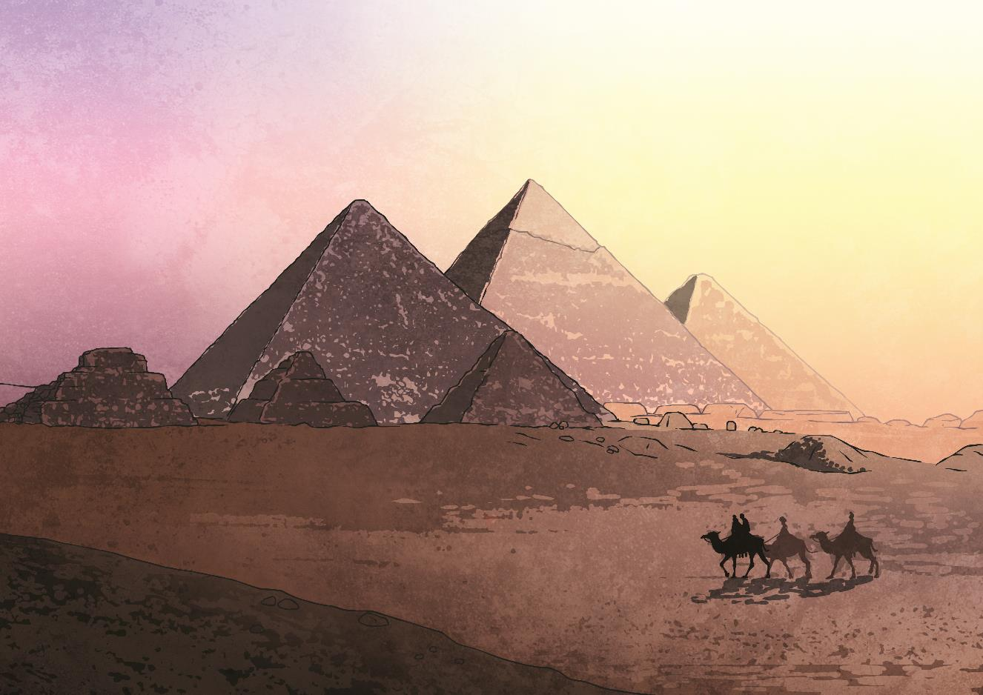
1
Part
Booking a Group Tour

Slide 7
Imagine you’re travelling to Egypt. You have decided to go see the pyramids. There are two tours available.
Lucky Cairo Day Tour
Egypt’s Best Day Tour
150$
9:00 - 12:00
Giza Pyramids
Sphinx
Market
Lunch
Camel Ride
190$
9:00 - 14:00
Hotel pick-up
Giza Pyramids
Sphinx
Lunch
Nile Boat Cruise (2 hr)
Which do you choose and why?

Slide 8
See what you can remember
about the tour information.
Customer: Hi there, I’d like to see the Pyramids today.
Clerk: We have two tours today, the Lucky ______ Day Tour, and Egypt’s _____ Day Tour. They both start at 9.
Customer: What’s the difference between them?
Clerk: The first one includes a ______ ride and is ____ $, while the second option is 190$, and offers a ____ Cruise instead.
Customer: Hmm. I don’t really like riding animals. How long is the cruise?
Clerk: About __ hours.
Customer: All right. I’ll book Egypt’s Best Day Tour, for three people please. Do you take Mastercard?
Clerk: Of course.
Cairo
Best
camel
190
Nile
2

Slide 9
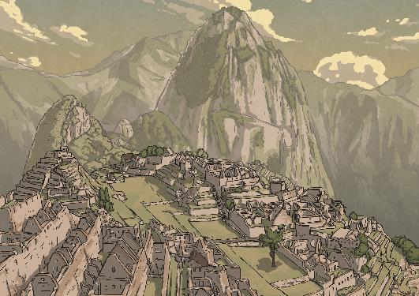
Think of 3 questions you could ask the tour operator
before signing up for this tour.
Peru Machu Picchu 4-Day Hiking Tour!
800$
Airport transfer included
Local hiking guide
Entrance, permits, fees included
Meals included
Sleeping bag provided on request
Glamping option available
Email us to book

Slide 10
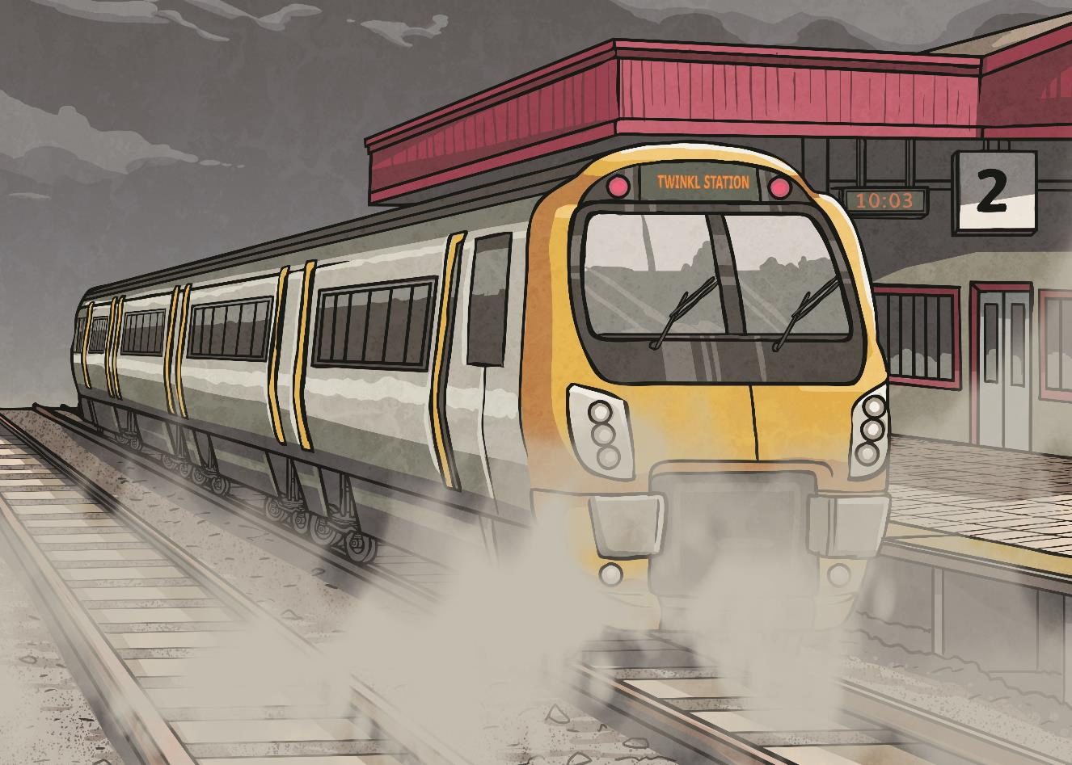
2
Part
Buying a Train Ticket

Slide 11
What phrases can you use to book a train ticket?
1
Yes
Two tickets to Milan, please.
2
No
I want to use your train.
3
Yes
I want to get to Milan this afternoon.
4
No
I want to get on the continuous train to Milan.
5
Yes
Are there any non-stop trains to Milan?

Slide 12
You’re in Naples and it’s 13:00. You want to get to Rome, as quickly as possible. Which train do you choose? Why?
TRAIN CODE
DEPARTURE TIME
ARRIVAL TIME
DESTINATION
TRAIN TYPE
PRICE
A001
12:10
16:20
Milan
Red
109 €
A002
13:10
14:50
Rome
Red
15 €
A003
13:40
14:55
Rome
White-Bullet
33 €
A004
14:00
15:15
Rome
White-Bullet
38 €

Slide 13
Read the following text. Fill in the blanks.
to
non-stop
15 €
bullet
tickets
departing
take
to
Customer: Hi there, two tickets __ Rome, please.
Clerk: No problem. We have a red train __________ at 13:10, and white train at 13:30. The first one is a slower train, and the second is a ______ train.
Customer: How much does each cost?
Clerk: The slower train is _____, and the bullet is 33 €.
Customer: I think I’ll _____ the bullet train. I’m in a hurry. Two _______ for the 13:30 train.
Clerk: No problem, here are your tickets.
Customer: Thank you. Is the train __________?
Clerk: Correct, there are no stops on the way to Rome.
departing
bullet
15 €
take
tickets
non-stop

Slide 14
Divide into pairs. Study the timetable and
roleplay the situation.
TRAIN CODE
DEPARTURE TIME
ARRIVAL TIME
DESTINATION
TRAIN TYPE
PRICE
B001
9:10
12:55
Florence
Red
45 €
B002
05:30
11:40
Venice
White-Bullet
108 €
B003
14:00
16:45
Florence
White-Bullet
66 €
B004
14:00
17:10
Milan
Red
90 €
Customer start: Hi there, I’d like to get to Florence today. What trains are available?

Slide 15
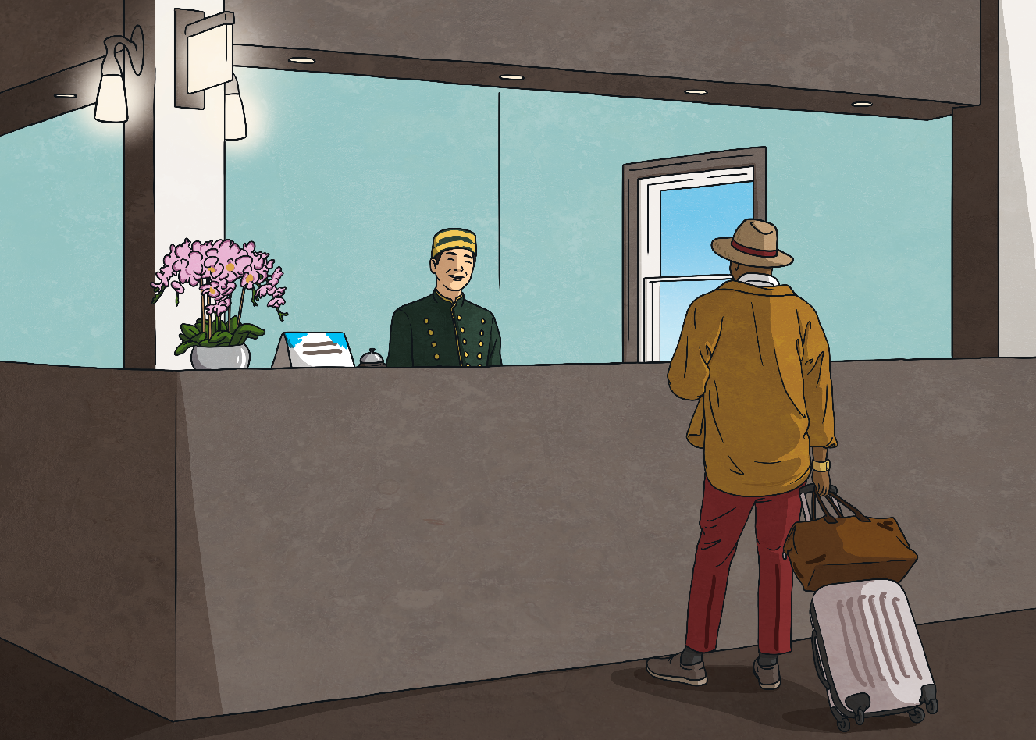
3
Part
Booking a Hotel Room

Slide 16
Which of the following phrases are polite, impolite or confusing?
1
Impolite
Give me two rooms.
2
Polite
I’d like to reserve two rooms for the 21st of June.
3
Polite
Do you have any seaview apartments available?
4
Confusing
I’d like to sleep in your hotel tonight.
5
Polite
Do you have breakfast options available?
6
Polite
What time is check-out?
7
Confusing
I want to eat breakfast here.

Slide 17
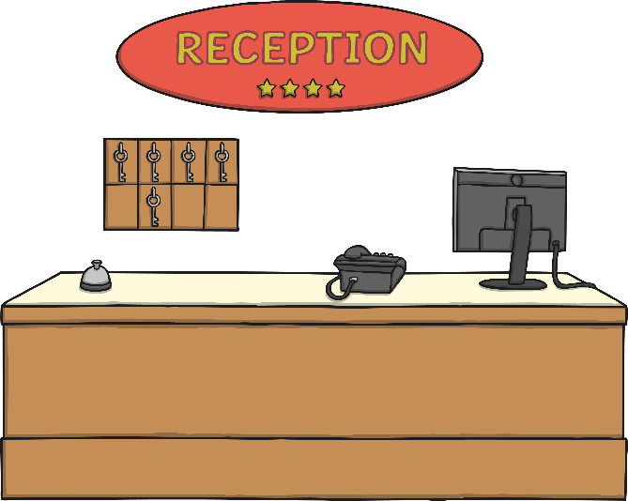
Read the following roleplay. Spot the
inappropriate language
Clerk: Hello. Welcome to the Golden Hotel. Why are you here?
Customer: Hi. I want to sleep in your hotel tonight. I want to book one room for five people.
Clerk: Sorry, we can only allow two people in a room. Would you like to book three rooms?
Customer: Yes, three rooms will be fine.
Clerk: Please give me 120 dollars.
Customer: Here’s my card.
Click for the correct language

Slide 18
Clerk: Hello. Welcome to the Golden Hotel. How can we help you?
Customer: Hi. I’d like a room for tonight. I want to book one room for five people.
Clerk: Sorry, we can only allow two people in a room. Would you like to book three rooms?
Customer: Yes, three rooms will be fine.
Clerk: That will be 120 dollars. Cash or card?
Customer: Here’s my card.

Slide 19
Get into pairs and choose a role.
Roleplay a conversation.
Clerk
Customer
You work at Silverlight Hotel.
You only accept cards.
You only have 2 rooms available tonight.
You’d like to book 3 rooms at Silverlight Hotel tonight.
You want to know if there is a breakfast option in the morning.
Clerk begins: Hello, welcome to Silverlight Hotel.

Slide 20
Review – where are these sentences appropriate to use?
1
Are airport transfers included?
Group Tour
2
What time is check-out?
Train station
3
I this a non-stop ticket?
Hotel
4
Are there any seaview rooms?

