Slide 4
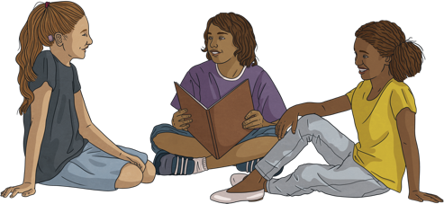
Conversation questions
What’s your name?
How old are you?
Where are you from?
Who is your teacher?
Do you like English? Why or why not?
What will you do after class?
What will you do this weekend?

Slide 5
Name 3…
things in a classroom
celebrities
films
sports
spicy foods
things on the beach
hot drinks
school subjects
things at a restaurant

Slide 6
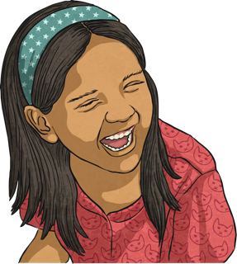
Funny tongue twisters
Red lorry, yellow lorry.
How much wood could a woodchuck chuck if a woodchuck could chuck wood?
She sells sea shells on the sea shore.
A big black bug bit a big black bear.
Divers dive deep in the deep blue sea.
Can you can a can as a canner can a can?
Kitty caught the kitten eating chicken in the kitchen.

Slide 7
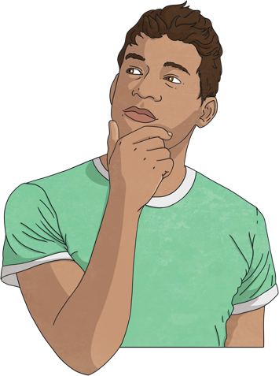
Would you rather…?
Go to school in the morning or at night?
Have homework every day or never have homework?
Watch a film or play games during English class?
Never have a phone or never have a TV?
Wear the same outfit every day, or never wear the same outfit twice?
Fight 100 duck-sized horses or fight 1 horse-sized duck?

Slide 8
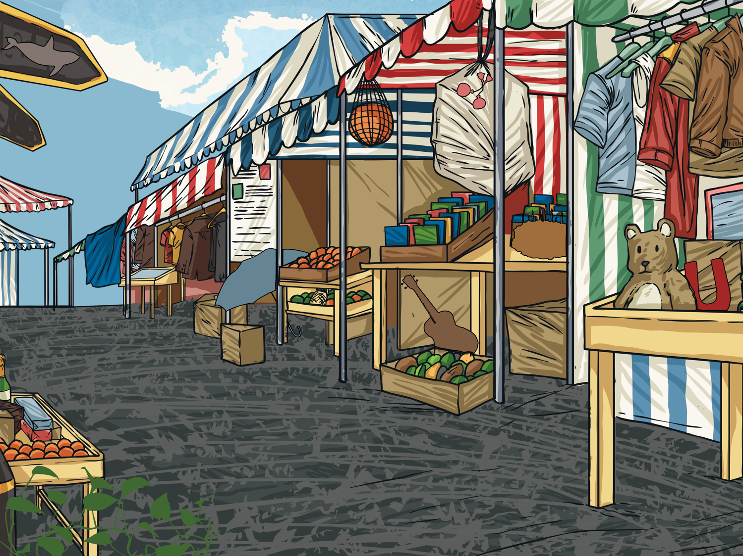
How good is your memory?
Look at the following picture. Try remember as many objects as you can.

Slide 9
True or false?
There was a guitar.
True
There was a magnet.
True
There was a ball.
True
There was an umbrella.
True
There was a chair.
False
There were socks.
False
There was a teddy bear.
True
There was a shark.
True
There were cups.
False
There was a salt shaker.
False
Click to reveal answer

Slide 10
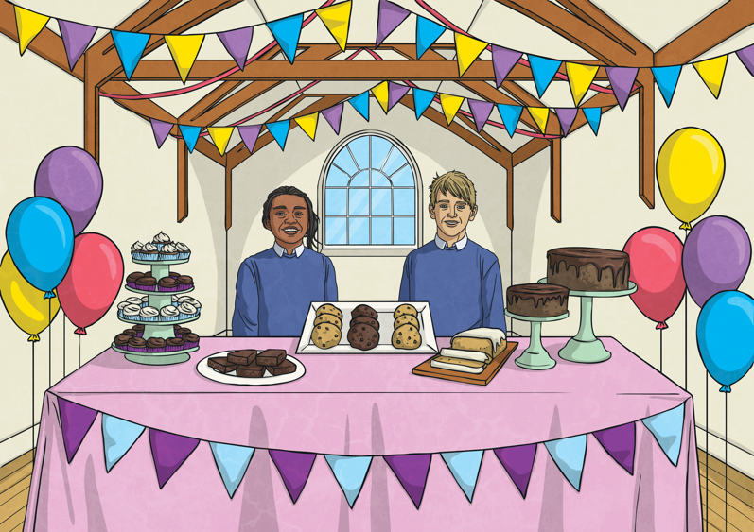
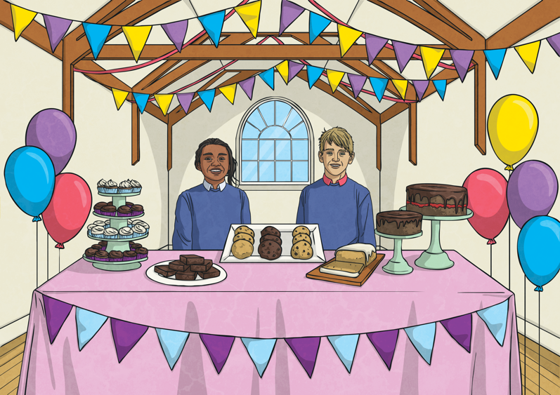
Spot the differences
Spot the differences between the pictures.
Click to reveal answers

Slide 11
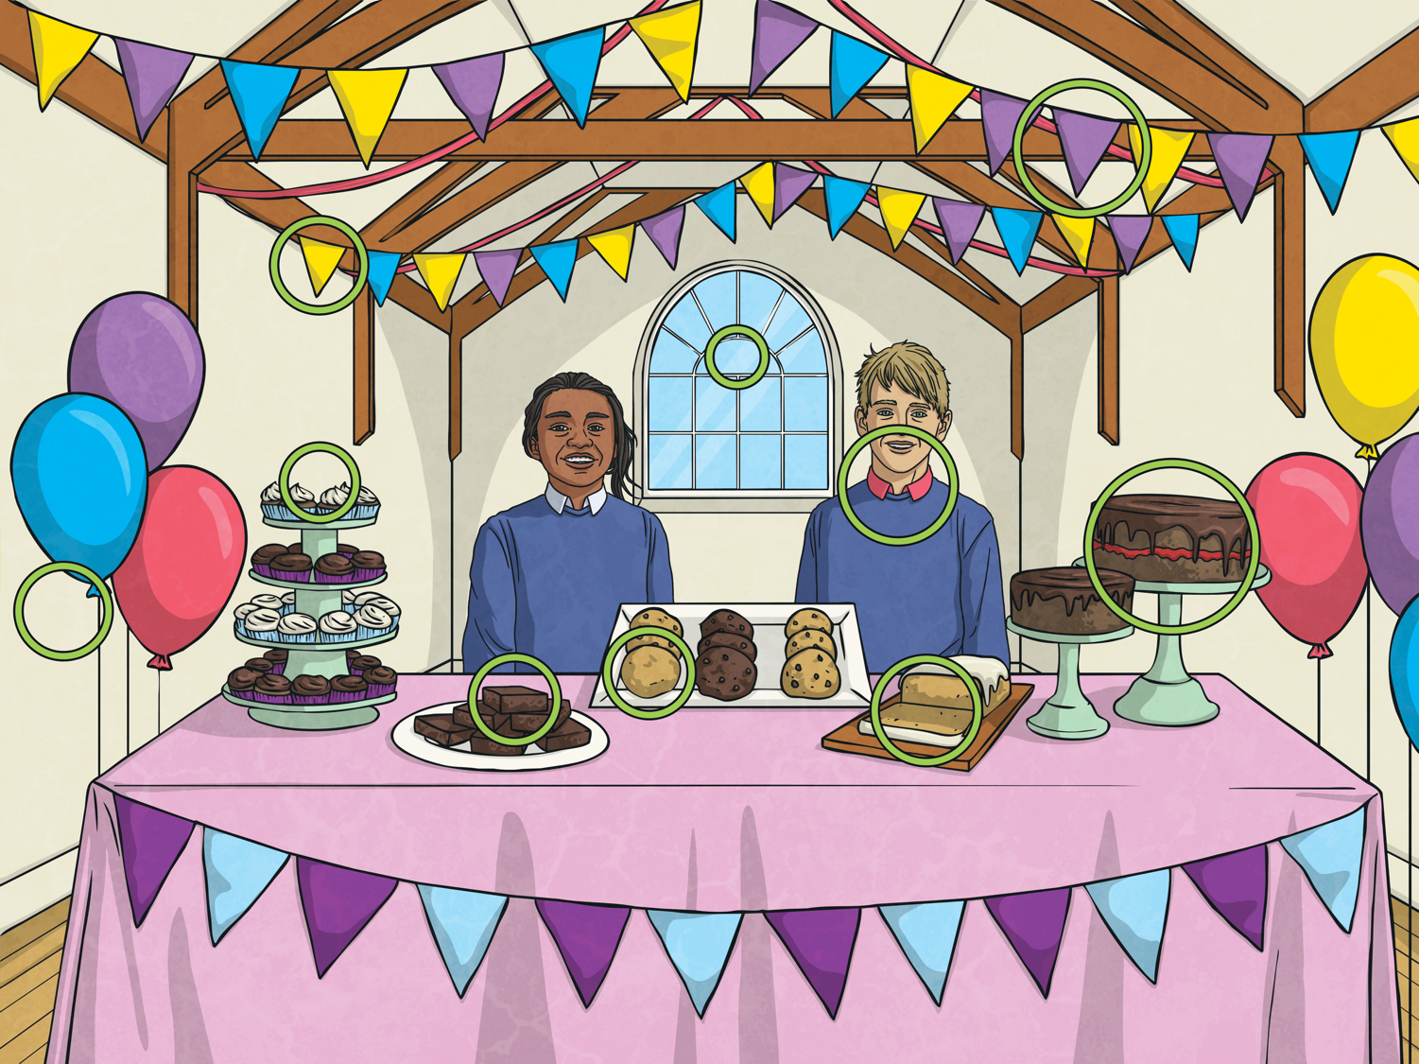
Answers
How many did you get?

Slide 12
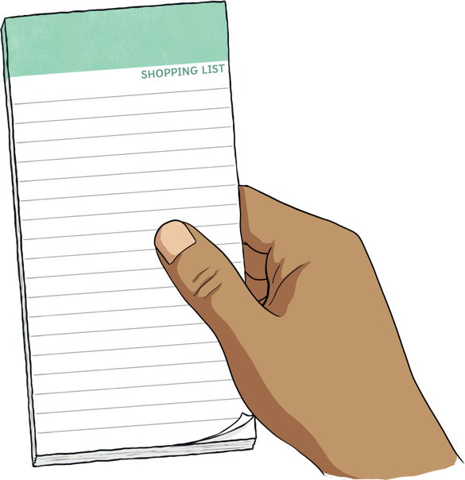
English class shopping list
Instructions:
One student starts a sentence with ‘I need to buy...’ and says an object, e.g. ‘a pencil’.
The next student must remember that object and add their own, e.g. ‘I need to buy a pencil and an eraser’.
Continue for as long as you can. For extra points, see if you can do it in alphabetical order.

Slide 13
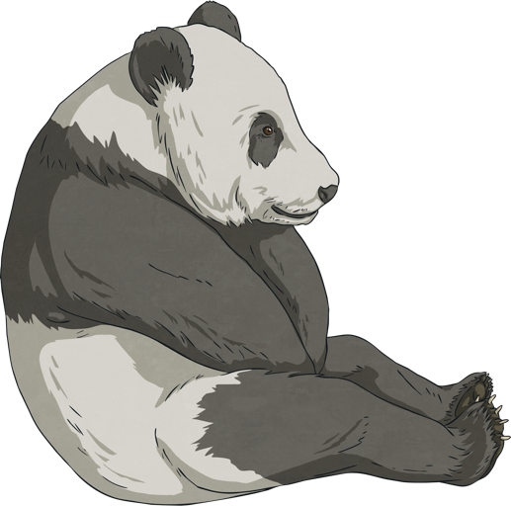
Look at the description. Guess the item.
It’s an animal that eats bamboo and is black and white.
Panda
Click to reveal answer

Slide 14
Look at the description. Guess the item.
It’s a type of warm drink that tastes bitter.
Coffee
Click to reveal answer

Slide 15
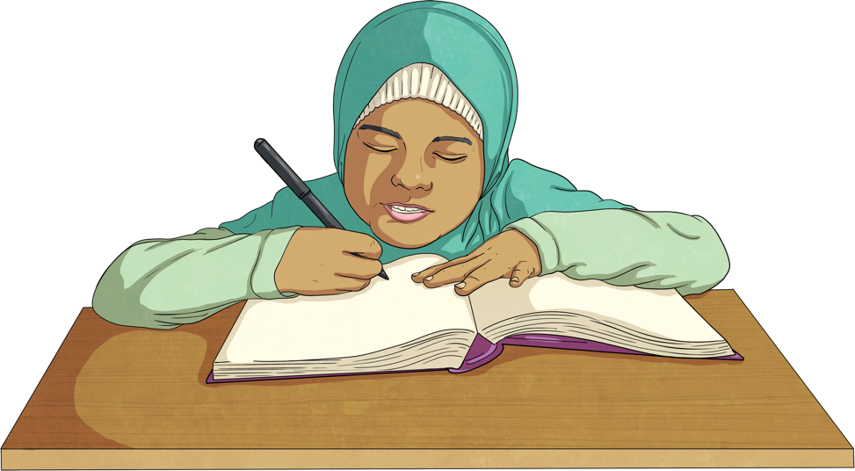
Look at the description. Guess the item.
It's the extra activities you should do after class.
Homework
Click to reveal answer

Slide 16
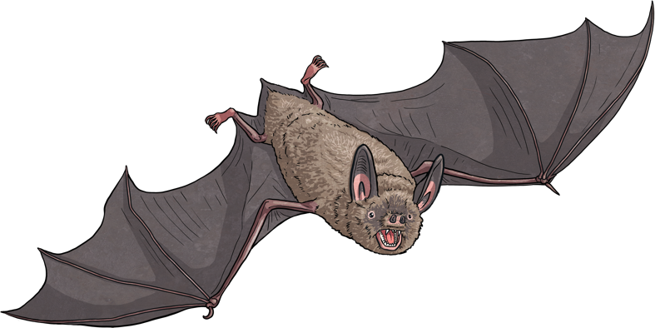
Look at the description. Guess the item.
It’s a flying animal that isn’t a bird. It is brown and lives in a cave.
Bat
Click to reveal answer

Slide 17
Look at the description. Guess the item.
It’s the person who stands in a classroom and gives students new information.
Teacher
Click to reveal answer

Slide 18
Look at the description. Guess the place.
It's the continent with the fewest people.
Antarctica
Click to reveal answer

Slide 19
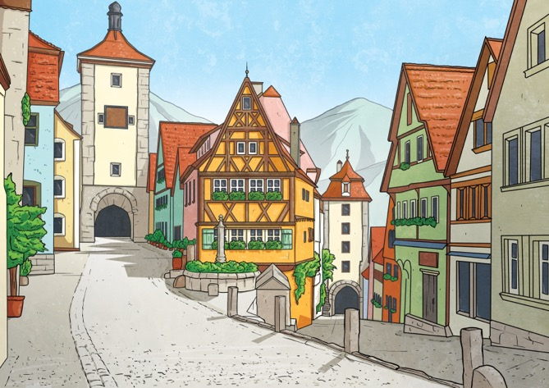
Look at the description. Guess the place.
It’s a name for a place that’s smaller than a city, but bigger than a village.
A town
Click to reveal answer

Slide 20
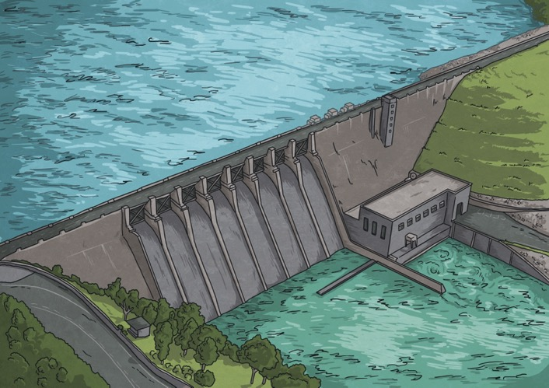
Look at the description. Guess the place.
It’s a name for an unnatural lake.
A dam
Click to reveal answer

Slide 21
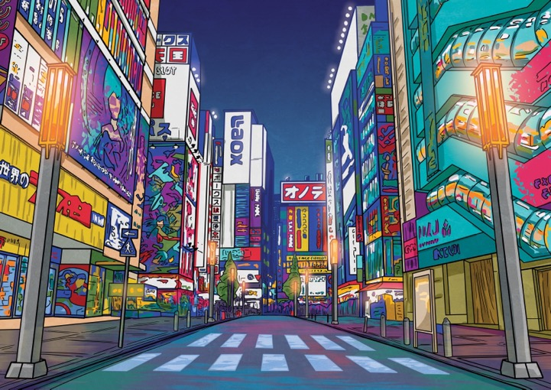
Look at the description. Guess the place.
It’s the city with the most people.
Tokyo
Click to reveal answer

Slide 22
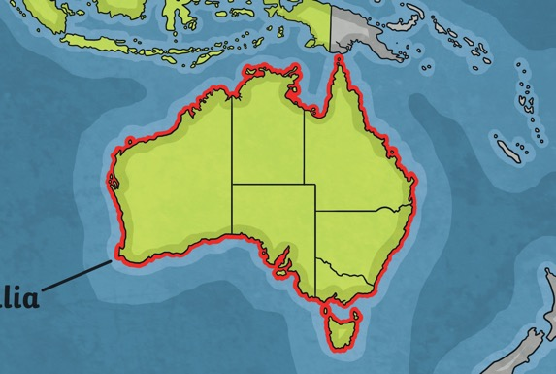
Look at the description. Guess the place.
It’s both a country and a continent.
Australia
Click to reveal answer

Slide 23
True or false?
The sun’s surface is 5500C.
True
In the Southern hemisphere, summer is in July.
False. Summer is in December - February.
2456 ÷ 8 = 307
True
In the UK, cars drive on the left side of the road.
True
A human has 34 teeth.
False. A human has 32 adult teeth.
Click to reveal answer

Slide 24
Thanks for playing!

