Slide 3
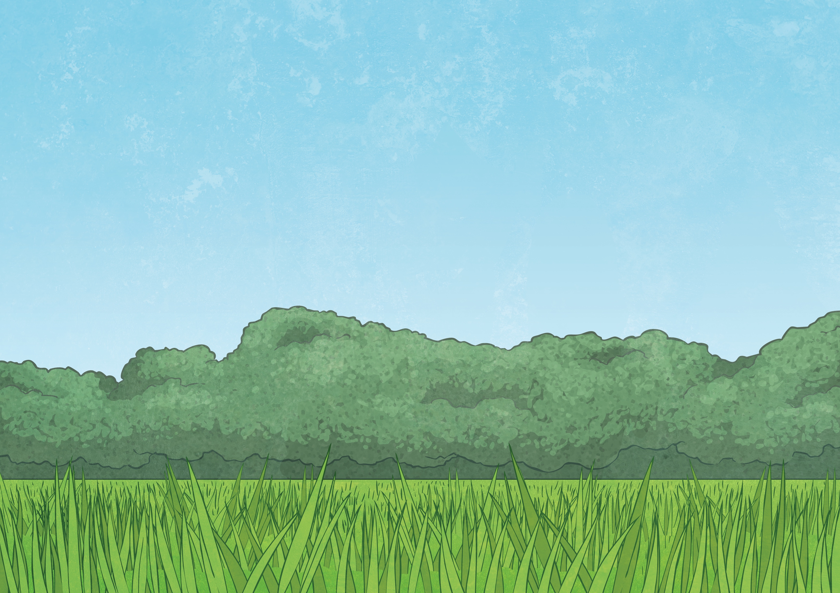
Warm-up questions:
Warm-up questions:
Warm-up questions:
What are your favourite summer activities?
Would you rather go on vacation to a city, or a beach?
Would you rather be too hot or too cold?

Slide 4
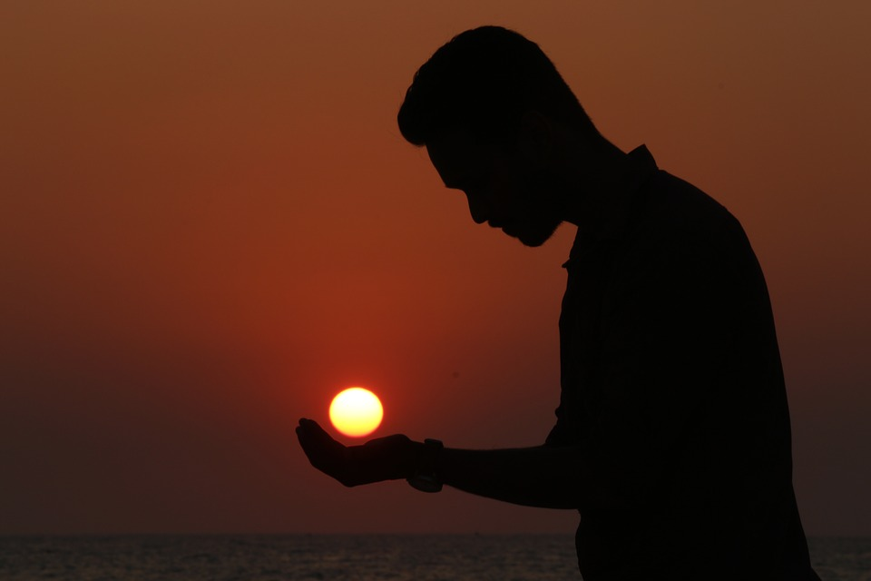
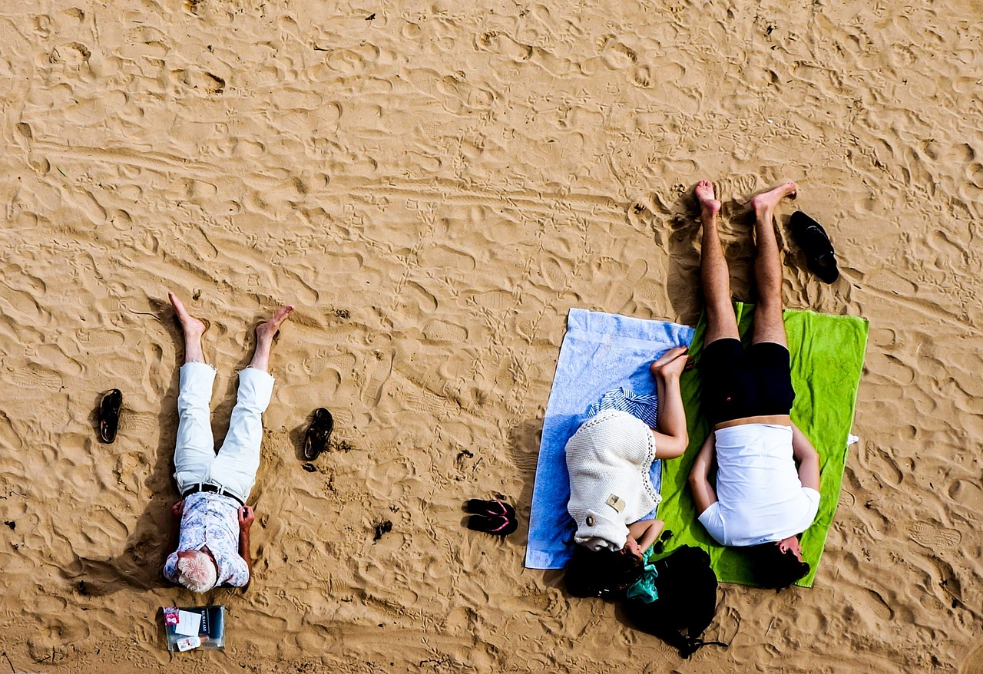
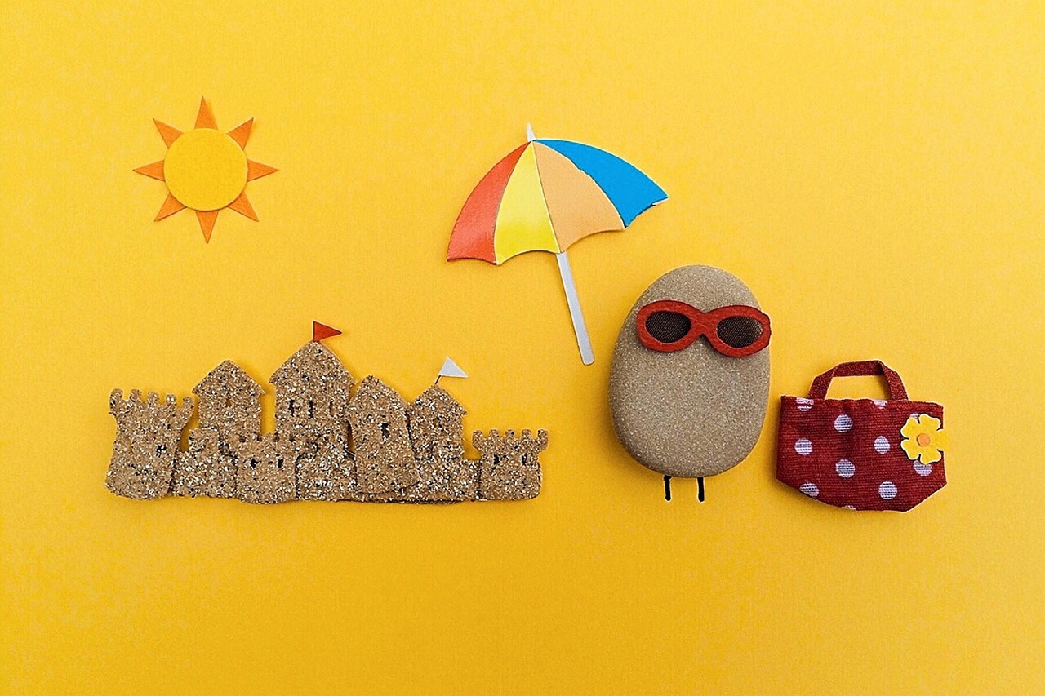
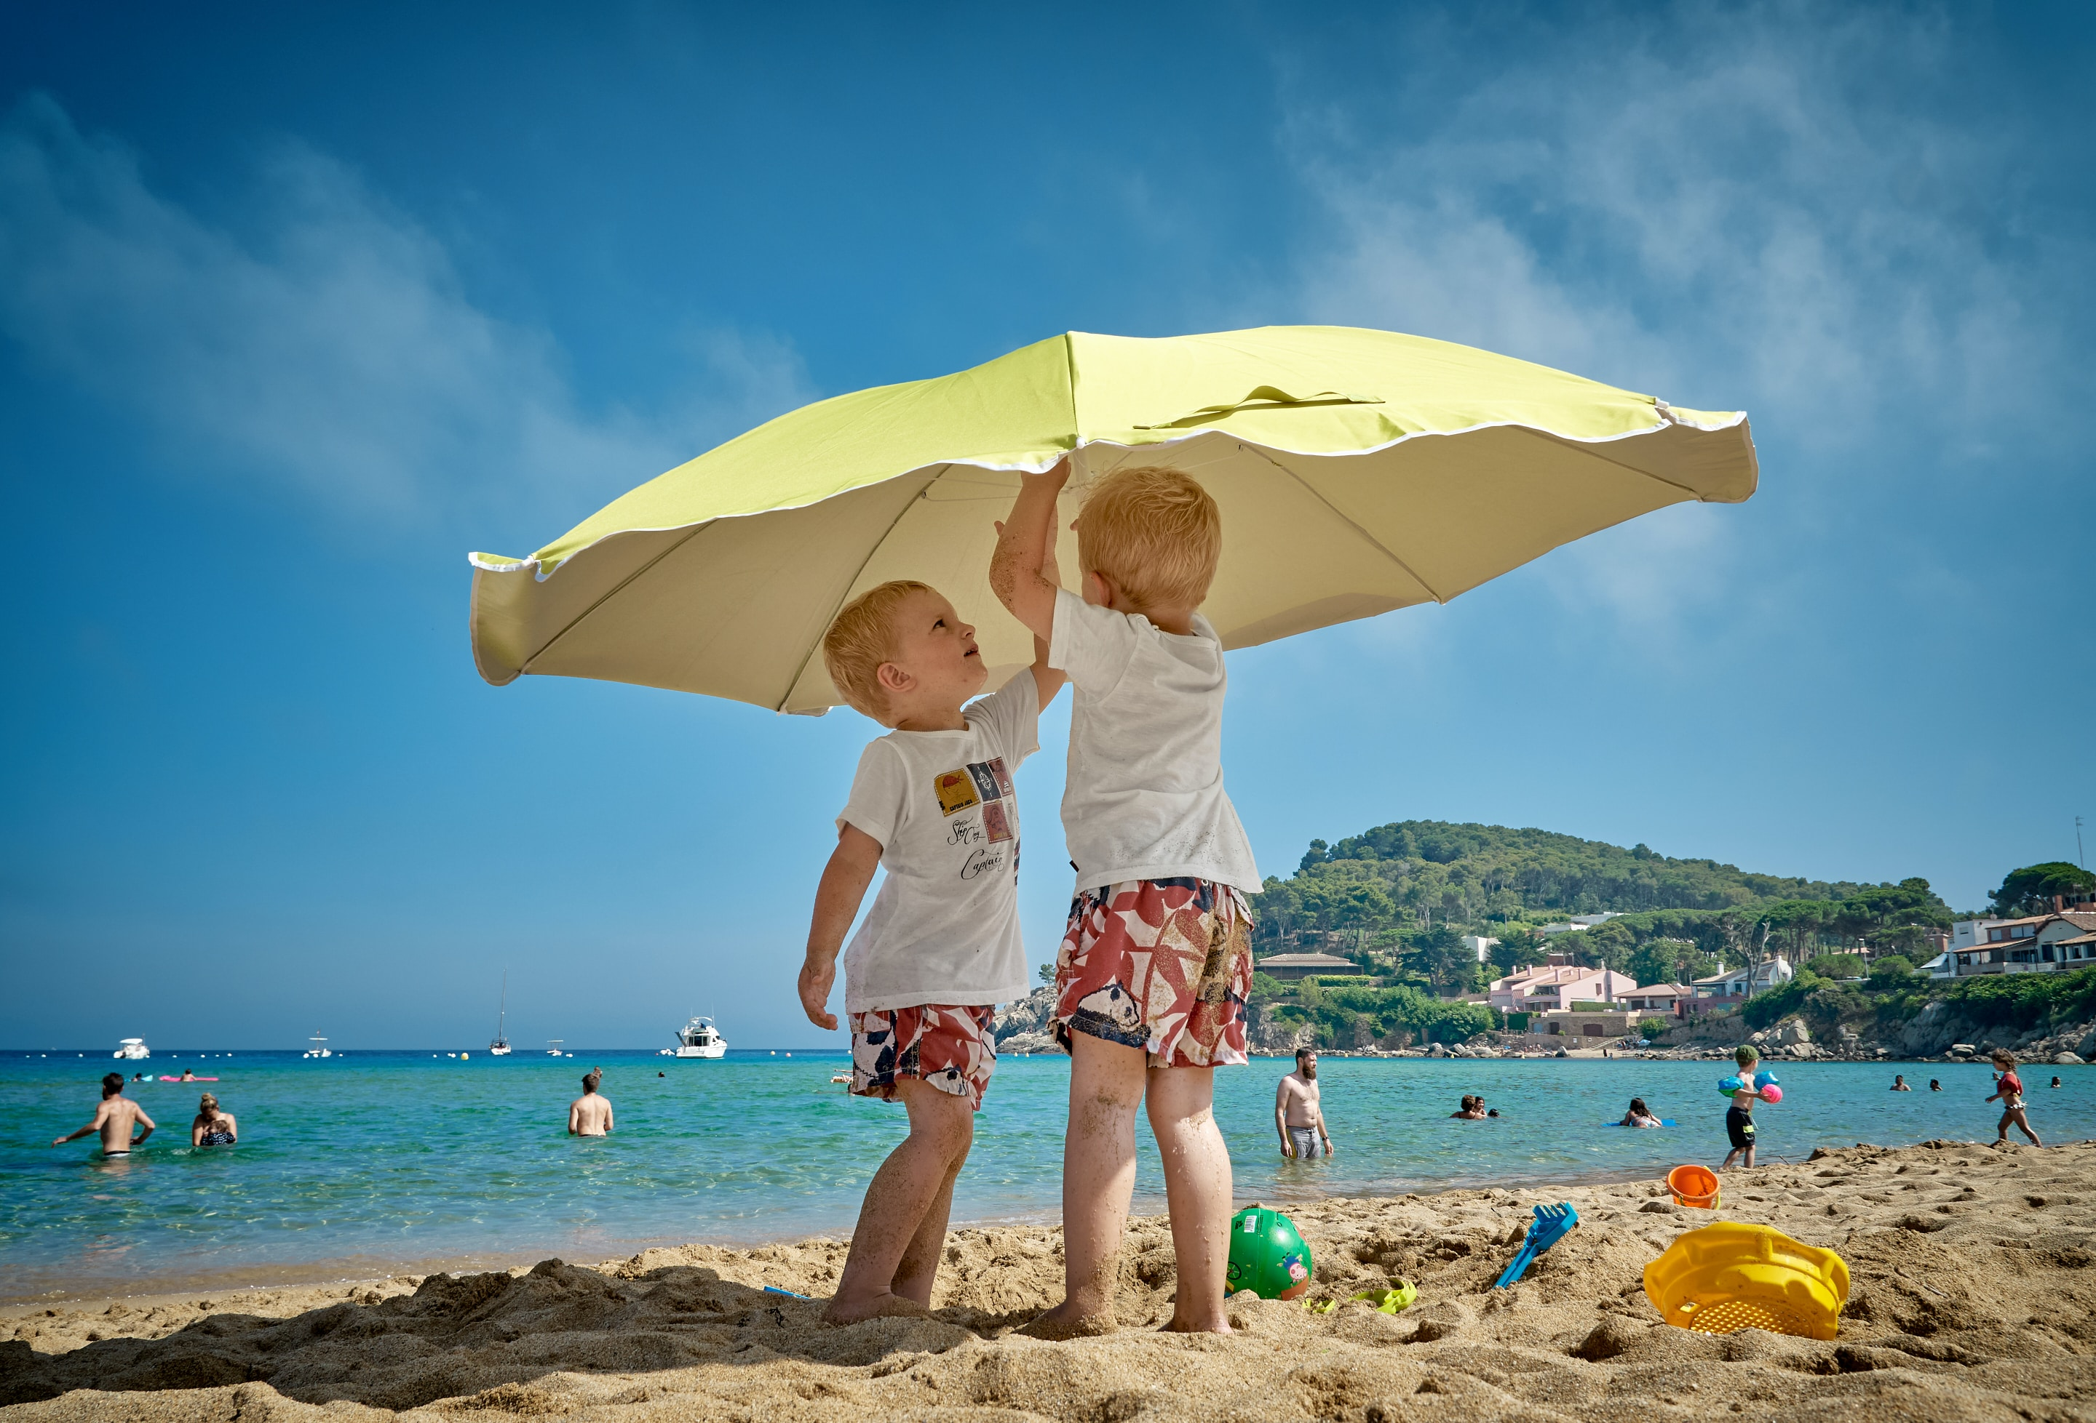
Look at the following photos. Take notes of what objects you can see, and what you think happened before/after the photo. Discuss your observations with your teacher or partner.

Slide 5
What do you see?
What materials are in this photo?

Slide 6
What do you see?
Are there people in the photo?
What optical illusion is used?

Slide 7
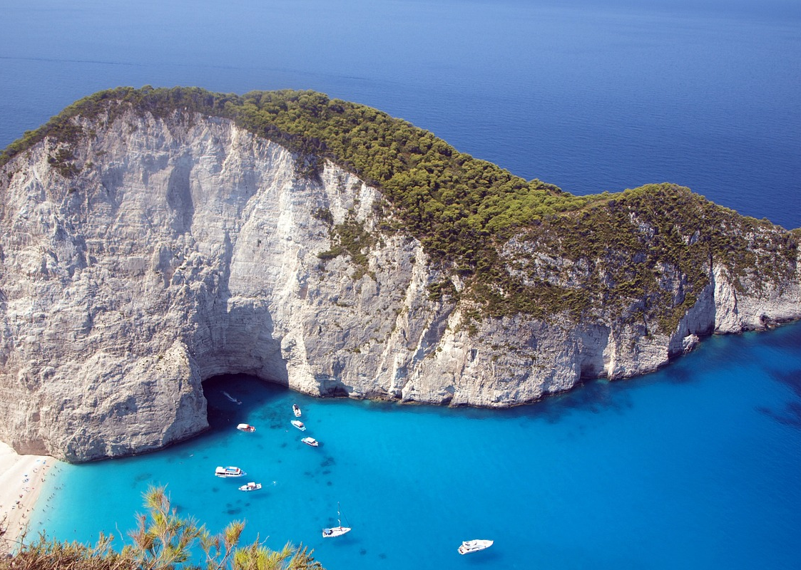
What do you see?
Are there people in the photo?
What geographical features are in this photo?

Slide 8
What do you see?
What do you think happened before this photo was taken?
What will happen when they wake up?

Slide 9
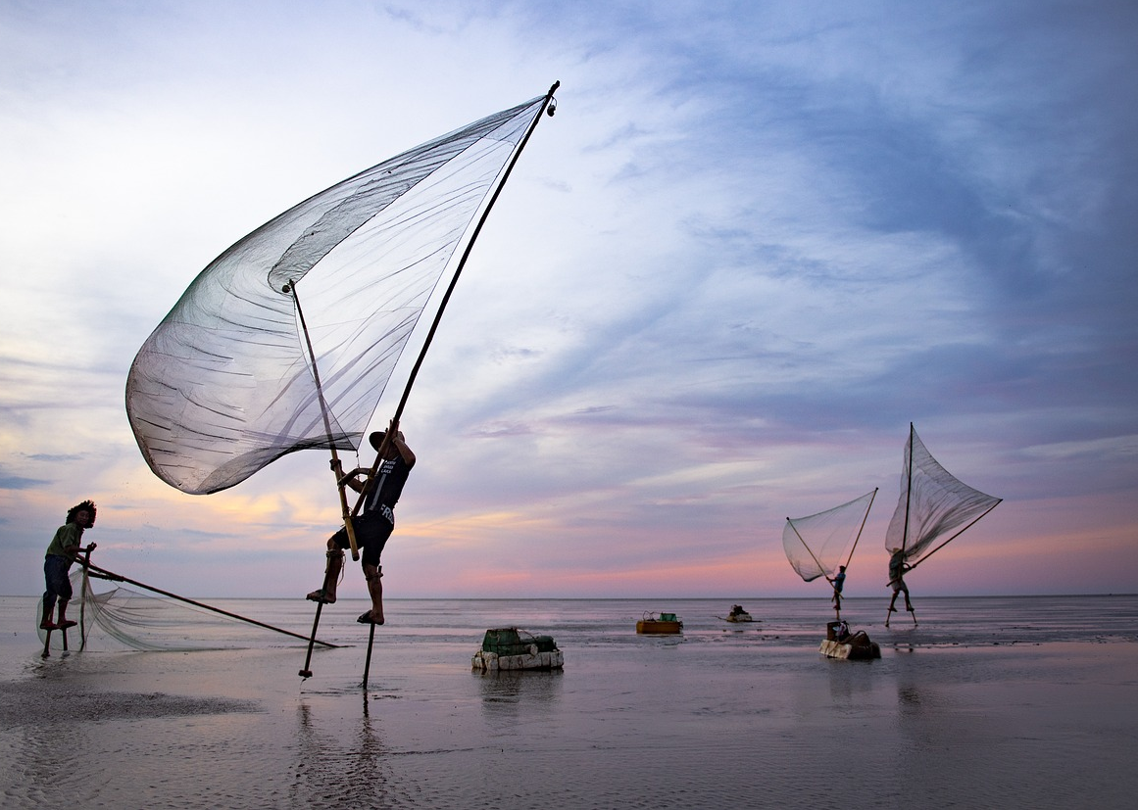
What do you see?
What are they doing? Why?
Would you like to this?

Slide 10
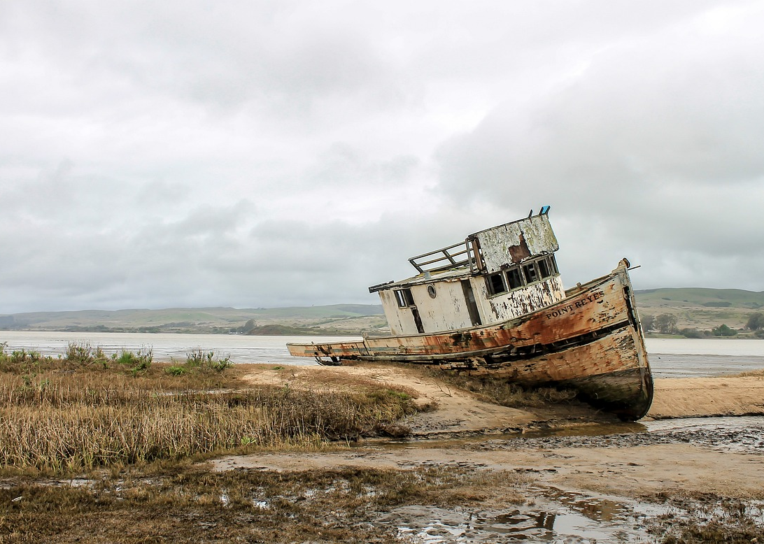
What do you see?
What happened to the ship?
Where do you think this photo was taken?

Slide 11
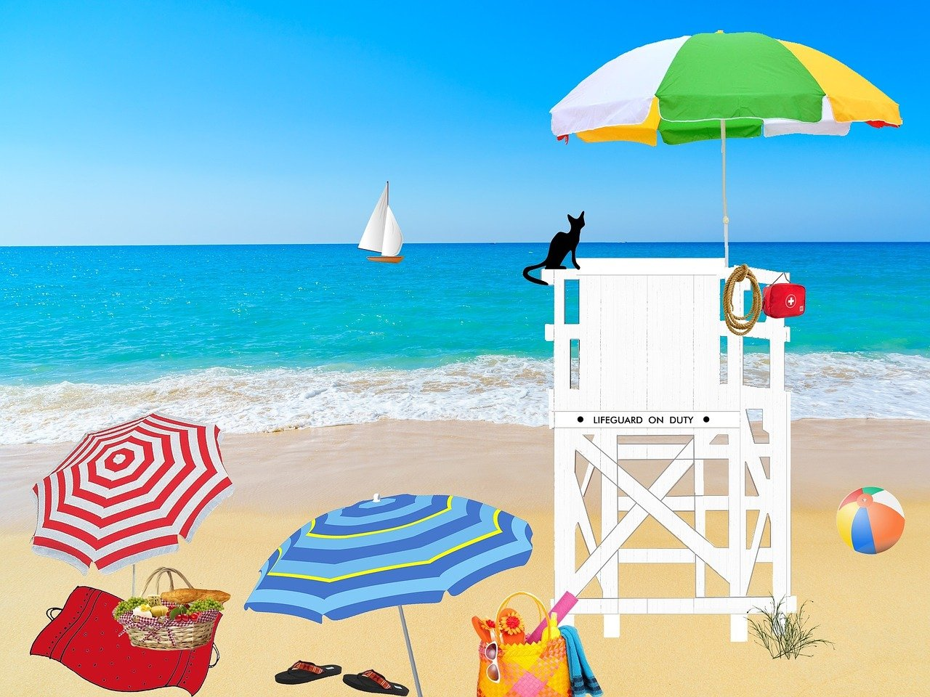
How many different items are there?
What’s in the background?
What animal is in the photo?

Slide 12
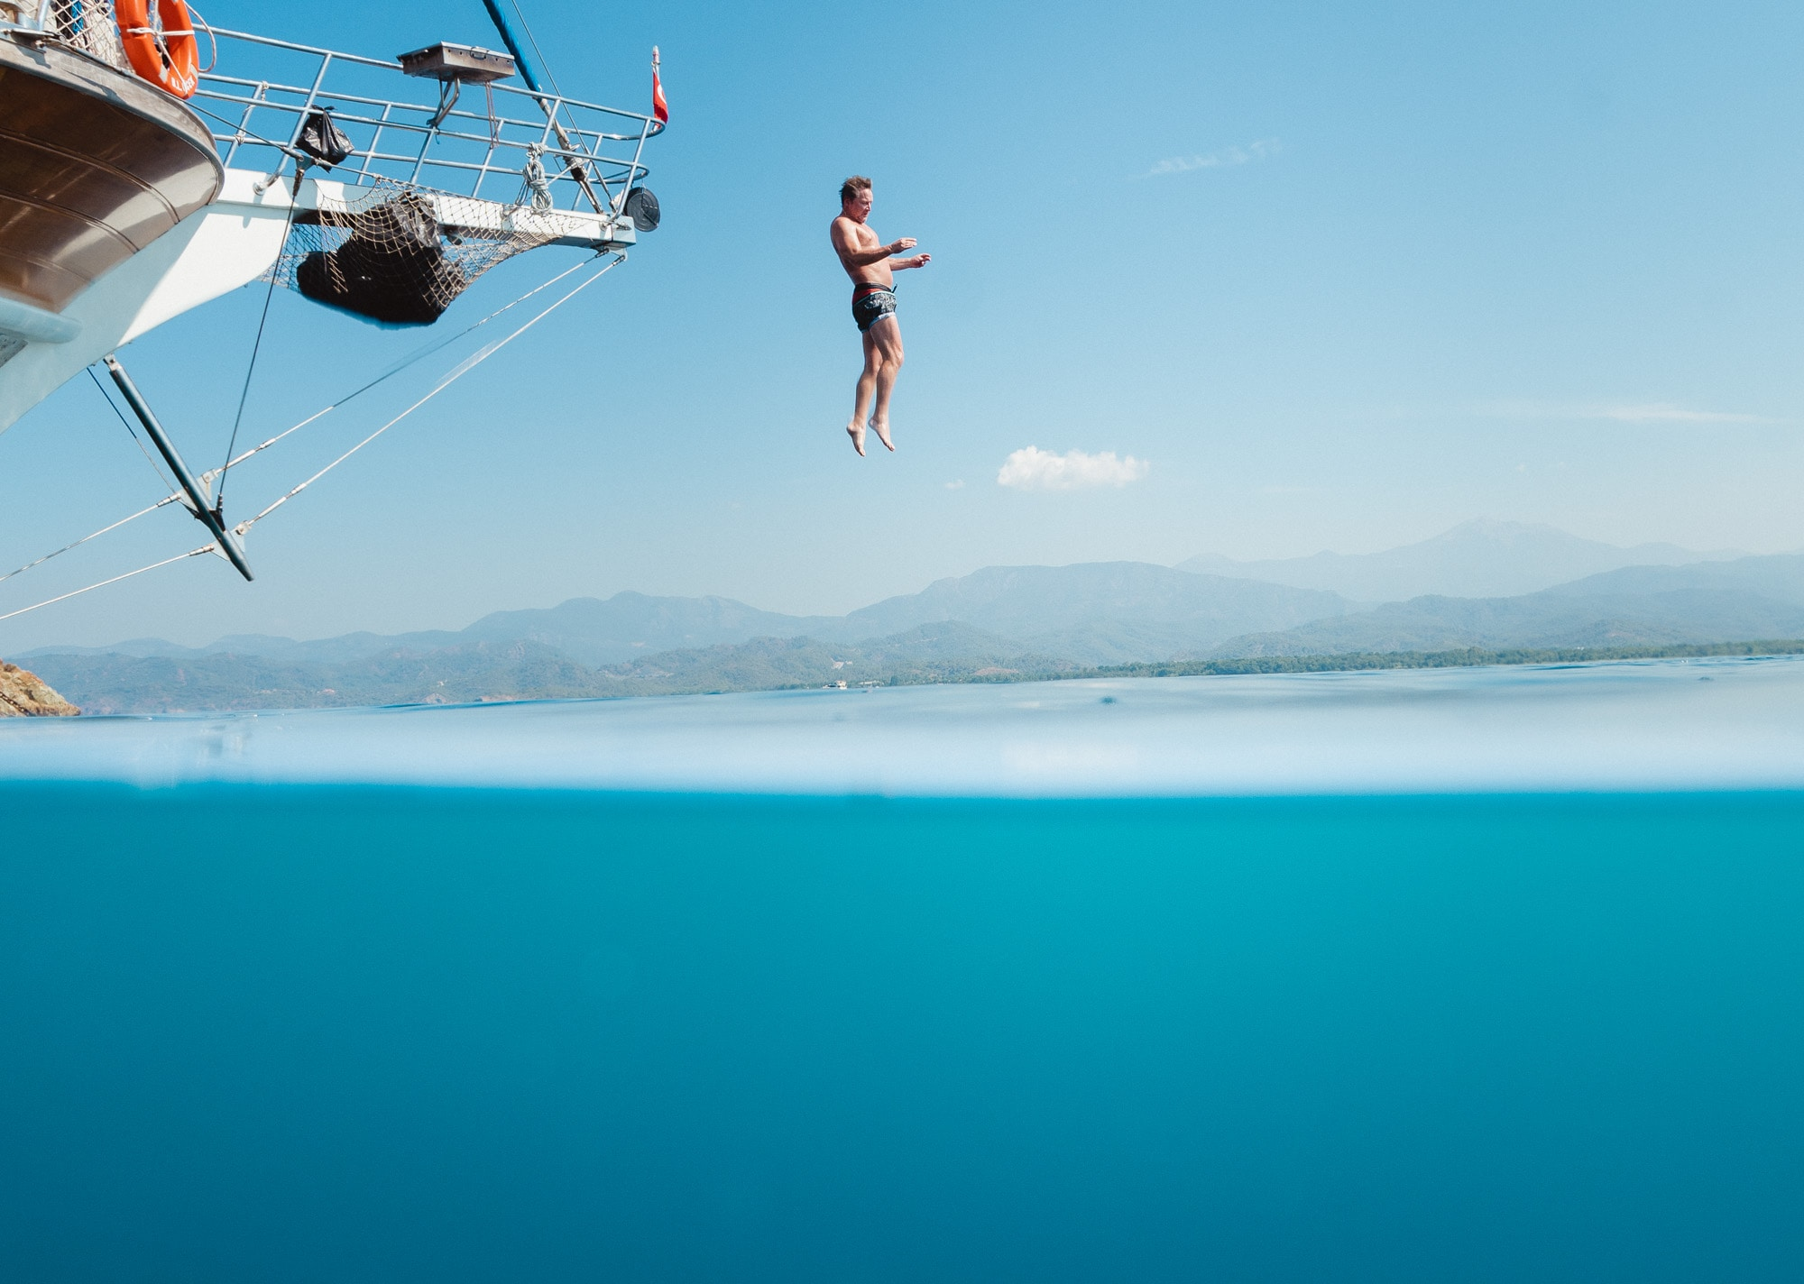
What do you see?
How do you think this photo was taken?
What do you think happened after the man jumped?

Slide 13
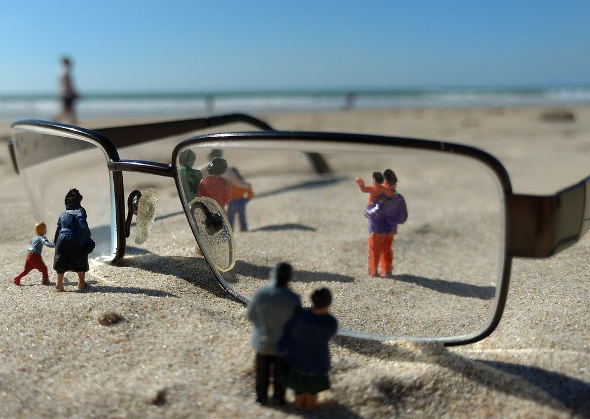
What do you see?
Are there people in this photo?
What optical illusion is used in this photo?

Slide 14
What do you see?
Where do you think this photo was taken?
Why do you think there is both a pool and the ocean?

Slide 15
What do you see?
What types of fruit can you see?
What do you think happened after this photo was taken?

Slide 16
What do you see?
What type of sport is this?
What’s in the background?
Where was this photo taken?

Slide 17
What do you see?
Why are the children using the umbrella?
Do you think they’re siblings? Why?

Slide 18
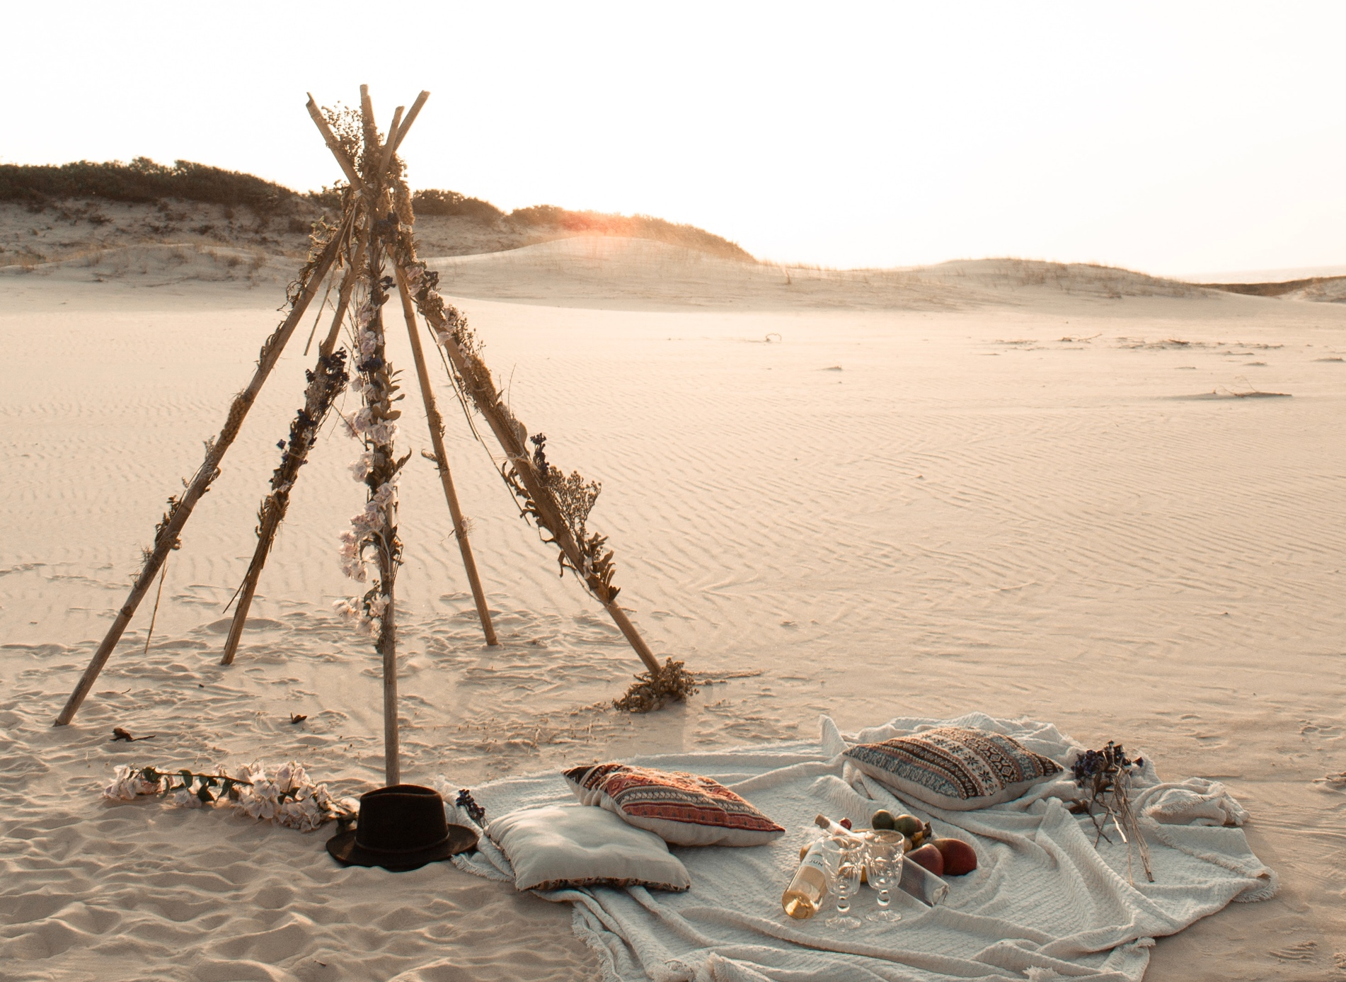
What do you see?
What do you think happened after this photo was taken?

