Slide 3
Warm up Questions
How often do you think about the future?
What does the word ‘ambition’ mean to you?
Where do you see yourself in the next five years?

Slide 4
Dreams vs Goals
A dream is a wish, a thought or hope that something will one day happen.
A goal is a well-planned idea of the future and needs hard work to happen.

Slide 5
Set a goal
Achieve a goal

Slide 6
Match each sentence to the sentence that has the same meaning.
A
Set a goal.
Accomplish a goal.
1
B
Achieve a goal.
Make a goal.
2

Slide 7
Set a goal
Complete the sentences with the correct question word.
Where | When | What | Who | Why | How
do you want to achieve?
What
can help you accomplish the goal?
Who
will you work on your goal?
Where
will you achieve your goal i.e. date?
When
is it important to accomplish your goal?
Why
will you achieve this goal i.e method?
How

Slide 8
Think about something you want to achieve. Answer the questions.
What do you want to achieve?
Who can help you accomplish the goal?
Where will you work on your goal?
When will you achieve your goal i.e. date?
Why is it important to accomplish your goal?
How will you achieve this goal i.e method?

Slide 9
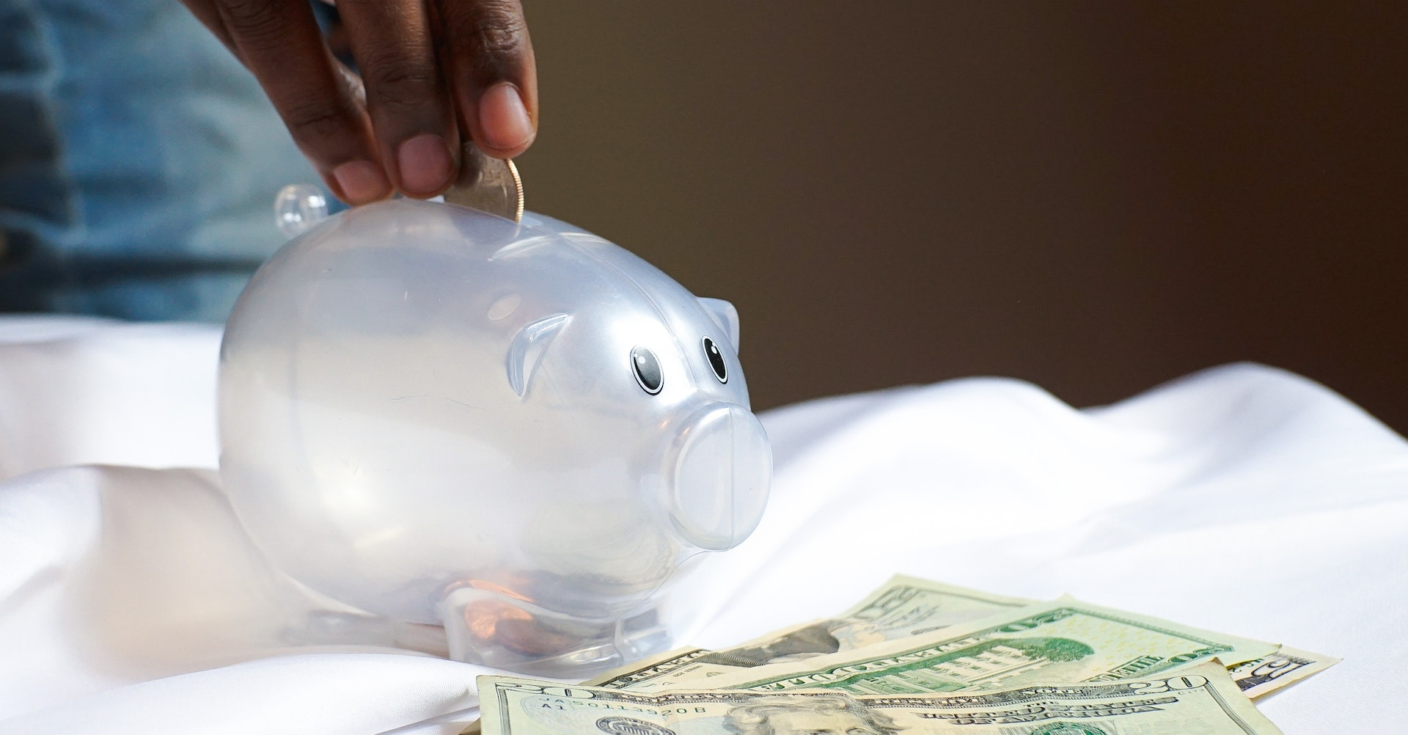
Vocabulary - Goal Types
Health
Personal
Financial
Professional

Slide 10
Read the sentence and choose the correct answer.
What kind of goal is it?
You plan to visit 20 countries before your 30th birthday.
A
Personal goal
B
Health goal
C
Professional goal

Slide 11
Read the sentence and choose the correct answer.
What kind of goal is it?
Shahad wants to start her own business after university but she needs more experience, so she’s going to work as intern this summer.
A
Health goal
B
Professional goal
C
Financial goal

Slide 12
Read the sentence and choose the correct answer.
What kind of goal is it?
Heinz wants to buy his first house. He saves 25% of his salary every month.
A
Personal goal
B
Health goal
C
Financial goal

Slide 13
Read the sentence and choose the correct answer.
What kind of goal is it?
Elisa plans to walk 10,000 steps a day, 5 times a week. She wants to sit less and move more.
A
Financial goal
B
Health goal
C
Personal goal

Slide 14
Discussion questions
Why do you think it’s important to have strong, smart goals?
Are having goals important to living a successful life? Why or why not?
What kind of goals do you usually have? Personal, professional, financial or health goals?

