Slide 3
In this lesson, we will…
Learn some new words
Read a conversation
Learn about the gerund
Talk about our hobbies

Slide 4
Hobbies
What is a ‘hobby’?
Reveal Answer
How many hobbies do you know in English?
Do you have any hobbies? What are they?

Slide 5
Hobbies
What is a ‘hobby’?
A hobby is something we do for fun in our free time. We do hobbies to relax or learn something new.
How many hobbies do you know in English?
Do you have any hobbies? What are they?

Slide 6
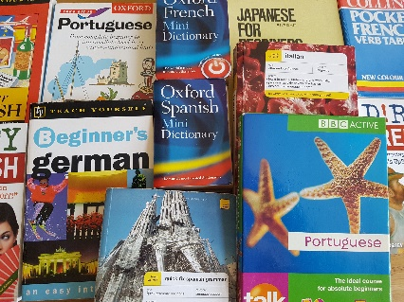
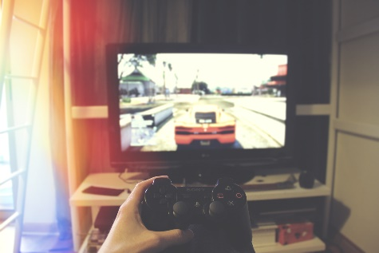
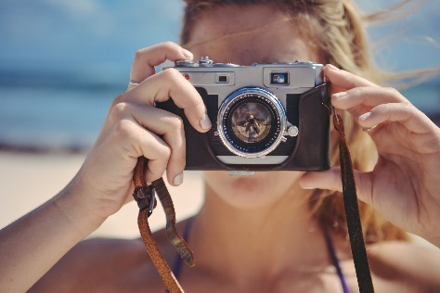
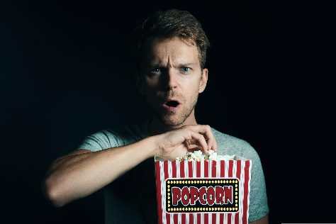
Vocabulary
What are the hobbies?
Reveal Answers

Slide 7
Vocabulary
What are the hobbies?
cooking
reading books
travelling
learning
(a language)
playing
computer games
taking photos
watching movies
listening to music

Slide 8
Vocabulary
What are the hobbies?
She really likes ___________, so I bought her a new frying pan for Christmas.
He hates airports and long journeys, so he doesn’t like __________.
They have a lot of records and CDs because they love ____________.
____________ is fun so I studied literature at university.
It’s quite expensive, so I don’t like ______________ at the cinema.
We just bought a new camera because we love ____________.
My children never ask for a new games console because they think ______________ is boring.
________________ is a great way to speak to new people.
cooking | reading books | travelling | learning (a language)
playing computer games | taking photos | watching movies | listening to music
Reveal Answer

Slide 9
Vocabulary
What are the hobbies?
She really likes cooking, so I bought her a new frying pan for Christmas.
He hates airports and long journeys, so he doesn’t like travelling.
They have a lot of records and CDs because they love listening to music.
4. Reading books is fun so I studied literature at university.
It’s quite expensive, so I don’t like watching movies at the cinema.
We just bought a new camera because we love taking photos.
My children never ask for a new games console because they think playing computer games is boring.
8. Learning a language is a great way to speak to new people.
cooking | reading books | travelling | Learning (a language)
playing computer games | taking photos | watching movies | listening to music

Slide 10
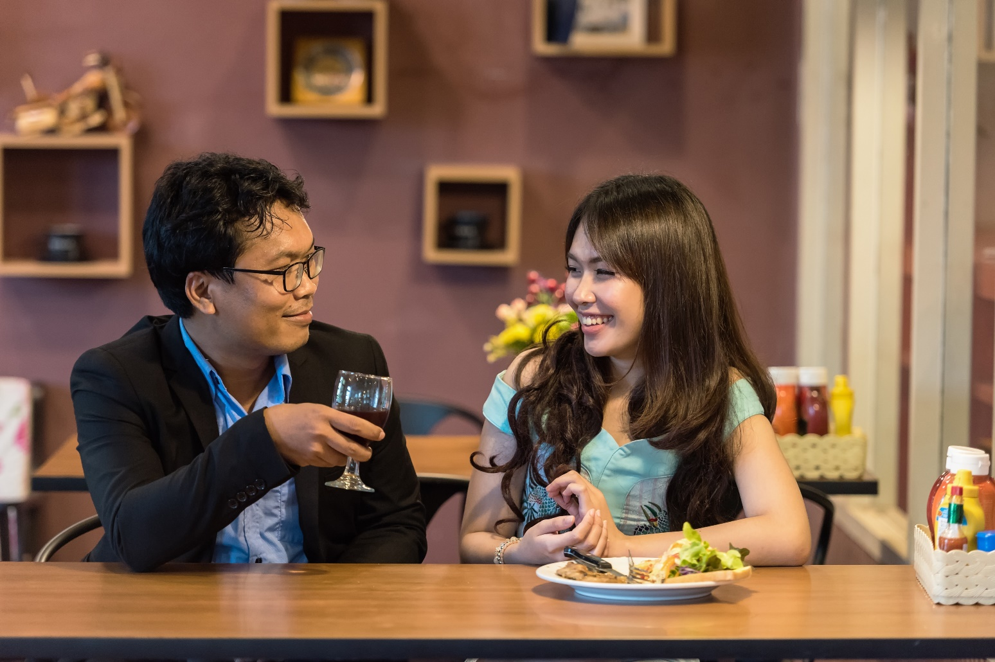
Somchai and Malee are meeting for the first time. They are talking about their hobbies.

Slide 11
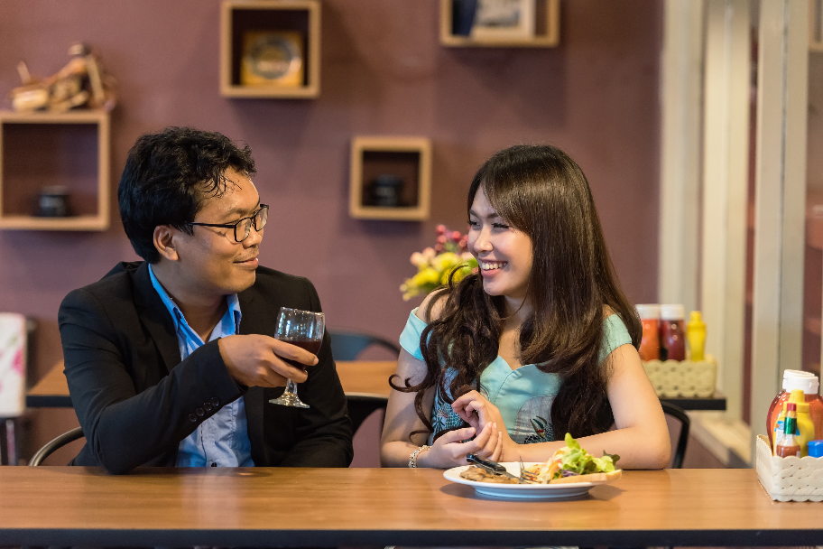
What are your hobbies?
Hmm, I have many! I like taking photographs, watching TV dramas, and learning English! How about you?
Well, I don’t really like taking photographs. I like watching TV dramas though! And I quite like learning languages. I like learning English, and learning Japanese is fun too.
Oh, I see! I really enjoy learning Japanese too.
Malee
Somchai

Slide 12
With your partner or teacher, practise the conversation.
What are your hobbies?
Hmm, I have many! I like _____ photographs, ______ TV dramas, and _______ English! How about you?
Well, I don’t really like _____ photographs. I like _______ TV dramas though! And I quite like ______ languages. I like _____ English, and _______ Japanese is fun too.
Oh, I see! I really enjoy ________ Japanese too.

Slide 13
Grammar Time
In English, we can use -ing verbs like nouns. These are called ‘gerunds’.
We can use gerunds when talking about likes and dislikes, the same way we do with nouns:
I like apples.
I like eating apples.
I like football.
I like playing football.
Movies are fun.
Watching movies is fun.
Books are boring.
Reading books is boring.
Grammar tip: We use ‘is’ with the gerund, even if the object has an ‘s’. So we say ‘Eating apples is healthy.’

Slide 14
Grammar Time
Some gerunds are usually used with an object.
It would be unusual to say ‘I like watching’ or ‘Taking is fun’. We would say ‘I like watching movies/TV/theatre’ and ‘Taking photographs is fun’.
Other gerunds, like running or swimming, don’t need an object:
I love running.
Swimming is difficult.

Slide 15
Grammar Time
Look at the prompts below. Turn them into sentences with the gerund.
I/like/watch/TV
She/not/like/swim
My sister/love/take/photos
They/really like/cook/Chinese food
Read/books/boring
Reveal Answer

Slide 16
Grammar Time
I/like/watch/TV
She/not/like/swim
My sister/love/take/photos
They/really like/cook/Chinese food
Read/books/boring
I like watching TV.
She doesn’t like swimming.
My sister loves taking photos.
They really like cooking Chinese food.
Reading books is boring.

Slide 17
Talking Time
You are going to talk about your hobbies with your partner or teacher.
For a few minutes, write down some of the things you like and don’t like doing.

Slide 18
Talking Time
With your partner, pretend you are meeting for the first time. You want to find out what they like and don’t like.
I don’t really enjoy…
Do you like…
______ is fun.

Slide 19
Final Activity
Look at the sentences below. Can you spot the mistakes?
I likes playing sports.
Watching movies are fun.
They enjoy watching photos.
I cooking Korean food like.
They do like not swimming
Reveal Answer

Slide 20
Final Activity
I like playing sports.
Watching movies is fun.
They enjoy taking photos.
I like cooking Korean food.
They do not like swimming.

