Slide 2
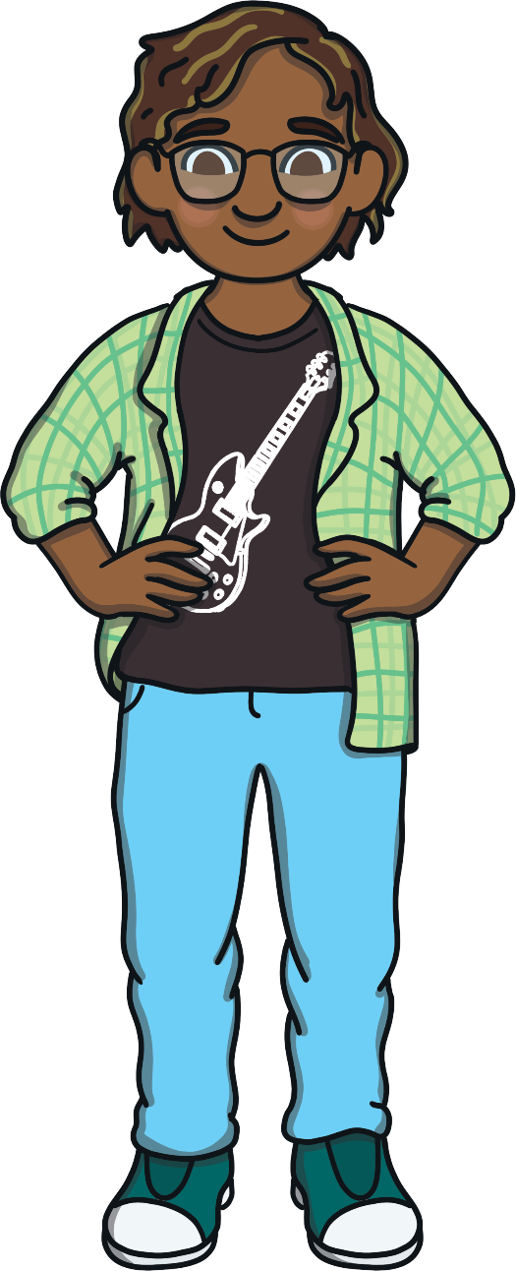
Hi my name is Nnamdi Noun and I like naming things. My job is to make sure people, places and animals have a name.

Slide 3
A noun is a naming word. It can name a person, place or thing.

Slide 4
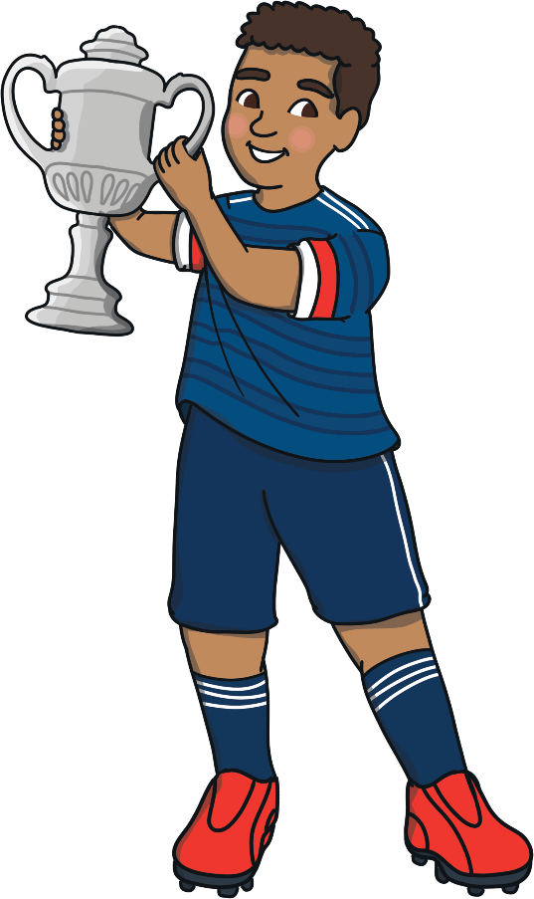
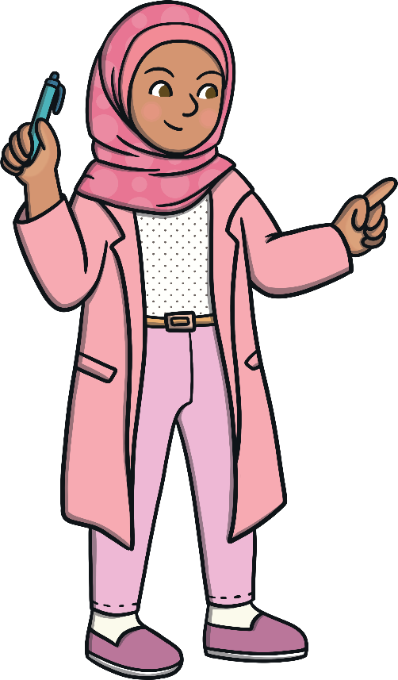
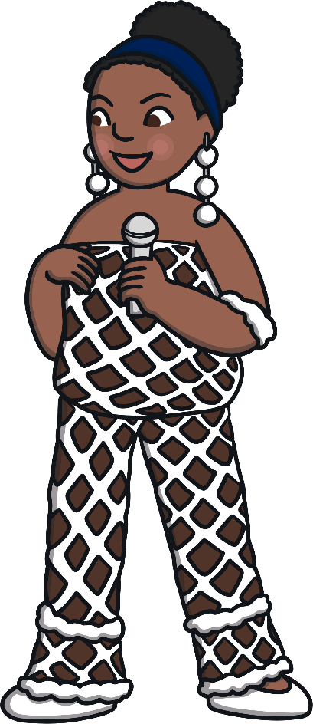
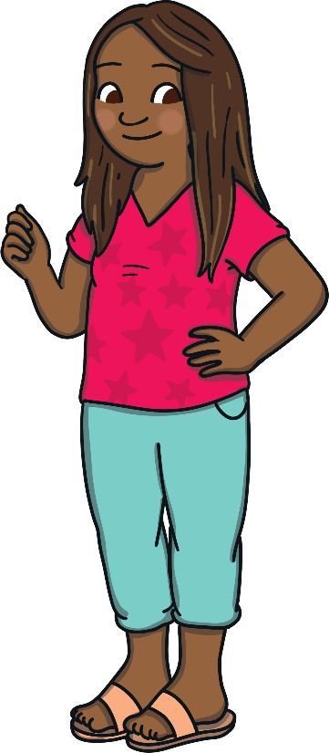
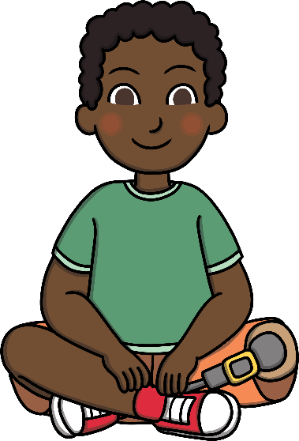
Name of a Person
Faith
footballer
doctor
teacher
boy
popstar

Slide 5
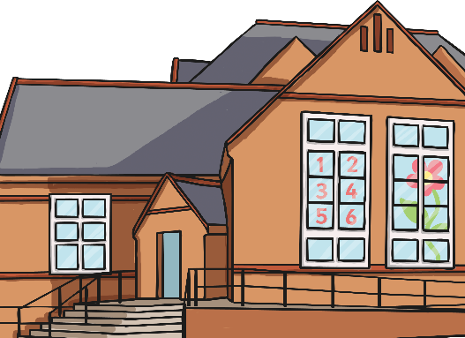
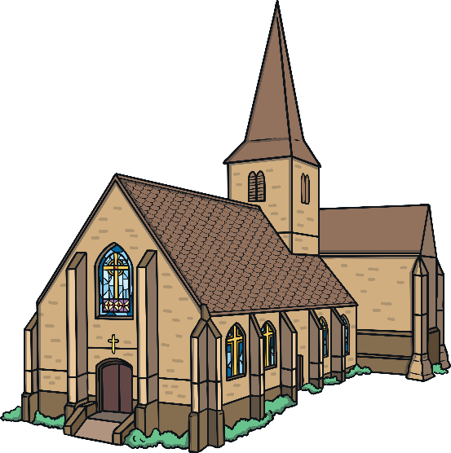
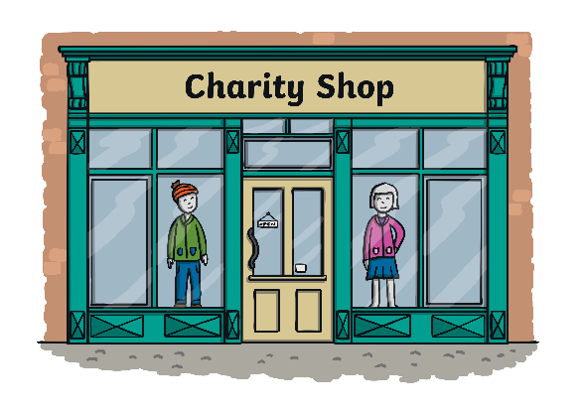
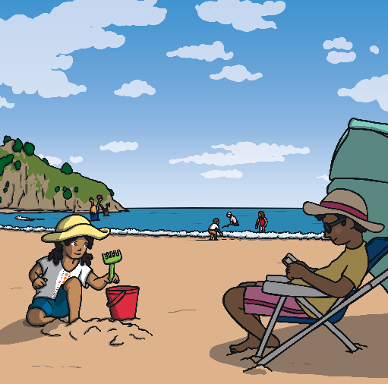
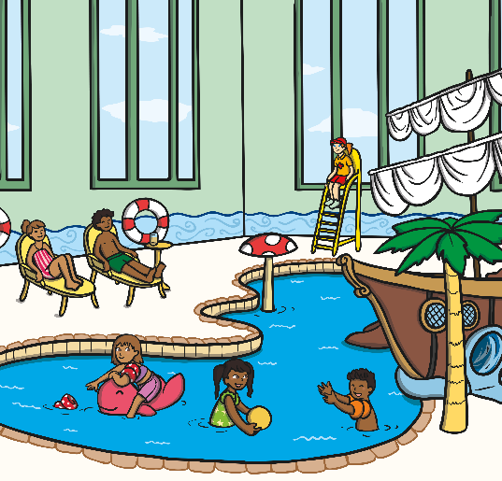
Name of a Place
school
London
shop
church
swimming pool
beach

Slide 6
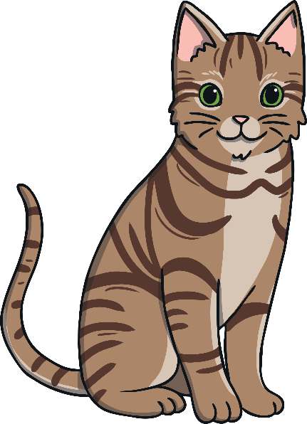
Name of a Thing
book
cat
pencil
television
ball
chair

Slide 7
Find the Nouns
Look at the words below. Which ones are nouns?
candle
pretty
dancing
owl
bird
Joshua
flying
plane
car
tree
brown
crispy
tall
trousers
t-shirt
bed
dog
jacket
skipping rope
shiny

Slide 8
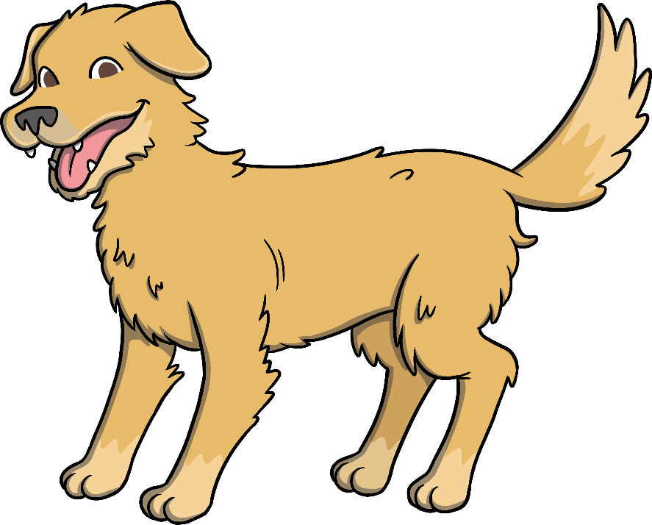
Can you find the noun in this sentence? Click for the answer.
The dog is wet.
dog
Answer: dog

Slide 9
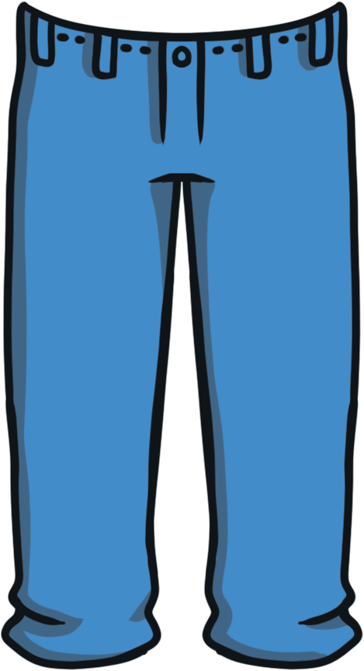
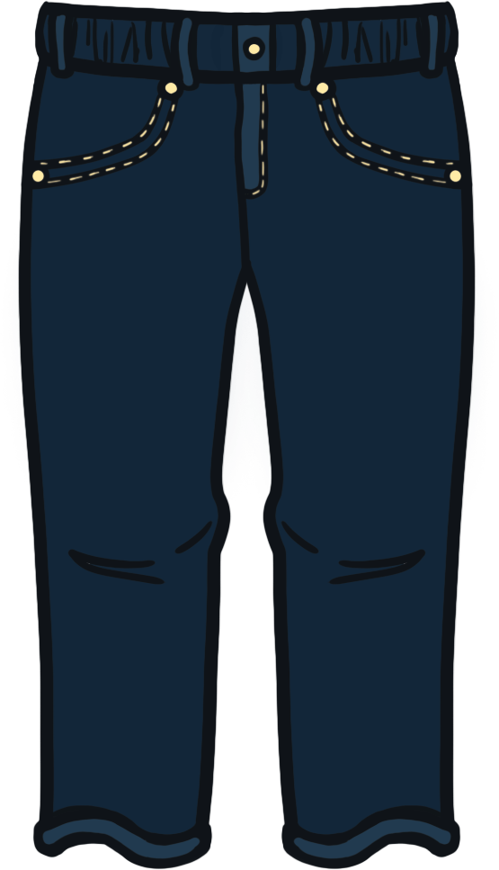
Can you find the noun in this sentence? Click for the answer.
The trousers are blue.
trousers
Answer: trousers

Slide 10
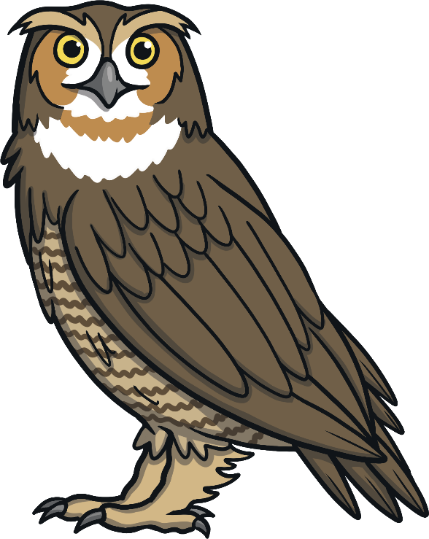
Can you find the noun in this sentence? Click for the answer.
Look at the beautiful owl.
owl
Answer: owl

Slide 11
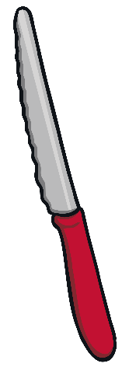
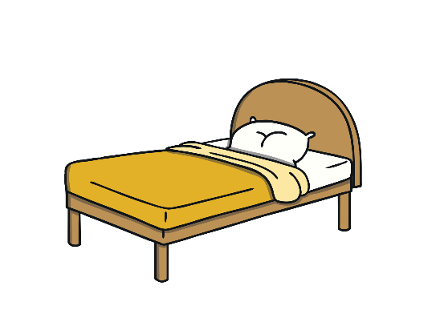
Solve the puzzle below by finding the correct noun.
Something you use for cutting bread
Choose the correct noun.
knife
spoon
cat
bed

Slide 12
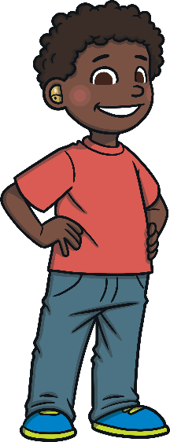
Solve the puzzle below by finding the correct noun.
An animal that barks.
Choose the correct noun.
chair
dog
Ikenna
Light

Slide 13
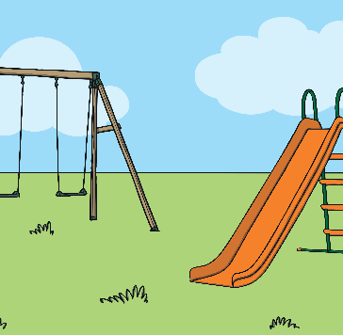
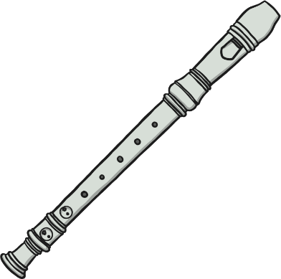
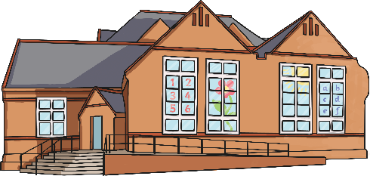
Solve the puzzle below by finding the correct noun.
A place you go to learn.
Choose the correct noun.
park
school
recorder
candle

Slide 14
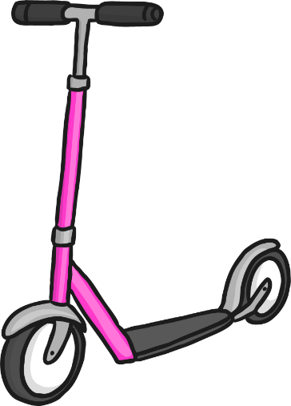
Solve the puzzle below by finding the correct noun.
Something you use to write with.
Choose the correct noun.
scooter
strawberry
book
pencil

