Slide 2
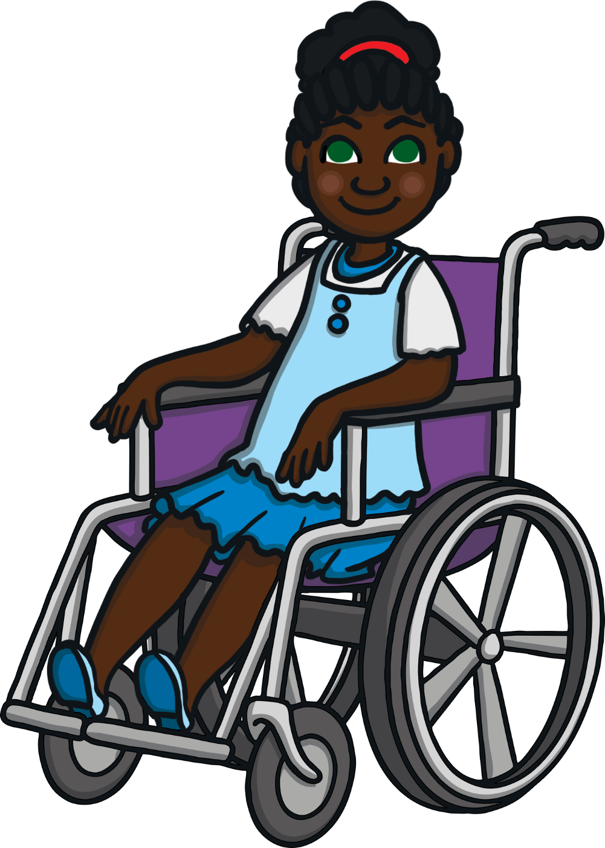
Hi, my name is Victoria Verb. I love to move and am always busy doing different actions.
Do you know what a verb is?
Let’s look at some pictures on the next few pages to try to work it out.

Slide 3
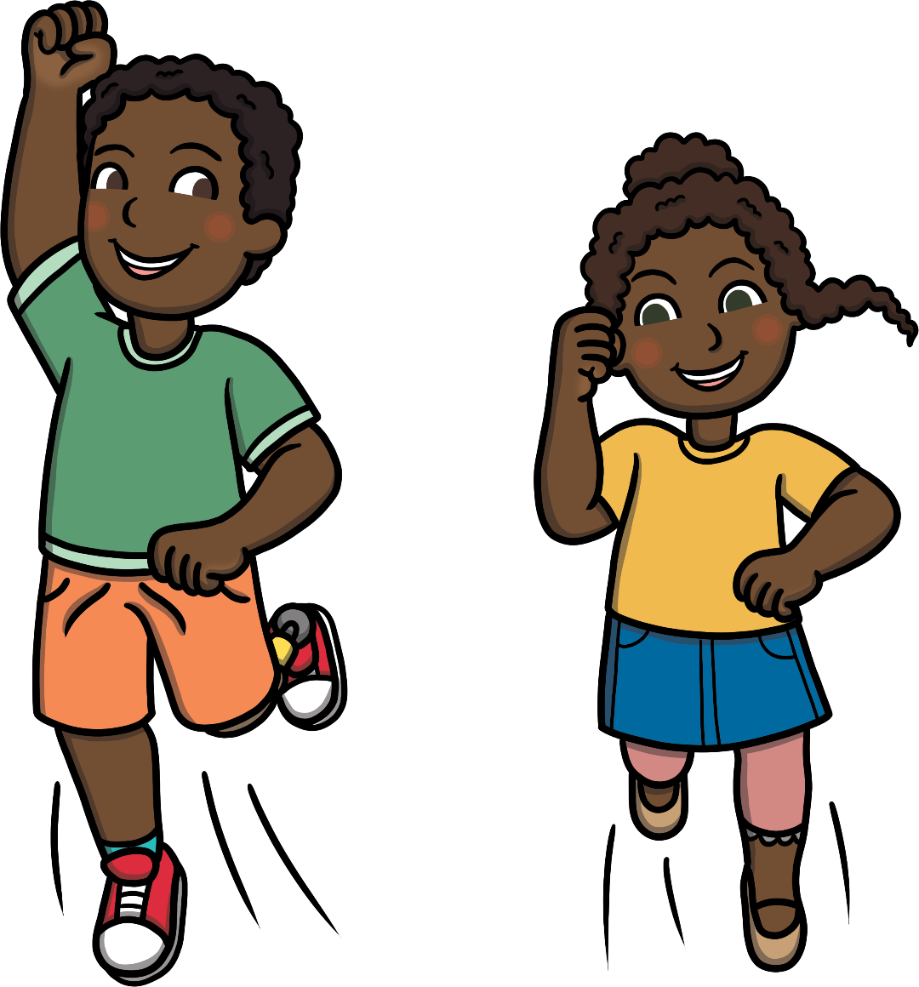
What Is a Verb?
jump

Slide 4
What Is a Verb?
clap

Slide 5
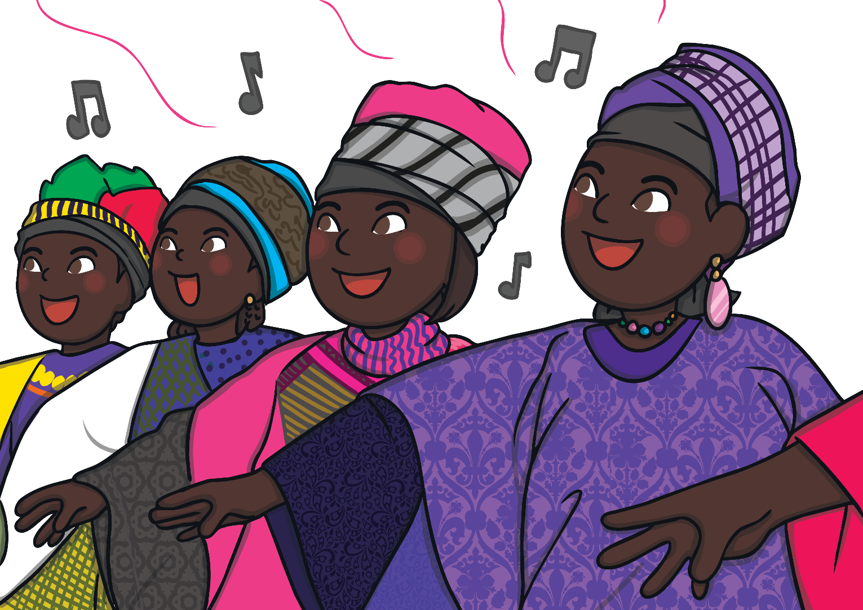
What Is a Verb?
sing

Slide 6
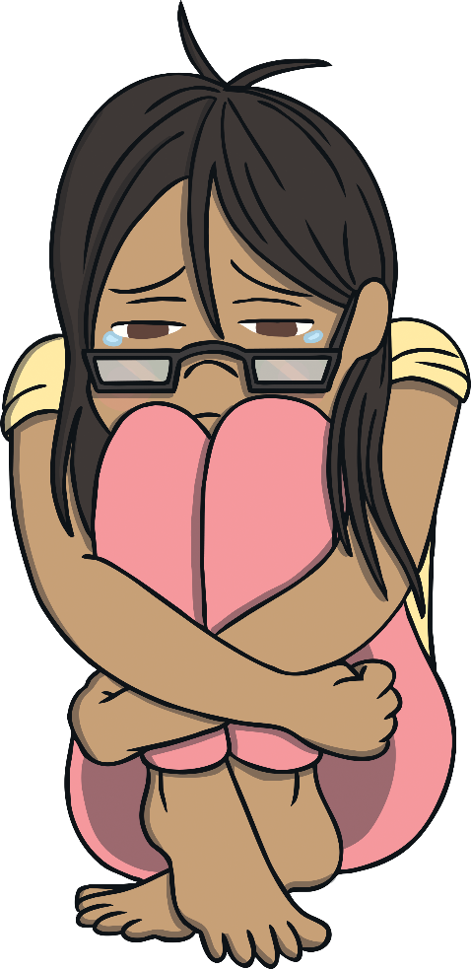
What Is a Verb?
cry

Slide 7
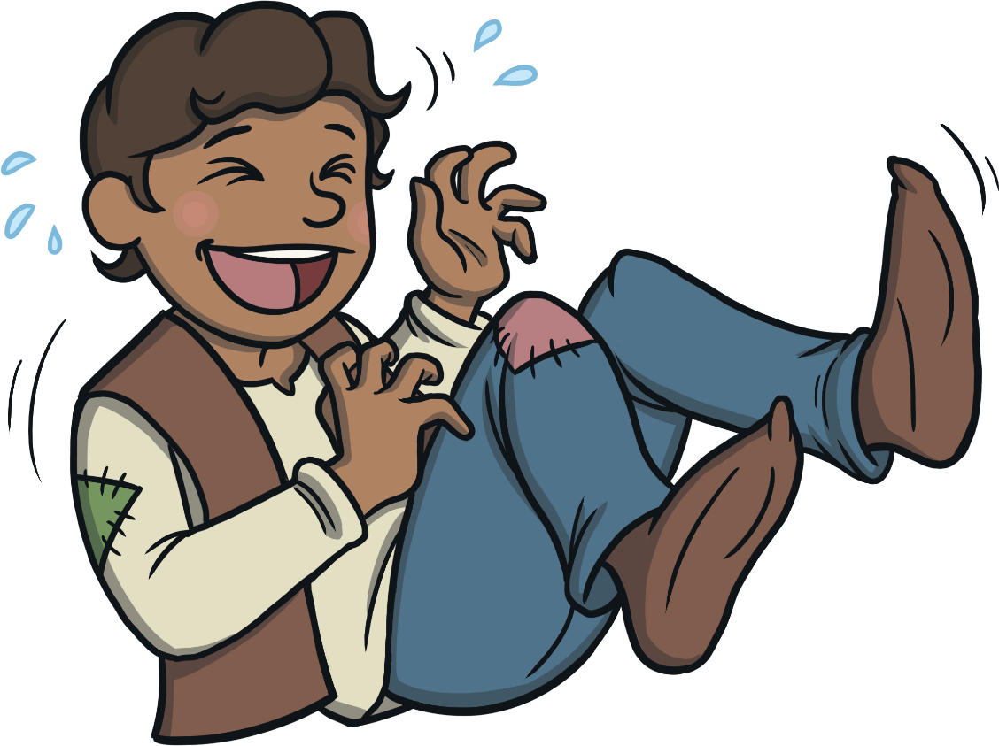
What Is a Verb?
laugh

Slide 8
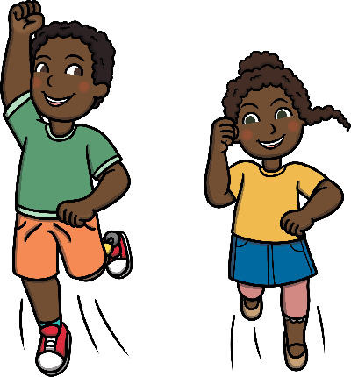
What Is a Verb?
Verbs are action words. They describe what someone is doing.

Slide 9
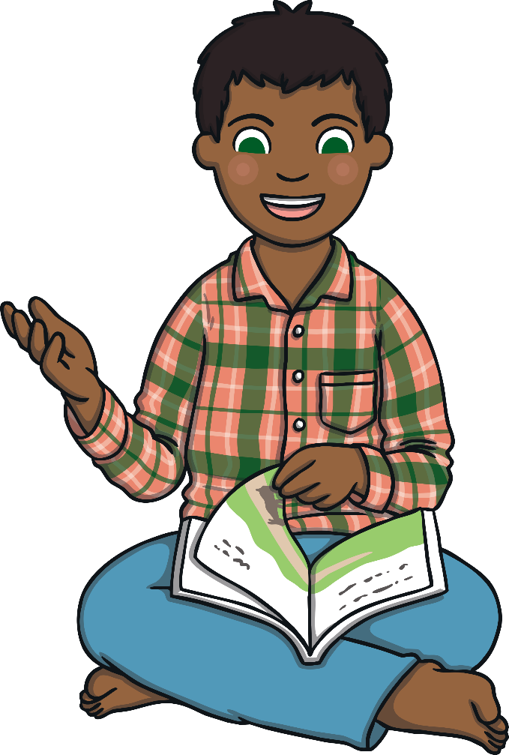
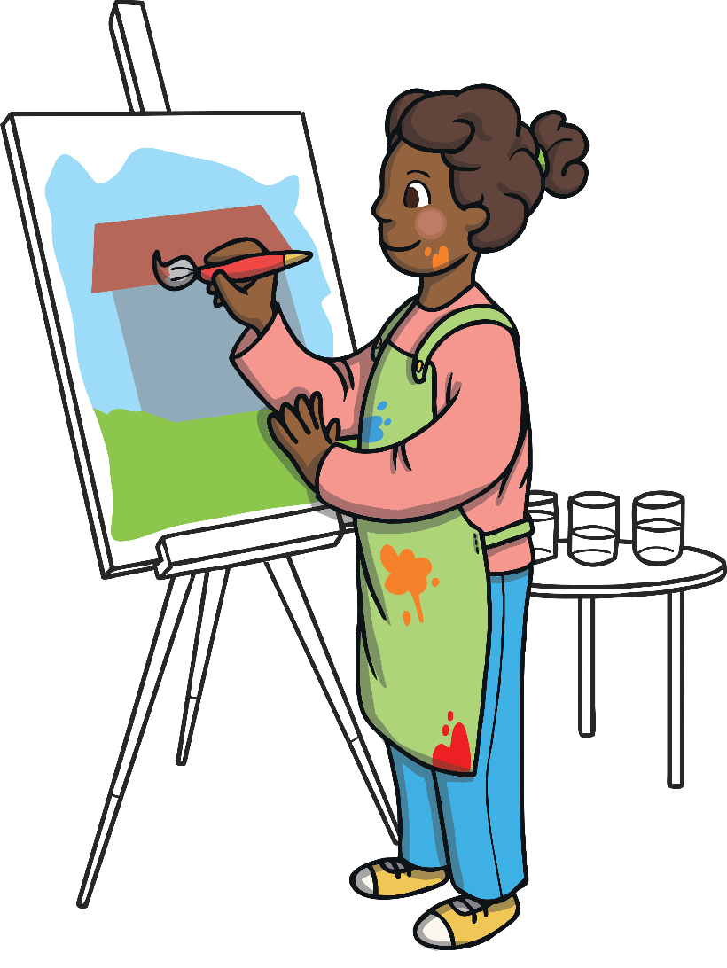
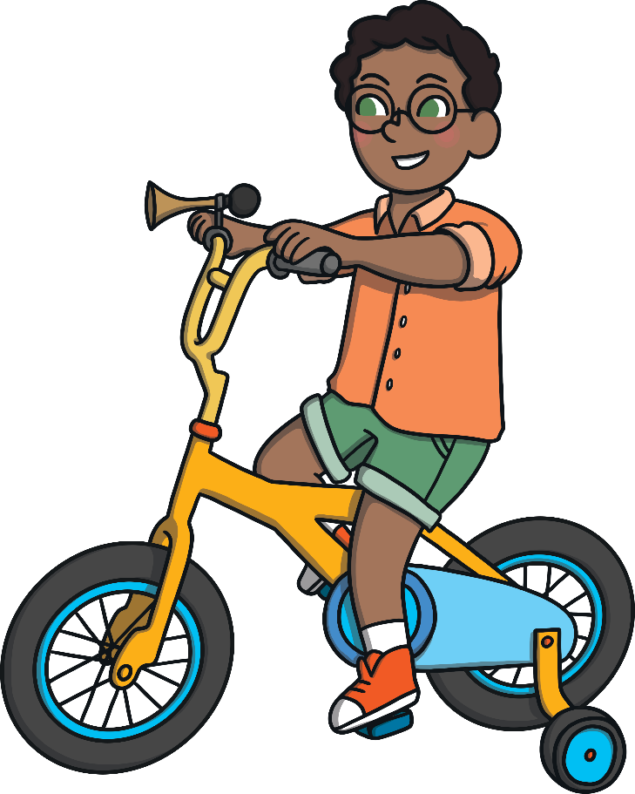
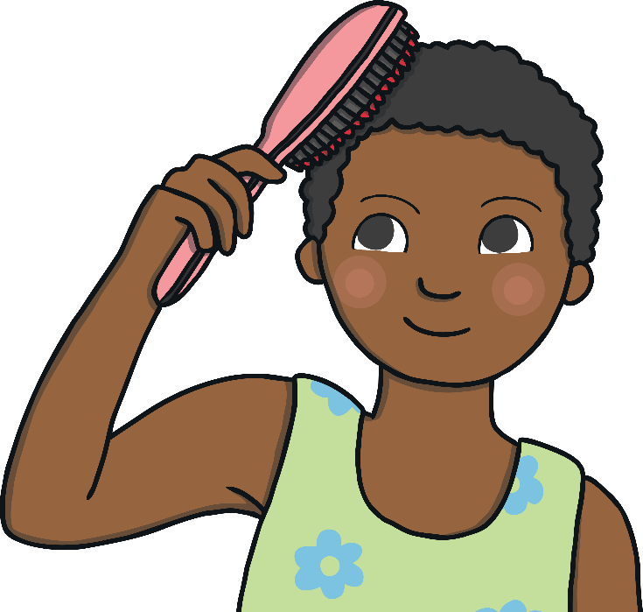
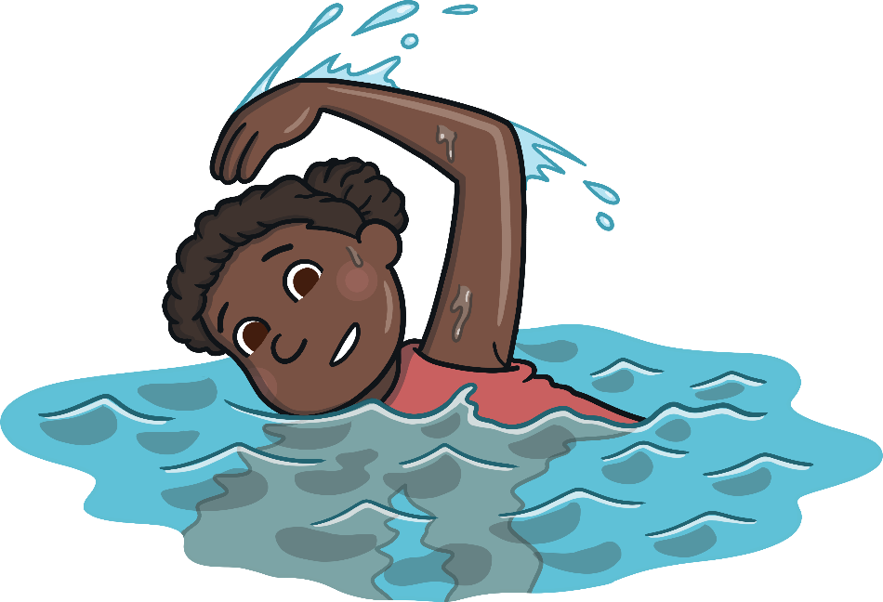
Find the Verbs
Blossom painted her picture
Blossom painted her picture
Chioma brushed her hair.
Chioma brushed her hair.
Aminu read his books in the library.
Aminu read his books in the library.
Ediye swam without arm bands.
Ediye swam without arm bands.
Sifon rode his bike to school.
Sifon rode his bike to school.

