Slide 2
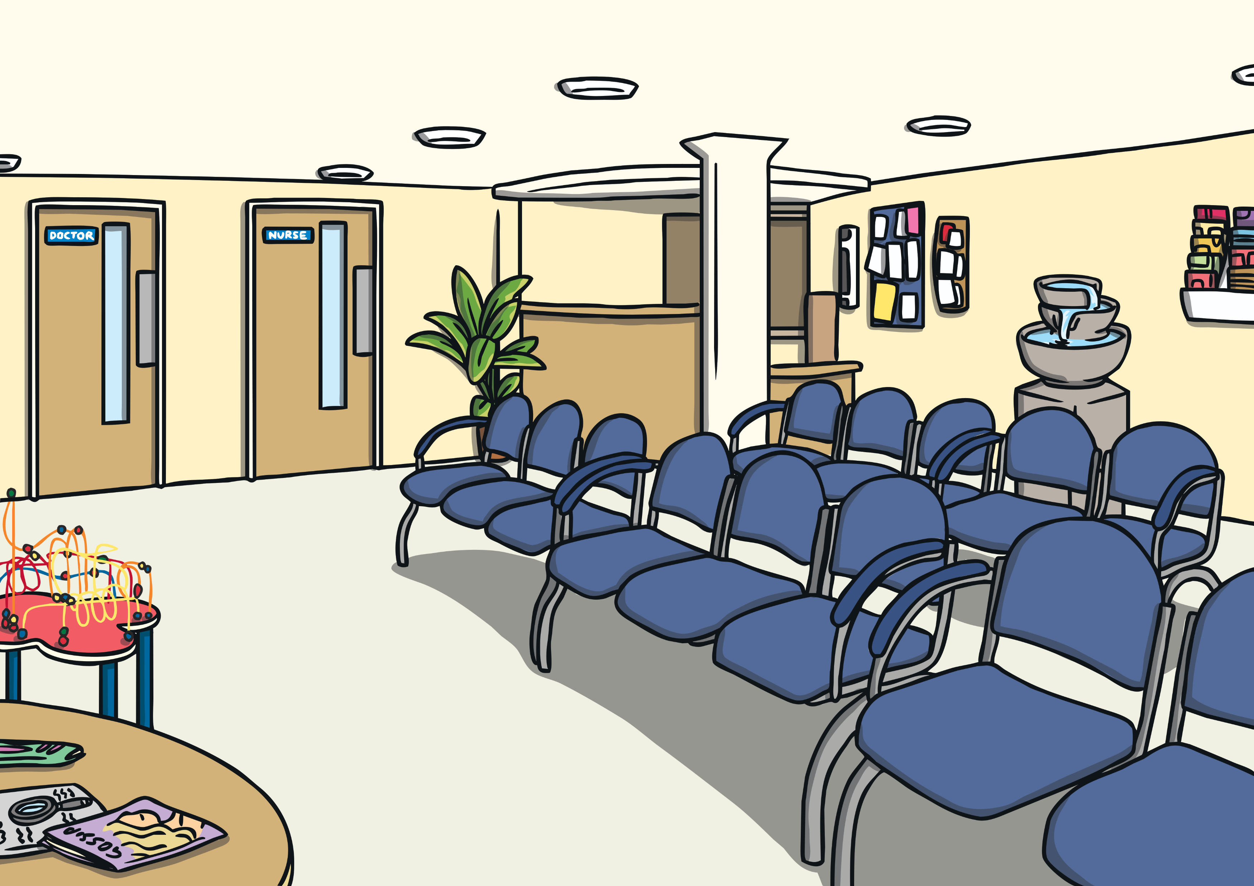
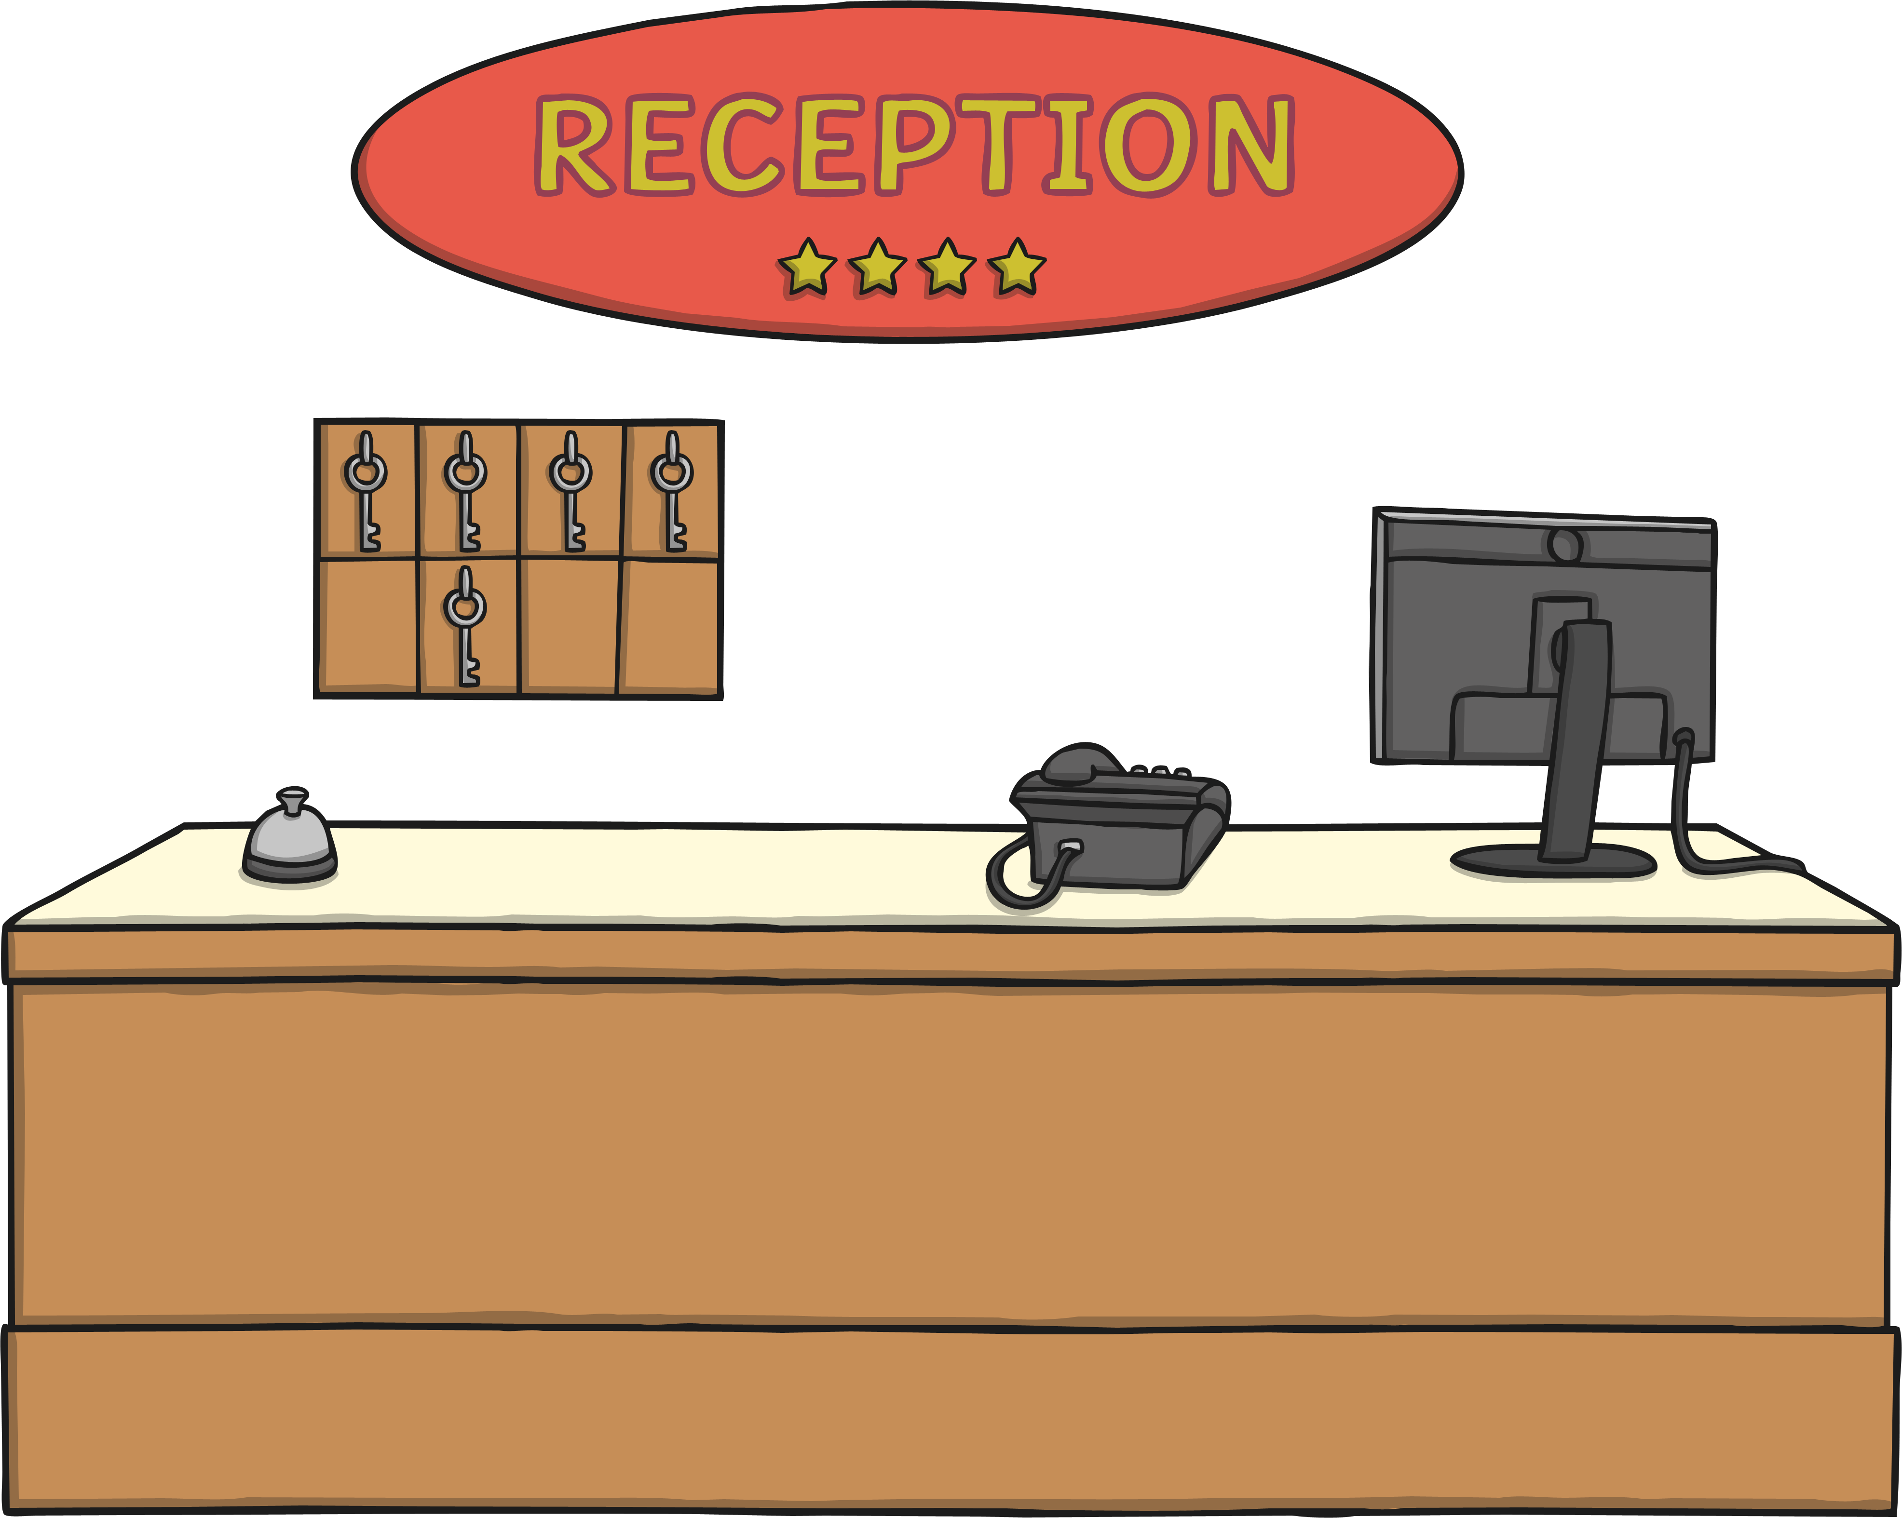
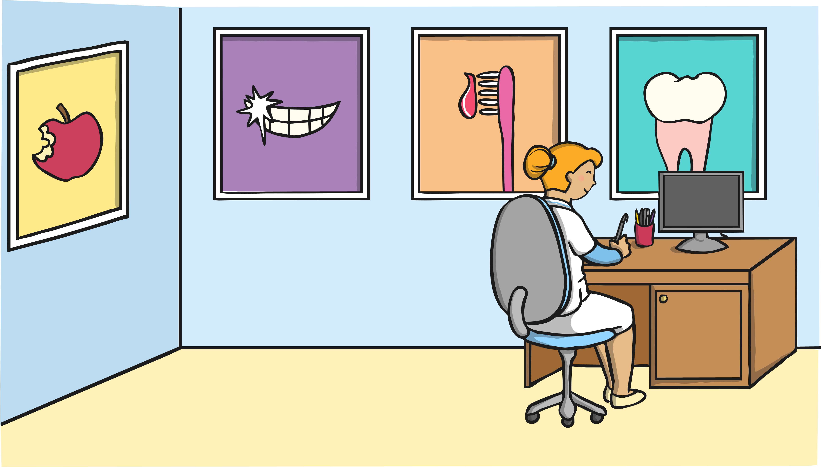
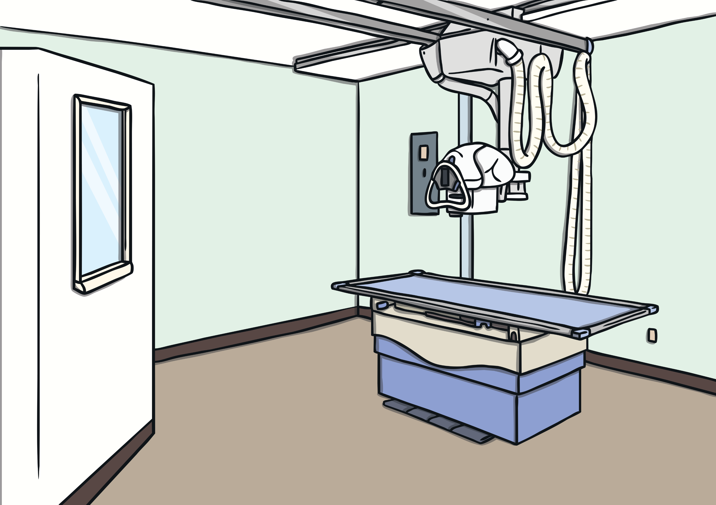
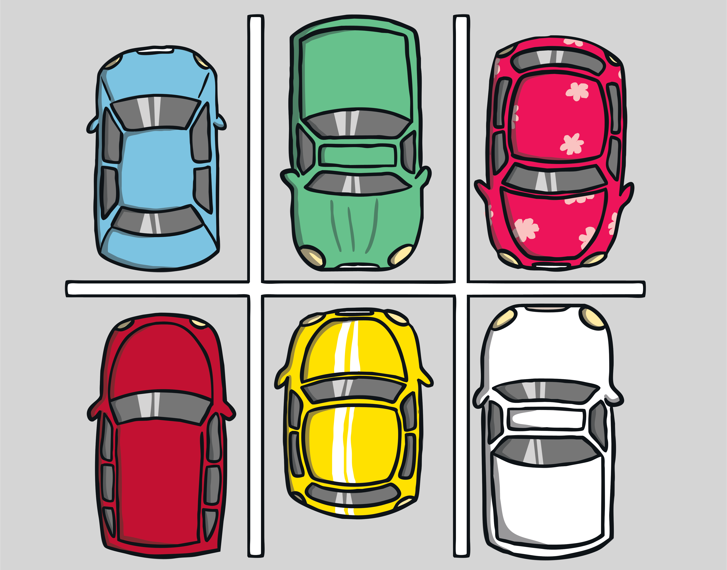
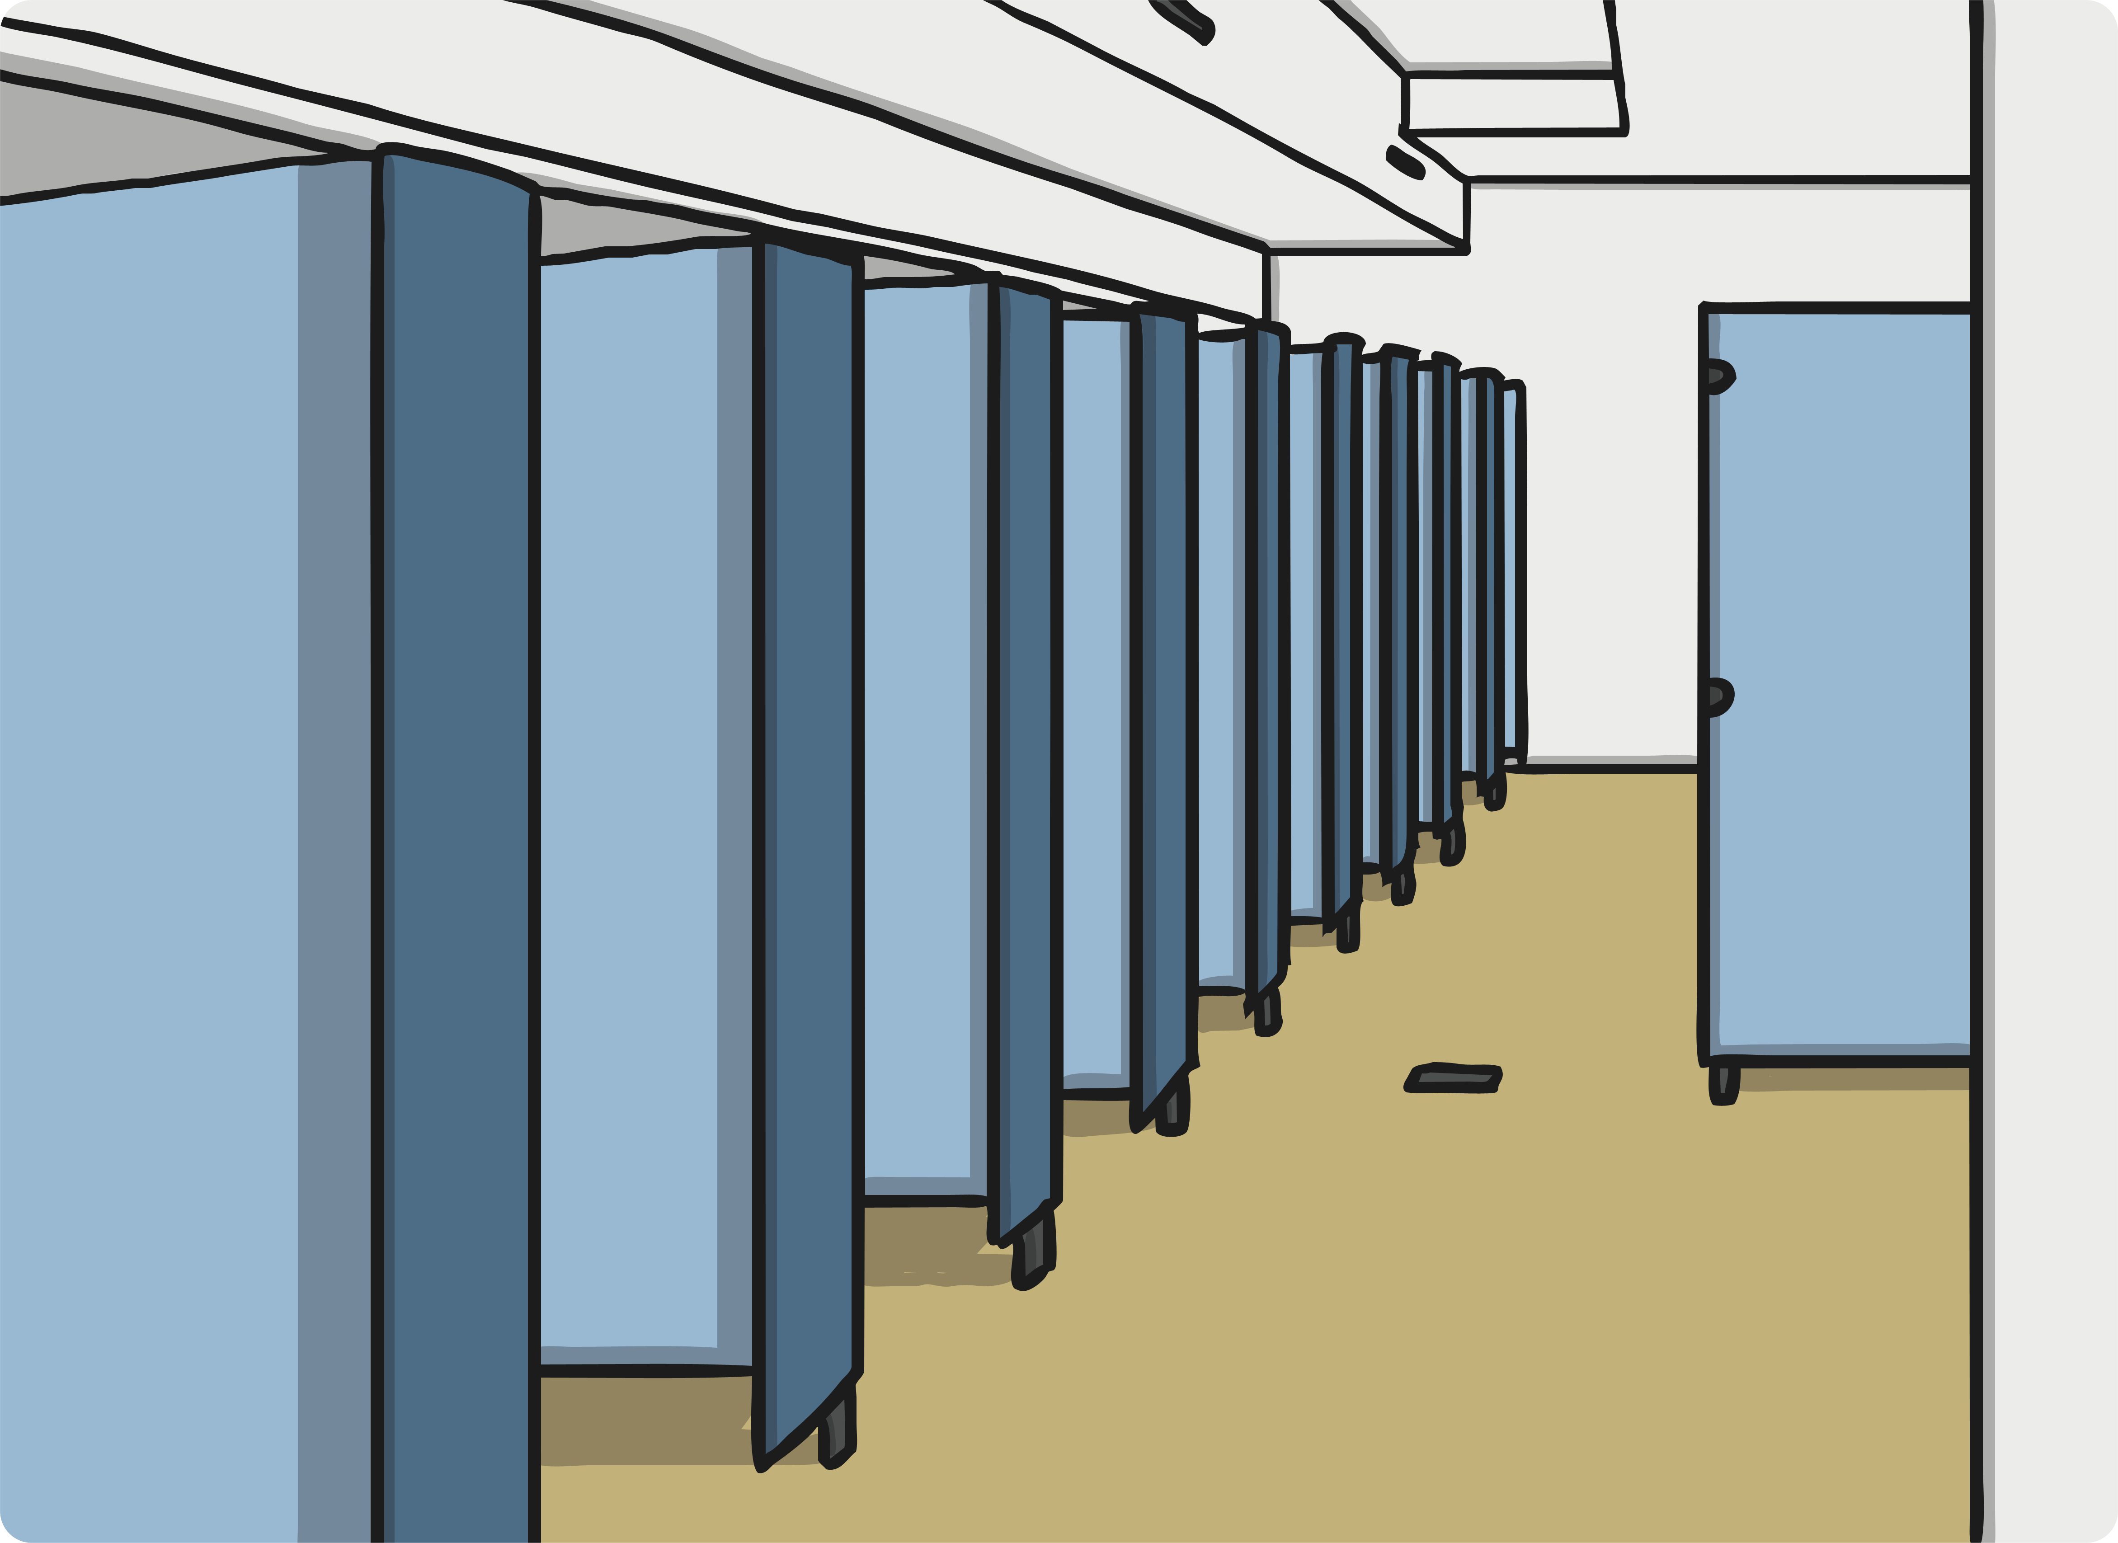
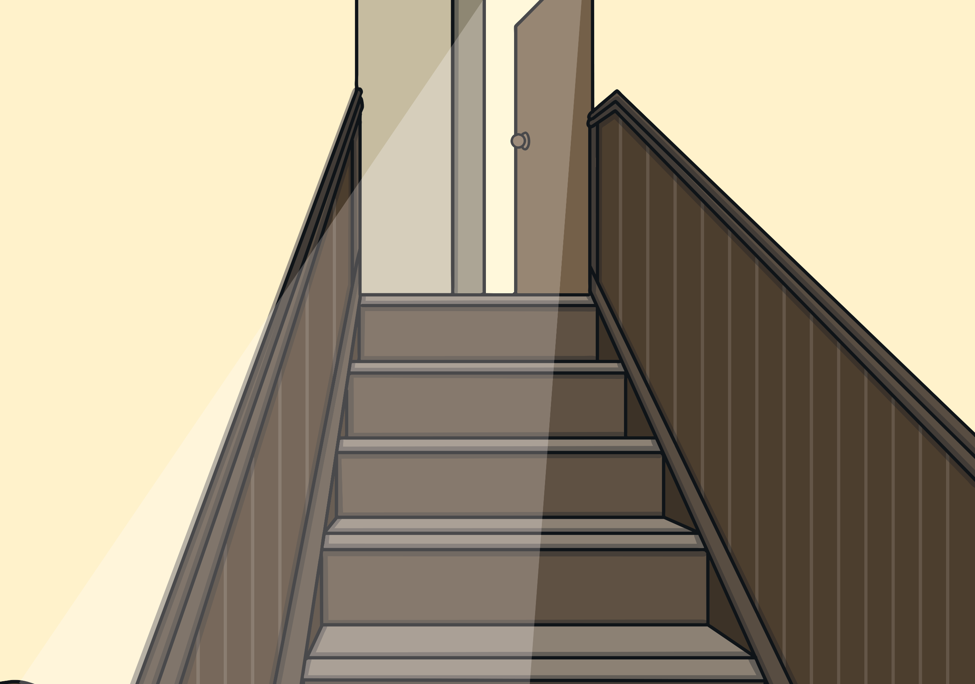
The Different Areas in the Dentist
Waiting Area
Reception
The Dentist Room
The X-Ray Room
Car Park
Toilets
Elevators/Stairs

Slide 3
Who Works in This Area?
What happens in this area?
Who works in this area?

Slide 4
Who Works in This Area?
What happens in this area?
Who works in this area?

Slide 5
Who Works in This Area?
What happens in this area?
Who works in this area?

Slide 6
Who Works in This Area?
What happens in this area?
Who works in this area?

Slide 7
Who Works in This Area?
What happens in this area?
Who works in this area?

Slide 8
Who Works in This Area?
What happens in this area?
Who works in this area?

Slide 9
Who Works in This Area?
What happens in this area?
Who works in this area?

Slide 10
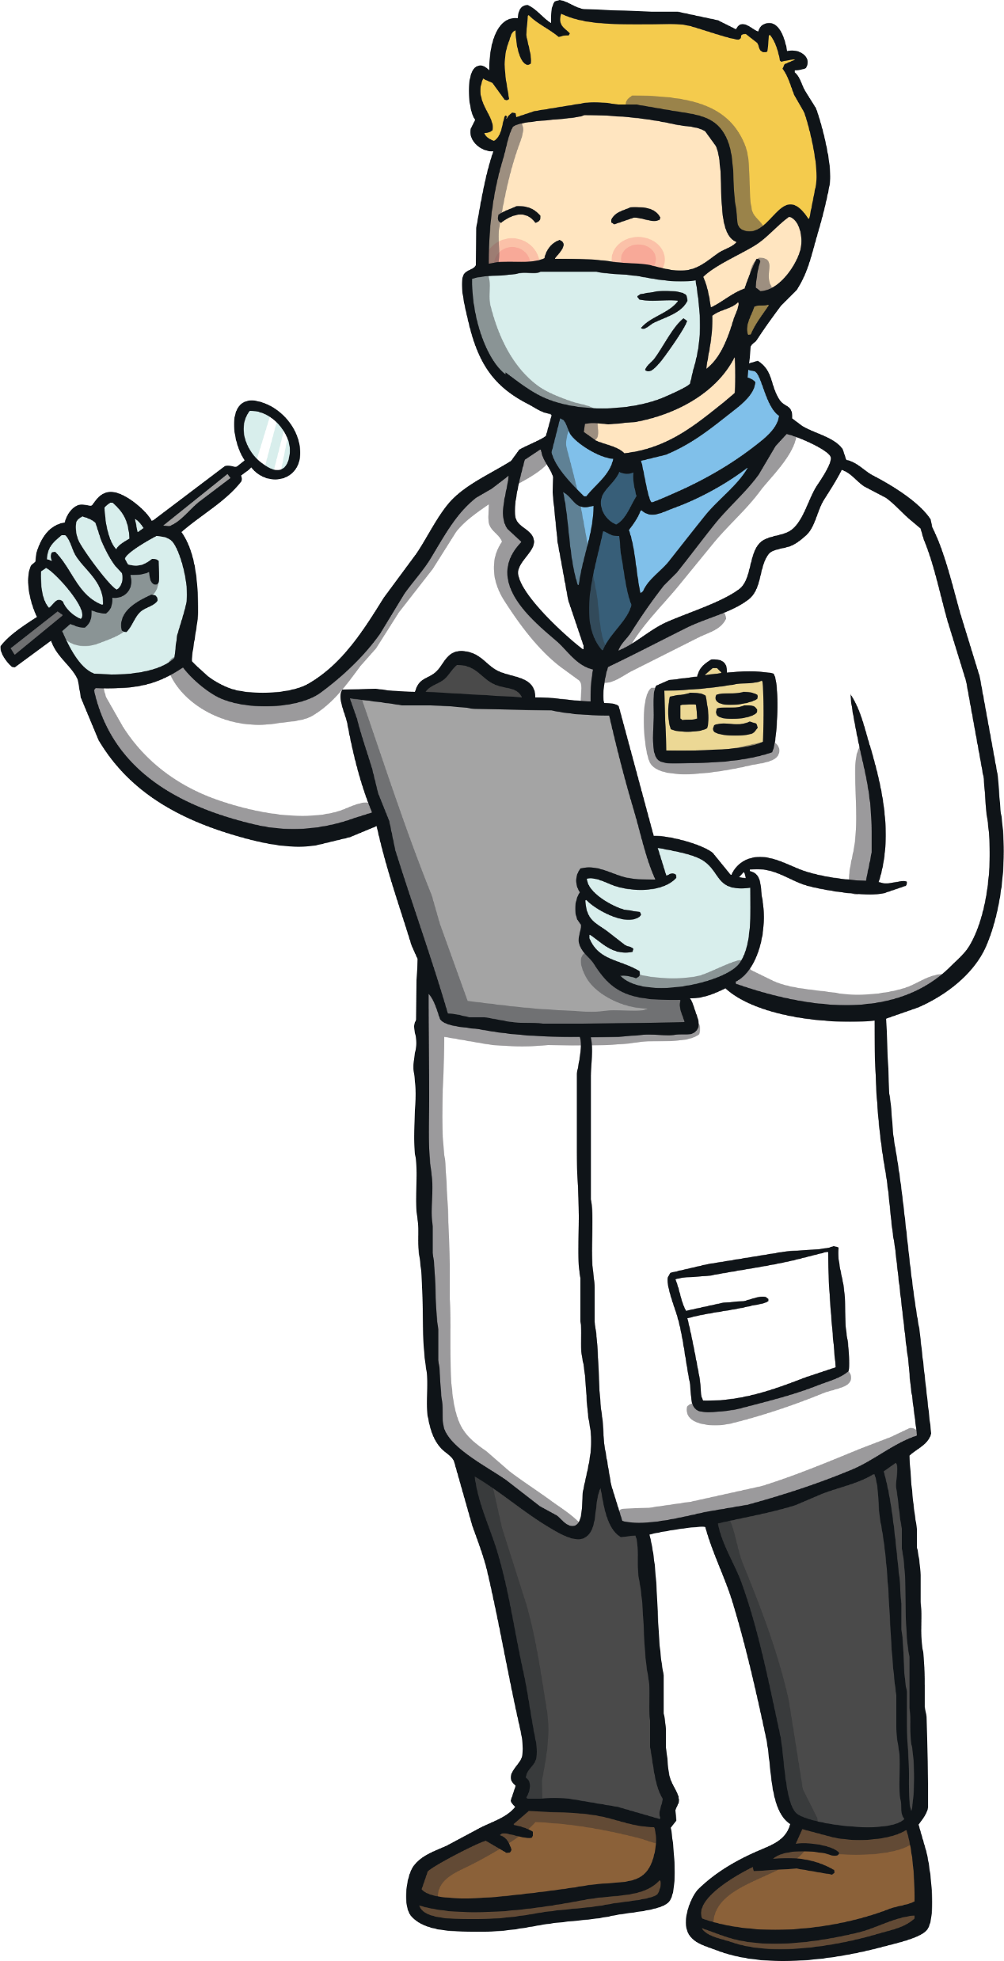
People Who Help Us at the Dentist
Receptionist
Dentist
Dental Nurse

Slide 11
Receptionist
Where does this person work at the dentist?
What does this person do at the dentist?

Slide 12
Dentist
Where does this person work at the dentist?
What does this person do at the dentist?

Slide 13
Dental Nurse
Where does this person work at the dentist?
What does this person do at the dentist?

Slide 14
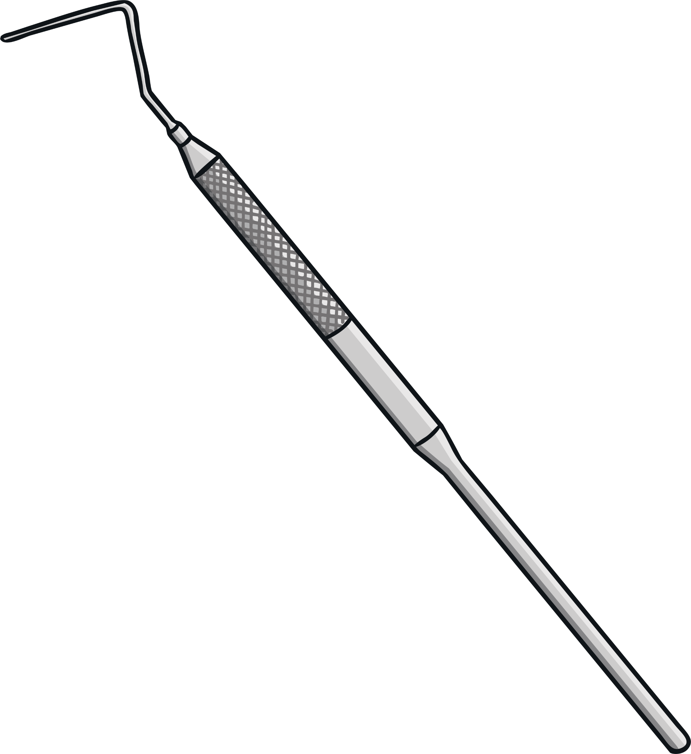
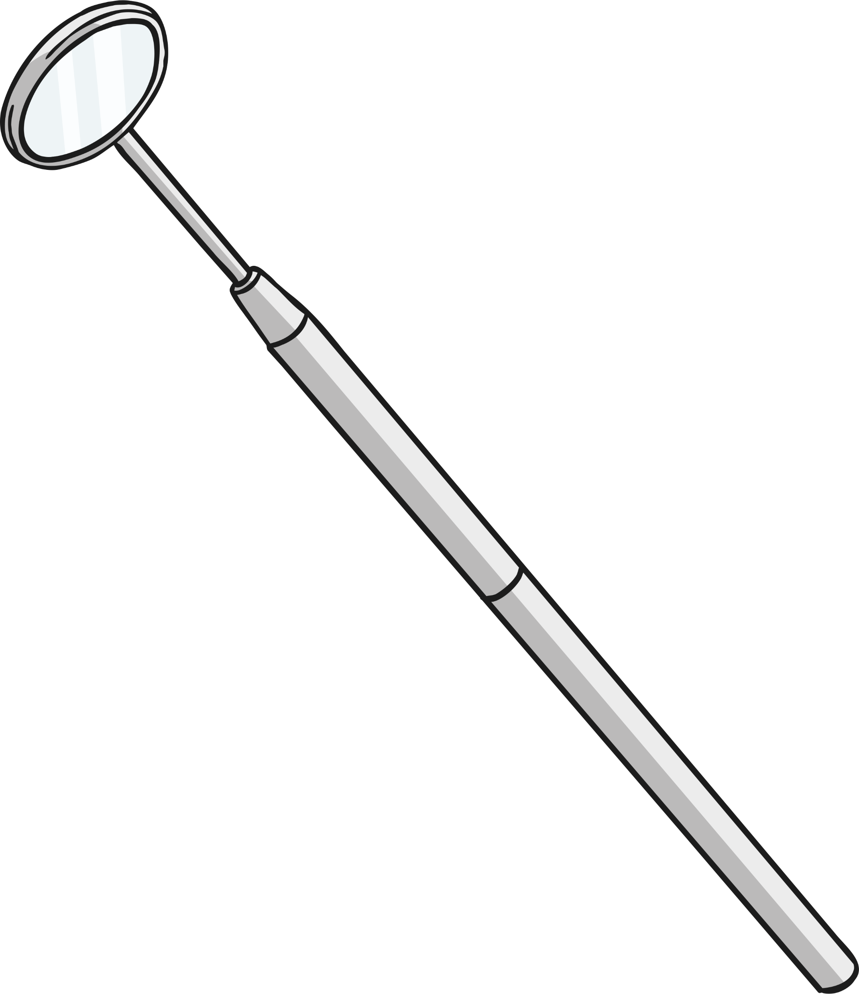
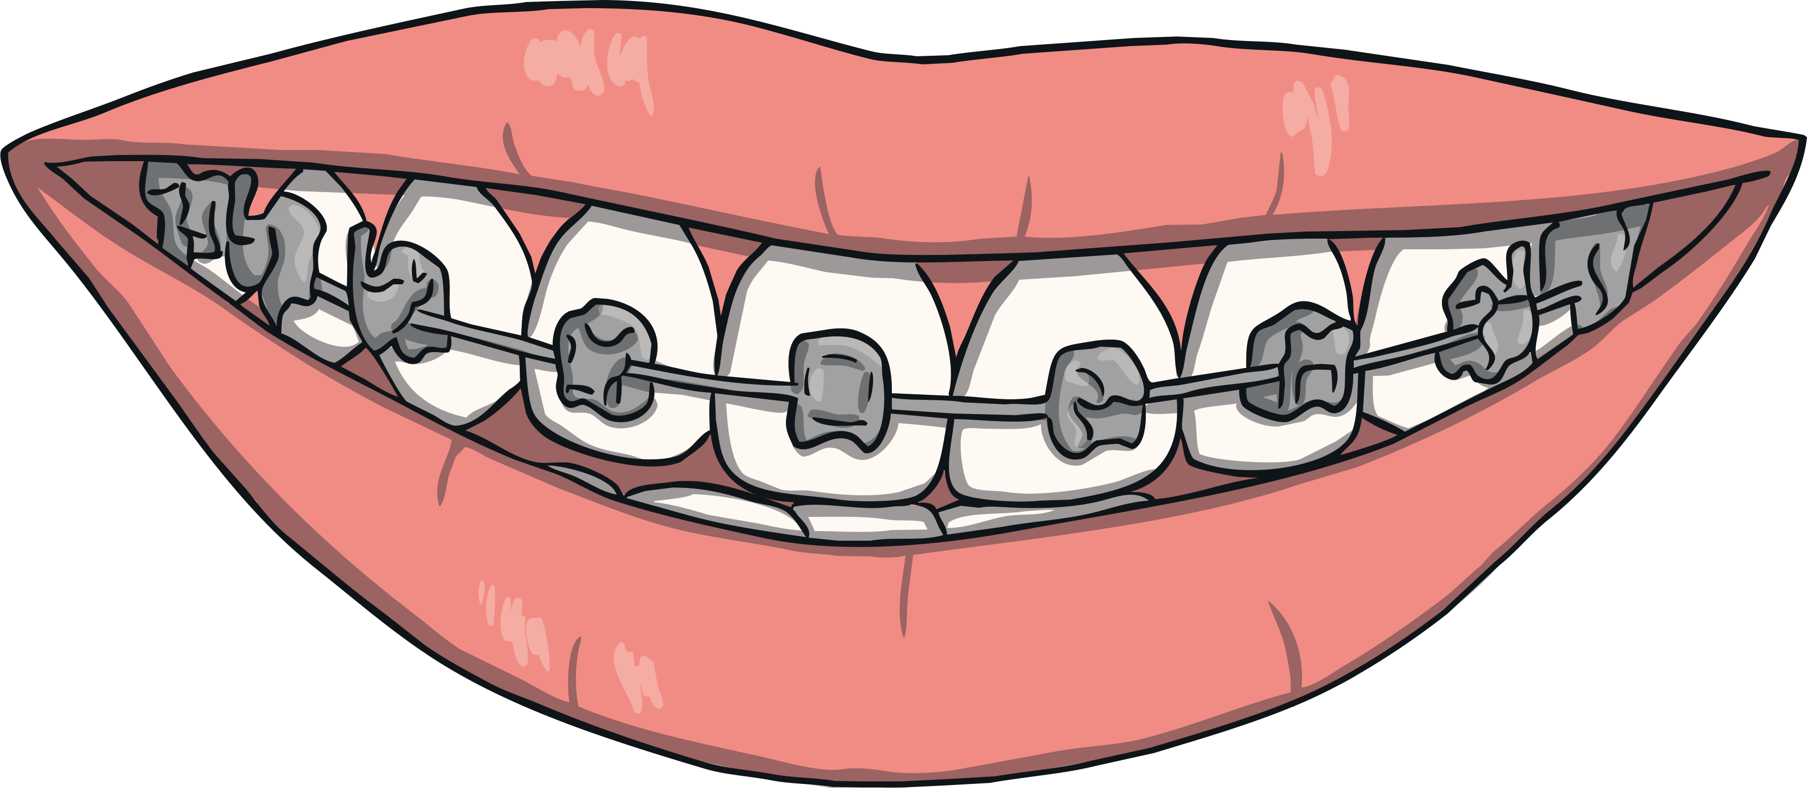
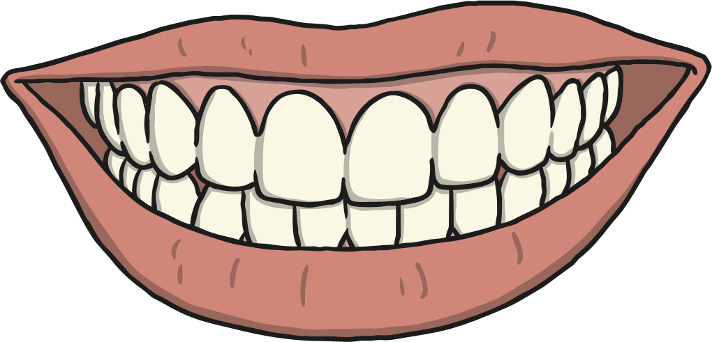
Why Do People Go to the Dentist?
1. For a dental check-up.
2. For broken teeth.
3. For x-rays of the mouth/teeth.
4. For a filling.
5. To get a deep clean on their teeth.
6. To get braces to straighten their teeth.
7. To investigate the cause of a toothache.
8. To have a tooth removed.
9. To get false teeth.

Slide 15
What Do People Who Work at the Dentist Use?
Syringe:
To numb a patient’s mouth before dental work.
Face Mask:
To protect themselves and the patient from germs.
Prescription:
A medicine order form from your dentist.
Mouth Rinse:
For a patient to rinse out their mouth.
Medicine (Tablets):
For a patient to take for their oral health.
Toothbrush:
To brush a patient’s teeth.
Medicine (Liquid):
For a patient to take for their oral health.
Toothpaste:
To use on the toothbrush for brushing a patient’s teeth.
Pen Light:
To look inside a patient’s mouth.
Braces:
To straighten a patient’s teeth.
Mirror:
To look in the hard-to-reach places in a patient’s mouth.
Dentures/False Teeth:
For a patient who is missing teeth.
Probe:
To check a patient’s tooth.
Oxygen Mask:
To give a patient oxygen.
X-Ray:
To see a patient’s teeth.

Slide 16
The Dentist Aistear
Now it’s your turn to pretend and make believe in your Aistear Dentist Corner! Don’t forget to use the different areas we covered, or to take on the roles of the different people who can be found in the dentist! If you’re a patient, decide what's wrong with you – why are you going to the dentist? If you’re the receptionist, make sure you check in all the patients! Finally, if you’re a dentist or a dental nurse don’t forget to use the different tools we mentioned!

