Slide 2
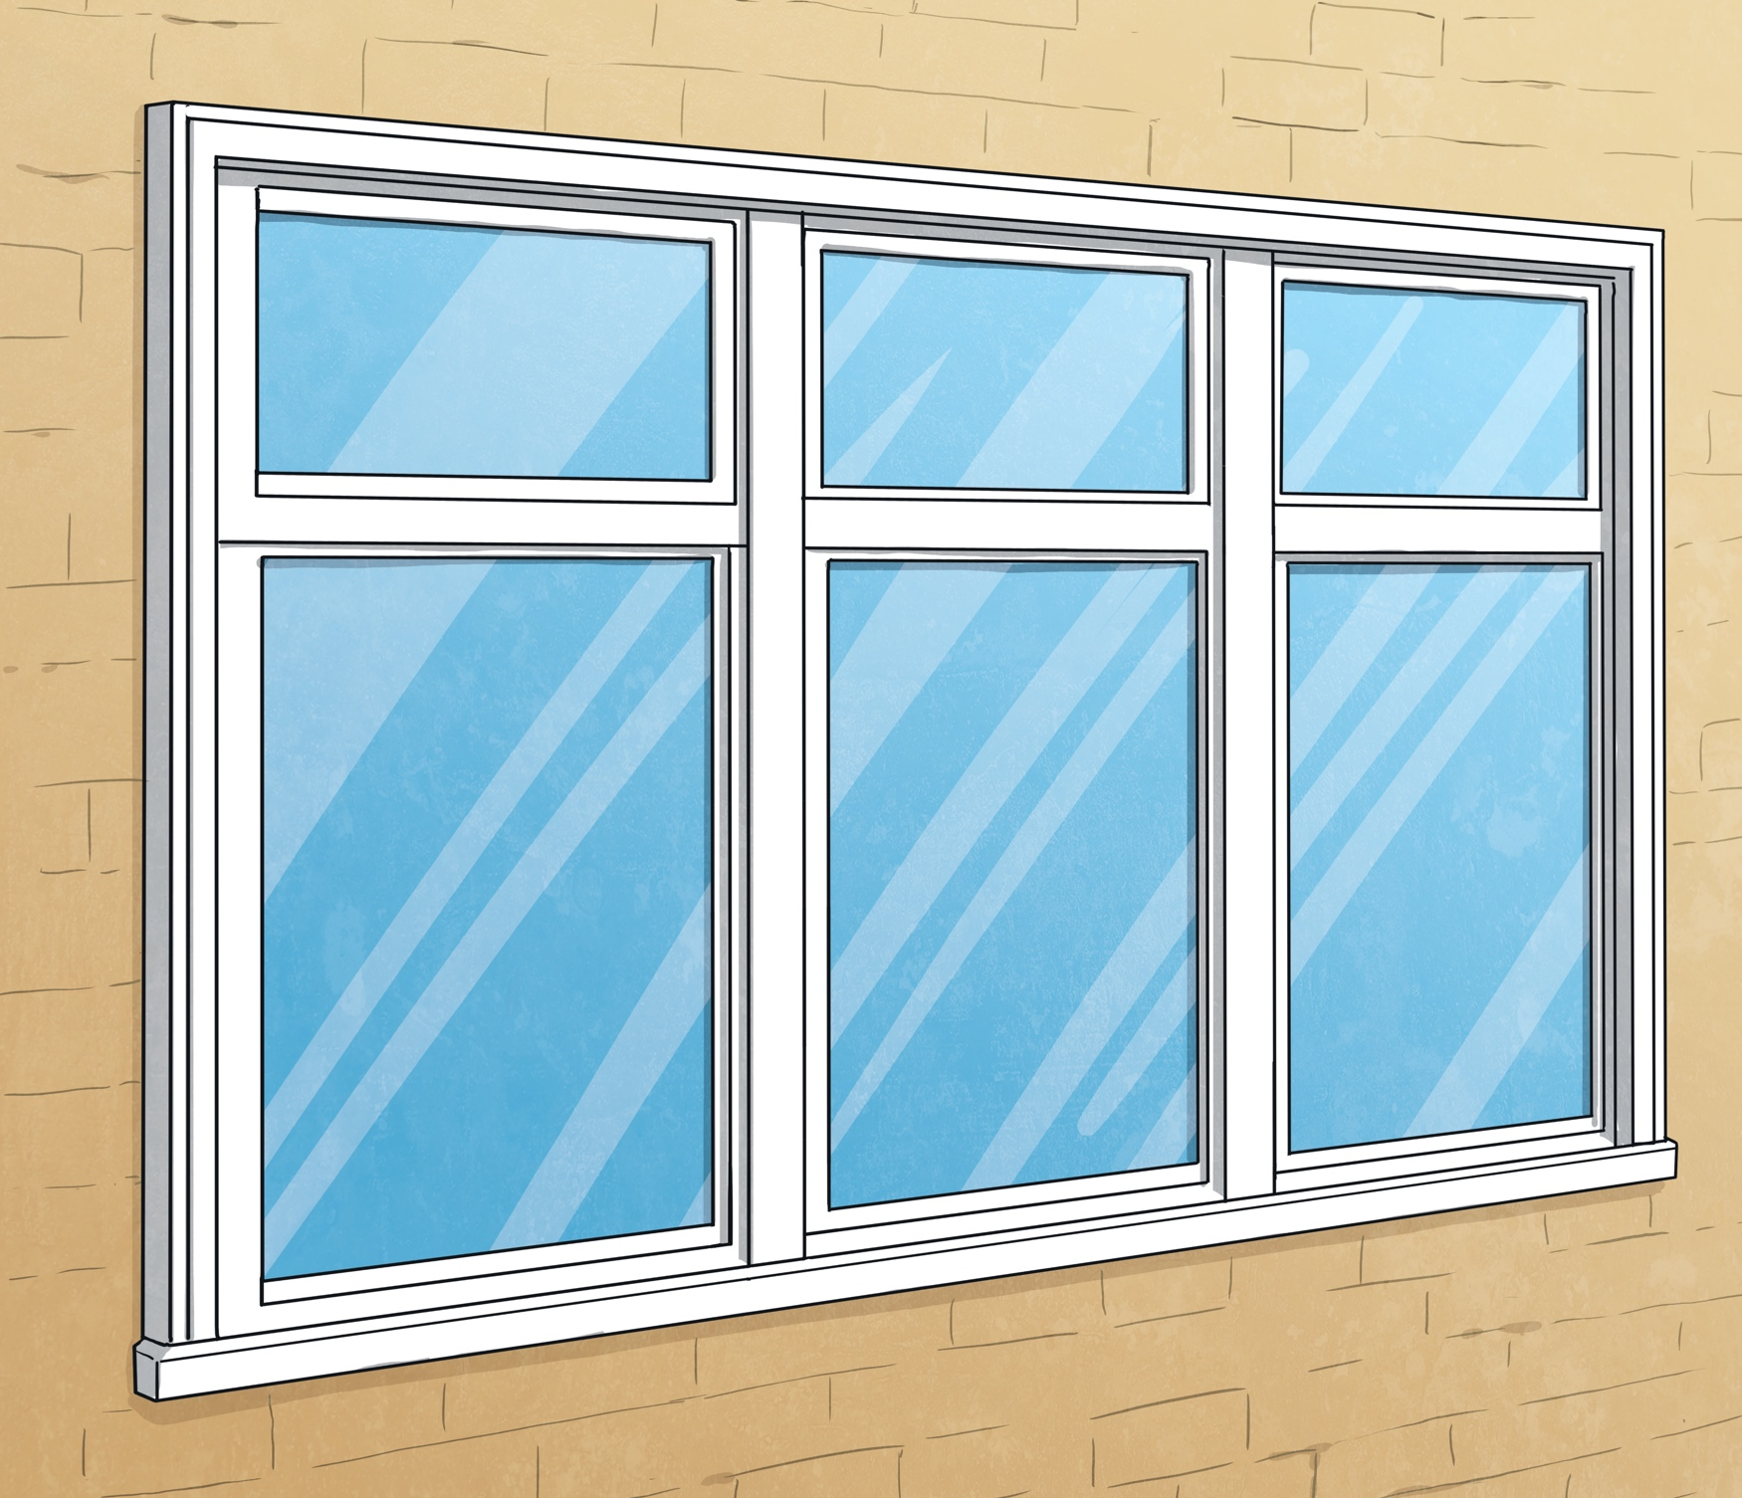
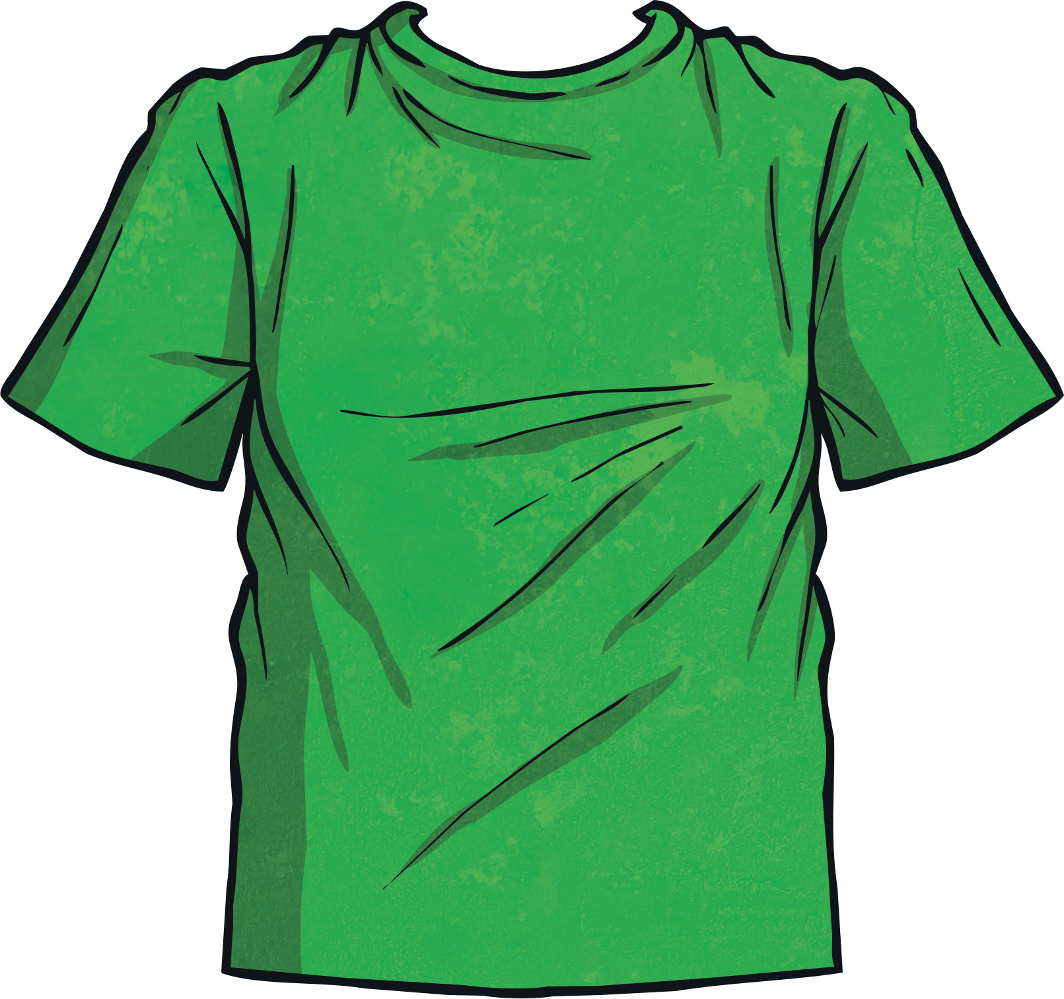
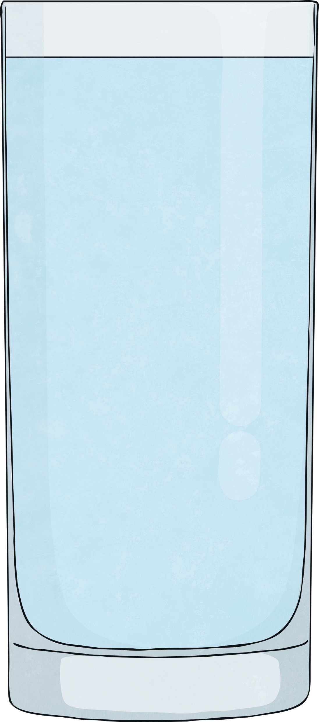
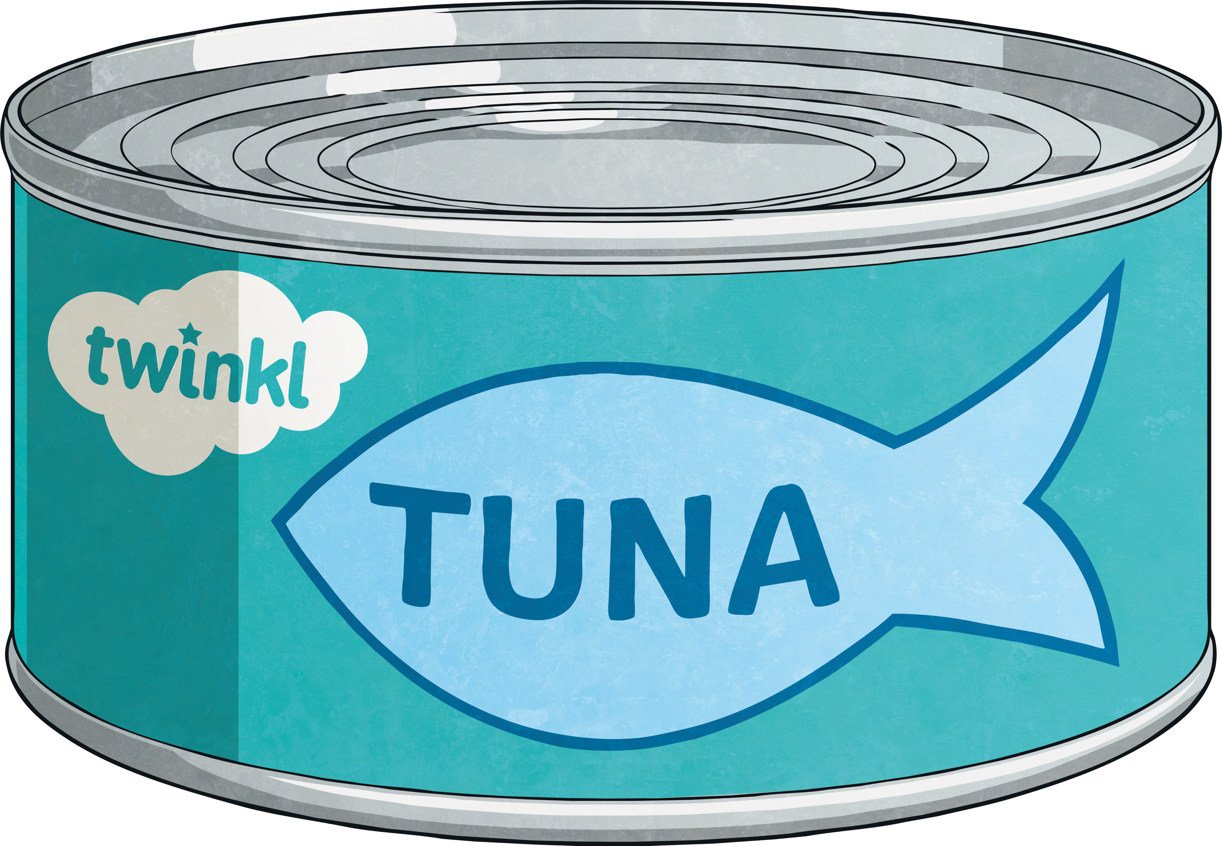
What Are Materials?
Materials are substances that make up an object. There are many different types of materials. Materials can be solid or liquid. Here are some examples of materials.
wood
glass
fabric
water
oil
plastic
metal

Slide 3
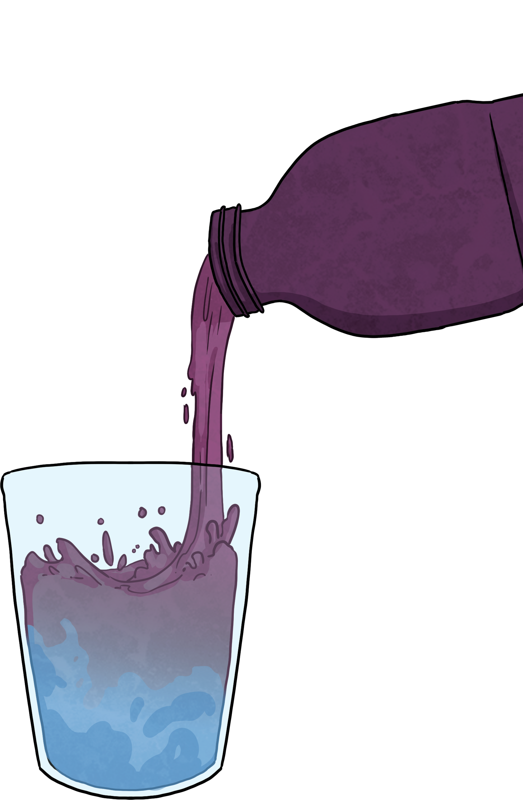
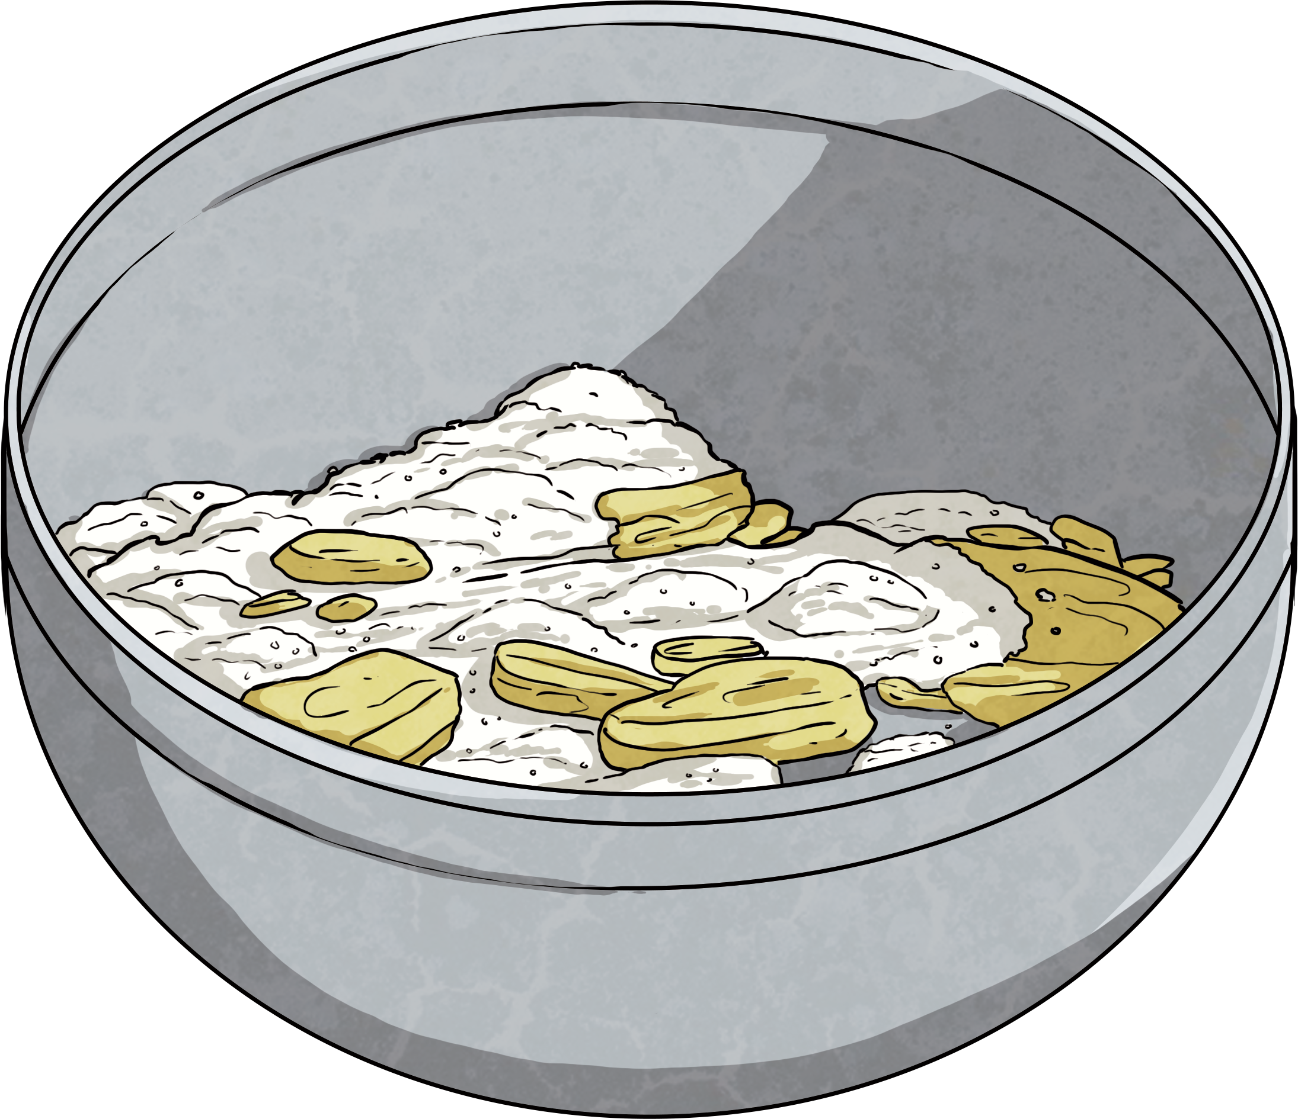
Mixing Materials
When mixing two materials together a mixture is formed.
Some materials can change state when mixed with another material and others cannot be changed.

Slide 4
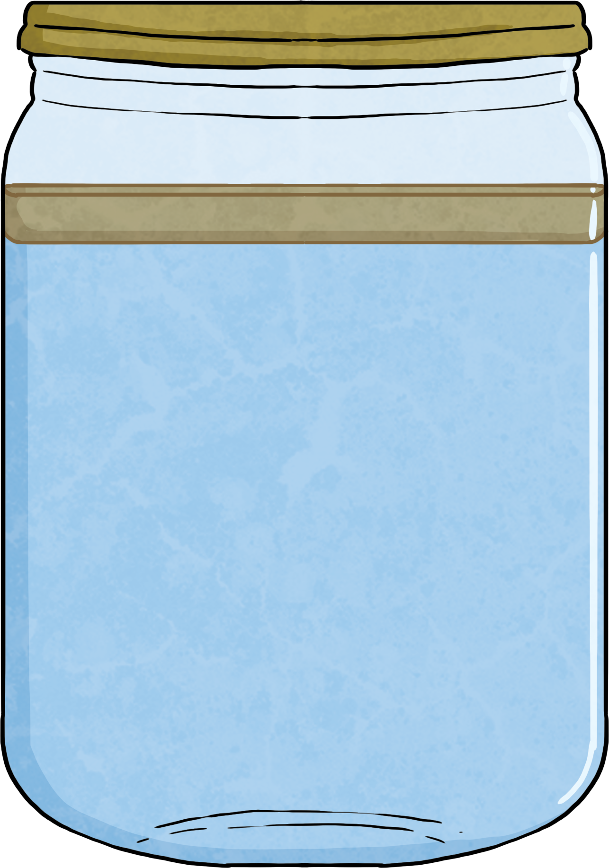
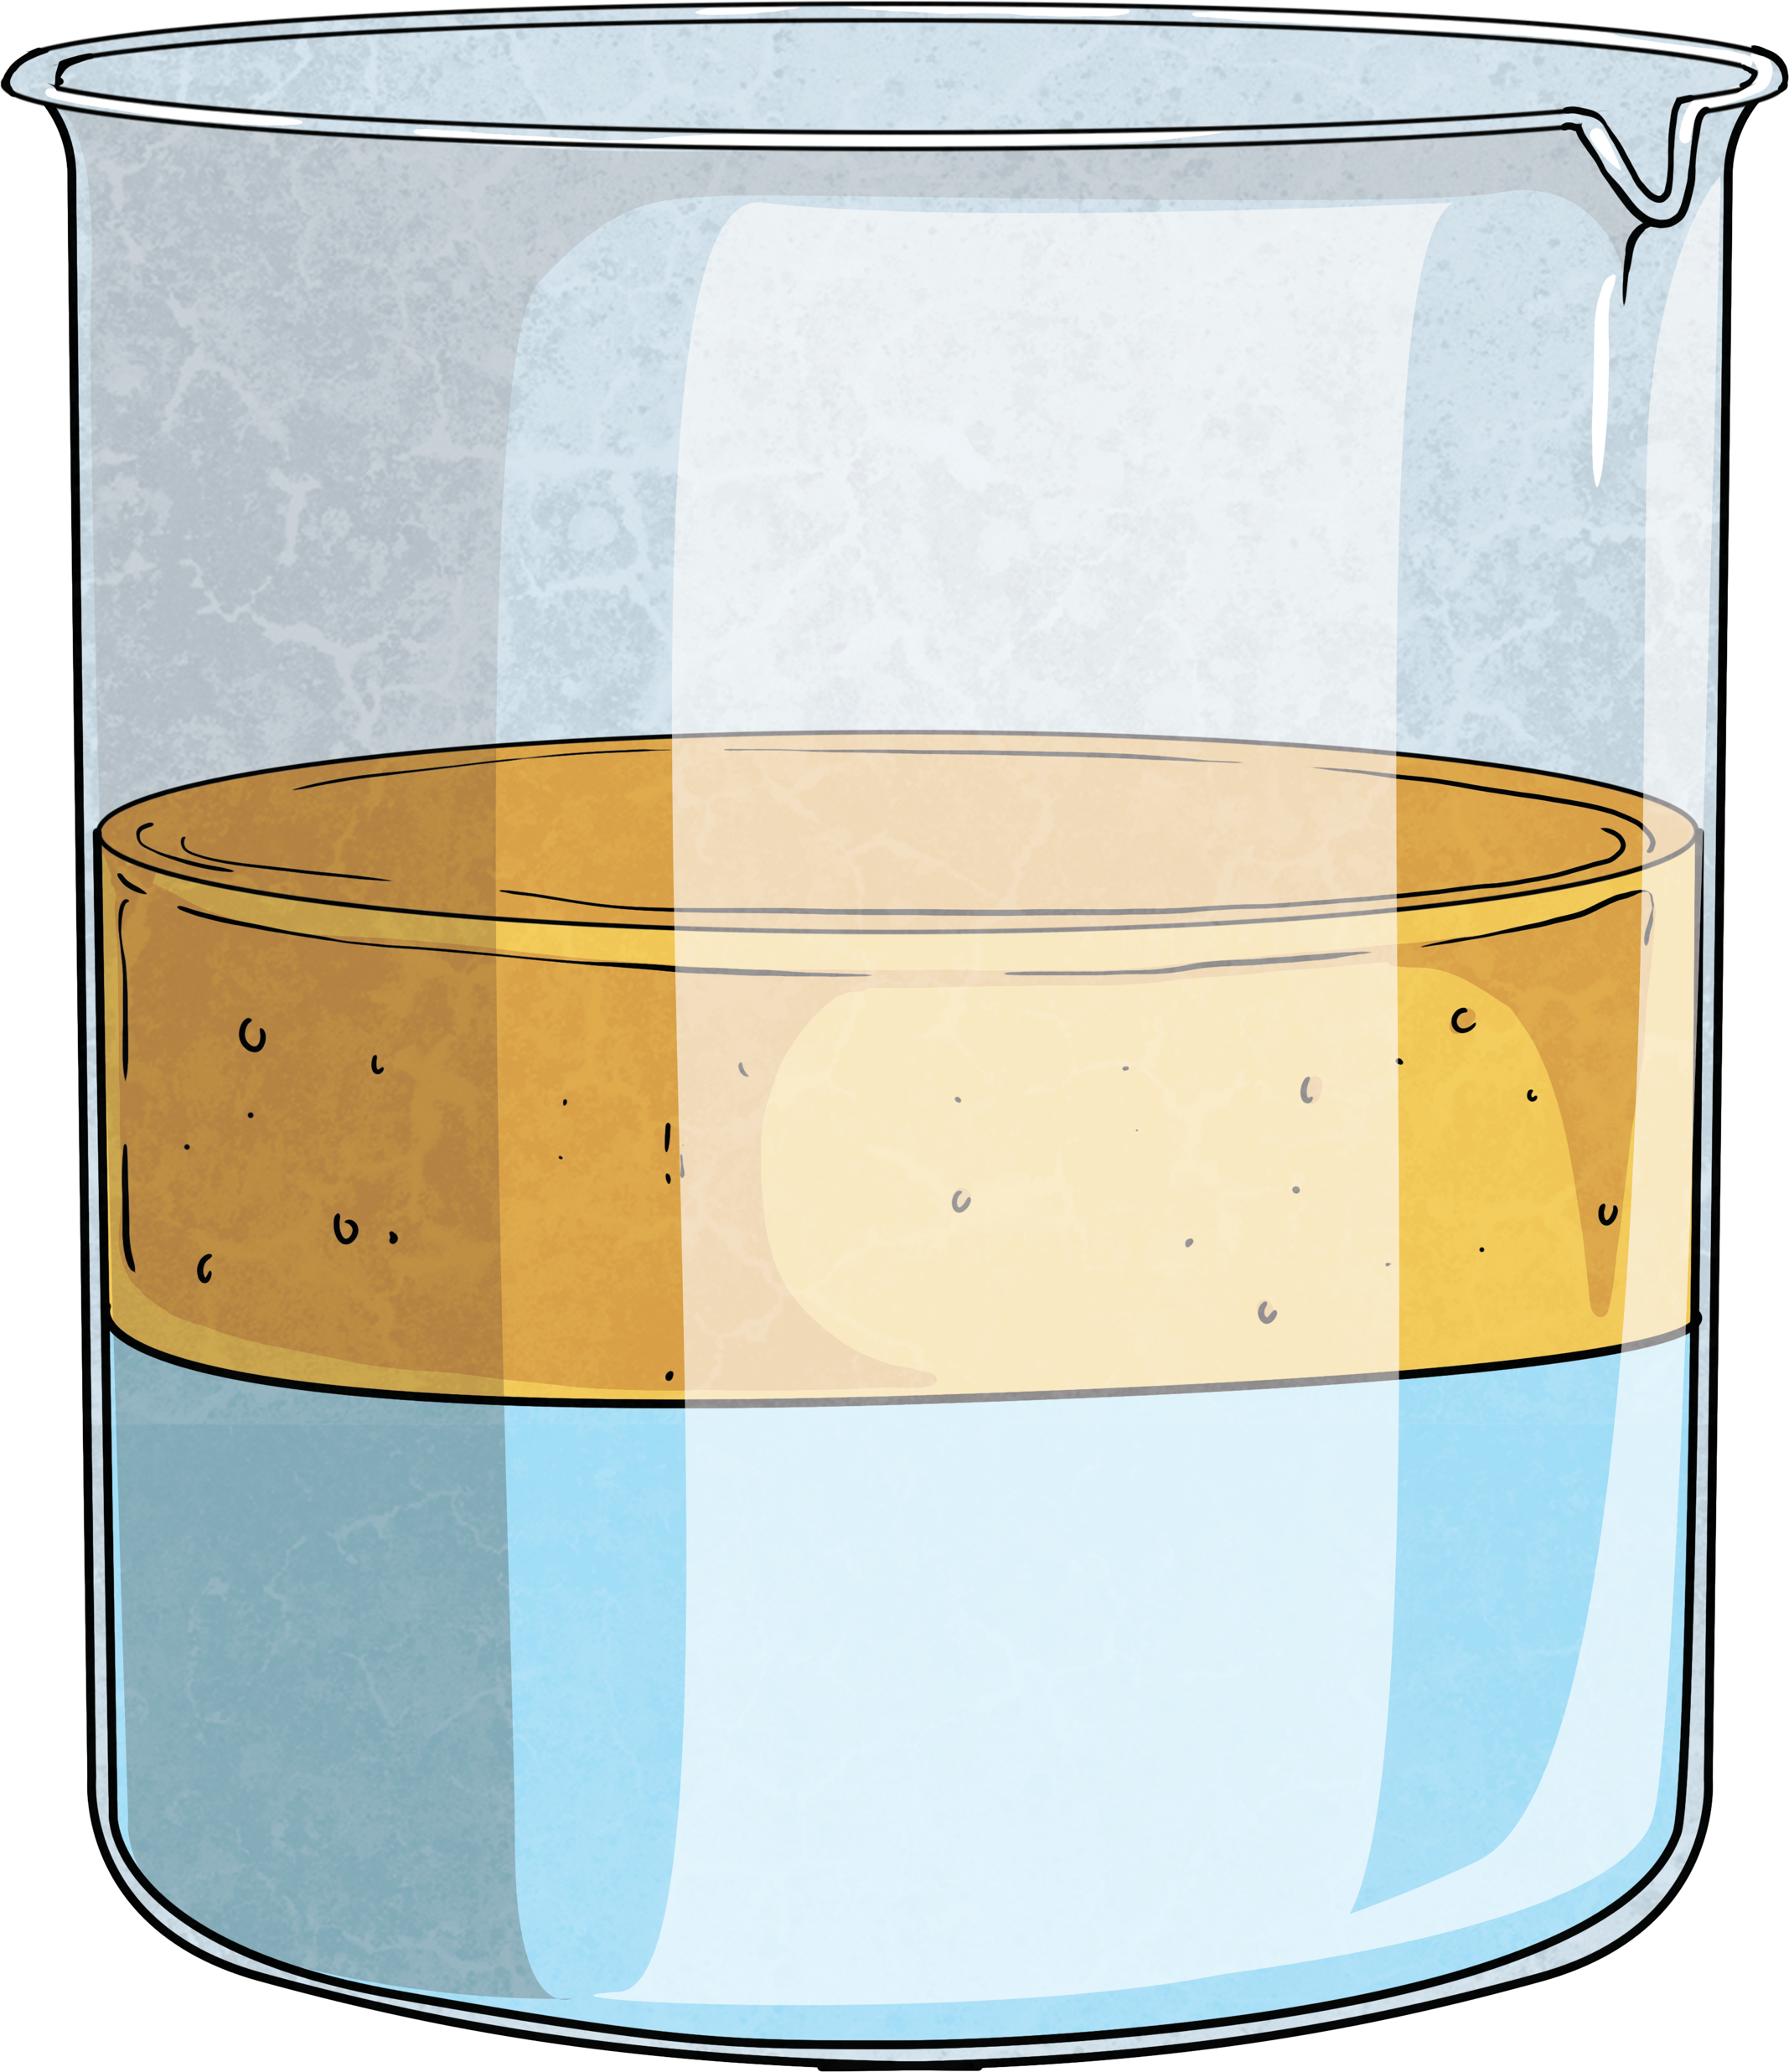
Mixing a Liquid with a Liquid
What do you think will happen when water is mixed with oil?
When water and oil are mixed together, the oil rises to the top of the water. The mixture cannot be mixed. However, this is not the case for all liquids.
What would happen if you mixed water and red food colouring? What colour would the water be?

Slide 5
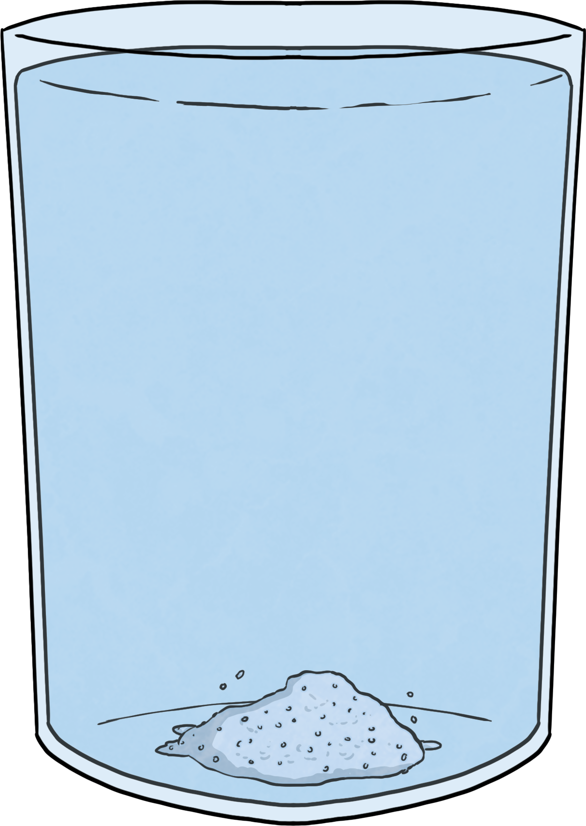
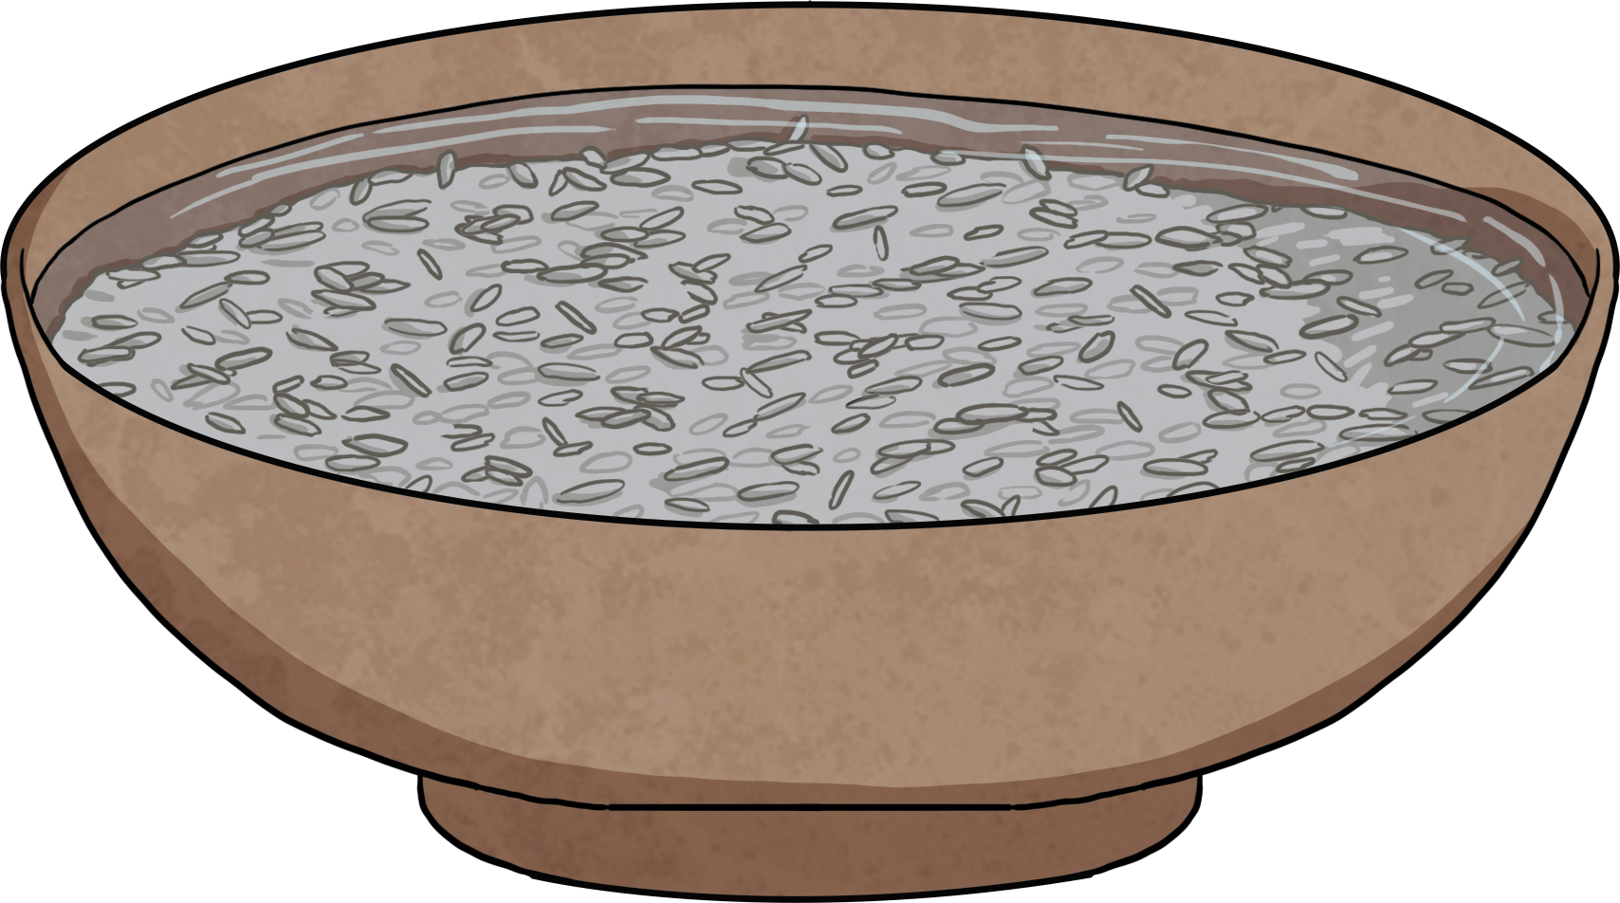
Mixing a Liquid with a Solid
When mixing a liquid and a solid sometimes changes can happen.
For example, mixing water and salt. The salt dissolves into the water after some time.
However, when you mix water and rice, there is no change.
Can you think of any other examples of when liquids and solids are mixed and no change happens?

Slide 6
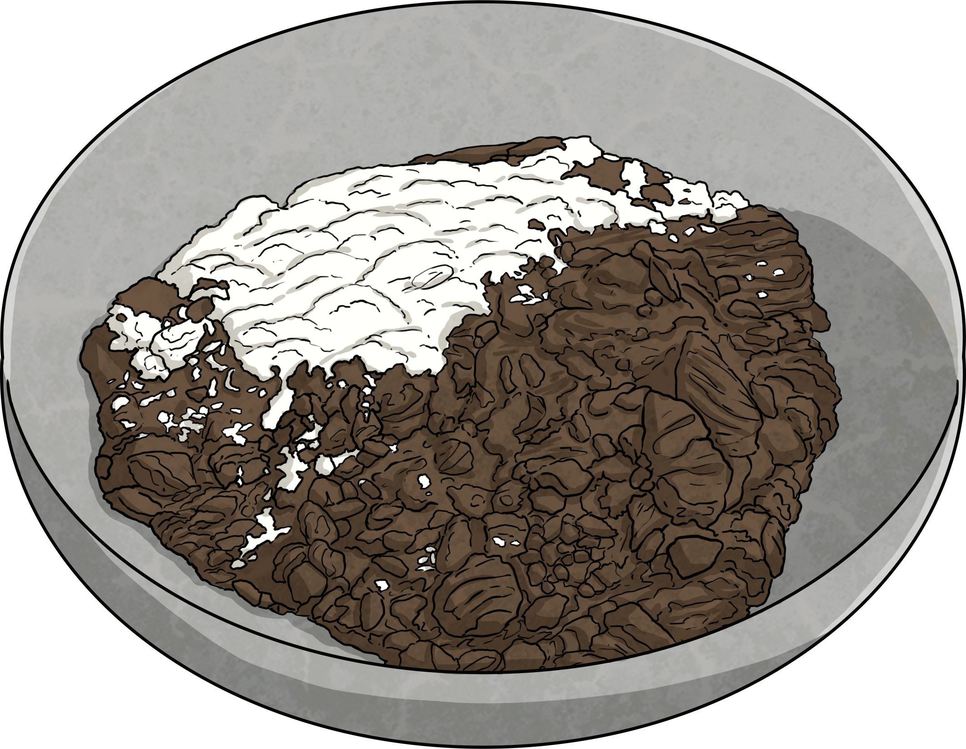
Mixing a Solid with a Solid
When mixing a solid with a solid some changes can occur.
For example, mixing flour and cocoa powder together, the mixture changes colour from white to brown.
However, sometimes there are no changes. For example, sugar and cereal.

Slide 7
Can you recall some of the changes that can happen when materials are mixed together?
They can change colour.
They can dissolve.
They can change state.
There is no change.

