Slide 2
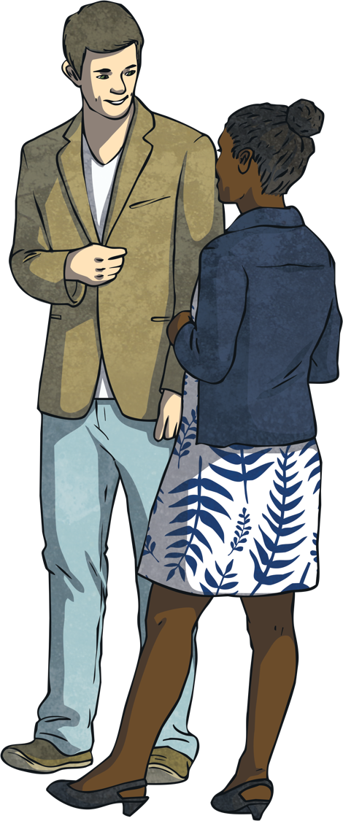
What is debating?
Debating is a form of argument. It is a formal way to discuss an issue or a topic.
What does opposing mean?
Opposing means in competition with something or someone. Both sides in a debate have opposing, or opposite points of view. Each team wants to convince the other side of their point of view.
There are normally two different sides in the debate contest, each side with opposing points of view.

Slide 3
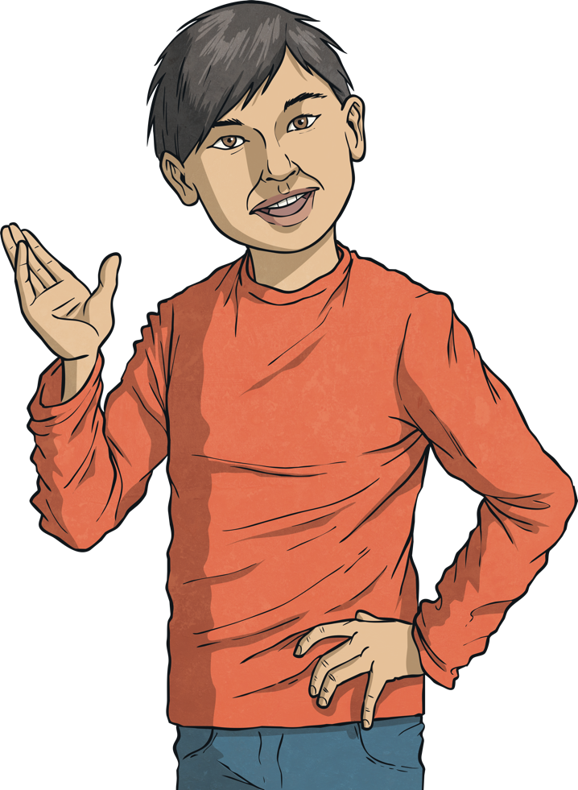
What is debating?
When you watch television you are sure to see lots of different people communicating and engaging in debate.
Think of politicians in Leinster House. They debate different issues affecting our country and our people.
They spend a lot of time debating what should be made law. They need to be able to express their opinions and argue their point of view in a convincing way.
Being able to convey our opinions in a clear, persuasive way is a good skill to have.

Slide 4
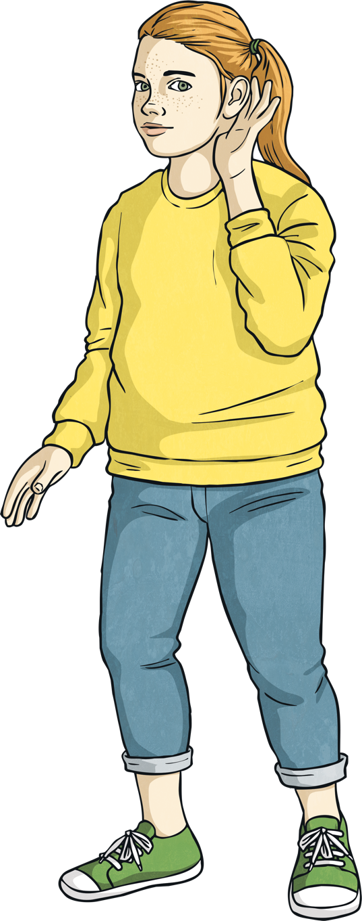
What is debating?
Debating allows us to become confident at communicating our opinions in a clear, structured way. When we debate, we learn to listen to others opinions and think about them.
Why might this be important?

Slide 5
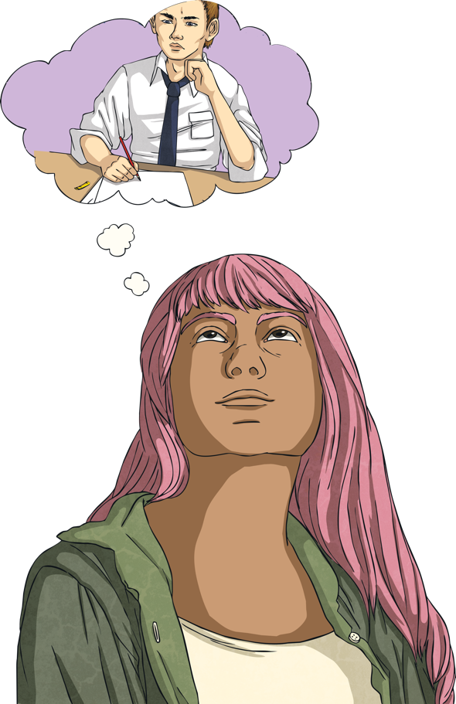
What is a motion?
A motion is needed to hold a debate. A motion is an idea that someone can argue for or argue against.
An example of a motion might be, ‘Schools should ban homework’.

Slide 6
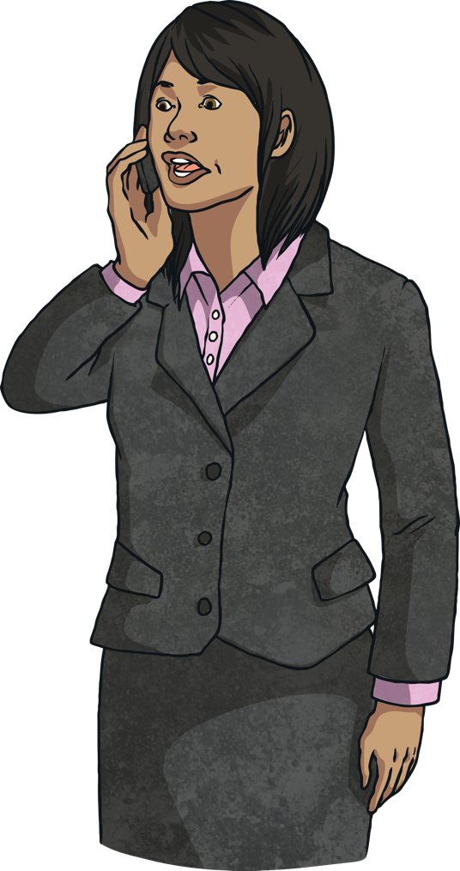
What is debating?
Those who support (or agree) with the motion are called proposers.
Those who do not support, or disagree with the motion are called opposers.
Both teams normally have 2 or 3 speakers, with a Captain on each team and then 1 or 2 other speakers.

Slide 7
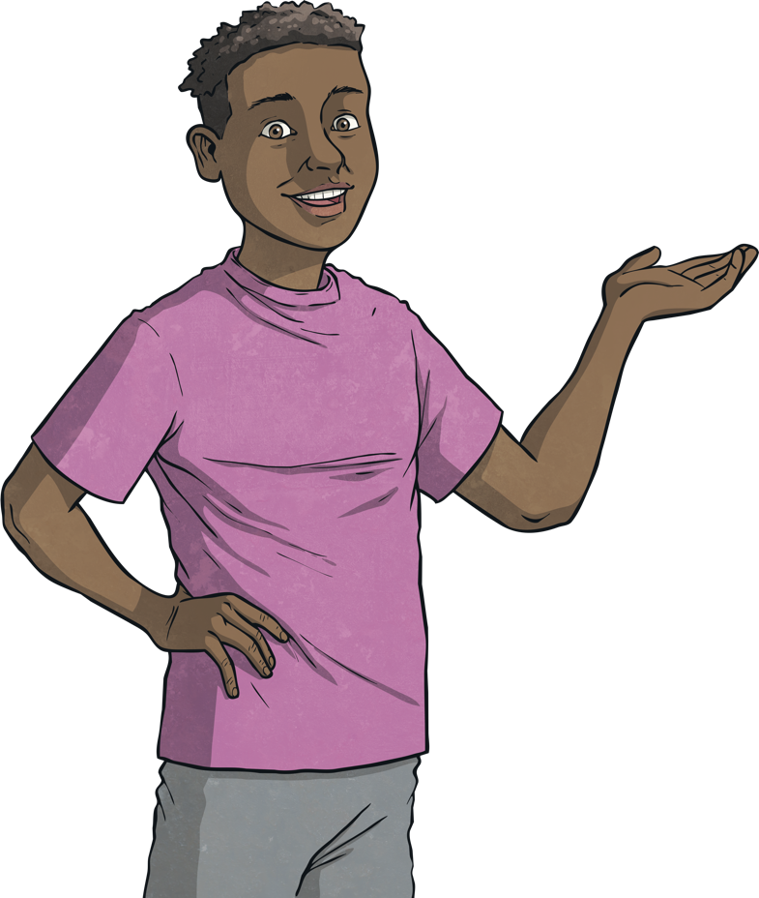
How to run a formal debate:
The Captain of the proposing team speaks first.
The Captain of the opposing team speaks next.
Then the second speaker on each team speaks in turn followed by the third on both teams.
The captain on both teams summarise their arguments.
Adjudicators or the audience at the debate decide the winning team.

Slide 8
How do we layout the room for a debate?
Chairperson and Time Keeper
Team for the motion
Team against the motion
Adjudicator/ Audience

Slide 9
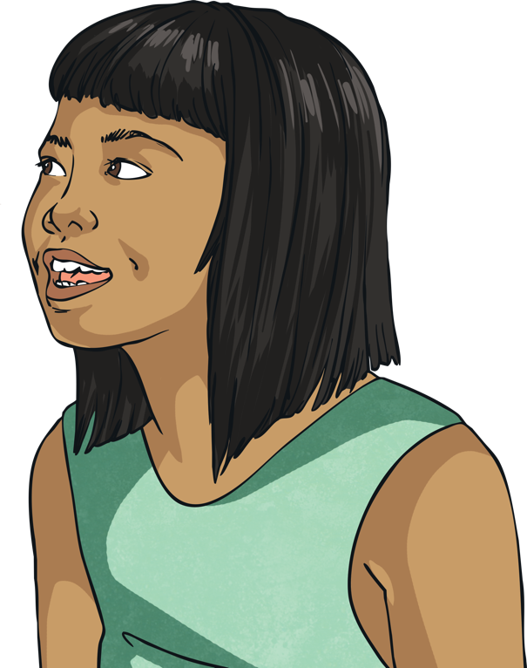
What skills should I have to debate well?
Confident speaking style
When we debate, we are aiming to persuade others of our point of view. To do this, we need to be confident and persuasive in the way we speak.
Speaking speed
Try not to speak too slowly or too quickly. We need people to understand what we are saying.

Slide 10
What skills should I have to debate well?
Volume
We must try to speak at a volume that allows everyone to hear us.
Tone
Try to vary your tone to make it interesting. By speaking in a varying tone, listeners will be more interested in what we are saying.

Slide 11
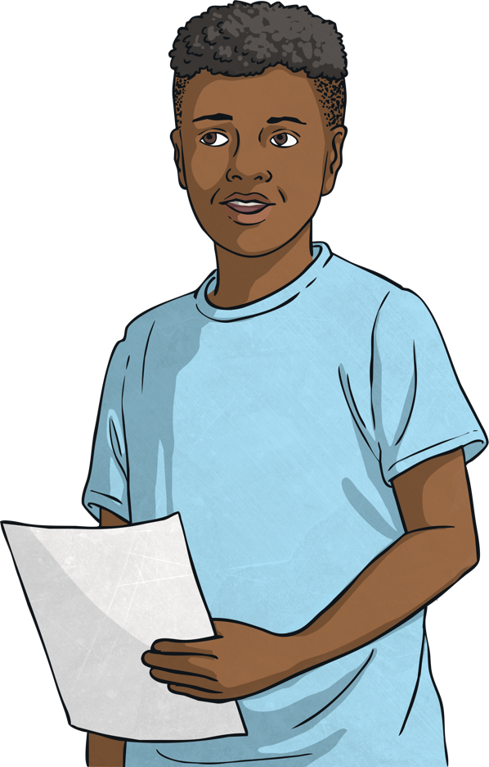
Debating rules
No interruptions are allowed. You must wait your turn to speak.
You can use notes to help you remember your points.
If you want to speak when it is not your turn, you must raise your hand.

Slide 12
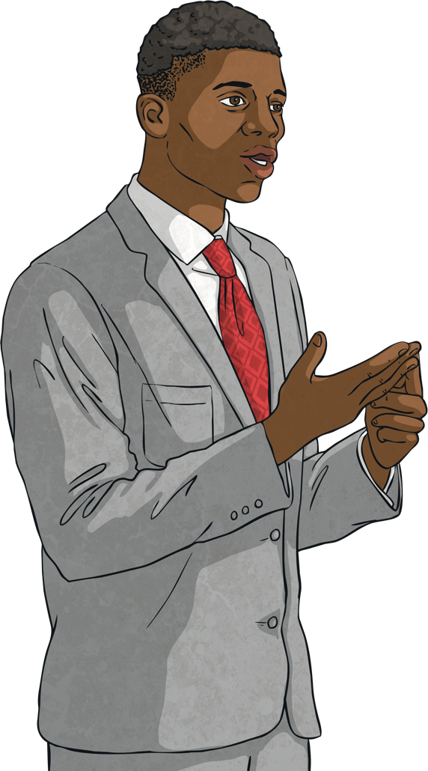
Dos and Dont’s when debating
Do make eye contact
Do pause between your arguments
Don’t read your notes. Try to memorise the main points.
Don’t criticise the other speakers. Criticise the argument.

Slide 13
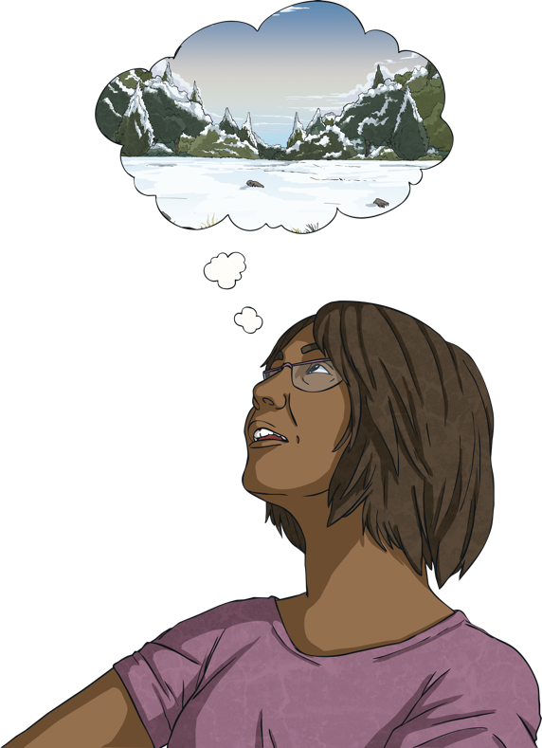
Do you propose or oppose this motion?
Motion: ‘Winter is the best season of the year’.
or

Slide 14
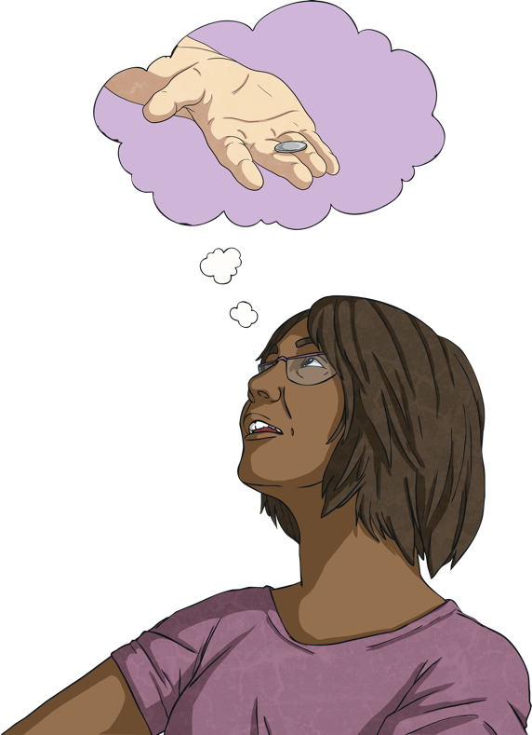
Do you propose or oppose this motion?
Motion: ‘Children should get pocket money.’
or

