Slide 2
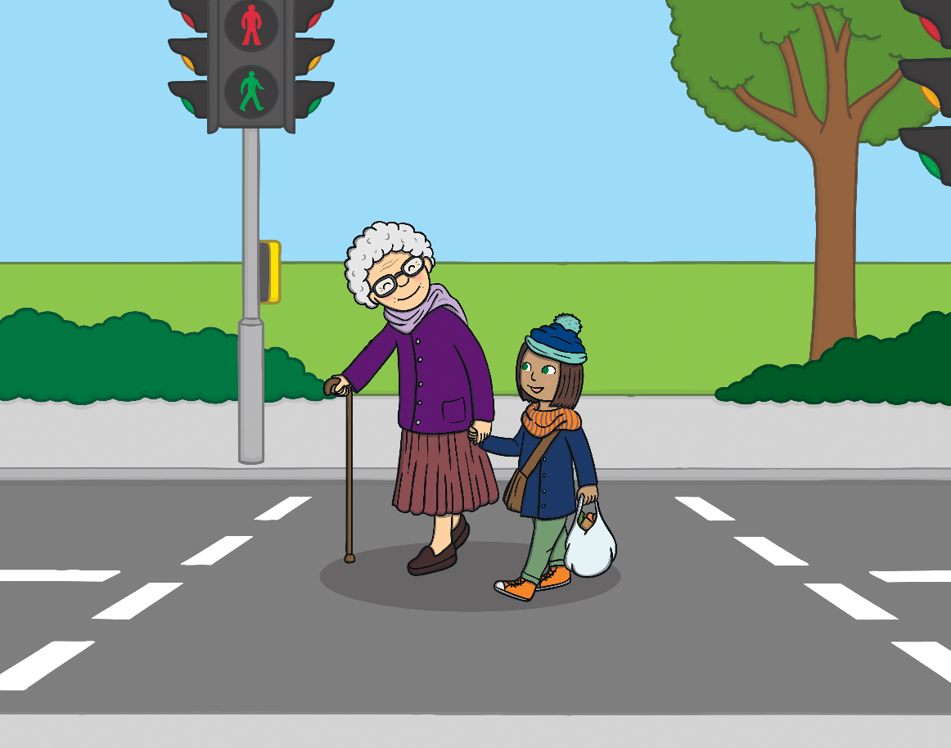
Why is the lady smiling?
It is her birthday.
The girl is helping her across the street.
It is sunny.

Slide 3
Correct!
Next question

Slide 4
Try again!
Previous question

Slide 5
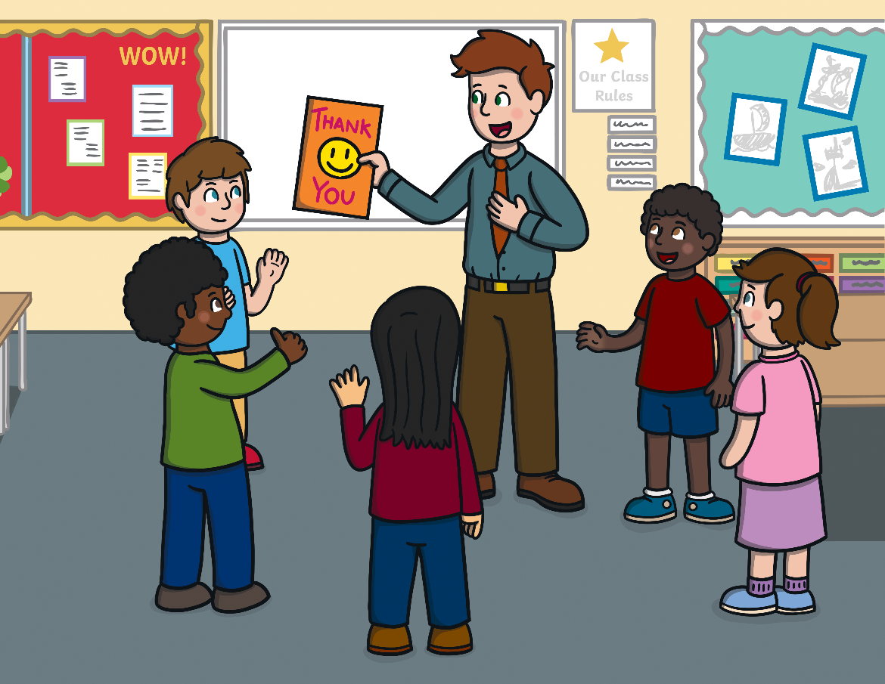
Why is the
teacher surprised?
The students made him a thank you card.
He is going on a vacation.
He is getting a puppy.

Slide 6
Correct!
Next question

Slide 7
Try again!
Previous question

Slide 8
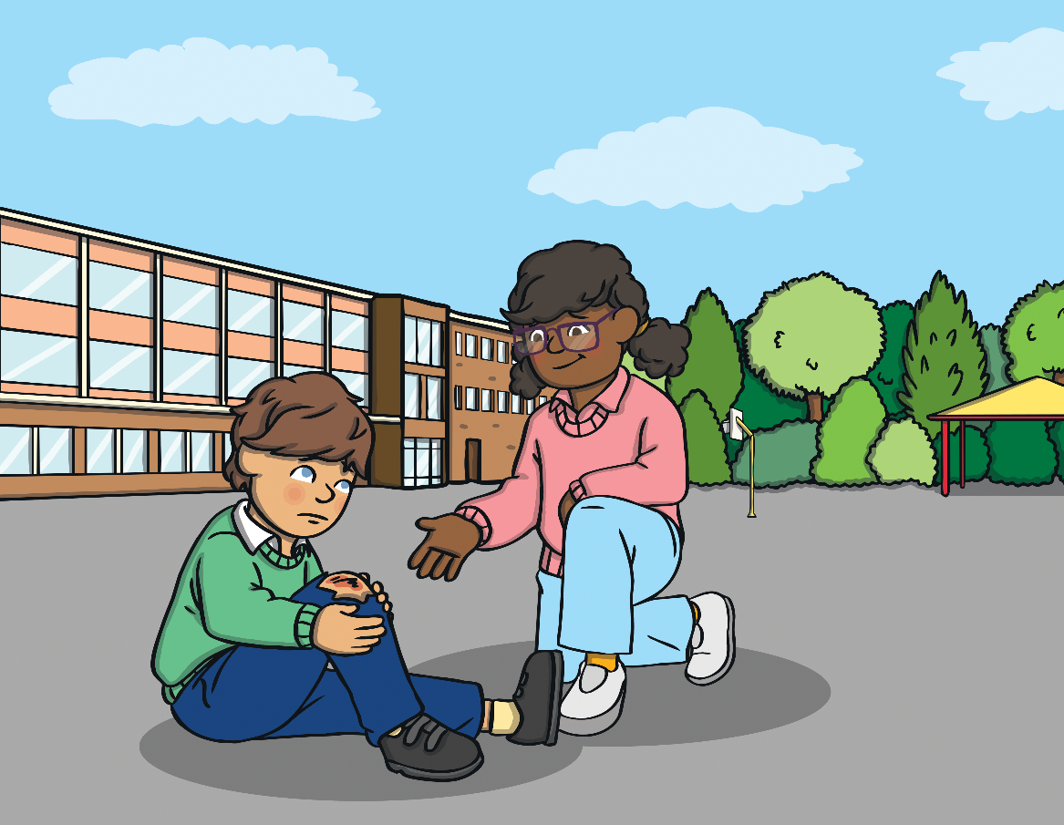
Why is the girl a good friend?
She made a thank you card.
She is helping the boy
that is hurt.
She gave the boy a balloon.

Slide 9
Correct!
Next question

Slide 10
Try again!
Previous question

Slide 11
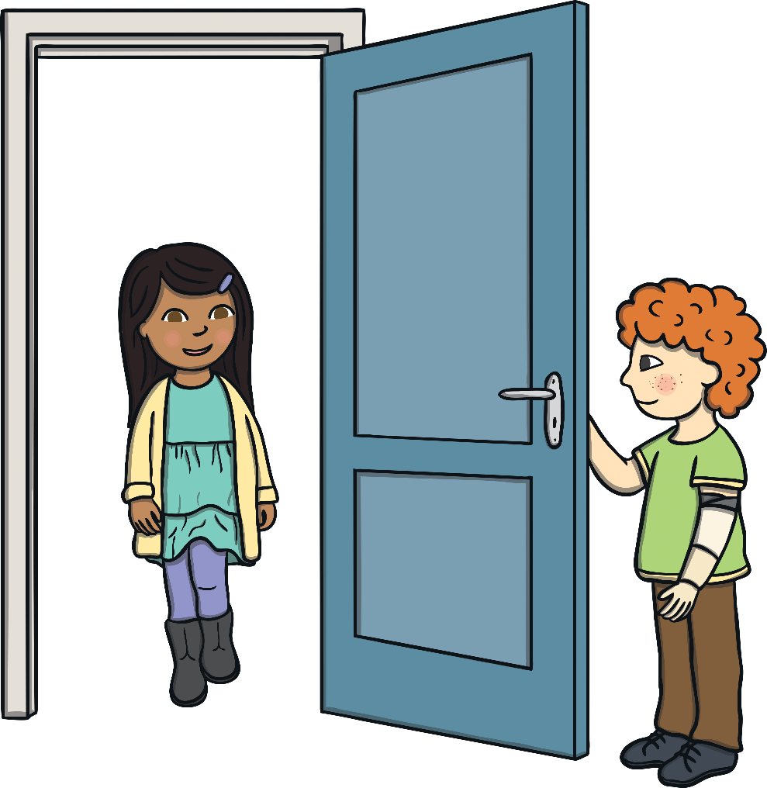
How is the boy showing kindness towards the girl?
He waved at her.
He gave her a flower.
He is holding the door open for her.

Slide 12
Correct!
Next question

Slide 13
Try again!
Previous question

Slide 14
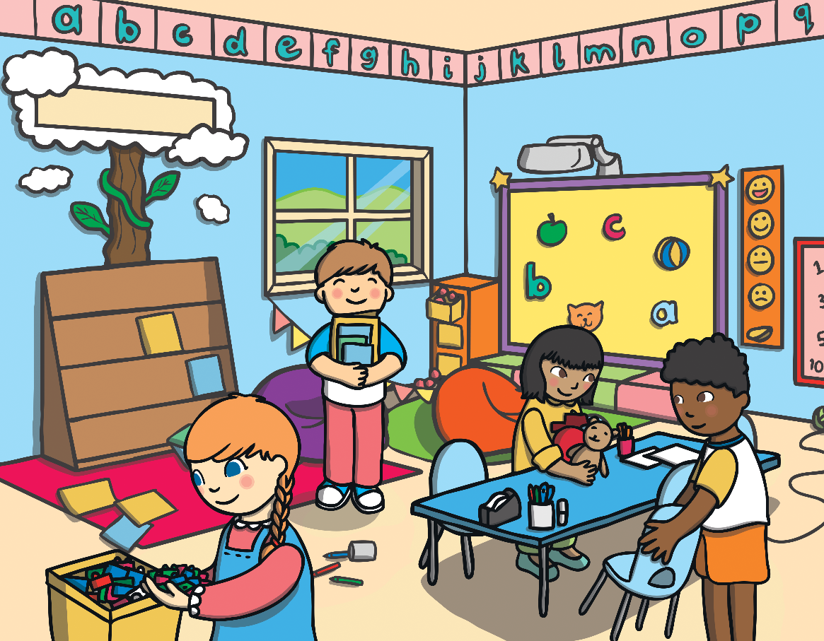
Why are the children happy?
The students are going to the playground.
The students cleaned up without their teacher asking them.
The students are
going home.

Slide 15
Correct!
Next question

Slide 16
Try again!
Previous question

Slide 17
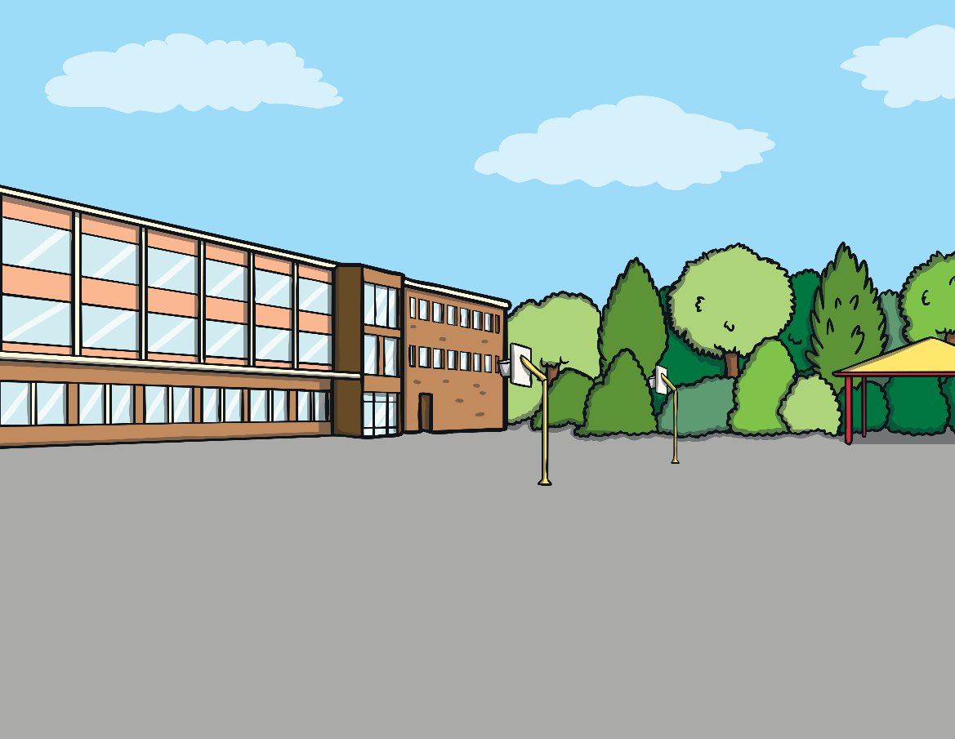
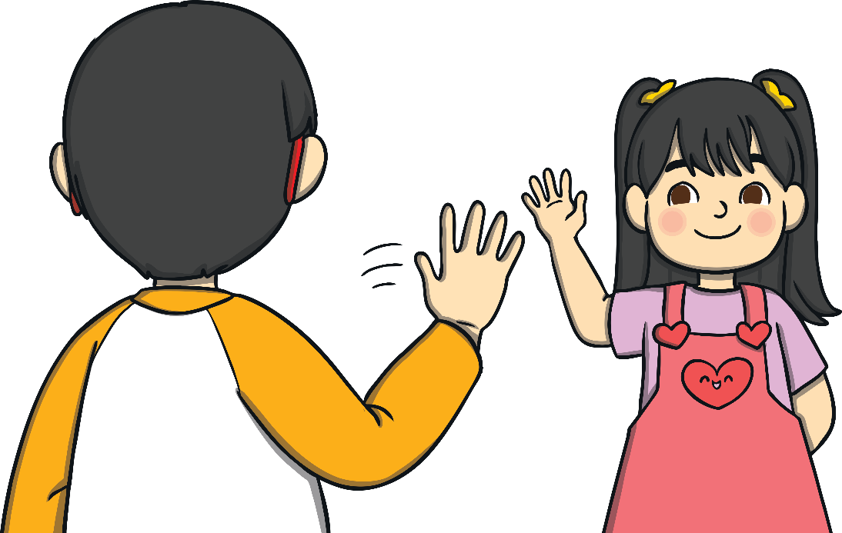
How is the girl showing friendship to the boy?
She is waving and
smiling at him.
She gave him a cupcake.
She is frowning at him.

Slide 18
Correct!
Next question

Slide 19
Try again!
Previous question

