Slide 2
van
Start Timer
Start Timer
Use Timer
Show Answer
Next

Slide 3
vux
Use Timer
Show Answer
Start Timer
Start Timer
Next

Slide 4
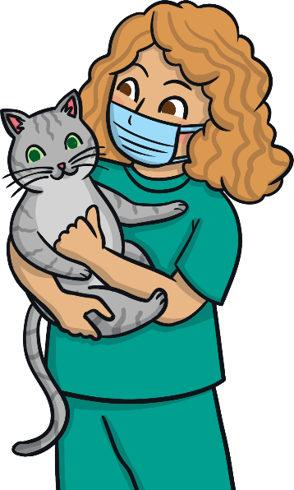
vet
Start Timer
Start Timer
Use Timer
Show Answer
Next

Slide 5
vot
Use Timer
Show Answer
Start Timer
Start Timer
Next

Slide 6
Bev
Start Timer
Start Timer
Use Timer
Show Answer
Next

Slide 7
vell
Use Timer
Show Answer
Start Timer
Start Timer
Next

Slide 8
Kevin
Start Timer
Start Timer
Use Timer
Show Answer
Next

Slide 9
vit
Use Timer
Show Answer
Start Timer
Start Timer
Next

Slide 10
velvet
Start Timer
Start Timer
Use Timer
Show Answer
Next

Slide 11
vaff
Use Timer
Show Answer
Start Timer
Start Timer
Next

