Slide 1
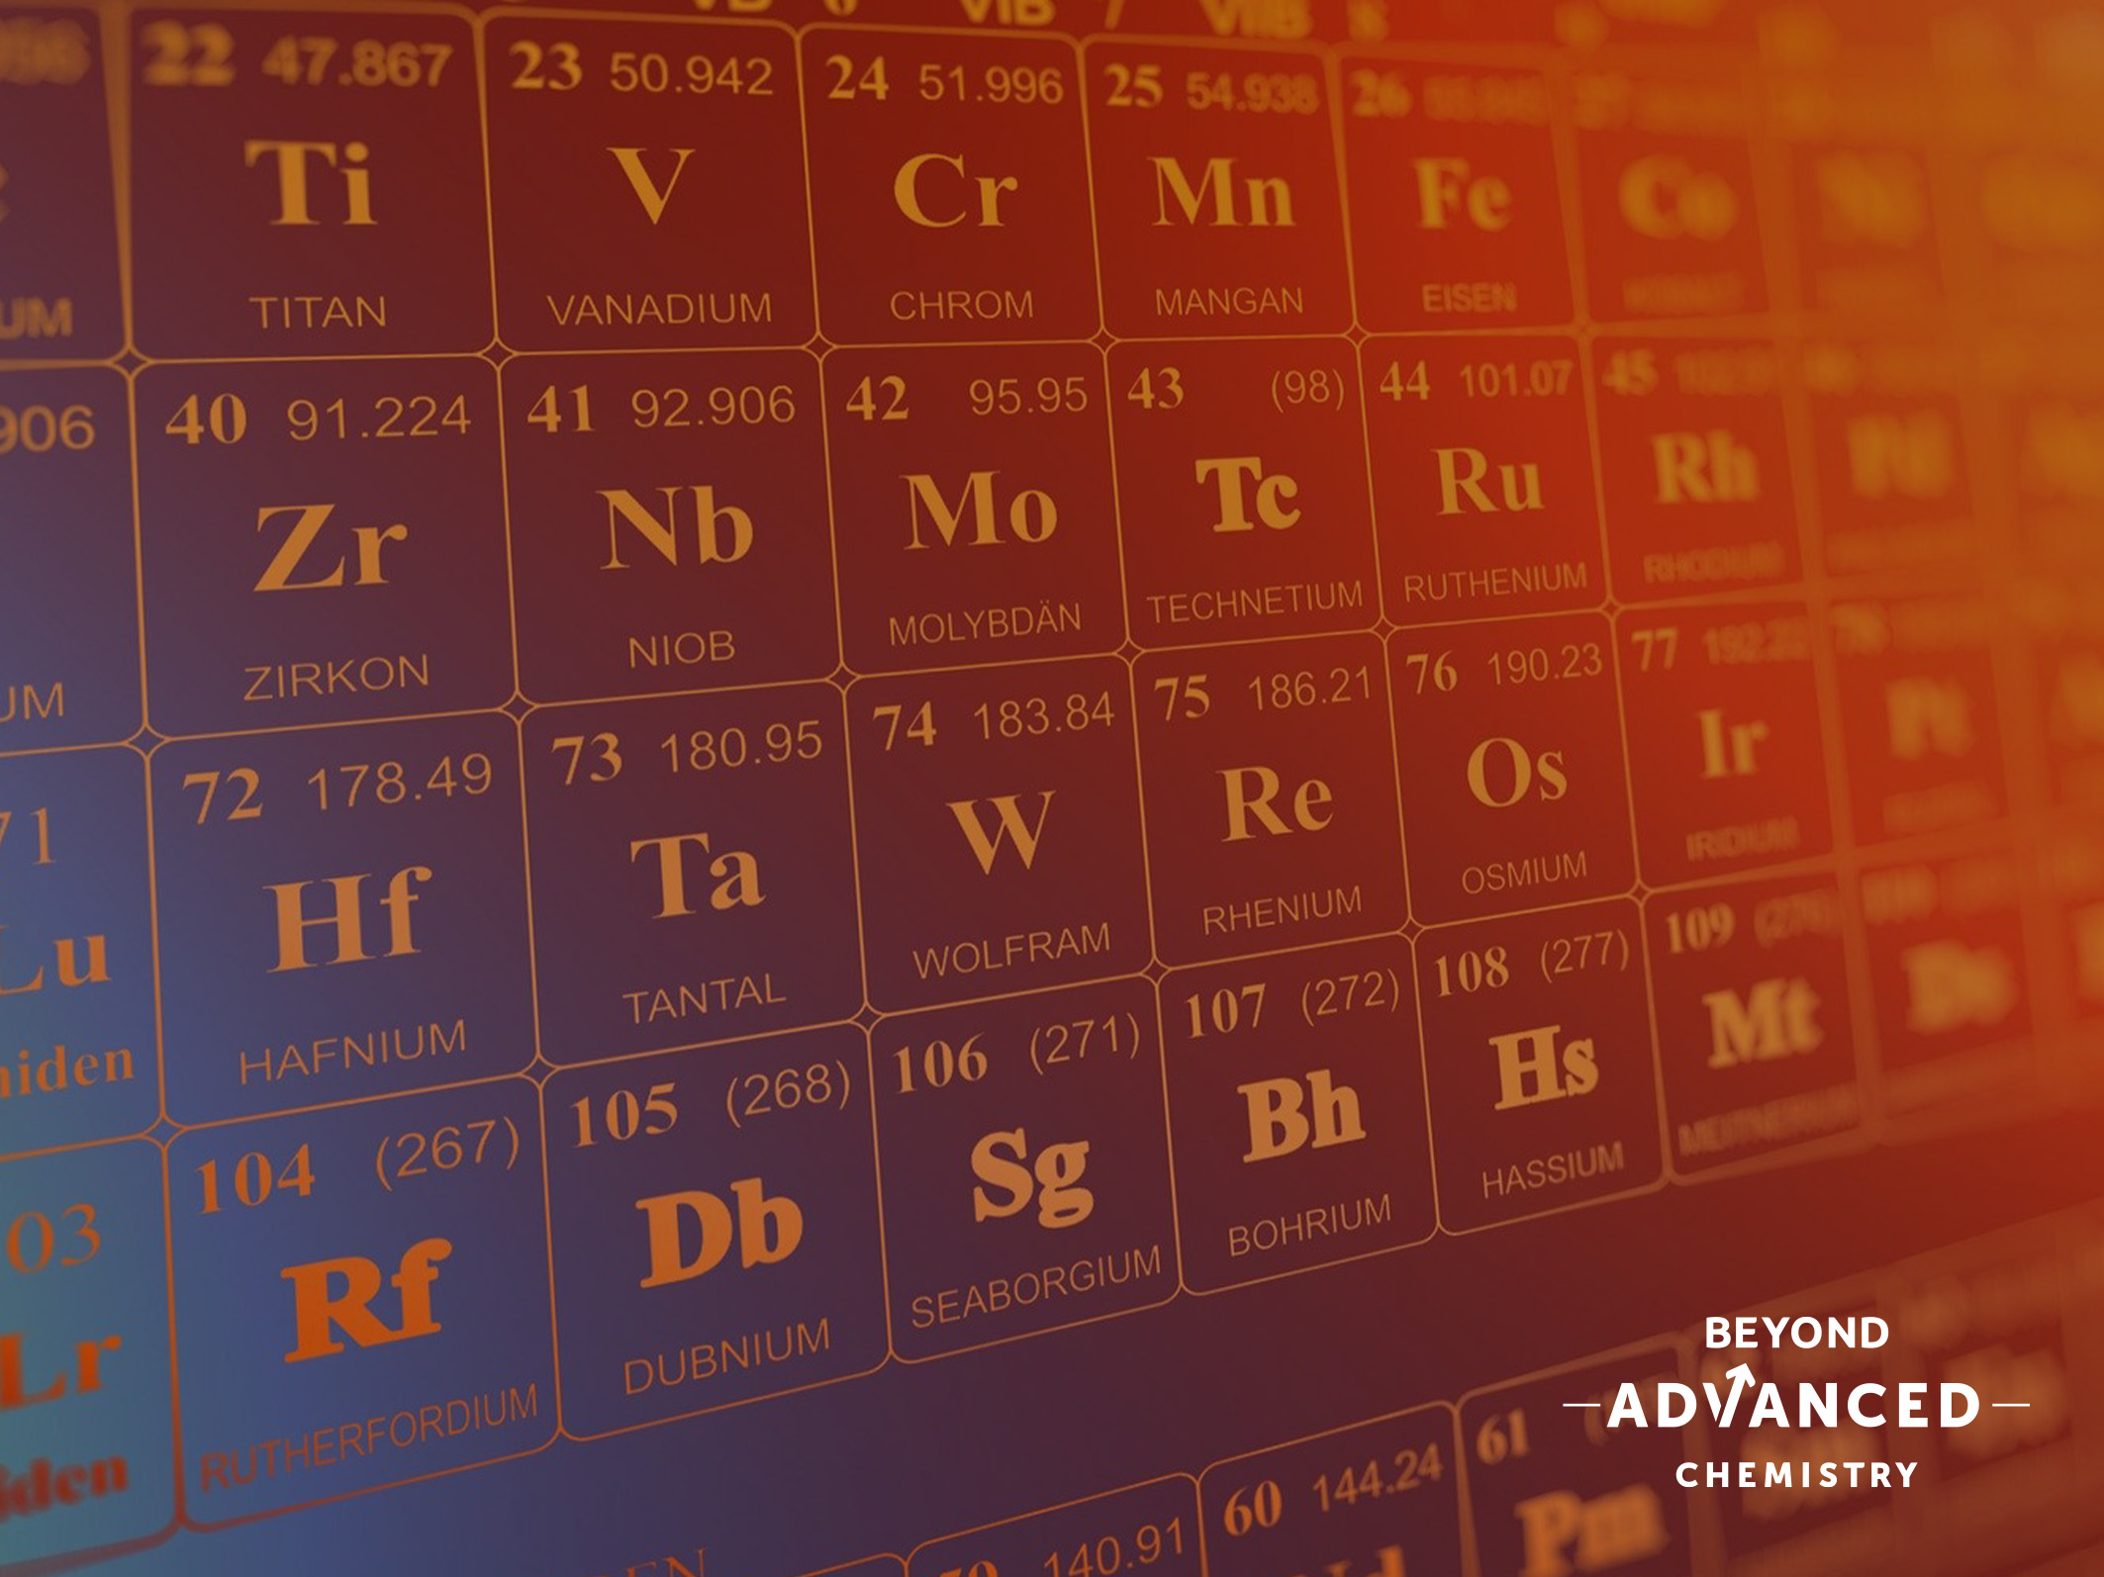
Periodicity
Multiple Choice Quiz

Slide 2
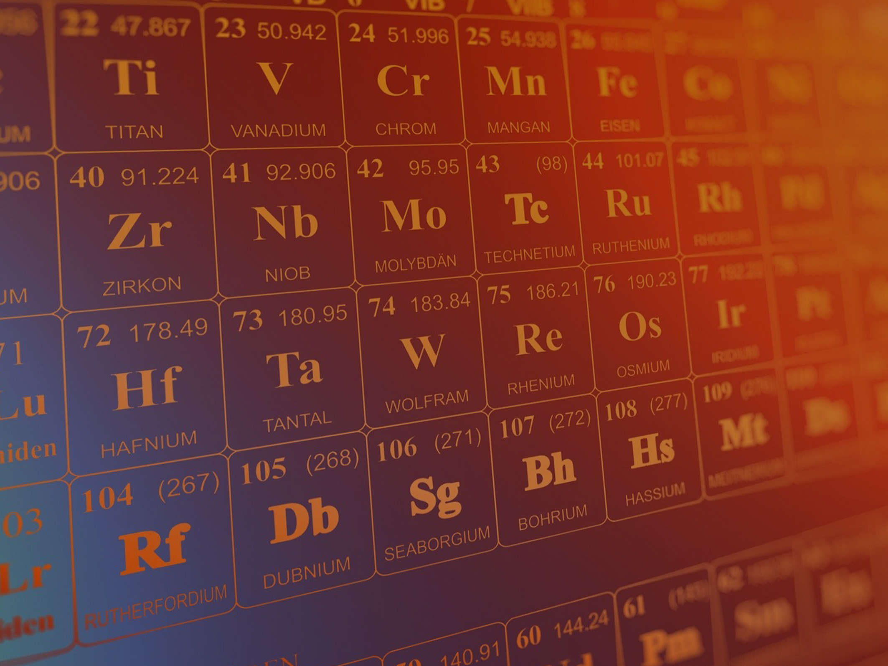
Question 1
s-block
p-block
d-block
f-block
What is the correct classification of the element mercury (Hg)?
C. d-block

Slide 3
Question 2
aluminium
calcium
copper
neodymium
Which of the following is an f-block element?
D. neodymium

Slide 4
Question 3
  the change in a physical property as you go down a group of elements in the periodic table
  the decreasing trend in a physical property across a row of elements in the periodic table
  the increasing trend in a physical property across a row of elements in the periodic table
  the pattern in a physical property across a row of elements in the periodic table, which repeats in the next row
What is periodicity?
the pattern in a physical property across a row of elements in the periodic table, which repeats in the next row

Slide 5
Question 4
chlorine
phosphorus
silicon
sodium
Which of the following elements has the largest atomic radius?
D. sodium

Slide 6
Question 5
argon
chlorine
silicon
sodium
Which of the following elements has the highest first ionisation energy?
A. argon

Slide 7
Question 6
aluminium
magnesium
phosphorus
silicon
Which of the following elements has the lowest first ionisation energy?
A. aluminium

Slide 8
Question 7
argon
chlorine
silicon
sodium
Which of the following elements has the highest melting point?
C. silicon

Slide 9
Question 8
argon
chlorine
phosphorus
sulfur
Which of the following elements has the lowest melting point?
A. argon

Slide 10
Question 9
  Atomic radius decreases across a period because the amount of shielding increases.
  Atomic radius decreases across a period because the atoms have more protons.
  Atomic radius increases across a period because the atoms have more electrons.
  Atomic radius stays the same across a period because there is a similar amount of shielding.
Which statement is true about atomic radius across a period?
  Atomic radius decreases across a period because the atoms have more protons.

Slide 11
Question 10
  Aluminium has a higher melting point than sodium because aluminium can form Al³⁺ ions.
  Argon has the lowest melting point of all period 3 elements because it forms weak covalent bonds.
  Sodium has a higher melting point than magnesium because sodium has a larger atomic radius.
  The melting point of phosphorus is higher than the melting point of sulfur because phosphorus has stronger London forces between its molecules.
Which of the following statements is correct?
  Aluminium has a higher melting point than sodium because aluminium can form Al³⁺ ions.

Slide 12
Periodicity
Multiple Choice Answers
C
D
D
D
A
6. A
7. C
8. A
B
A

Slide 13
