Slide 1
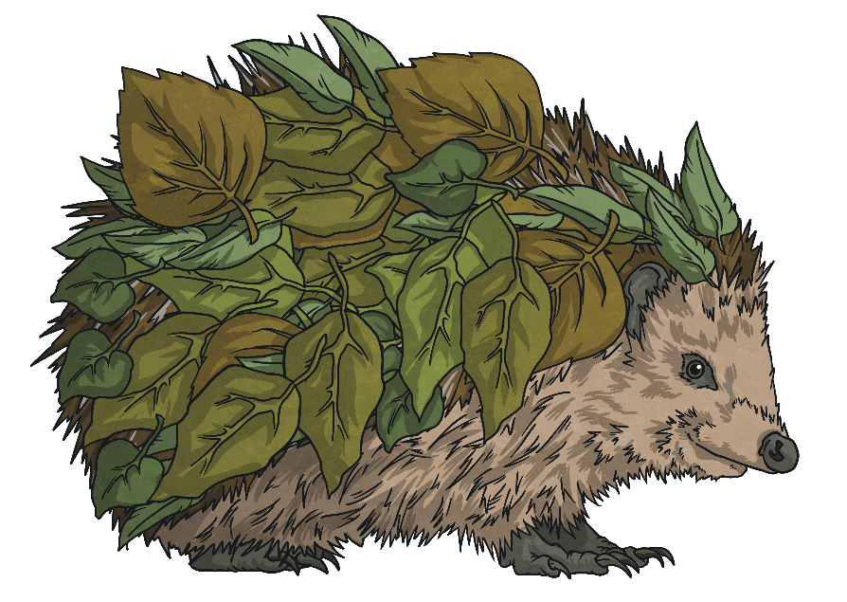

Slide 2
Word Classes
It is important that we know the names of these different types of words and the job/s that they have in a sentence.
The words that we use when writing can be organised into different ‘word classes’.

Slide 3
nouns
verbs
adjectives
adverbs
pronouns
prepositions

Slide 4
Nouns
Nouns are the names of things, objects, people and places.
For example: table; Armagh; Jack; sheep
In sentences, the person or thing performing an action can also be known as the subject.

Slide 5
Proper Nouns
Proper nouns require capital letters.
For example: Belfast City Hall; Rover; Thursday; July; Queen’s University Belfast
Days of the week and months of the year are proper nouns.
A proper noun is the name of a particular person, place or thing.

Slide 6
Common Nouns
These are the names of general things – not a particular person or place. Common nouns do not need capital letters.
adjectives
Concrete nouns are common nouns that are physical things – we can experience them with our senses; we can see, hear, taste, touch or smell them.
For example: shoe; hamster; pen; rain; nurse
Abstract nouns are common nouns that have no physical form – they are things such as ideas and emotions.
For example: friendship; loneliness; fear; harmony

Slide 7
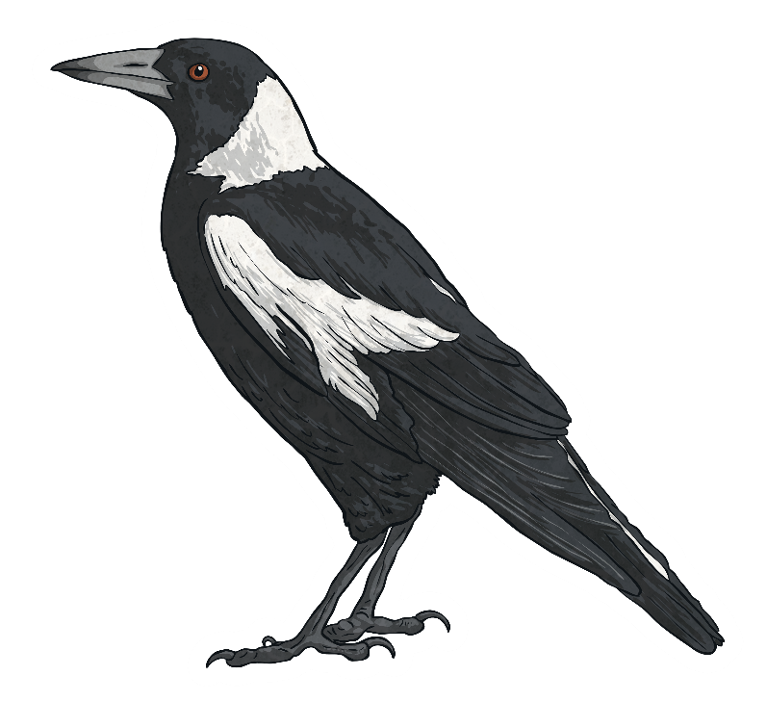
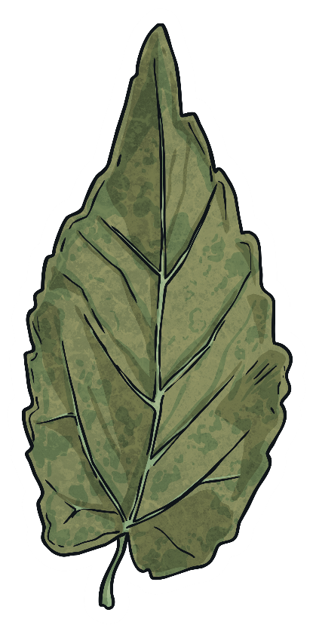
Collective Nouns
For example: a flock of sheep; a smack of jellyfish; a murmuration of starlings; a pack of cards; a choir of singers
Collective nouns refer to a group of things, people or places.

Slide 8
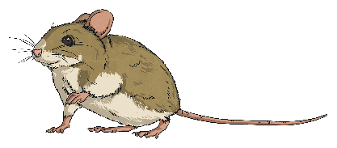
Verbs
Verbs can describe an action (e.g. sing, climb), emotion (e.g. loves, hates), thought (e.g. thinks), opinion (e.g. believes) or state of being (e.g. am, is, are, was, were).
adjectives
We use the singular form of a verb when writing about one person or thing.
I am; he is; Emily was; the car has
We use the plural form of a verb when we are speaking about more than one person or thing.
We are;
they were;
the boys have

Slide 9
Nouns
adjectives
Adjectives are words that describe nouns.
For example: hilarious joke; gnarled tree; two cranes. Adjectives can come before or after a noun.
If you use more than one adjective to describe something, you separate them with commas.
Try to make your chosen adjectives powerful, for example, use alternative words instead of ‘nice’.
Vary the adjectives that you choose; try not to use the same one twice.
Be warned! – Avoid using too many adjectives to describe something; this can become tiresome to read.

Slide 10
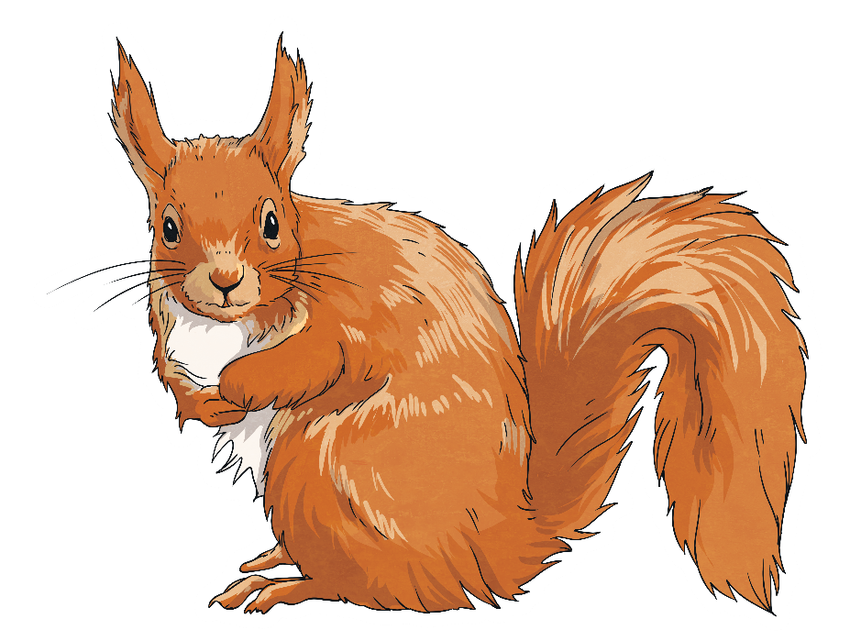
Adverbs
They tell us how, where, when, how much or how often something happens, happened or will happen.
For example: quickly; dimly; tomorrow; south; always; usually
An adverb is a word that tells us more about a verb.

Slide 11
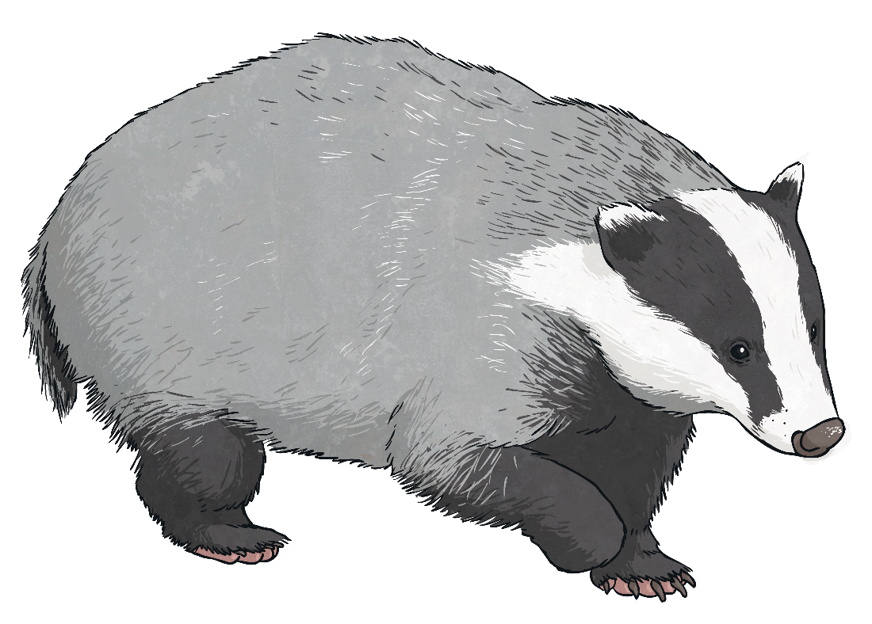
Pronouns
Pronouns are
words that can take the place of a noun, so that we can avoid repetition of the same word or name.
For example: she; his; their; them

Slide 12
Prepositions
Prepositions are linking words that inform us where something is in time or space.
For example: under the tree; beside the wall; before lunch, during winter

Slide 13
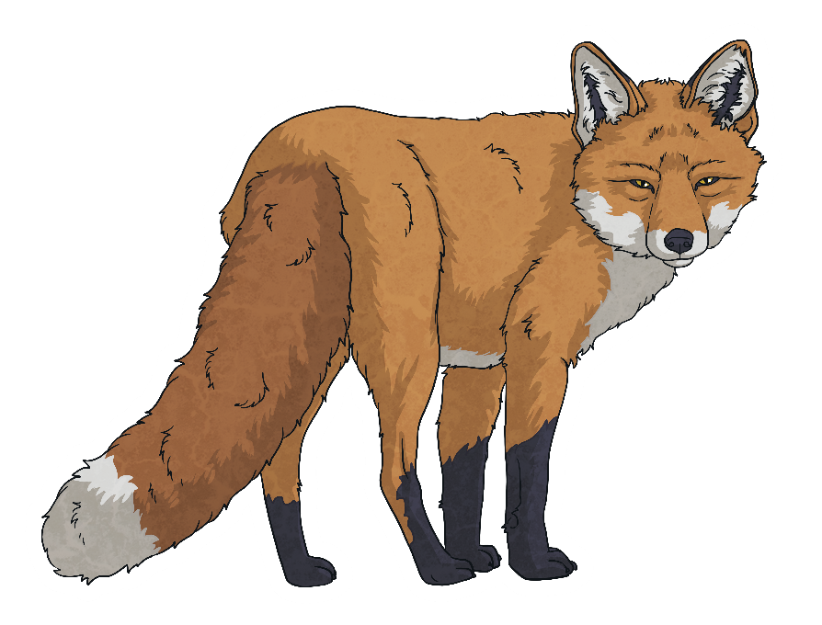
Be Careful!
adjectives
There are words that can fit into more than one class, so we have to think carefully about their job in that sentence.
For example, the word ‘watch’ can be a noun or a verb.
I always wear my watch on my left wrist.
I love to watch the birds flying across the sky.

Slide 14
Activity 1
Read the sentence carefully. Think about the job that each selected word is doing in this particular sentence and name the class of the words in bold.
Abbie pulled her colourful wellington boots on and stamped in all the puddles.
Abbie – noun (proper)
adjectives
colourful – adjective
in – preposition

Slide 15
Activity 2
Read the sentence carefully. Think about the job that each selected word is doing in this particular sentence and name the class of the words in bold.
James sat underneath the apple tree and read his book.
underneath – preposition
adjectives
his – pronoun
book – noun (common)

Slide 16
Activity 3
Read the sentence carefully. Think about the job that each selected word is doing in this particular sentence and name the class of the words in bold.
Lucy held the whistle in trembling hands as extra time drew to a close.
held – verb
adjectives
whistle – noun
trembling – adjective

Slide 17
Activity 4
Write a sentence of your own that focuses on sport.
Include and highlight:
verb
preposition
adjective
adjectives

Slide 18
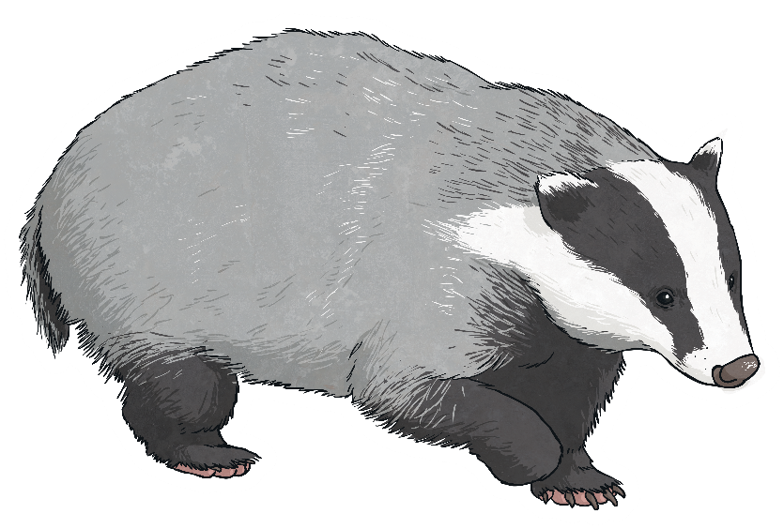
Activity 5
Write a sentence of your own that focuses on a local place.
Include and highlight:
noun
adjective
adverb
adjectives

Slide 19
Activity 6
Write a sentence of your own that focuses on a season.
Include and highlight:
verb
noun
pronoun
adjectives

Slide 20
Activity 7
Write a sentence of your own that focuses on an emotion.
Include and highlight:
adverb
preposition
verb
adjectives

Slide 21
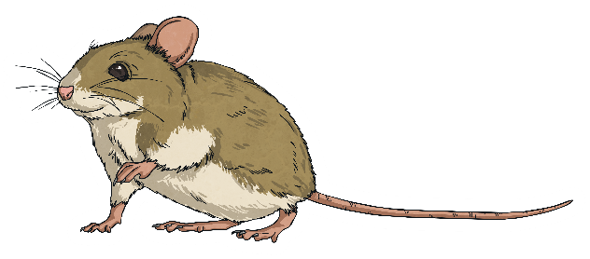
Activity 8
Choose a page from your reading book or novel that you have previously read.
Select three sentences.
Check to see if you can identify the word classes of each word in these sentences.
adjectives

