Slide 1
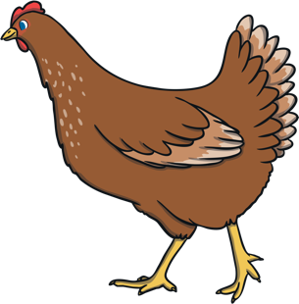
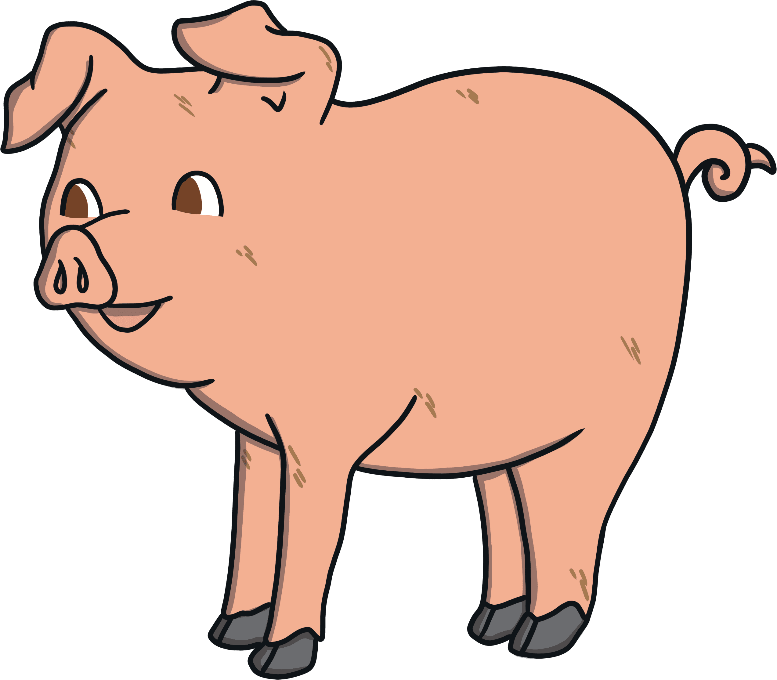

Slide 2
What is a food chain?
Thought shower…

Slide 3
What is a Food Chain?
A food chain describes the order in which organisms, or living things, depend on each other for food. Every ecosystem, or community of living things, has one or more food chains. Most food chains start with organisms that make their own food, such as plants. Scientists call these ‘producers’.

Slide 4
Can you guess what food chain this might be?

Slide 5
Yes! Beef cow food chain.
Please click and drag the images to the correct place.

Slide 6
Can you guess what food chain this might be?

Slide 7
Yes! Dairy cow food chain.
Please click and drag the images to the correct place.

Slide 8
Can you guess what food chain this might be?

Slide 9
Yes! Lamb food chain.
Please click and drag the images to the correct place.

Slide 10
Can you think of a different food chain?
Draw to create.

Slide 11
Challenge
Can you think of a longer food chain?
Draw to create.

